Slide 1
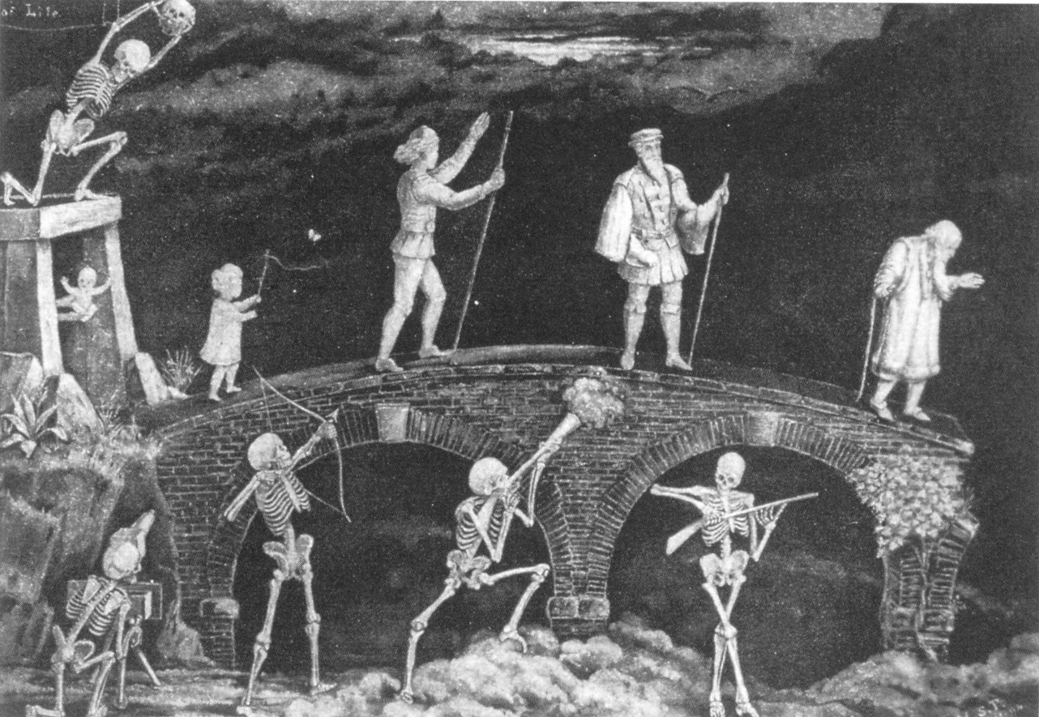

Understanding Biology: Going Beyond
Simple Statistical Extrapolation
or
Common Sense, Biological and Demographic Rules that are Bent or Broken by Assuming Linear Increases in Life Expectancy
S. Jay Olshansky, Ph.D.
University of Illinois at Chicago
Lapetus Solutions
September 30, 2016

Slide 2
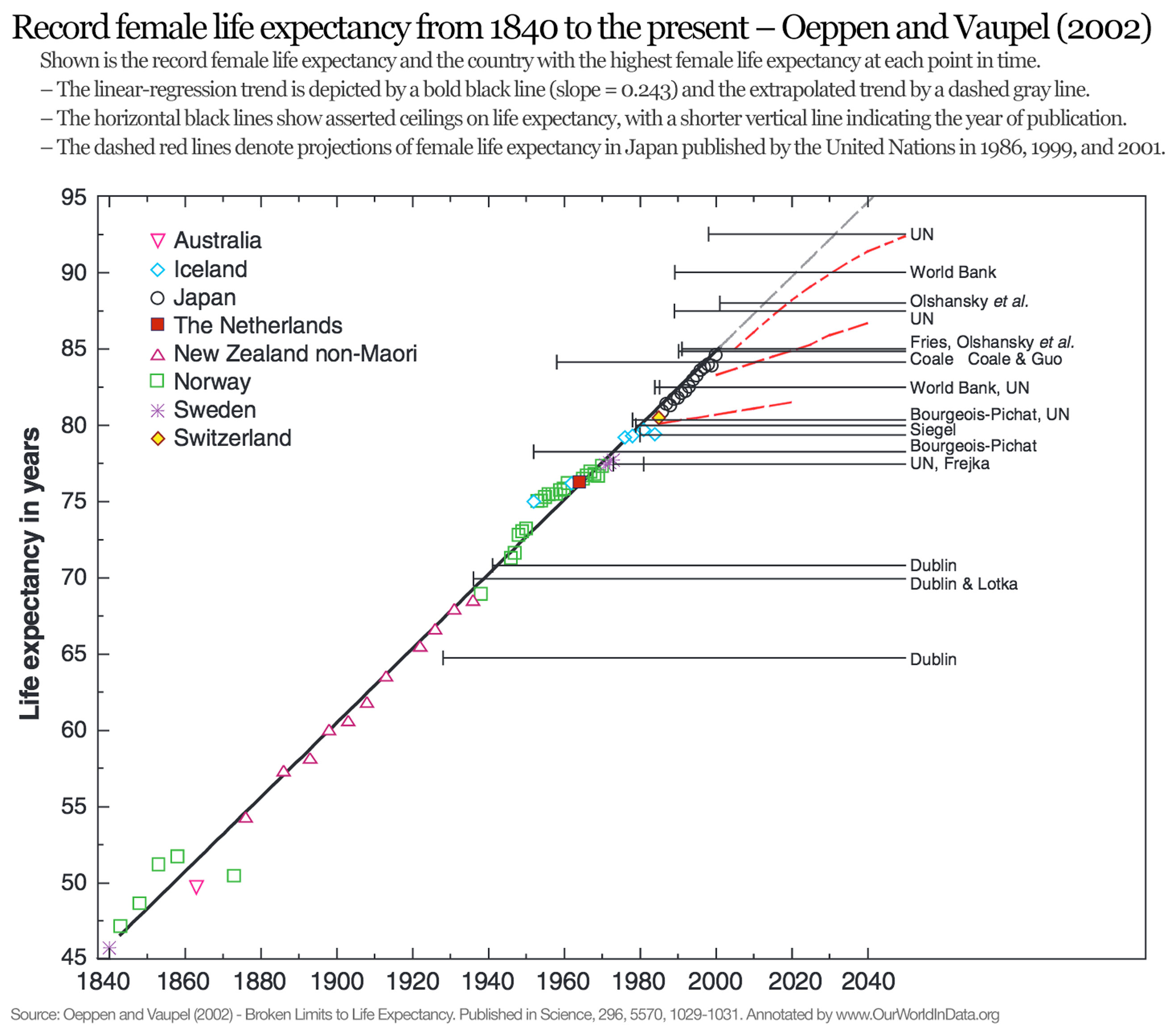
Rule # 1
Linear Extrapolations of Biological Phenomenon are Inherently Dangerous
Conclusion: Life expectancy at birth in the U.S. will rise to 100 by 2060.

Slide 3
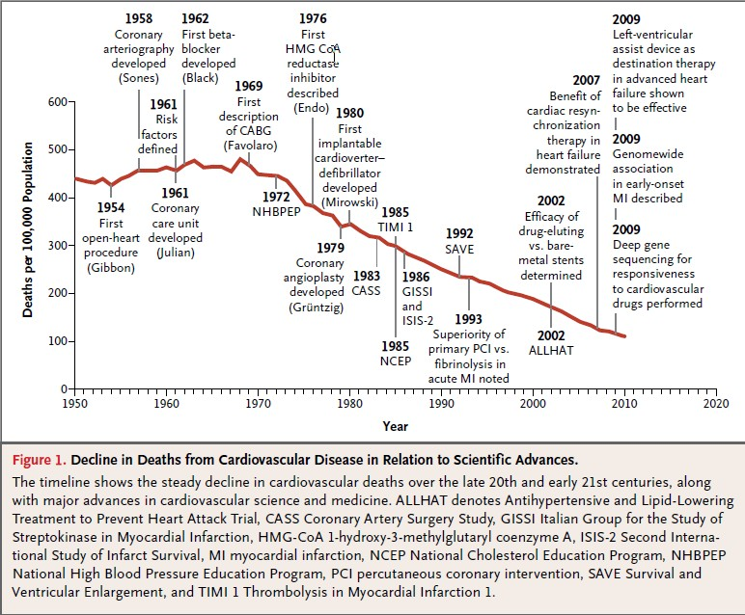

Slide 4
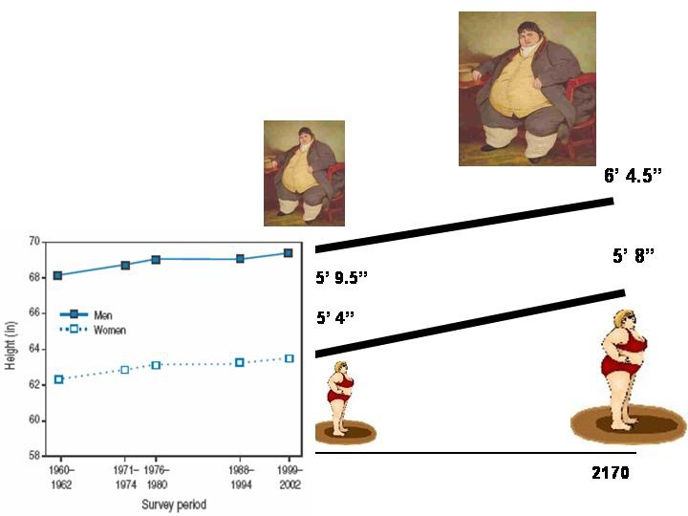

Slide 5
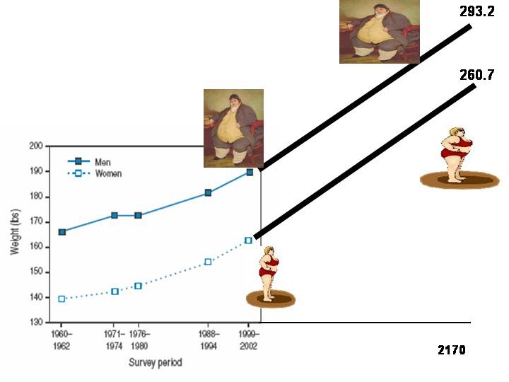

Slide 6

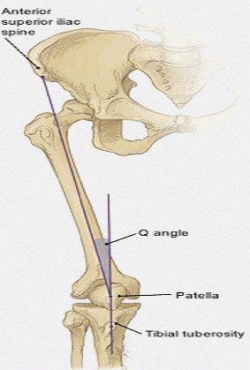
Although there is no genetic program that limits how fast humans are capable of running, there are nevertheless biomechanical constraints on running speed.
Although there is no genetic program that limits the duration of life, there are nevertheless biomechanical constraints on the functioning of body parts that influence how long we live.

Slide 7
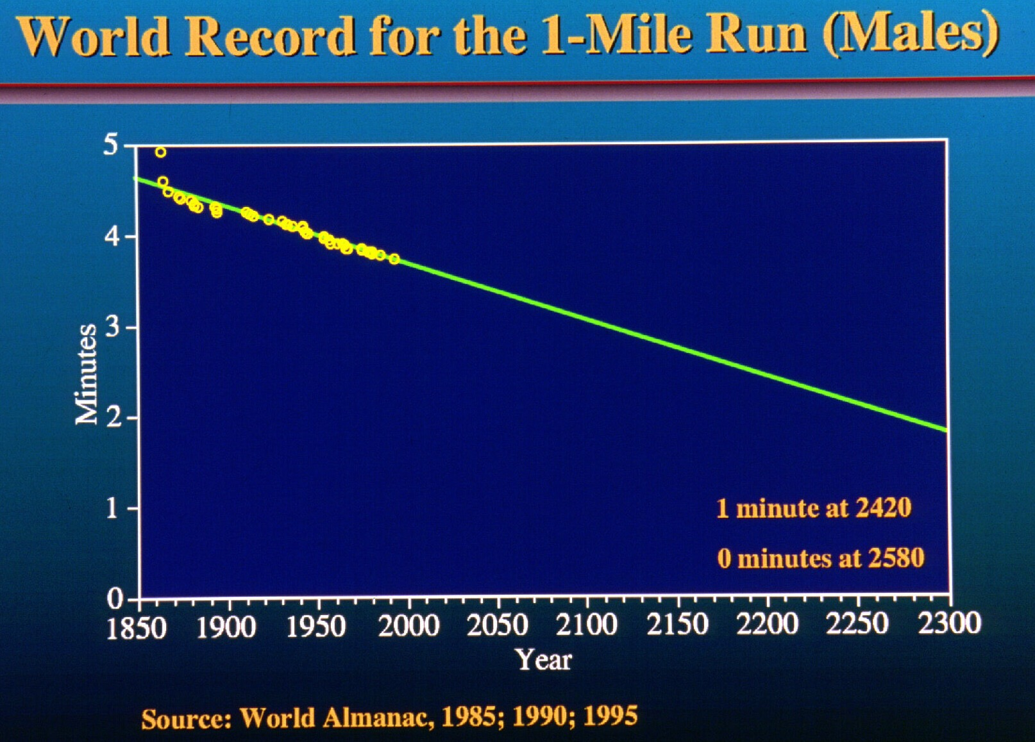

Slide 8
Unstated Assumptions That Accompany Linear Extrapolation of Life Expectancy
Past trends in life expectancy are more important than biology when it comes to forecasting.
Declines in mortality in the future will occur at a faster pace for people aged 65 and older than what was observed for infants and children in the early 20th century.
2a. Unknown medical technologies in the future will add decades to the lives of people aged 65 and older at a faster pace than public health added survival time to children in the 20th century.
3. Declines in mortality in the future will occur for diseases present today that have historically increased or stayed level – violating the underlying premise of linear extrapolation.
4. Deaths from cardiovascular diseases will be reduced to zero within the next decade.

Slide 9
Rule # 2
Aging Gets in the Way

Slide 10
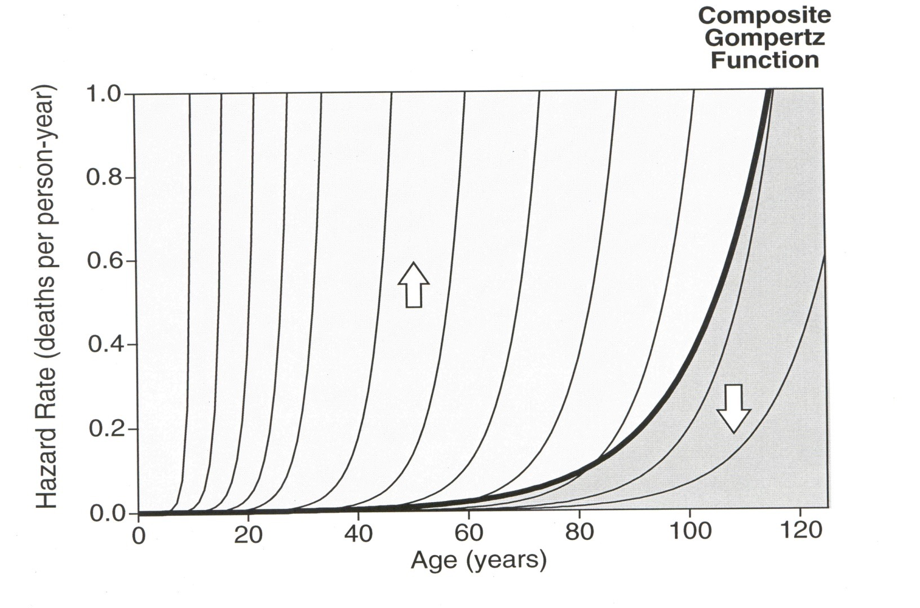
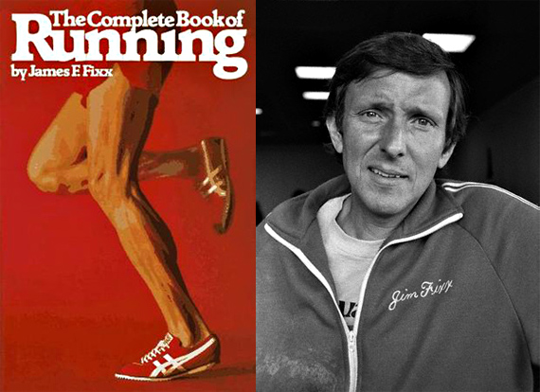
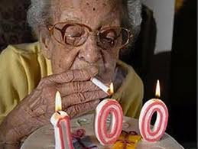
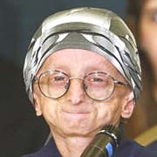
Populations Are Heterogeneous Mixtures
These subpopulations raise the composite death rates
These subpopulations lower the composite death rates
The usual approach to mortality is to see and measure only the dark black line, which represents the risk of death for an entire population. National populations are heterogeneous, with varying mortality risks.

Slide 11
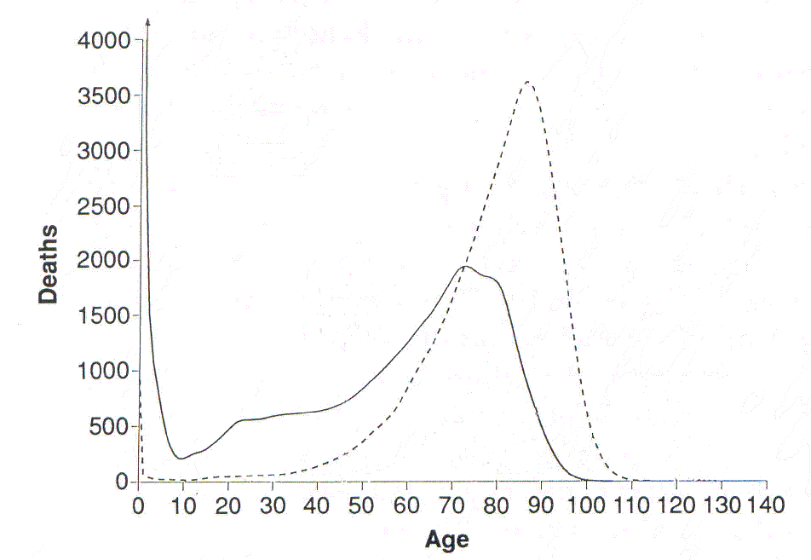
U.S. Females
Maximum Lifespan Potential = 120
Maximum Observed Age at Death = 105, 113 *
Period Life Expectancy at Birth = 49, 80 *
The Biology of Aging Gets in the Way of Radical Life Extension
2015
1900

Slide 12
Risk Factors for Heart Disease
Source: Aging as a Risk Factor. Kochanek KD, Xu J, Murphy SL, Miniño AM, Hsiang-Ching K (2011). Deaths: Preliminary Data from 2009. National Vital Stats. Rep. (2009) 59(4):1-68. Change 1999 – 2009 in Deaths from Selected Diseases (comparison of data from Kochanek et al. (2011) Table 2 with Heron et al (2009) Table 9). Heron M, Hoyert DL, Murphy SL, Xu J, Kochanek KD, Tejada-Vera B (2009). Deaths: Final data for 2006. .Natl Vital Stats. Rep. 57(14):1-136. Interpreted as percentage increase in the risk of death for a specified disease independent of all other risk factors.

Slide 13
Risk Factors for Heart Disease
Source: Aging as a Risk Factor. Kochanek KD, Xu J, Murphy SL, Miniño AM, Hsiang-Ching K (2011). Deaths: Preliminary Data from 2009. National Vital Stats. Rep. (2009) 59(4):1-68. Change 1999 – 2009 in Deaths from Selected Diseases (comparison of data from Kochanek et al. (2011) Table 2 with Heron et al (2009) Table 9). Heron M, Hoyert DL, Murphy SL, Xu J, Kochanek KD, Tejada-Vera B (2009). Deaths: Final data for 2006. .Natl Vital Stats. Rep. 57(14):1-136.

Slide 14
Risk Factors for Cancer
Source: Aging as a Risk Factor. Kochanek KD, Xu J, Murphy SL, Miniño AM, Hsiang-Ching K (2011). Deaths: Preliminary Data from 2009. National Vital Stats. Rep. (2009) 59(4):1-68. Change 1999 – 2009 in Deaths from Selected Diseases (comparison of data from Kochanek et al. (2011) Table 2 with Heron et al (2009) Table 9). Heron M, Hoyert DL, Murphy SL, Xu J, Kochanek KD, Tejada-Vera B (2009). Deaths: Final data for 2006. .Natl Vital Stats. Rep. 57(14):1-136.

Slide 15
Risk Factors for Cancer
Source: Aging as a Risk Factor. Kochanek KD, Xu J, Murphy SL, Miniño AM, Hsiang-Ching K (2011). Deaths: Preliminary Data from 2009. National Vital Stats. Rep. (2009) 59(4):1-68. Change 1999 – 2009 in Deaths from Selected Diseases (comparison of data from Kochanek et al. (2011) Table 2 with Heron et al (2009) Table 9). Heron M, Hoyert DL, Murphy SL, Xu J, Kochanek KD, Tejada-Vera B (2009). Deaths: Final data for 2006. .Natl Vital Stats. Rep. 57(14):1-136.

Slide 16
Risk Factors for Alzheimer’s Disease
Source: Aging as a Risk Factor. Kochanek KD, Xu J, Murphy SL, Miniño AM, Hsiang-Ching K (2011). Deaths: Preliminary Data from 2009. National Vital Stats. Rep. (2009) 59(4):1-68. Change 1999 – 2009 in Deaths from Selected Diseases (comparison of data from Kochanek et al. (2011) Table 2 with Heron et al (2009) Table 9). Heron M, Hoyert DL, Murphy SL, Xu J, Kochanek KD, Tejada-Vera B (2009). Deaths: Final data for 2006. .Natl Vital Stats. Rep. 57(14):1-136.

Slide 17
Risk Factors for Alzheimer’s Disease
Source: Aging as a Risk Factor. Kochanek KD, Xu J, Murphy SL, Miniño AM, Hsiang-Ching K (2011). Deaths: Preliminary Data from 2009. National Vital Stats. Rep. (2009) 59(4):1-68. Change 1999 – 2009 in Deaths from Selected Diseases (comparison of data from Kochanek et al. (2011) Table 2 with Heron et al (2009) Table 9). Heron M, Hoyert DL, Murphy SL, Xu J, Kochanek KD, Tejada-Vera B (2009). Deaths: Final data for 2006. .Natl Vital Stats. Rep. 57(14):1-136.

Slide 18
Unstated Assumptions Associated With Ignoring Human Biology When Forecasting
Diseases drive mortality, not aging.
Curing diseases yields large increases in life expectancy.
3. Treating diseases slows biological aging.
4. Everyone can live as long as the longest-lived subgroup. That is, there is no genetic heterogeneity.
5. Large increases in life expectancy require MUCH MORE than declines in death rates from diseases. It requires a modulation of aging itself.

Slide 19
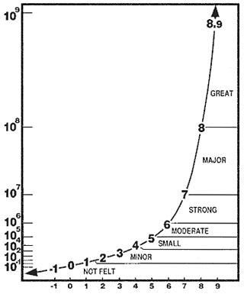
Rule # 3
Life Expectancy is an Inherently Bad Metric to Forecast
Richter Scale

Slide 20
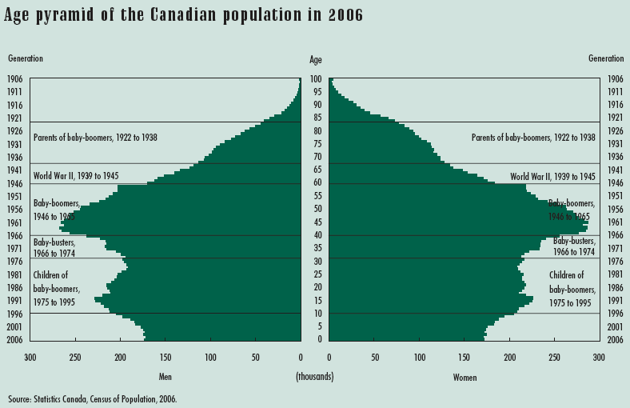
Populations Are Influenced by Life Events
The usual approach to forecasting is to look back in time at the mortality experience of older cohorts and then extend these observed trends forward.
The cohorts that will express mortality in the future are located in this region of the population.

Slide 21
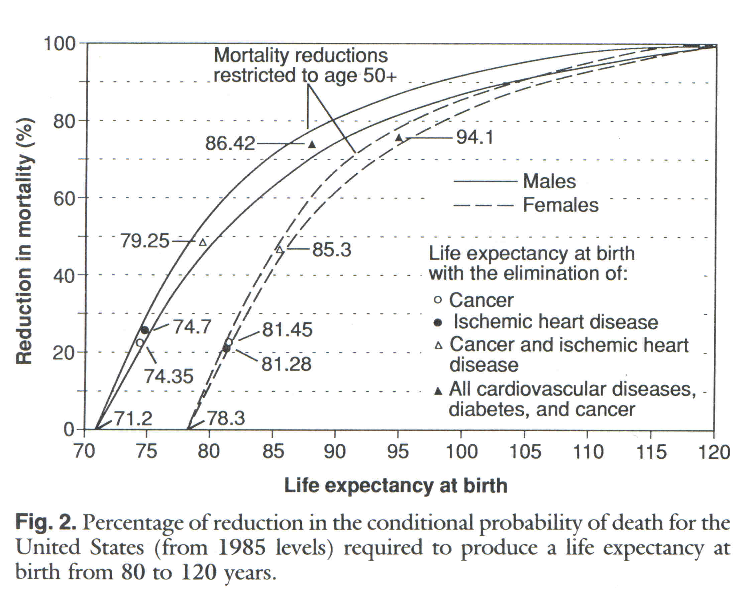
Source: Olshansky, Carnes and Cassel, 1990. Science.

Slide 22
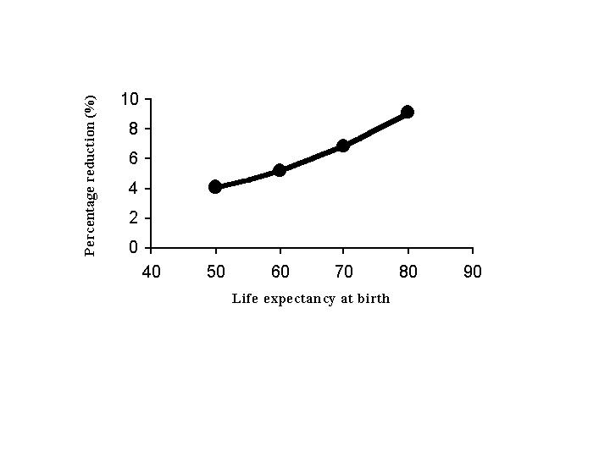
Percentage reduction in death rates at all ages required to raise life expectancy at birth by one year
SOURCE: Olshansky, Carnes and Désesquelles, 2001. Prospects for Human Longevity. Science.

Slide 23
Seismic energy yield
7.0 – 7.1 = 200 kilotons
8.0 – 8.1 = 6 megatons
9.0 – 91 = 300 megatons
Richter Scale used to measure energy released during an earthquake

Slide 24
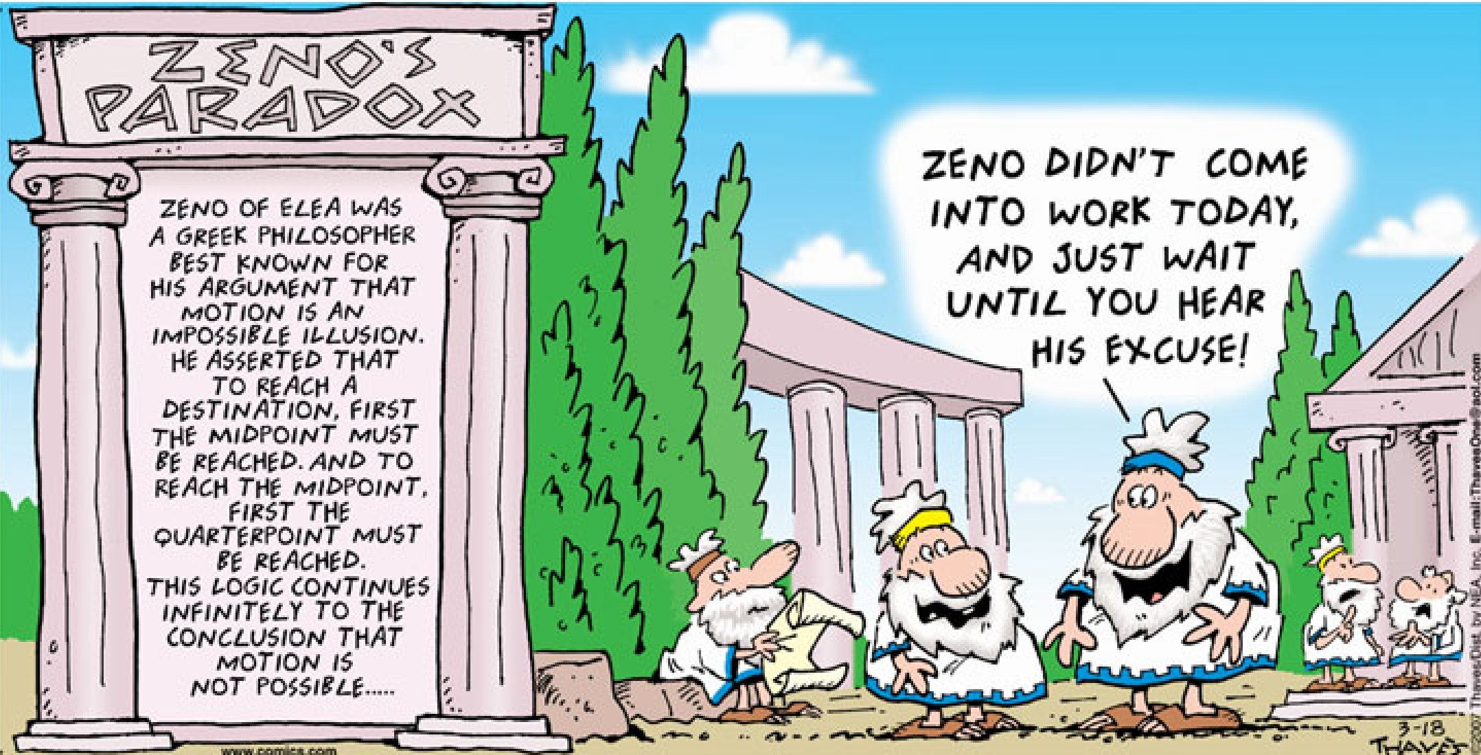
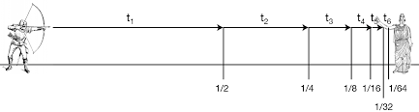
Rule # 4
Zeno’s Paradox of Immortality

Slide 25
Classic Examples of Zeno’s Paradox in Aging
Death rates can forever decline by half: “there is simply no convincing evidence (demographic, biological or otherwise) of a lower bound on death rates other than zero” (Source: Wilmoth, Science, 2001)
Radical Life Extension Is Already Here: “…in countries with high life expectancies most children born since the year 2000 will celebrate their 100th birthday…” (Source: Vaupel, Nature, 2010).
Live Long Enough to Live Forever: “…a program designed to slow aging and disease processes...This bridge to the future will enable those who dare to make the journey from this century to the next...and beyond. (Source: Kurzweil and Grossman, Fantastic Voyage, 2005).
Actuarial Escape Velocity (AEV): A scenario where “mortality rates fall so fast that people’s remaining (not merely total) life expectancy increases with time.” That is, technology adds survival time at a faster pace than living removes it. (Source: de Grey, PLoS Biol, 2004).

Slide 26
“If survival to age X is possible, and there are no biological or other reasons why survival to age X plus 1 day is not possible, then all we must do is reduce the risk of death to rates that match or exceed the passage of clock time, and we will become immortal.”
Source: Olshansky and Carnes, 2012. Zeno’s Paradox of Immortality. Gerontology.
Zeno’s Paradox of Immortality

Slide 27
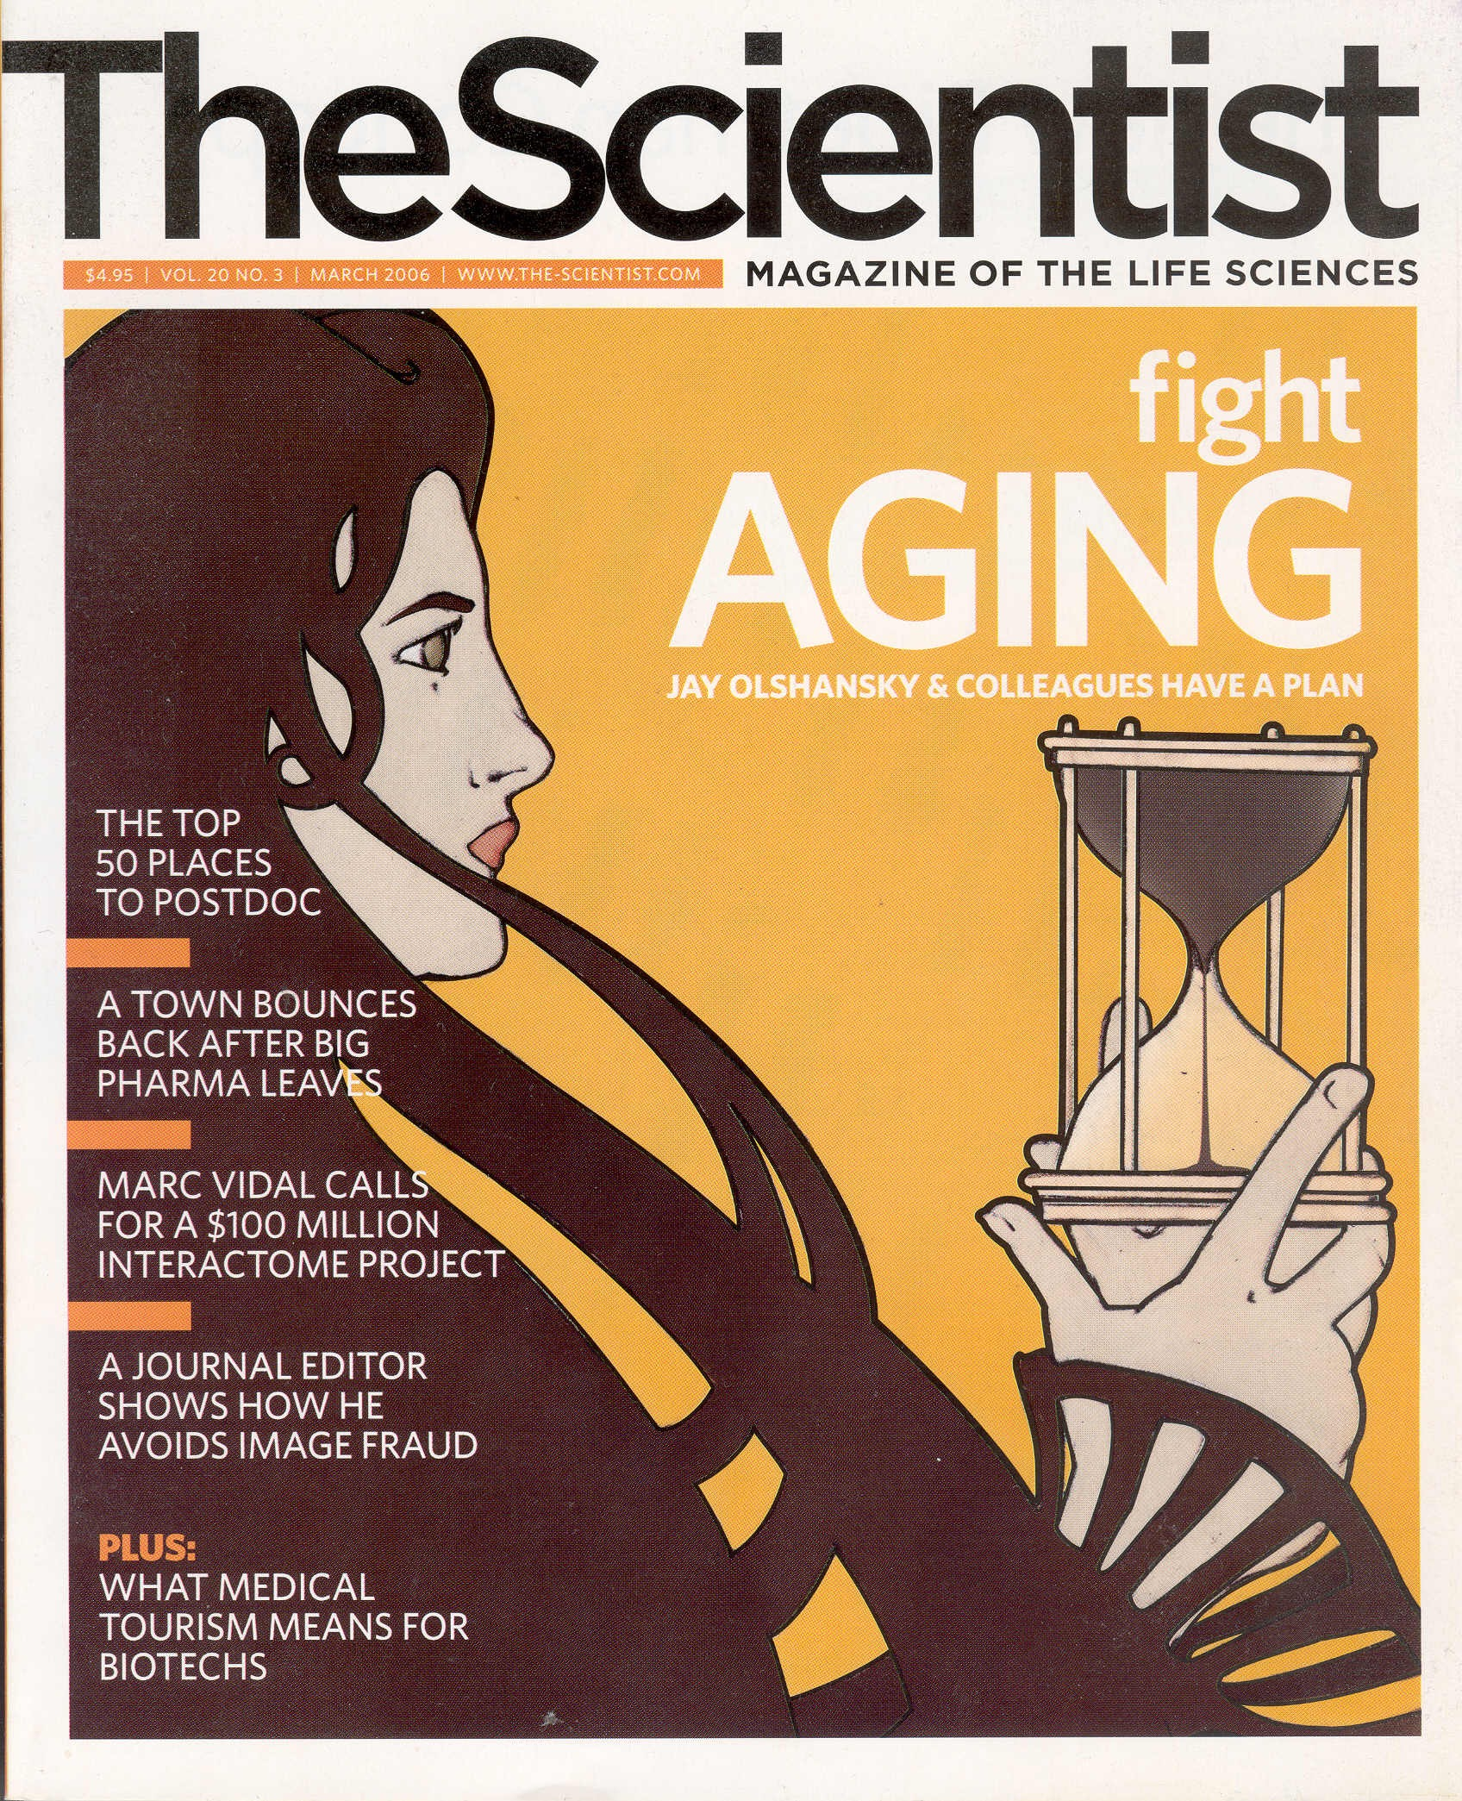

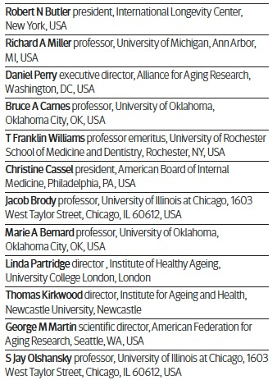

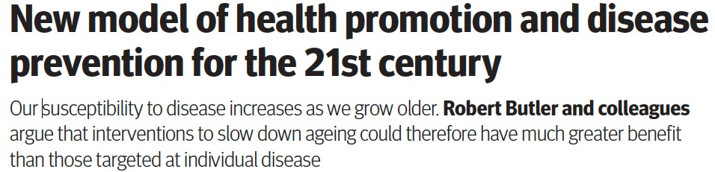
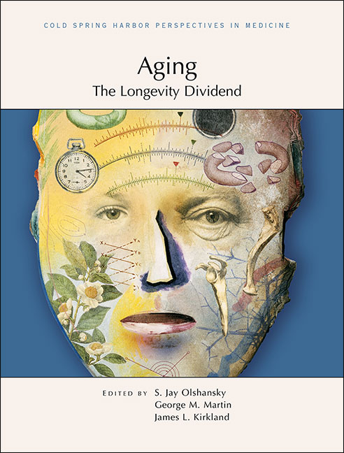

Daniel Perry Richard A. Miller Robert N. Butler
July, 2008

