Slide 1

A Forecast Reconciliation Approach to Cause-of-death Mortality Modeling
Dr Han Li
Macquarie University
Department of Actuairal Studies and Business Analytics Australia
The 14th International Longevity Risk and Capital Markets Solutions Conference
Amsterdam, the Netherlands
20–21 September 2018
Mortality Modeling
20–21 September 2018
1 / 20

Slide 2
Outline of the talk
Background
Trace minimization reconciliation
Empirical results
► Data description
► Unreconciled vs Reconciled forecasts
► Cause-elimination mortality projection
Conclusions
Mortality Modeling
20–21 September 2018
2 / 20

Slide 3
Some interesting facts about longevity
According to The Guardian:
“Australians are outliving their British and American cousins!”
Comparison of life expectancies in 2016: Australia: Male 81.5; Female 85.5
For full article see: https://www.theguardian.com/society/2018/aug/16/australians-living-longer-but-life- expectancy-dips-in-us-and-uk
Mortality Modeling
20–21 September 2018
3 / 20

Slide 4
Some interesting facts about longevity
According to The Guardian:
“Australians are outliving their British and American cousins!”
Comparison of life expectancies in 2016: Australia: Male 81.5; Female 85.5
U.K.: Male 79; Female 82.7
For full article see: https://www.theguardian.com/society/2018/aug/16/australians-living-longer-but-life- expectancy-dips-in-us-and-uk
Mortality Modeling
20–21 September 2018
3 / 20

Slide 5
Some interesting facts about longevity
According to The Guardian:
“Australians are outliving their British and American cousins!”
Comparison of life expectancies in 2016: Australia: Male 81.5; Female 85.5
U.K.: Male 79; Female 82.7
U.S.: Male 76.4; Female 81.4
For full article see: https://www.theguardian.com/society/2018/aug/16/australians-living-longer-but-life- expectancy-dips-in-us-and-uk
Mortality Modeling
20–21 September 2018
3 / 20

Slide 6
How do we model mortality rates?
Some notation/formula before we start!
Central mortality rate m_{x,t}, reflects the death probability for age x last birthday in the middle of the calender year t and it is estimated by:
_{mx =} dx,t .
,t
Ex,t
Lee-Carter model (1992):
log(m_{x,t}) = a_{x} + b_{x}κ_{t}
(1)
Mortality Modeling

Slide 7
Why Cause-of-death mortality modeling?
Mortality Modeling

Slide 8
Why Cause-of-death mortality modeling?
Mortality Modeling

Slide 9
Why Cause-of-death mortality modeling?
(a) Cancer
(b) External
(c) Diabetes
(d) Vascular
(e) Influenza
(f) Mental
Mortality Modeling

Slide 10
Current issues/challenges
Assumption of independence among causes: in fact, they are
competing!
Attempts to use copula models suffer from significant subjectivity. Independent forecasts don’t add up to the total level.
Can’t predict the impact of cause-elimination to life expectancy.
Mortality Modeling

Slide 11
Data
The death and exposure data used to calculate central mortality rates are downloaded from the Human Mortality Database (HMD)and the National Center for Health Statistics (NCHS).
Country: the United States.
8 causes considered: Cancer, Diabete, External, Influenza, Mental, Nephritis, Vascular, and Other.
Investigation period: 1970–2015.
Age range: 1–85.
Mortality Modeling

Slide 12
Forecast reconciliation
Figure: 2-level hierarchical tree of mortality rates
m_{t} (x)
Total
m1,t (x)
External
m2,t (x)
Cancer
m3,t (x) m4,t (x)
Diabetes Influenza
m5,t (x)
Mental
m6,t(x)
Nephritis
m7,t(x)
Vascular
m8,t(x)
Other
Mortality Modeling

Slide 13
Figure: 3-level hierarchical tree of mortality rates
m_{t} (x)
Total
m_{1,t}(x)
External
m¹(x)
m²(x)
m_{8,t}(x)
Other
t
Cluster1
t
Cluster2
m_{2,t} (x) m_{3,t} (x) m_{7,t} (x)
Cancer Diabetes Vascular
m_{5,t} (x) m6,t (x) m_{4,t} (x)
Mental
Nephritis Influenza
Mortality Modeling

Slide 14
Forecast reconciliation
y_{x,t} = Sb_{x,t}, (2)
where S is a “summing matrix” of dimension (J + 1) × J which aggregates cause-specific mortality rates to the total mortality rates.
Mortality Modeling

Slide 15
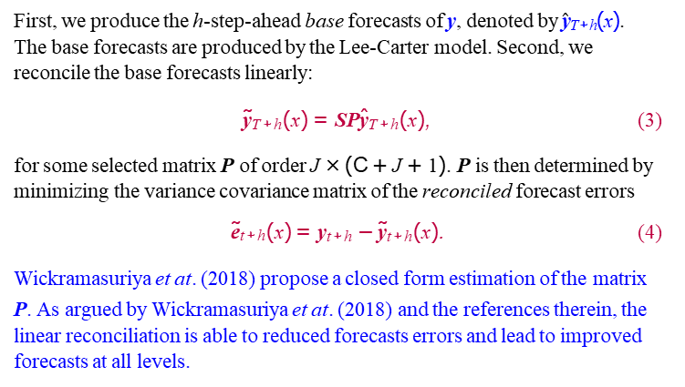
Forecast reconciliation
First, we produce the h-step-ahead base forecasts of y, denoted by $\hat{\text{y}}$_{T+h}(x). The base forecasts are produced by the Lee-Carter model. Second, we reconcile the base forecasts linearly:
˜y_{T+h}(x) = SPˆy_{T+h}(x), (3)
for some selected matrix P of order J × (C + J + 1). P is then determined by minimizing the variance covariance matrix of the reconciled forecast errors
˜e_{t+h}(x) = y_{t+h} − ˜y_{t+h}(x). (4) Wickramasuriya et at. (2018) propose a closed form estimation of the matrix
P. As argued by Wickramasuriya et at. (2018) and the references therein, the linear reconciliation is able to reduced forecasts errors and lead to improved forecasts at all levels.
Mortality Modeling

Slide 16
Unreconciled vs Reconciled forecasts
0.20
Level
Level
Base
Bottom Up
MAPE
0.10
0.00
2
4
6 8 10 12 14
Forecast Horizon
Mortality Modeling

Slide 17
Independent vs Reconciled forecasts
0.20
level
level
Base
MAPE
0.15 0.25 0.35
0.15
MAPE
0.10
0.05
0.05
2
4
6 8 10
Forecast Horizon
12
14
2
4
6 8 10
Forecast Horizon
12
14
(a) Cancer
(b) Diabetes
0.35
MAPE
0.10 0.15 0.20
MAPE
0.25
0.15
0.05
0.05
2 | 4 | 6 8 10 | 12 | 14 | 2 | 4 | 6 8 10 | 12 | 14
 |  | Forecast Horizon |  |  |  |  | Forecast Horizon
(c) Influenza
(d) External
Mortality Modeling

Slide 18
Independent vs Reconciled forecasts
0.20
MAPE
0.35 0.45 0.55
0.15
MAPE
0.10
0.05
0.25
2
4 6 8 10
Forecast Horizon
12
14
2
4
6 8 10 12 14
Forecast Horizon
(e) Mental
(f) Nephritis
0.20
MAPE
0.15 0.25 0.35
0.15
MAPE
0.10
0.05
0.05
2 | 4 | 6 8 10 | 12 | 14 | 2 | 4 | 6 8 10 | 12 | 14
 |  | Forecast Horizon |  |  |  |  | Forecast Horizon
(g) Vascular
(h) Other
Mortality Modeling

Slide 19
Cause-elimination mortality projection
What if . . . cancer deaths are eliminated?
Figure: Mortality projection for 2050
All−cause
Reconciled
Independent
0
−2
log mortality rate
−4
−6
−10 −8
0
20
40
Age
Mortality Modeling
60
80

Slide 20
Cause-elimination mortality projection
What if . . . external deaths are eliminated?
Figure: Mortality projection for 2050
All−cause
Reconciled
Independent
0
−2
log mortality rate
−4
−6
−10 −8
0
20
40
Age
Mortality Modeling
60
80

Slide 21
Beyond the numbers . . .
Going back to Australia:
Mortality Modeling
20 / 20

Slide 22
Beyond the numbers . . .
Going back to Australia:
During 2017, there were 1,225 road deaths.
Mortality Modeling
20 / 20

Slide 23
Beyond the numbers . . .
Going back to Australia:
During 2017, there were 1,225 road deaths.
The rate of annual deaths per 100,000 population stands at 5.0.
Mortality Modeling
20 / 20

Slide 24
Beyond the numbers . . .
Going back to Australia:
During 2017, there were 1,225 road deaths.
The rate of annual deaths per 100,000 population stands at 5.0.
How do we estimate the age-specific rates?
Mortality Modeling
20 / 20

Slide 25

Beyond the numbers . . .
Walking upside down in
the sky,
Between the satellites
passing by,
I am looking for my
dreams,
. . .
Professor Colin O’Hare
(20th Dec 1974 – 1st Aug 2018)
Mortality Modeling
20 / 20

Slide 26
End of presentation
Thank you!
Any questions/ comments/ suggestions?
Contact email: han.li@mq.edu.au
Research Gate page: http://www.researchgate.net/profile/Han_Li51
Mortality Modeling

