Slide 1
Board governance and relationships with staff: the NDCS perspective
Susan Daniels
Chief Executive NDCS

Slide 2

Contents
NDCS – vision and strategy
Governance arrangements
The role of trustees
Conclusion

Slide 3
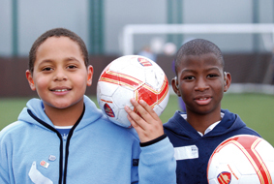
Our vision...
A world without barriers for every deaf child

Slide 4
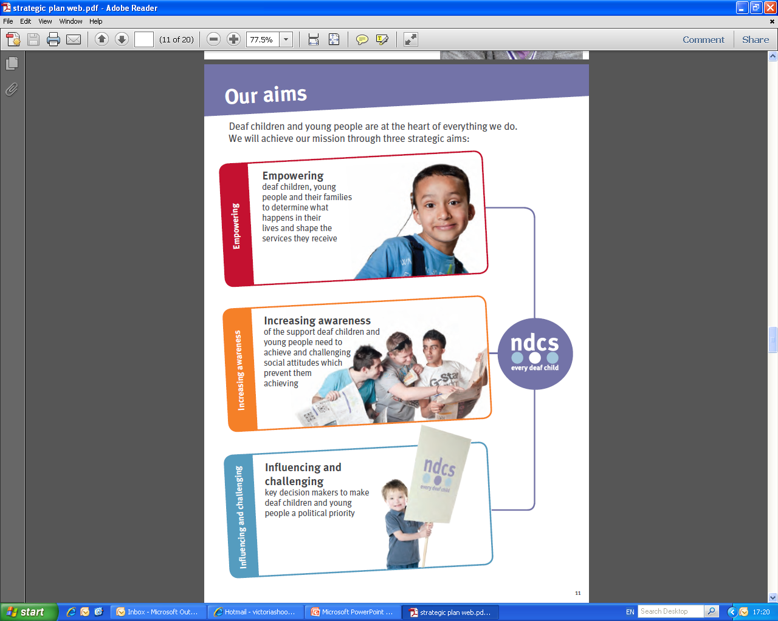
Our strategy
Notes:
- What’s still relevant now and what’s new?
Looking at our history, its clear how much has been achieved over the past 68 years. And looking at the aims we have set ourselves for the next six years, we can see how closely we have stuck to the founding principles set all those years ago.
The main changes today are that we are able to take advantage of better technology and more opportunities to get our messages out there. We are in a stronger financial position, which means we can support more parents than ever before and our members provide valuable insights to help guide our work.

Slide 5
We work with :
Children
Families
Professionals
Communities
Statutory bodies
Other voluntary organisations
Politicians and opinion formers

Slide 6
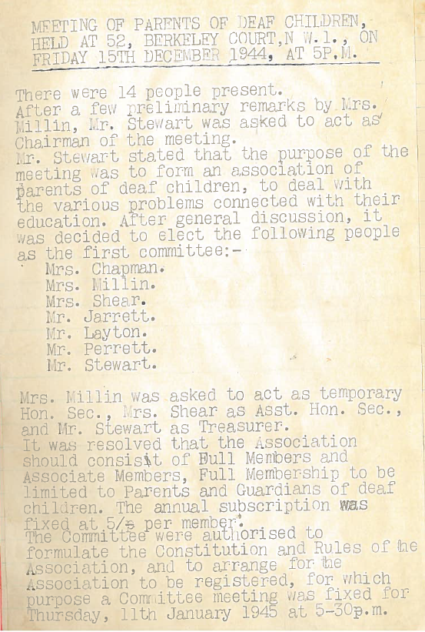
Small beginnings
When did NDCS start?
  5pm,15 December 1944
  14 parents of deaf children met at Mrs Mullins’ house in Berkley Court, London
Notes:
Miss Mary Hare – her vision was that deaf children were capable of realising the full potential of their intellect and that they had no need of shelter from the rigours of hearing society in the growing number of asylums for the deaf and dumb.
She worked to over-turned view that child's prime needs were for care and protection, by establishing a small school in London in 1883. By 1916 this centre of learning had blossomed into the Dene Hollow Oral School for the Deaf based in Sussex
Shortly after her death in 1945, Dene Hollow School was redesignated as the National Grammar School for the Deaf. Bearing her name, The Mary Hare Grammar School came to serve the needs of potentially able severely and profoundly deaf children throughout the United Kingdom. The rapid growth that this change brought necessitated a move to larger premises, and in 1948 the school acquired and occupied its present site close to Newbury in Berkshire.

Slide 7
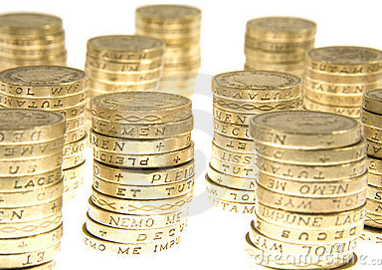
Growth – income
1945 - £97
3 years later… £648
19 years later…£26k
55 years later…£3.8m
59 years later…£11.5m
In our 60th year…£10.4m
68 years after we were founded…£21.m (budgeted)
Notes:
Income

Slide 8
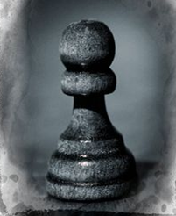
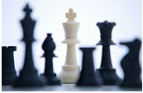
Growth : staff
1952 = 1
2012 = 204
Notes:
Employees

Slide 9
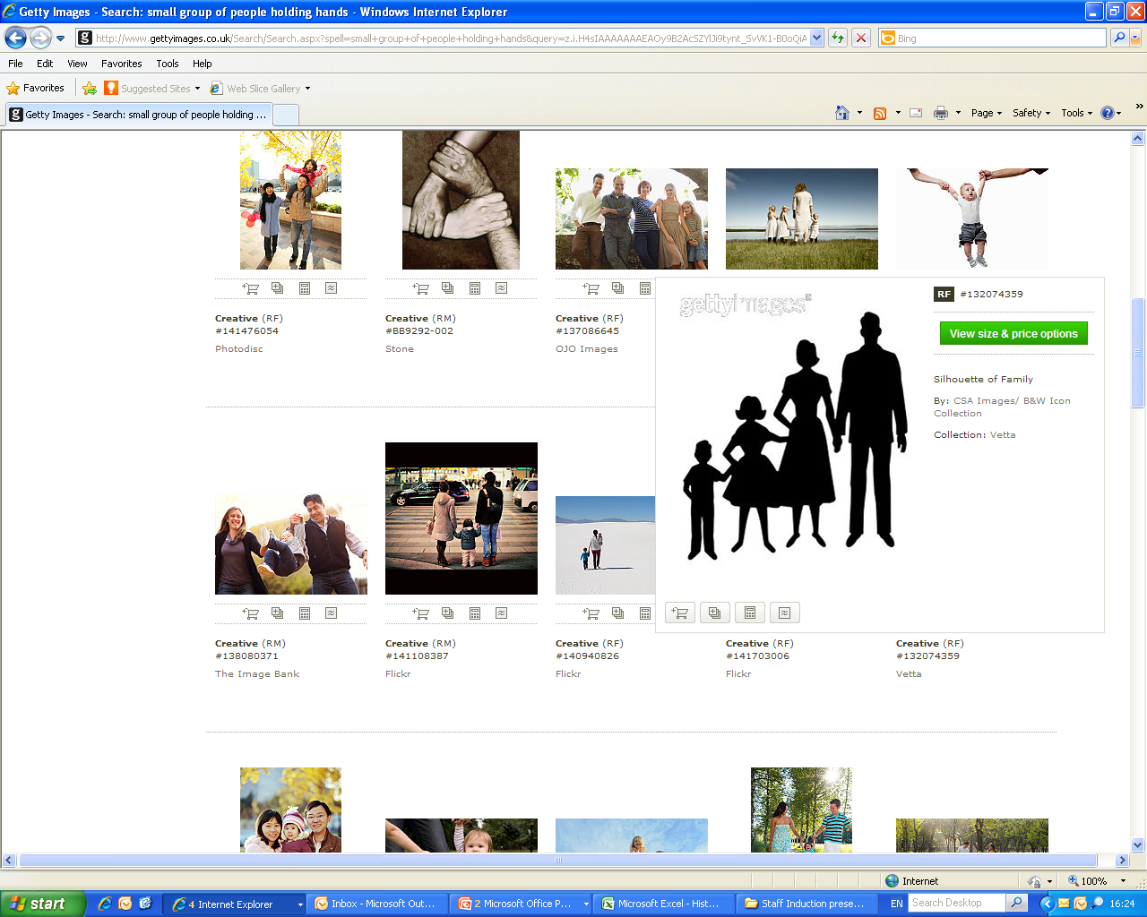
Growth : members
2012
28,864
2006
2000
13,672
1988
9,357
7,532
1967
4,500
1945
1946
1949
125
245
589
Notes:
Membership

Slide 10
Major Strategic
Developments
1993: Regional delivery commences
2002 : International arm (Deaf Child Worldwide) which works in South Asia, East Africa and Latin America was formed
2007 : Policy and campaign function established – national and regional campaigns teams
2009 : Direct work with deaf children and young people commences

Slide 11
Governance
NDCS is a registered charity in England, Wales and Scotland, and a limited company.
Our constitution (M&A) sets out our objects (what NDCS is set up to do), how we are governed and who our members are.
NDCS is governed by a Trustee Board of up to 12 Trustees, up to 8 of whom must be the parent of a deaf child and up to 4 more who bring additional skills required. Board meets four times each year.
Our SMT consists of the Chief Executive and 5 Executive Directors.

Slide 12
Key developments in Board effectiveness
2003 - maximum terms of 9 years for trustees
2003 - governance framework – role description, policies, induction
2008 - Board reduced from 19 to 12 trustees
2008 - principle of competence (not representation) as the basis for trustee recruitment, with rigorous recruitment and selection process
2008 - trustee appraisal and board development process introduced.

Slide 13
Key outcomes
Parents of deaf children have remained at the heart of the governance of NDCS
The development of the board has mirrored the growth of NDCS
Recruitment, selection and board development processes has led to enhanced trustee effectiveness

Slide 14
Trustees’ formal responsibilities
To set the strategy for NDCS
To monitor performance
To ensure NDCS is run effectively, to manage its assets prudently, to comply with relevant regulation.
To act always in the best interests of NDCS.

Slide 15
So what do our Trustees actually do?
See the big picture for NDCS and our users
Give leadership
Set priorities
Scrutinise, monitor, challenge and
hold the SMT to account
Comply with legislation and regulation
Serve as ambassadors and advocates

Slide 16
What Trustees should not do
Manage the charity day to day
Make operational decisions (“cancel this event”)
Allow cliques to form on the Board
Champion particular services, user groups, or staff.
Bypass the CEO!

Slide 17
The Board and the CEO
Trustees need to understand the CEO’s role (should be part of trustee induction)
Trustees should hold the CEO to account, but allow him/her to implement strategy and manage the charity
Trustees must recruit the CEO and must not delegate this
The Board’s primary staff relationship is with the CEO, and can take many styles………

Slide 18
Trustees and the CEO
– how is it for you?
High support
Low challenge | Supporters club “We’re here to support the CE” | Partner or critical friend “We share everything – good or bad.” | High challenge
 | Abdicators “We leave it to the professionals” | Adversaries “We keep a very close eye on the staff”
Low support

Slide 19
The Trustees’ relationship with senior staff: what makes it work
A strategic partnership – both contribute vision and expertise.
A clear understanding of both roles
Communication – regular, open and honest
Trust and mutual respect
Willingness to work hard at the relationship (keep talking)
No surprises – from either party!
Shared experience of good and bad times

Slide 20
Conclusion
Trustees and CEO/SMT are a partnership
Understand your role and stick to it
The partnership between the Board Chair and the CEO is key

Slide 21

Any questions?

