Slide 1

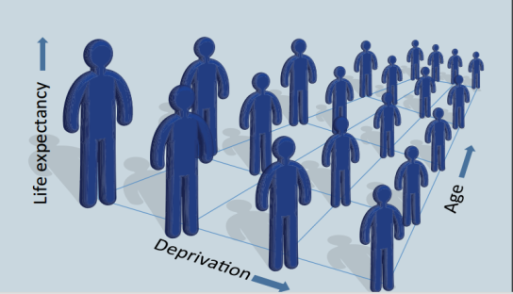
Inequalities matter!
An investigation into the impact of deprivation on demographic inequalities in adults
Professor Les Mayhew Cass Business School
Dr. Gillian Harper Queen Mary ULU
Dr. Andrés M. Villegas UNSW Australia
lesmayhew@googlemail.com

Slide 2
The index of multiple deprivation (IMD)
The IMD consists of 37 separate indicators in 7 policy domains: e.g. education, health, and crime.
Each small area is score on each domain and give a combined score overall
The IMD is a relative measure and so cannot deal with absolute differences in deprivation over time
It is also measured slightly differently in constituent countries so our focus is on England

Slide 3
Research design
The research considers inequalities between men and women as well as inequalities related to deprivation. It also looks forwards in time as well as backwards

Slide 4
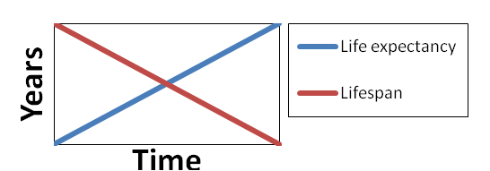
Holding patterns in inequalities
The convergent phase: Improved life expectancy and equality in lifespan ( 19th C-1939)
The parallel phase: Improved life expectancy but equality unchanged (1950 -1990)
3. Divergent phase: Faltering life expectancy increased inequality 2011- ??
See ‘An investigation into inequalities in adult lifespan: Mayhew and Smith, ILC 2016

Slide 5
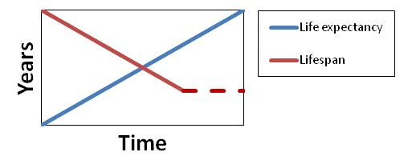
Holding patterns in inequalities
The convergent phase: Improved life expectancy and equality in lifespan ( 19th C-1939)
The parallel phase: Improved life expectancy but equality unchanged (1950 -1990)
3. Divergent phase: Faltering life expectancy increased inequality 2011- ??
See ‘An investigation into inequalities in adult lifespan: Mayhew and Smith, ILC 2016

Slide 6
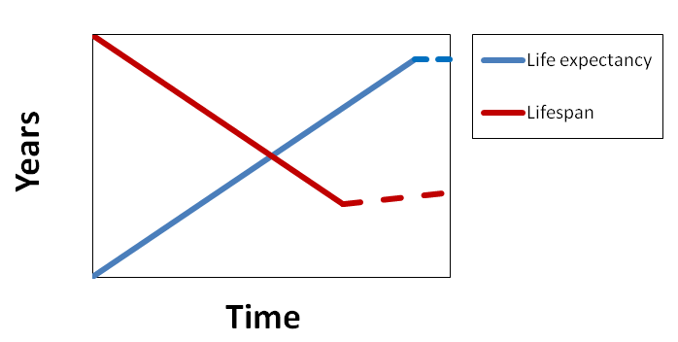
Holding patterns in inequalities
The convergent phase: Improved life expectancy and equality in lifespan ( 19th C-1939)
The parallel phase: Improved life expectancy but equality unchanged (1950 -1990)
3. Divergent phase: Faltering life expectancy increased inequality 2011- ??
See ‘An investigation into inequalities in adult lifespan: Mayhew and Smith, ILC 2016

Slide 7
Distribution in ages of death

Slide 8
Distribution in ages of death

Slide 9
Convergence in mortality rates
This shows the pace of convergence in terms of mortality rates. Although the gender gap in life expectancy at age 30 has shrunk, but it was not until 1990 that men reached the level that women were at in 1950. If trends underway continue there would be complete convergence after 2030.

Slide 10
Trends in partial life expectancy
Partial life expectancy measures how many years a person can expect to live out of the next ten given that he or she has reached age 30, 40, ………80,90. The tables are for 2001, 2016 and 2031 and show that many more who died in their 80s will now live into their 90s, particularly among men.

Slide 11
Male trends in partial life expectancy (1950 to 2035)
This chart is for men with each curve representing partial life expectancy at different start ages between 30, …, and 80. The dotted extensions are projections towards the maximum possible improvement of 10 years.(see also Mayhew and Smith, ‘Jam Jar model of Life expectancy’: ILC 2015)

Slide 12
Deprivation adjusted life expectancy by decile at age 30 (males)
In 2006 there was an 8.6 year gap in life expectancy between the most and least deprived areas which has increased from 8 years in 2001 and will rise further to 8.8 years by 2031

Slide 13
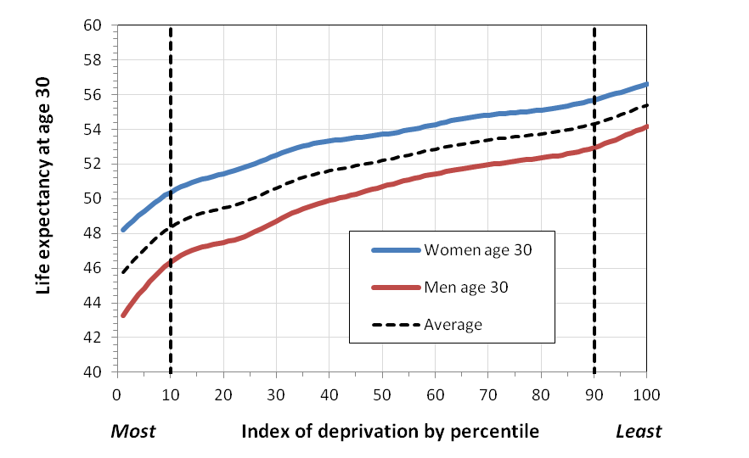
Inequalities in life expectancy by deprivation percentile
The boost to longevity in the least deprived percentile
The shortening impact on longevity of in the most deprived percentile
Longevity receives an additional boost in the wealthiest few percent of the population and a negative boost in the poorest few percentiles. The maximum male gap is 10.9 years (8.4 years W). The gender gap is smallest in the wealthiest percentile.

Slide 14
Trends in male lifespan by deprivation decile at age 30
Inequalities in male life span are narrowest in the wealthiest decile and greatest in the poorest. Variation in average lifespan is unchanged in the poorest deciles and reducing in the richer deciles. The poor-rich gap, which was 8.7 years in 2001, is forecast to increase to 12.3 years by 2031
Notes:
Lets turn to the results by deprivation decile. We report these for bot genders for life expectanc and lifespan.
As life expectancy increases the variation in lifespan between the richest and poorest initially reduced and then remained constant. Now it appears to be enlarging as can be seen from this table. Again using men as my illustration the gap is widening such that by 2081 it will be 12.3 years as compared with 8.7 years in 2001. In the poorest decile that gap hardly changes but in the richest decile the gap reduces by 2.2 years.

Slide 15
Mortality differential by deprivation decile
Charts showing relative male mortality by deprivation decile in England versus the England average. Men aged 42 in the most deprived decile are 4.4 times more likely to die than men of the same age in the richest decile.

Slide 16
Pattern of deprivation in England
A
B
C
The worst deprivation is highly concentrated with 50% of all neighbourhoods in decile 1 being concentrated in only 10% of councils; 50% of district have no neighbourhoods at all in decile 1.

Slide 17
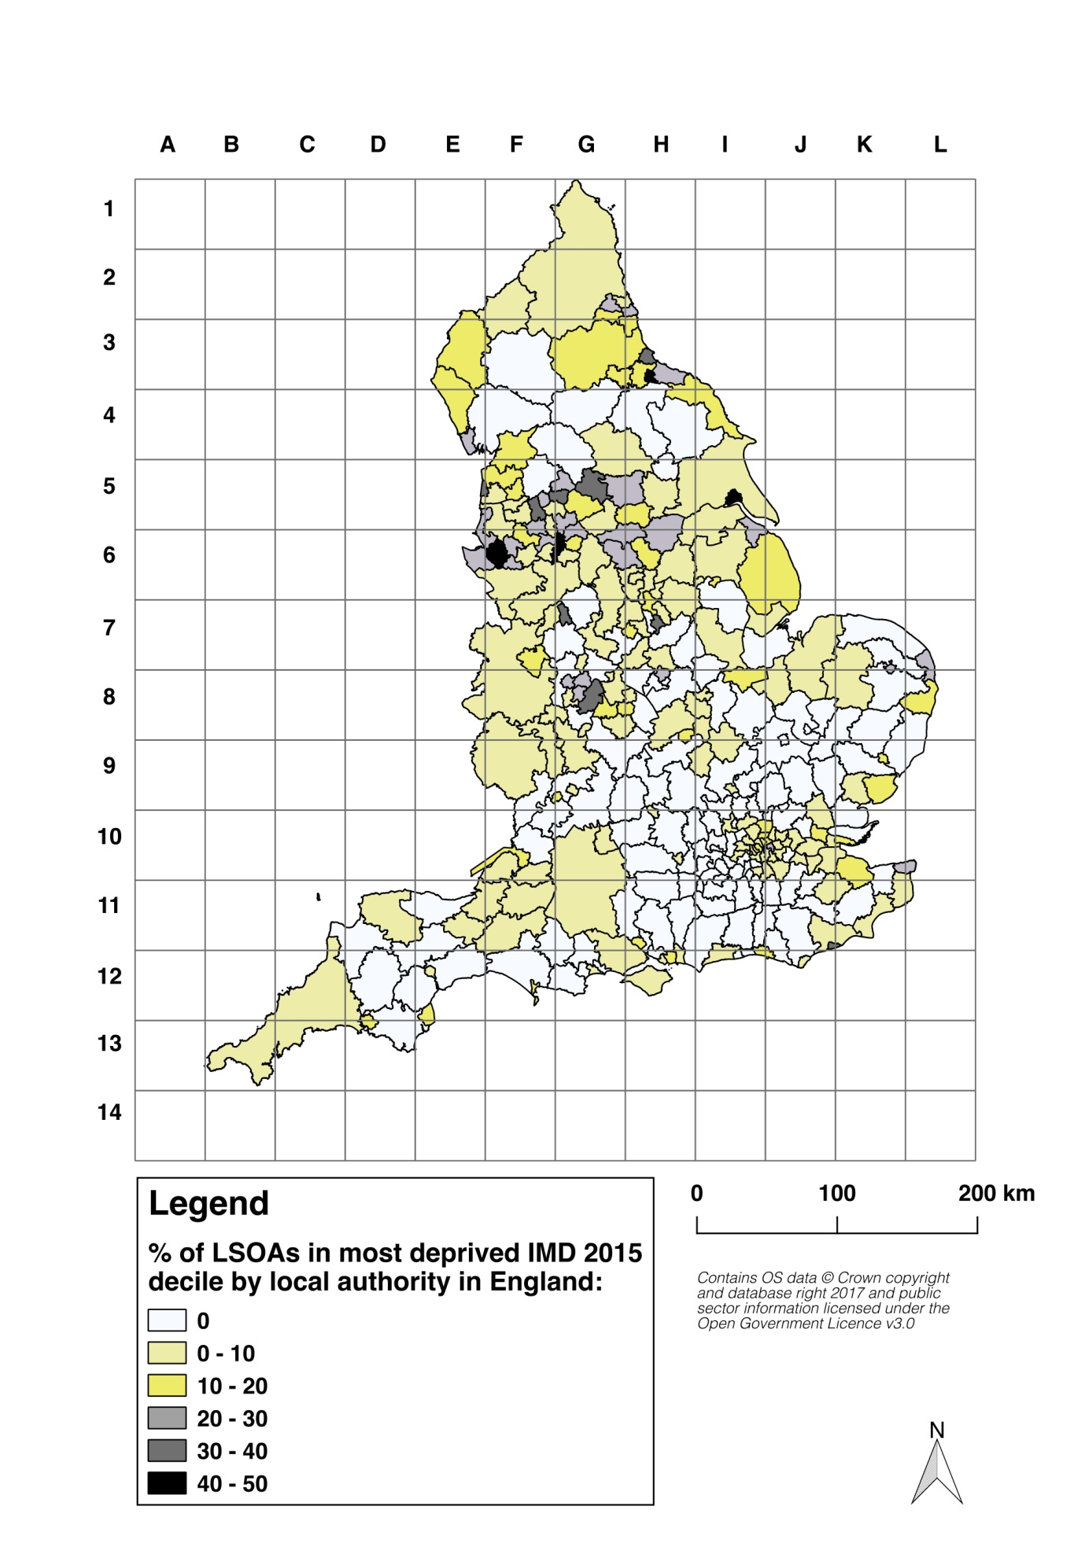
Map showing the percentage of LSOAs in decile one (most deprived) among English districts
Map shows upper tier and unitary authorities according to the proportion of neighbourhoods in the most deprived deciles.
Northwest and northeast towns are the worst affected, but coastal counties are also included. The southeast is free from the most extreme deprivation except in localised parts of London.

Slide 18
The impact of poor health on longevity
Changes in inequalities tell an important story but there are many explanatory gaps
Good health is a work enabler helping people to fulfil their potential
New data show that the gap between health and life expectancy is much higher in deprived areas
So there is a strong argument that delaying or avoiding a disease altogether is good for you and for society

Slide 19
The proportion of life spent in disability and years to death
A
B
A person becoming physically disabled as a result of a chronic illness at age 40 (A) could expect to die at age 70 with 30 years spent in ill health or 43% of their whole life. A person becoming physically disabled at age 75 (B) could expect to die at age 86, another 11 years, and so would have spent only 13% of their life in disability

Slide 20

Strategic messages
While a growing population will lead to greater GDP it may not translate into improved GDP per capita and living standards will fall if inequalities persist
We need to understand better how inequalities and poor health interact with, and impact on, the wider economy to make the economic as well as demographic case for their reduction
Increases in life expectancy need to be balanced by improvements in disability-free life expectancy because this increases working life expectancy
Early onset disability is bad for individuals and for society because it shortens life and increases the chances of dependency. It is also largely avoidable.

Slide 21
The proportion of life spent in disability and years to death
A
B
A person becoming physically disabled as a result of a chronic illness at age 40 (A) could expect to die at age 70 with 30 years spent in ill health or 43% of their whole life. A person becoming physically disabled at age 75 (B) could expect to die at age 86, another 11 years, and would have spent only 13% of their life in disability

