Slide 1
The Impact of Retirement Benefit Cuts: Evidence from a Natural Experiment in Pension Reform
Yen-Chih Chen
Feng Chia University
Gene Lai
University of North Carolina at Charlotte
Xiaoyi Li
Southwestern University of Finance and Economics
Jinjing Wang
The University of Akron
L20, Singapore, 2025

Slide 2
1. Motivation
Longevity risk and population aging have raised concerns about the sustainability of defined benefit (DB) pensions in many countries (WEF, 2017).
In addition to high public debt and rising inflation, governments are finding it challenging to provide the pension benefits they had promised.
To protect the interests of retirees, policymakers try to improve the sustainability of pension systems through decreasing benefits and/or increasing the retirement age (OECD, 2022).

Slide 3
1. Motivation
As the government faces the challenges of unfunded liabilities in defined benefit pension plans, the following are some measures:
  (1) Reducing pension benefits,
  (2) Raising the minimum retirement age,
  (3) Shifting from a DB to a DC system
  (4) Increasing government subsidies
  (5) Increasing the contribution ratio of employees
While pension reforms can alleviate the financial burdens of the government, their impact on household decisions, such as consumption and savings, merits a comprehensive examination.

Slide 4
1. Motivation
The Effect of Conducting Pension Reform
Some studies examine the introduction of DC pension plans and estimate the crowding-out effect between contributions and private savings (Gale, 1998; Aguila, 2011; Lachowska and Myck, 2018; Yang, 2020).
Others study the impact of current workers’ savings and pension wealth after pension reform (Fields and Mitchell, 1984; Bottazzi, Jappelli, and Padula, 2006), the impact of an increase in the early retirement age (Etgeton, Fischer, and Ye, 2023; Seibold, 2021; Rabaté, Jongen and Atav, 2024) or on the financial market (Scharfstein, 2018).
It’s crucial to know the effect of conducting pension reform on households’ consumption and saving decisions.

Slide 5
2. Pension System in Taiwan
In Taiwan, pension systems have traditionally followed the World Bank's three-pillar classification.
Private sector employees must participate in the Labor Insurance system (the mandatory first pillar, a DB plan), and Labor Pension System (the mandatory second pillar, a DC plan).
Public-sector employees are covered by the Government Employee and Teacher and Staff Pension Insurance (mandatory first pillar, a DB plan) and the Public Service Pension System (mandatory second pillar, a DB plan).
The Taiwanese government initiated a pension reform in 2017. The pension reform focused only on the Public Service Pension System.

Slide 6
2. Pension System in Taiwan
Pension Benefit Cut of Public-sector employees
The pension reform is a shock to public employees. The government initiated discussions in 2017, and the reforms were implemented in 2018.
.

Slide 7
2. Pension System in Taiwan
Pension Benefit Cut of Public-sector employees
Four key changes were made.
  First, the retirement age for receiving a full pension gradually increased from age 50 to age 65.
  Second, the calculation base changed from the final month’s salary to the average of the highest salary over the course of 15 years.
  Third, the special 18% preferential savings rate for public employees was set to be phased out by 2021.
  Fourth, the replacement rate gradually decreased from approximately 75% in 2017 to 60% in 2027 over a ten-year period.
.

Slide 8
2. Pension System in Taiwan
Pension Benefit Cut of Public-sector employees
  Retired employees experience a reduction in their monthly pension to approximately 80-85% of the amount promised.
  Current public-sector employees will see their monthly pension reduced to approximately 80% of the amount promised.
  For current employees, there is also an increase in the retirement age
  An increase in both the government's and the current employees' contributions.

Slide 9
3. Data
We use the Taiwanese Survey of Family Income and Expenditure (TSFIE) data. The TSFIE database is a representative repeated cross-sectional survey conducted annually by the Directorate General of Budget, Accounting, and Statistics.
It is a nationwide survey conducted by the government that includes 2% of households in Taiwan, about 15,000 households yearly.
The primary sample is from the TSFIE database in 2014-2016 and 2018-2020, excluding the reform discussion year 2017.

Slide 10
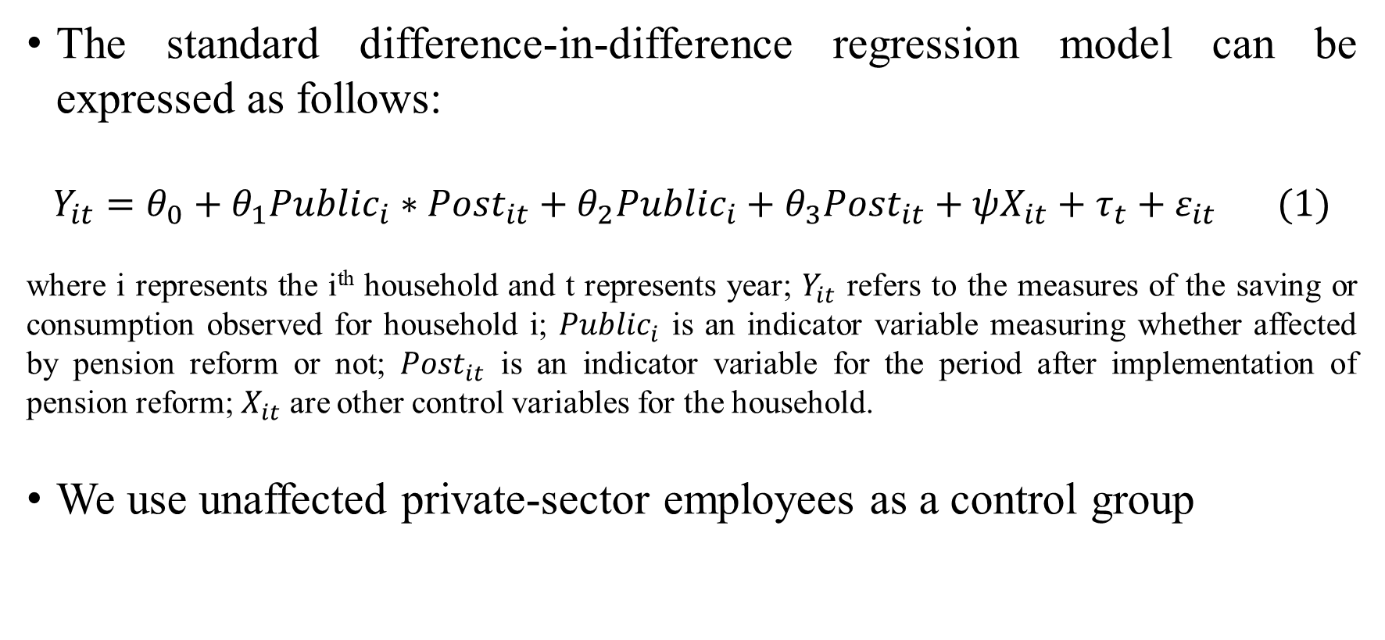
4. Research Models
The standard difference-in-difference regression model can be expressed as follows:
$$Y_{it}=θ_{0}+θ_{1}{Public}_{i}∗{Post}_{it}+θ_{2}{Public}_{i}+θ_{3}{Post}_{it}+ψX_{it}+τ_{t}+ε_{it} (1)$$
where i represents the i^{th} household and t represents year; $Y_{it}$ refers to the measures of the saving or consumption observed for household i; ${Public}_{i}$ is an indicator variable measuring whether affected by pension reform or not; ${Post}_{it}$ is an indicator variable for the period after implementation of pension reform; $X_{it}$ are other control variables for the household.
We use unaffected private-sector employees as a control group

Slide 11
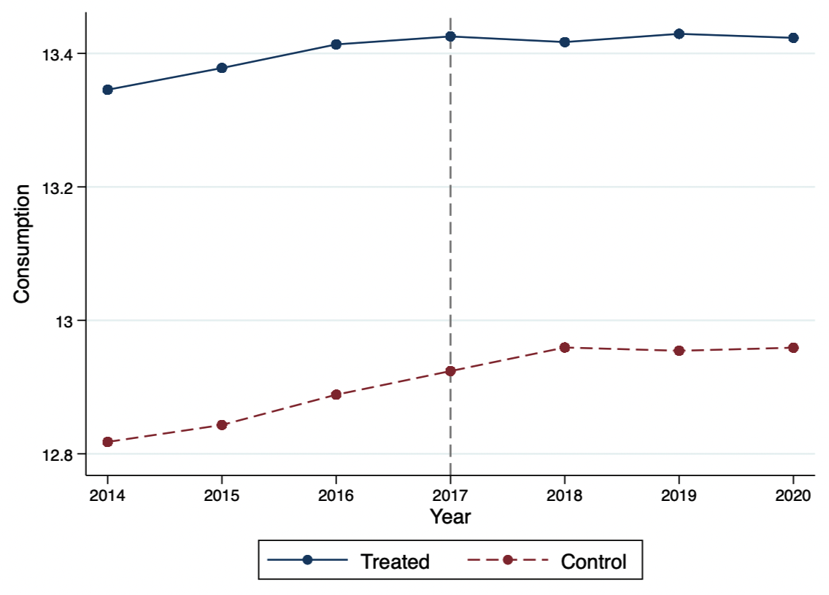
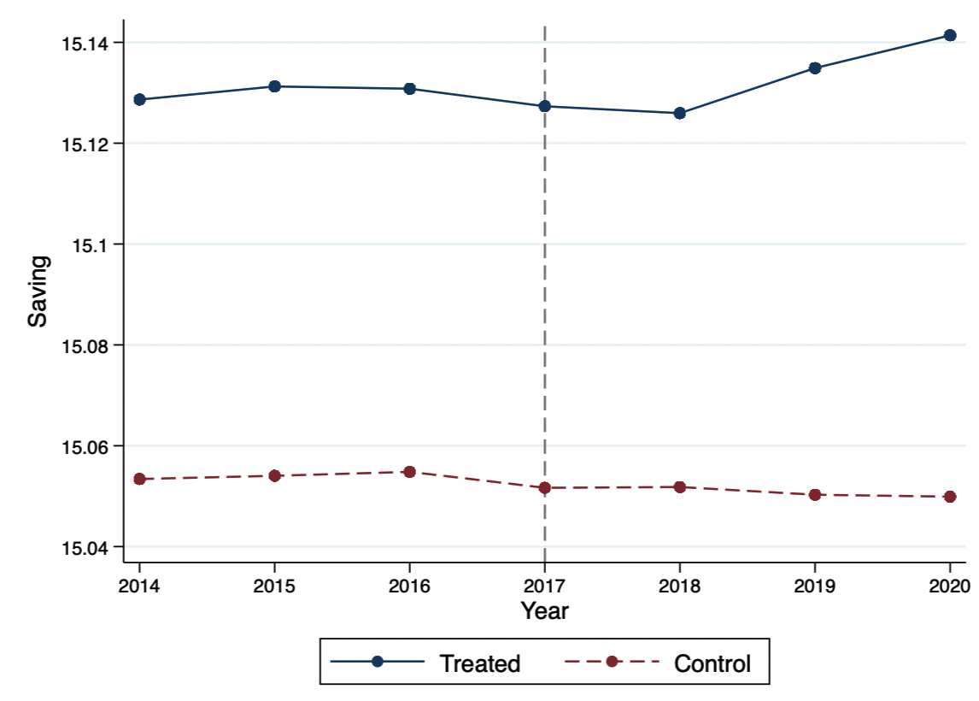
a. Consumption before and after the pension reform
b. Savings before and after the pension reform
Figure 1. Consumption and savings of retiree households before and after the pension reform by treated and control groups

Slide 12
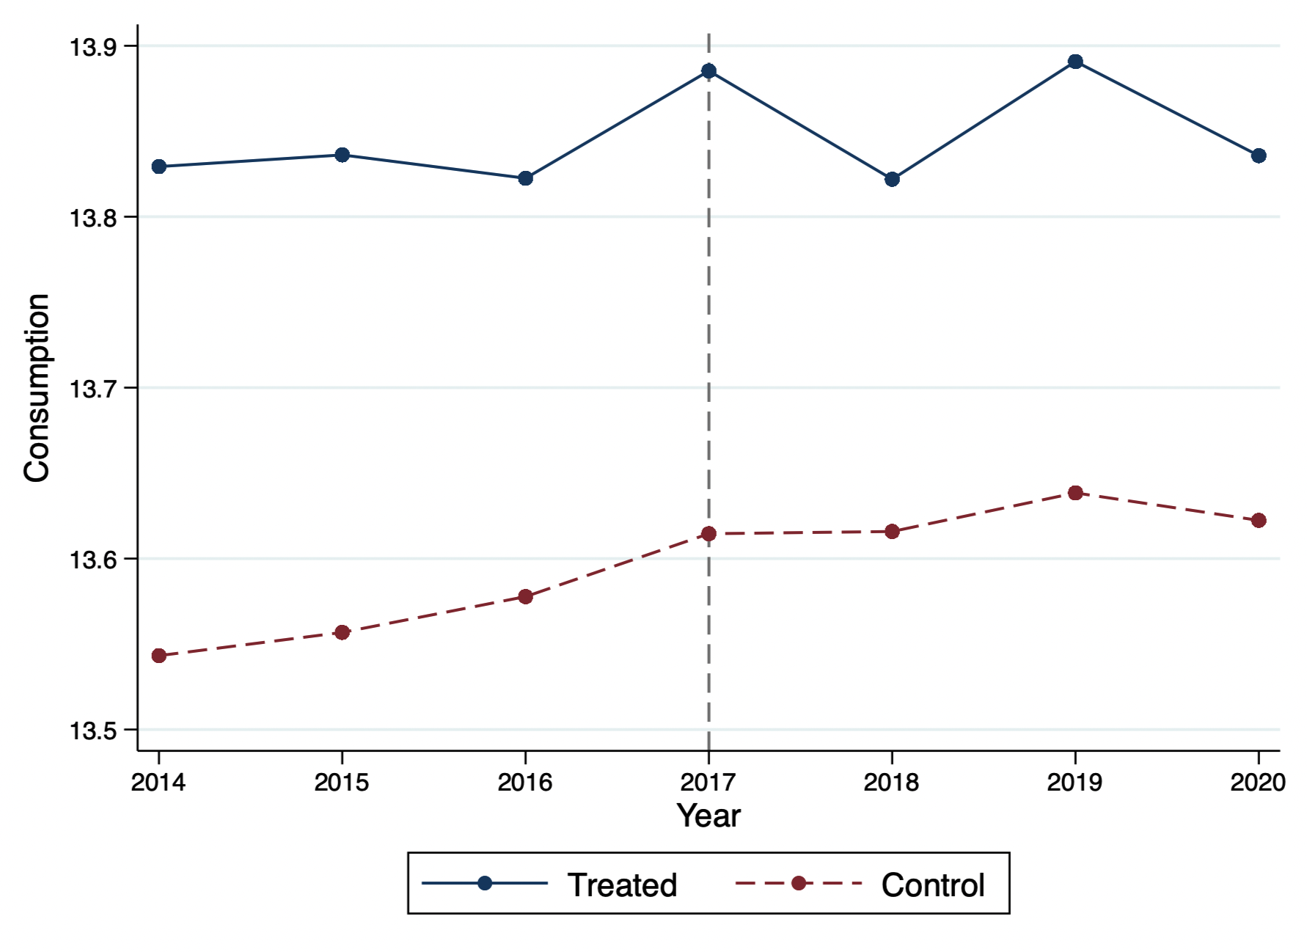
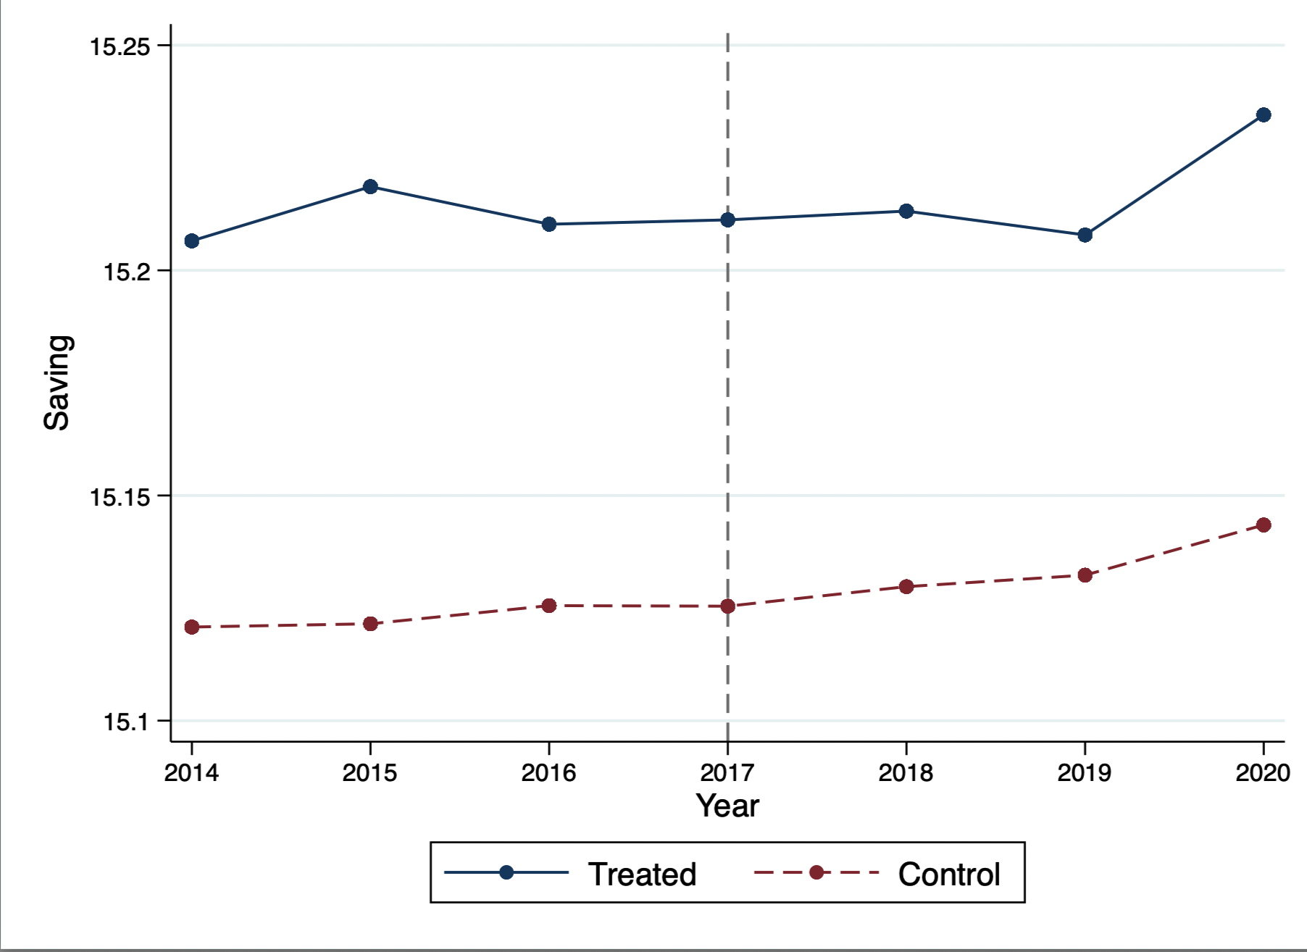
a. Consumption before and after the pension reform
b. Savings before and after the pension reform
Figure 2. Consumption and savings of current employee households before and after the pension reform by treated and control groups

Slide 13
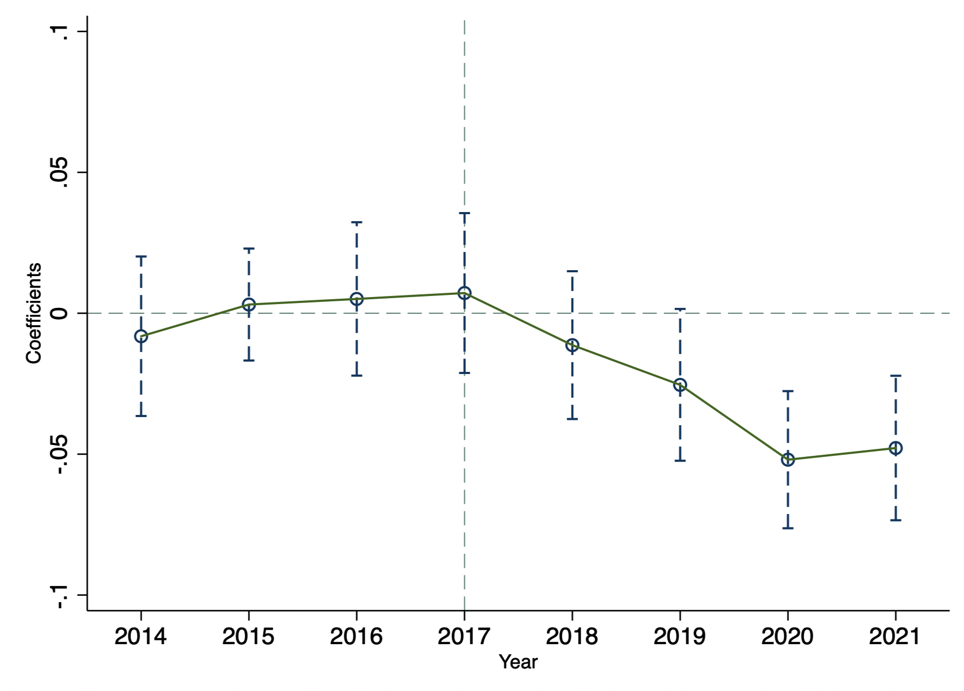
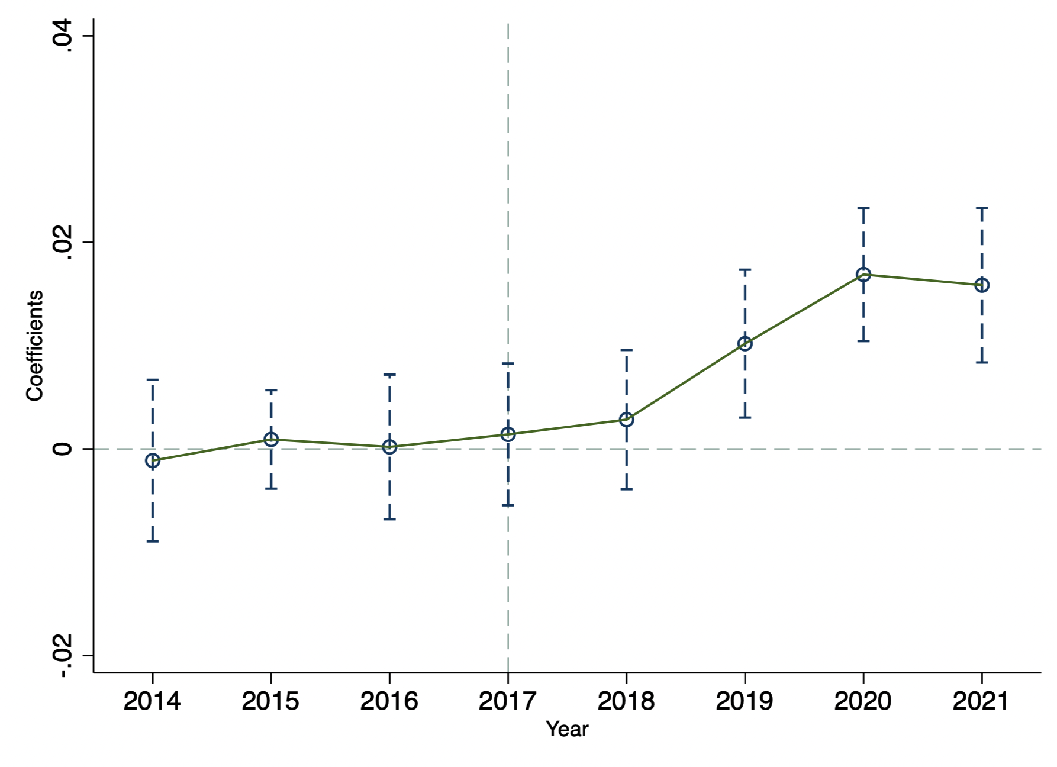
a. The effect of the pension reform on consumption
b. The effect of the pension reform on savings
Figure 3. Parallel trend of households with retired public employees vs. households with unaffected retired public employees

Slide 14
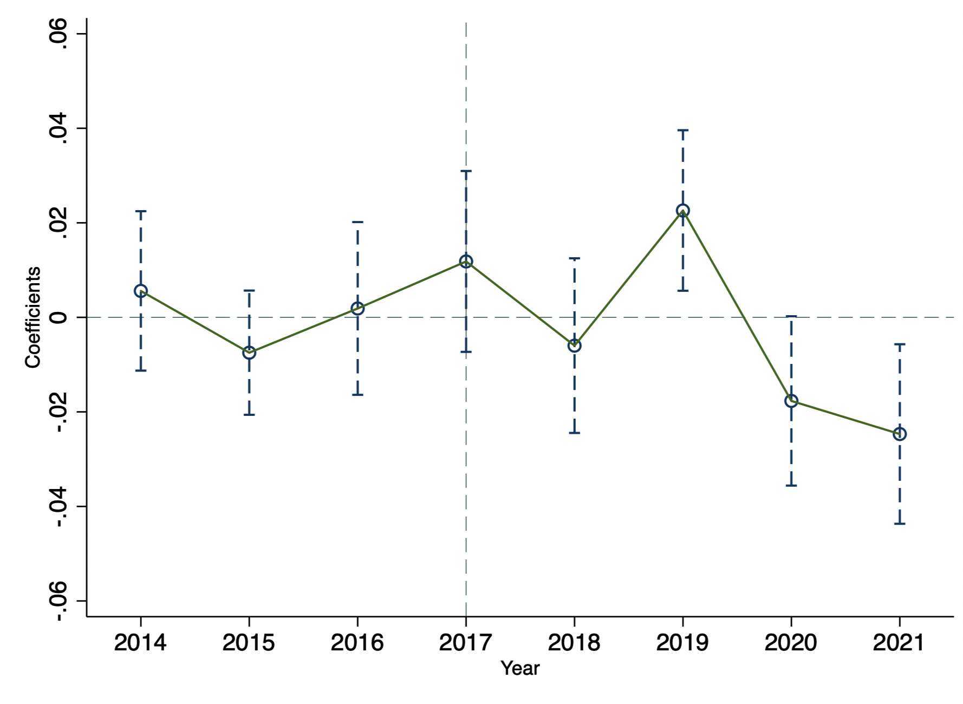
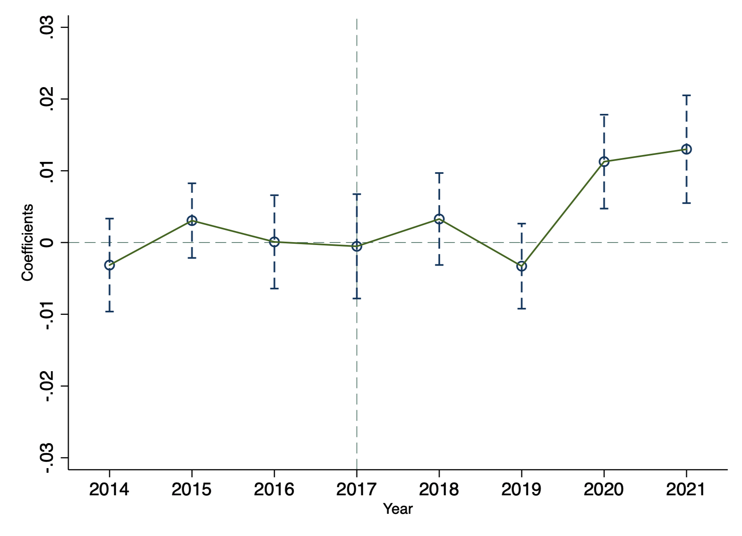
a. The effect of the pension reform on consumption
b. The effect of pension reform on savings
Figure 4. Parallel trend of households with current public employees vs. households with current private-sector employees

Slide 15
Table 1. Summary statistics
Panel A Full Sample
 | Public sector |  |  |  |  | Private sector
 | Pre-reform (2015-2016) | Post-reform (2018-2019) | Diff. | T-test |  | Pre-reform (2015-2016) | Post-reform (2018-2019) | Diff. | T-test
Consumption | 711,573.20 | 740,678.00 | 29,104.80** | 2.336 |  | 440,819.00 | 489,842.00 | 49,023.00*** | 10.608
Savings | 3,740,147.00 | 3,739,819.00 | -328.000 | 0.025 |  | 3,456,726.00 | 3,444,887.00 | -11,839.00*** | 3.419

Slide 16
Table 1. Summary statistics
Panel A Full Sample
 | Public sector |  |  |  |  | Private sector
 | Pre-reform (2015-2016) | Post-reform (2018-2019) | Diff. | T-test |  | Pre-reform (2015-2016) | Post-reform (2018-2019) | Diff. | T-test
Consumption | 711,573.20 | 740,678.00 | 29,104.80** | 2.336 |  | 440,819.00 | 489,842.00 | 49,023.00*** | 10.608
Savings | 3,740,147.00 | 3,739,819.00 | -328.000 | 0.025 |  | 3,456,726.00 | 3,444,887.00 | -11,839.00*** | 3.419
Age18_64 | 0.708 | 0.636 | -0.072* | 1.912 |  | 0.539 | 0.483 | -0.056*** | 4.242
Age>65 | 1.354 | 1.385 | 0.031 | 0.983 |  | 1.171 | 1.227 | 0.056*** | 4.459
Age<18 | 0.044 | 0.043 | -0.001 | 0.120 |  | 0.050 | 0.042 | -0.008* | 1.715
Age of the head of household | 72.705 | 72.00 | -0.705* | 1.725 |  | 71.230 | 71.460 | 0.230 | 1.436
Education of the head of household | 13.889 | 14.371 | -0.482*** | 3.871 |  | 7.826 | 8.316 | 0.49*** | 6.787
House size | 45.825 | 48.630 | 2.805*** | 3.280 |  | 39.900 | 41.610 | 1.710*** | 4.538
Spouse’s age | 56.780 | 53.750 | -3.030*** | 2.826 |  | 36.930 | 36.150 | -0.780 | 1.283
Spouse’s education | 9.563 | 9.426 | -0.137 | 0.603 |  | 3.989 | 4.244 | 0.255*** | 3.049
Income | 1,028,081.00 | 1,056,858.00 | 28,777.00 | 1.630 |  | 473,906.00 | 511,090.00 | 37,184.00*** | 6.507

Slide 17
Table 1. Summary statistics
Panel B PSM sample
 | Public sector |  |  |  |  | Private sector
 | Pre-reform (2015-2016) | Post-reform (2018-2019) | Diff. | T-test |  | Pre-reform (2015-2016) | Post-reform (2018-2019) | Diff. | T-test
Consumption | 711,573.20 | 740,678.00 | 29,104.800** | 2.336 |  | 728,134.00 | 782,338.00 | 54,204.00*** | 4.131
Saving | 3,740,147.00 | 3,739,819.00 | -328.00 | 0.025 |  | 3,553,000.00 | 349,800.00 | -55,000.00*** | 3.888

Slide 18
Table 1. Summary statistics
Panel B PSM sample
 | Public sector |  |  |  |  | Private sector
 | Pre-reform (2015-2016) | Post-reform (2018-2019) | Diff. | T-test |  | Pre-reform (2015-2016) | Post-reform (2018-2019) | Diff. | T-test
Consumption | 711,573.20 | 740,678.00 | 29,104.800** | 2.336 |  | 728,134.00 | 782,338.00 | 54,204.00*** | 4.131
Saving | 3,740,147.00 | 3,739,819.00 | -328.00 | 0.025 |  | 3,553,000.00 | 349,800.00 | -55,000.00*** | 3.888
Age18_64ª | 0.708 | 0.636 | -0.072* | 1.912 |  | 0.743 | 0.670 | -0.073** | 2.034
Age>65 | 1.354 | 1.385 | 0.031 | 0.983 |  | 1.265 | 1.345 | 0.080*** | 2.609
Age<18 | 0.044 | 0.043 | -0.001 | 0.120 |  | 0.055 | 0.051 | -0.003 | 0.319
Age of the head of household | 72.705 | 72.000 | -0.705* | 1.725 |  | 71.580 | 71.540 | -0.040 | 0.104
Education of the head of household | 13.889 | 14.371 | -0.482*** | 3.871 |  | 12.760 | 12.500 | -0.260** | 2.130
House size | 45.825 | 48.630 | 2.805*** | 3.280 |  | 44.960 | 46.090 | 1.130 | 1.200
Spouse’s age | 56.780 | 53.750 | -3.030*** | 2.826 |  | 52.390 | 50.570 | -1.820 | 1.555
Spouse’s edu | 9.563 | 9.426 | -0.137 | 0.603 |  | 7.997 | 7.773 | -0.224 | 1.040
Income | 1,028,081.00 | 1,056,858.00 | 28,777.00 | 1.630 |  | 857,768.00 | 857,049.00 | -719.00 | 0.037

Slide 19
Table 2. Pearson correlation matrix
Variables | Consumption | Savings | Age18_64 | Age>65 | Age<18 | Age of the head of household | Education of the head of household | House size | Spouse’s age | Spouse’s edu | Income
Consumption | 1.000
Saving | 0.212* | 1.000
Age18_64 | 0.588* | 0.218* | 1.000
Age>65 | -0.106* | -0.084* | -0.498* | 1.000
Age<18 | 0.337* | 0.004 | 0.180* | -0.174* | 1.000
Age of the head of household | -0.343* | -0.073* | -0.467* | 0.408* | -0.326* | 1.000
Education of the head of household | 0.492* | 0.207* | 0.288* | -0.224* | 0.173* | -0.547* | 1.000
House size | 0.278* | 0.083* | 0.164* | 0.040* | 0.099* | -0.026* | 0.107* | 1.000
Spouse’s age | 0.239* | 0.076* | 0.081* | 0.171* | 0.049* | 0.414* | -0.109* | 0.135* | 1.000
Spouse’s edu | 0.485* | 0.173* | 0.328* | -0.151* | 0.343* | -0.025* | 0.286* | 0.170* | 0.722* | 1.000
Income | 0.871* | 0.531* | 0.577* | -0.137* | 0.252* | -0.332* | 0.503* | 0.252* | 0.209* | 0.455* | 1.000

Slide 20
Table 3 The effect of the pension reform on consumption and savings by households with retired public employees
Panel A. Full Sample
 | (1) Consumption | (2) Savings
Public_Retired*Post | -0.022* | 0.006*
 | (0.012) | (0.003)
Public_Retired | -0.192*** | 0.041***
 | (0.010) | (0.002)
Post | 0.039*** | -0.008***
 | (0.006) | (0.001)
Constant | 4.340*** | 14.294***
 | (0.172) | (0.025)
Year fixed effects | Yes | Yes
Observations | 16,591 | 16,591
R-squared | 0.775 | 0.398

Slide 21
Table 3 The effect of the pension reform on consumption and savings by households with retired public employees
Panel A. Full Sample
 | (1) Consumption | (2) Savings
Public_Retired*Post | -0.022* | 0.006*
 | (0.012) | (0.003)
Public_Retired | -0.192*** | 0.041***
 | (0.010) | (0.002)
Post | 0.039*** | -0.008***
 | (0.006) | (0.001)
Age18_64 | 0.164*** | -0.025***
 | (0.006) | (0.001)
Age>65 | 0.144*** | -0.021***
 | (0.007) | (0.002)
Age<18 | 0.095*** | -0.015***
 | (0.010) | (0.002)
Age of the head of household | -0.001*** | 0.000
 | (0.000) | (0.000)
Education of the head of household | 0.015*** | -0.001***
 | (0.001) | (0.000)
House size | 0.002*** | -0.000***
 | (0.000) | (0.000)
Spouse’s age | 0.000*** | -0.000***
 | (0.000) | (0.000)
Spouse’s edu | 0.004*** | 0.000
 | (0.001) | (0.000)
Income | 0.630*** | 0.064***
 | (0.014) | (0.002)
Constant | 4.340*** | 14.294***
 | (0.172) | (0.025)
Year fixed effects | Yes | Yes
Observations | 16,591 | 16,591
R-squared | 0.775 | 0.398

Slide 22
Table 3 The effect of the pension reform on consumption and savings by households with retired public employees
Panel B. PSM sample
 | (1) Consumption | (2) Savings
Public_Retired *Post | -0.040*** | 0.013***
 | (0.015) | (0.004)
Public_Retired | -0.177*** | 0.023***
 | (0.010) | (0.003)
Post | 0.056*** | -0.016***
 | (0.012) | (0.003)
Constant | 4.462*** | 13.205***
 | (0.175) | (0.068)
Year fixed effects | Yes | Yes
Observations | 5,500 | 5,500
R-squared | 0.588 | 0.450

Slide 23
Table 3 The effect of the pension reform on consumption and savings by households with retired public employees
Panel B. PSM sample
 | (1) Consumption | (2) Savings
Public_Retired *Post | -0.040*** | 0.013***
 | (0.015) | (0.004)
Public_Retired | -0.177*** | 0.023***
 | (0.010) | (0.003)
Post | 0.056*** | -0.016***
 | (0.012) | (0.003)
Age18_64 | 0.133*** | -0.030***
 | (0.007) | (0.002)
Age>65 | 0.130*** | -0.031***
 | (0.009) | (0.003)
Age<18 | 0.069*** | -0.016***
 | (0.013) | (0.004)
Age of the head of household | -0.002*** | 0.000***
 | (0.001) | (0.000)
Education of the head of household | 0.001 | 0.001
 | (0.001) | (0.000)
House size | 0.001*** | -0.000***
 | (0.000) | (0.000)
Spouse’s age | -0.001*** | 0.000***
 | (0.000) | (0.000)
Spouse’s edu | 0.007*** | -0.001***
 | (0.001) | (0.000)
Income | 0.645*** | 0.140***
 | (0.013) | (0.005)
Constant | 4.462*** | 13.205***
 | (0.175) | (0.068)
Year fixed effects | Yes | Yes
Observations | 5,500 | 5,500
R-squared | 0.588 | 0.450

Slide 24
Table 4. The effect of the pension reform on consumption and savings by households with retired public employees: Heterogeneity analysis on different income groups
Panel A: Full sample
Dependent variable | (1) Consumption |  | (2) Savings
 | Low-income | High-income | Low-income | High-income
Public_Retired *Post | -0.033** | -0.041* | 0.006** | 0.017**
 | (0.016) | (0.024) | (0.003) | (0.007)
Public_Retired | -0.174*** | -0.165*** | 0.034*** | 0.031***
 | (0.012) | (0.017) | (0.002) | (0.005)
Post | 0.033*** | 0.085*** | -0.004*** | -0.026***
 | (0.006) | (0.021) | (0.001) | (0.007)
Age18_64 | 0.175*** | 0.125*** | -0.023*** | -0.032***
 | (0.006) | (0.009) | (0.001) | (0.003)
Constant | 4.520*** | 6.210*** | 14.597*** | 11.611***
 | (0.232) | (0.407) | (0.012) | (0.158)
Year fixed effects | Yes | Yes | Yes | Yes
Observations | 14,132 | 2,459 | 14,132 | 2,459
R-squared | 0.723 | 0.330 | 0.322 | 0.480

Slide 25
Table 4. The effect of the pension reform on consumption and savings by households with retired public employees: Heterogeneity analysis on different income groups
Panel A: Full sample
Dependent variable | (1) Consumption |  | (2) Savings
 | Low-income | High-income | Low-income | High-income
Public_Retired *Post | -0.033** | -0.041* | 0.006** | 0.017**
 | (0.016) | (0.024) | (0.003) | (0.007)
Public_Retired | -0.174*** | -0.165*** | 0.034*** | 0.031***
 | (0.012) | (0.017) | (0.002) | (0.005)
Post | 0.033*** | 0.085*** | -0.004*** | -0.026***
 | (0.006) | (0.021) | (0.001) | (0.007)
Age18_64 | 0.175*** | 0.125*** | -0.023*** | -0.032***
 | (0.006) | (0.009) | (0.001) | (0.003)
Age>65 | 0.149*** | 0.127*** | -0.019*** | -0.035***
 | (0.007) | (0.013) | (0.001) | (0.004)
Age<18 | 0.093*** | 0.071*** | -0.011*** | -0.015***
 | (0.012) | (0.017) | (0.002) | (0.005)
Age of the head of household | -0.001*** | 0.000 | 0.000*** | 0.000
 | (0.000) | (0.001) | (0.000) | (0.000)
Education of the head of household | 0.015*** | -0.001 | -0.001*** | 0.001
 | (0.001) | (0.002) | (0.000) | (0.001)
House size | 0.002*** | 0.001** | -0.000*** | -0.000***
 | (0.000) | (0.000) | (0.000) | (0.000)
Spouse’s age | 0.000 | -0.001** | 0.000*** | 0.000***
 | (0.000) | (0.000) | (0.000) | (0.000)
Spouse’s edu | 0.007*** | 0.004** | -0.001*** | -0.001**
 | (0.001) | (0.002) | (0.000) | (0.001)
Income | 0.614*** | 0.515*** | 0.039*** | 0.256***
 | (0.019) | (0.030) | (0.001) | (0.012)
Constant | 4.520*** | 6.210*** | 14.597*** | 11.611***
 | (0.232) | (0.407) | (0.012) | (0.158)
Year fixed effects | Yes | Yes | Yes | Yes
Observations | 14,132 | 2,459 | 14,132 | 2,459
R-squared | 0.723 | 0.330 | 0.322 | 0.480

Slide 26
Table 4. The effect of the pension reform on consumption and savings by households with retired public employees: Heterogeneity analysis on different income groups
Panel B PSM sample
Dependent variable | (1) Consumption |  | (2) Savings
 | Low-income | High-income | Low-income | High-income
Public_Retired*Post | -0.049*** | -0.036 | 0.009*** | 0.017**
 | (0.018) | (0.025) | (0.003) | (0.007)
Public_Retired | -0.183*** | -0.170*** | 0.028*** | 0.032***
 | (0.012) | (0.018) | (0.002) | (0.005)
Post | 0.032** | 0.082*** | -0.005** | -0.026***
 | (0.013) | (0.023) | (0.003) | (0.007)
Constant | 3.417*** | 6.315*** | 14.228*** | 11.551***
 | (0.258) | (0.414) | (0.045) | (0.159)
Year fixed effects | Yes | Yes | Yes | Yes
Observations | 3,182 | 2,318 | 3,182 | 2,318
R-squared | 0.492 | 0.330 | 0.316 | 0.479

Slide 27
Table 4. The effect of the pension reform on consumption and savings by households with retired public employees: Heterogeneity analysis on different income groups
Panel B PSM sample
Dependent variable | (1) Consumption |  | (2) Savings
 | Low-income | High-income | Low-income | High-income
Public_Retired*Post | -0.049*** | -0.036 | 0.009*** | 0.017**
 | (0.018) | (0.025) | (0.003) | (0.007)
Public_Retired | -0.183*** | -0.170*** | 0.028*** | 0.032***
 | (0.012) | (0.018) | (0.002) | (0.005)
Post | 0.032** | 0.082*** | -0.005** | -0.026***
 | (0.013) | (0.023) | (0.003) | (0.007)
Age18_64 | 0.153*** | 0.123*** | -0.029*** | -0.032***
 | (0.010) | (0.010) | (0.003) | (0.003)
Age>65 | 0.139*** | 0.122*** | -0.027*** | -0.034***
 | (0.013) | (0.014) | (0.003) | (0.004)
Age<18 | 0.052*** | 0.075*** | -0.010** | -0.016**
 | (0.016) | (0.020) | (0.004) | (0.006)
Age of the head of household | -0.002*** | 0.000 | 0.000** | 0.000
 | (0.001) | (0.001) | (0.000) | (0.000)
Education of the head of household | 0.001 | 0.001 | 0.000 | 0.000
 | (0.002) | (0.002) | (0.000) | (0.001)
House size | 0.002*** | 0.001** | -0.000*** | -0.000***
 | (0.000) | (0.000) | (0.000) | (0.000)
Spouse’s age | -0.001*** | -0.001* | 0.000*** | 0.000**
 | (0.000) | (0.000) | (0.000) | (0.000)
Spouse’s edu | 0.010*** | 0.003 | -0.002*** | -0.001*
 | (0.001) | (0.002) | (0.000) | (0.001)
Income | 0.722*** | 0.508*** | 0.065*** | 0.260***
 | (0.019) | (0.030) | (0.003) | (0.012)
Constant | 3.417*** | 6.315*** | 14.228*** | 11.551***
 | (0.258) | (0.414) | (0.045) | (0.159)
Year fixed effects | Yes | Yes | Yes | Yes
Observations | 3,182 | 2,318 | 3,182 | 2,318
R-squared | 0.492 | 0.330 | 0.316 | 0.479

Slide 28
Table 5 The effect of the pension reform on consumption and savings by households with current public employees
Panel A Full Sample
 | (1) Consumption | (2) Savings
Public_Current *Post | 0.014 | -0.002
 | (0.008) | (0.003)
Public_Current | -0.088*** | 0.022***
 | (0.006) | (0.002)
Post | 0.030*** | -0.006***
 | (0.003) | (0.002)
Constant | 4.796*** | 12.620***
 | (0.046) | (0.028)
Year fixed effects | Yes | Yes
Observations | 53,552 | 53,552
R-squared | 0.741 | 0.299

Slide 29
Table 5 The effect of the pension reform on consumption and savings by households with current public employees
Panel A Full Sample
 | (1) Consumption | (2) Savings
Public_Current *Post | 0.014 | -0.002
 | (0.008) | (0.003)
Public_Current | -0.088*** | 0.022***
 | (0.006) | (0.002)
Post | 0.030*** | -0.006***
 | (0.003) | (0.002)
Age18_64 | 0.082*** | -0.022***
 | (0.001) | (0.001)
Age>65 | 0.078*** | -0.025***
 | (0.002) | (0.001)
Age<18 | 0.086*** | -0.022***
 | (0.001) | (0.001)
Age of the head of household | -0.000 | 0.000***
 | (0.000) | (0.000)
Education of the head of household | 0.015*** | -0.003***
 | (0.000) | (0.000)
House size | 0.001*** | -0.000***
 | (0.000) | (0.000)
Spouse’s age | -0.000 | 0.000
 | (0.000) | (0.000)
Spouse’s edu | 0.005*** | -0.001***
 | (0.000) | (0.000)
Income | 0.594*** | 0.190***
 | (0.004) | (0.002)
Constant | 4.796*** | 12.620***
 | (0.046) | (0.028)
Year fixed effects | Yes | Yes
Observations | 53,552 | 53,552
R-squared | 0.741 | 0.299

Slide 30
Table 5 The effect of the pension reform on consumption and savings by households with current public employees
Panel B PSM sample
 | (1) Consumption | (2) Savings
Public_Current *Post | 0.002 | 0.006
 | (0.012) | (0.005)
Public_Current | -0.085*** | 0.009***
 | (0.008) | (0.003)
Post | 0.053*** | -0.020***
 | (0.010) | (0.004)
Constant | 5.386*** | 11.134***
 | (0.127) | (0.092)
Year fixed effects | Yes | Yes
Observations | 8,334 | 8,334
R-squared | 0.618 | 0.584

Slide 31
Table 5 The effect of the pension reform on consumption and savings by households with current public employees
Panel B PSM sample
 | (1) Consumption | (2) Savings
Public_Current *Post | 0.002 | 0.006
 | (0.012) | (0.005)
Public_Current | -0.085*** | 0.009***
 | (0.008) | (0.003)
Post | 0.053*** | -0.020***
 | (0.010) | (0.004)
Age18_64 | 0.092*** | -0.031***
 | (0.004) | (0.002)
Age>65 | 0.074*** | -0.025***
 | (0.005) | (0.002)
Age<18 | 0.095*** | -0.031***
 | (0.004) | (0.002)
Age of the head of household | 0.002*** | -0.001***
 | (0.000) | (0.000)
Education of the head of household | 0.015*** | -0.005***
 | (0.001) | (0.001)
House size | 0.000*** | -0.000**
 | (0.000) | (0.000)
Spouse’s age | -0.001*** | 0.001***
 | (0.000) | (0.000)
Spouse’s edu | 0.007*** | -0.003***
 | (0.001) | (0.000)
Income | 0.546*** | 0.301***
 | (0.010) | (0.007)
Constant | 5.386*** | 11.134***
 | (0.127) | (0.092)
Year fixed effects | Yes | Yes
Observations | 8,334 | 8,334
R-squared | 0.618 | 0.584

Slide 32
Table 6. The effect of the pension reform on consumption and savings by households with current public employees: Heterogeneity analysis of different income groups
Panel A Full Sample
Dependent variable | (1) Consumption |  | (2) Savings
 | Low-income | High-income | Low-income | High-income
Public_Current *Post | 0.061** | 0.010 | -0.010 | -0.002
 | (0.030) | (0.009) | (0.006) | (0.003)
Public_Current | -0.084*** | -0.087*** | 0.012*** | 0.017***
 | (0.021) | (0.006) | (0.004) | (0.002)
Post | 0.031*** | 0.031*** | -0.005*** | -0.008***
 | (0.004) | (0.004) | (0.001) | (0.002)
Constant | 4.392*** | 5.451*** | 14.068*** | 11.404***
 | (0.130) | (0.074) | (0.018) | (0.051)
Year fixed effects | Yes | Yes | Yes | Yes
Observations | 19,093 | 34,459 | 19,093 | 34,459
R-squared | 0.623 | 0.517 | 0.256 | 0.281

Slide 33
Table 6. The effect of the pension reform on consumption and savings by households with current public employees: Heterogeneity analysis of different income groups
Panel A Full Sample
Dependent variable | (1) Consumption |  | (2) Savings
 | Low-income | High-income | Low-income | High-income
Public_Current *Post | 0.061** | 0.010 | -0.010 | -0.002
 | (0.030) | (0.009) | (0.006) | (0.003)
Public_Current | -0.084*** | -0.087*** | 0.012*** | 0.017***
 | (0.021) | (0.006) | (0.004) | (0.002)
Post | 0.031*** | 0.031*** | -0.005*** | -0.008***
 | (0.004) | (0.004) | (0.001) | (0.002)
Age18_64 | 0.126*** | 0.067*** | -0.020*** | -0.019***
 | (0.003) | (0.002) | (0.000) | (0.001)
Age>65 | 0.099*** | 0.067*** | -0.015*** | -0.022***
 | (0.003) | (0.002) | (0.001) | (0.002)
Age<18 | 0.106*** | 0.077*** | -0.017*** | -0.021***
 | (0.002) | (0.002) | (0.001) | (0.001)
Age of the head of household | 0.001*** | 0.000* | -0.000*** | -0.000
 | (0.000) | (0.000) | (0.000) | (0.000)
Education of the head of household | 0.016*** | 0.013*** | -0.003*** | -0.004***
 | (0.001) | (0.001) | (0.000) | (0.000)
House size | 0.001*** | 0.001*** | -0.000*** | -0.000***
 | (0.000) | (0.000) | (0.000) | (0.000)
Spouse’s age | 0.000 | -0.001*** | 0.000 | 0.000
 | (0.000) | (0.000) | (0.000) | (0.000)
Spouse’s edu | 0.002*** | 0.006*** | -0.001*** | -0.001***
 | (0.001) | (0.000) | (0.000) | (0.000)
Income | 0.612*** | 0.553*** | 0.083*** | 0.276***
 | (0.010) | (0.006) | (0.001) | (0.004)
Constant | 4.392*** | 5.451*** | 14.068*** | 11.404***
 | (0.130) | (0.074) | (0.018) | (0.051)
Year fixed effects | Yes | Yes | Yes | Yes
Observations | 19,093 | 34,459 | 19,093 | 34,459
R-squared | 0.623 | 0.517 | 0.256 | 0.281

Slide 34
Table 6. The effect of the pension reform on consumption and savings by households with current public employees: Heterogeneity analysis of different income groups
Panel B PSM sample
Dependent variable | (1) Consumption |  | (2) Savings
 | Low-income | High-income | Low-income | High-income
Public_Current *Post | 0.011 | 0.003 | -0.002 | 0.006
 | (0.038) | (0.012) | (0.008) | (0.005)
Public_Current | -0.063** | -0.089*** | 0.009 | 0.015***
 | (0.028) | (0.008) | (0.006) | (0.003)
Post | 0.087*** | 0.048*** | -0.011 | -0.021***
 | (0.032) | (0.010) | (0.007) | (0.005)
Constant | 6.617*** | 5.578*** | 13.321*** | 10.580***
 | (1.089) | (0.146) | (0.304) | (0.108)
Year fixed effects | Yes | Yes | Yes | Yes
Observations | 700 | 7,634 | 700 | 7,634
R-squared | 0.456 | 0.538 | 0.323 | 0.592

Slide 35
Table 6. The effect of the pension reform on consumption and savings by households with current public employees: Heterogeneity analysis of different income groups
Panel B PSM sample
Dependent variable | (1) Consumption |  | (2) Savings
 | Low-income | High-income | Low-income | High-income
Public_Current *Post | 0.011 | 0.003 | -0.002 | 0.006
 | (0.038) | (0.012) | (0.008) | (0.005)
Public_Current | -0.063** | -0.089*** | 0.009 | 0.015***
 | (0.028) | (0.008) | (0.006) | (0.003)
Post | 0.087*** | 0.048*** | -0.011 | -0.021***
 | (0.032) | (0.010) | (0.007) | (0.005)
Age18_64 | 0.168*** | 0.086*** | -0.028*** | -0.028***
 | (0.014) | (0.004) | (0.003) | (0.002)
Age>65 | 0.112*** | 0.070*** | -0.018*** | -0.021***
 | (0.019) | (0.005) | (0.004) | (0.002)
Age<18 | 0.132*** | 0.091*** | -0.026*** | -0.029***
 | (0.015) | (0.004) | (0.005) | (0.002)
Age of the head of household | 0.003** | 0.002*** | -0.000 | -0.001***
 | (0.001) | (0.001) | (0.000) | (0.000)
Education of the head of household | 0.028*** | 0.013*** | -0.006*** | -0.004***
 | (0.006) | (0.001) | (0.002) | (0.001)
House size | 0.001** | 0.000*** | -0.000** | -0.000**
 | (0.001) | (0.000) | (0.000) | (0.000)
Spouse’s age | -0.000 | -0.002*** | 0.000 | 0.001***
 | (0.001) | (0.000) | (0.000) | (0.000)
Spouse’s edu | 0.003 | 0.008*** | -0.001 | -0.003***
 | (0.004) | (0.001) | (0.001) | (0.000)
Income | 0.419*** | 0.537*** | 0.144*** | 0.338***
 | (0.082) | (0.011) | (0.023) | (0.008)
Constant | 6.617*** | 5.578*** | 13.321*** | 10.580***
 | (1.089) | (0.146) | (0.304) | (0.108)
Year fixed effects | Yes | Yes | Yes | Yes
Observations | 700 | 7,634 | 700 | 7,634
R-squared | 0.456 | 0.538 | 0.323 | 0.592

Slide 36
Table 7. The effect of the pension reform on consumption and savings by households with current public employees: Heterogeneity analysis of different age groups
Panel A Full sample
 | (1) | (2) | (3) | (4)
Age Group | >=50 | <50 | >=50 | <50
Dependent variable | Consumption | Consumption | Saving | Saving
Public_Current *Post | -0.000 | 0.022** | 0.001 | -0.005
 | (0.014) | (0.010) | (0.005) | (0.004)
Public_Current | -0.066*** | -0.106*** | 0.013*** | 0.031***
 | (0.009) | (0.007) | (0.004) | (0.003)
Constant | 5.332*** | 4.324*** | 12.227*** | 12.973***
 | (0.069) | (0.063) | (0.042) | (0.038)
Year fixed effects | Yes | Yes | Yes | Yes
Observations | 21,864 | 31,688 | 21,864 | 31,688
Pseudo R-squared | 0.740 | 0.746 | 0.551 | 0.176

Slide 37
Table 7. The effect of the pension reform on consumption and savings by households with current public employees: Heterogeneity analysis of different age groups
Panel B PSM sample
 | (1) | (2) | (3) | (4)
Age Group | >=50 | <50 | >=50 | <50
Dependent variable | Consumption | Consumption | Saving | Saving
Public_Current *Post | -0.007 | 0.035** | 0.009 | -0.005
 | (0.019) | (0.014) | (0.008) | (0.006)
Public_Current | -0.082*** | -0.110*** | 0.004 | 0.021***
 | (0.013) | (0.010) | (0.005) | (0.004)
Post | 0.042*** | 0.019 | -0.017** | -0.008
 | (0.016) | (0.012) | (0.007) | (0.005)
Age18_64 | 0.110*** | 0.067*** | -0.040*** | -0.022***
 | (0.006) | (0.005) | (0.003) | (0.002)
Age>65 | 0.092*** | 0.054*** | -0.032*** | -0.019***
 | (0.009) | (0.006) | (0.004) | (0.003)
Age<18 | 0.101*** | 0.094*** | -0.032*** | -0.028***
 | (0.007) | (0.005) | (0.003) | (0.002)
Age of the head of household | -0.002* | 0.000 | 0.001 | -0.000
 | (0.001) | (0.001) | (0.001) | (0.000)
Education of the head of household | 0.016*** | 0.011*** | -0.006*** | -0.004***
 | (0.002) | (0.002) | (0.001) | (0.001)
House size | 0.000** | 0.000** | -0.000 | -0.000*
 | (0.000) | (0.000) | (0.000) | (0.000)
Spouse’s age | -0.002*** | 0.002*** | 0.001*** | -0.000
 | (0.001) | (0.001) | (0.000) | (0.000)
Spouse’s edu | 0.012*** | -0.002 | -0.004*** | -0.000
 | (0.002) | (0.002) | (0.001) | (0.001)
Income | 0.508*** | 0.594*** | 0.344*** | 0.264***
 | (0.015) | (0.013) | (0.011) | (0.010)
Constant | 6.095*** | 4.922*** | 10.490*** | 11.613***
 | (0.189) | (0.169) | (0.133) | (0.135)
Year fixed effects | Yes | Yes | Yes | Yes
Observations | 3,326 | 5,008 | 3,326 | 5,008
Pseudo R-squared | 0.608 | 0.629 | 0.662 | 0.487

Slide 38
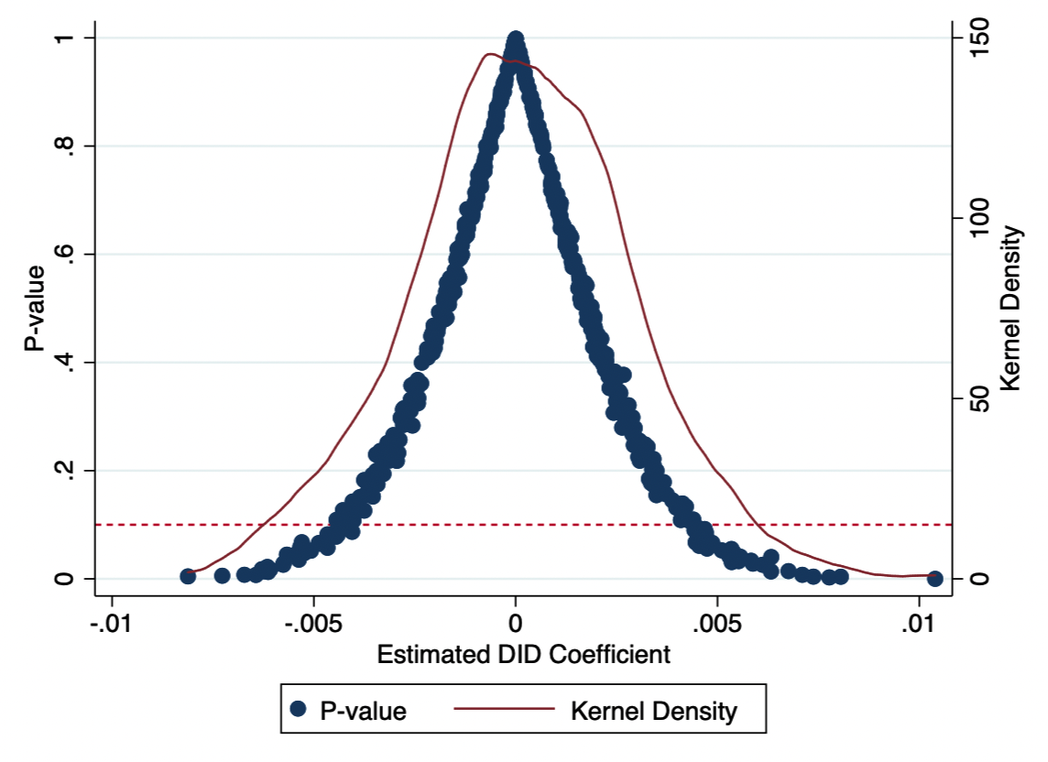
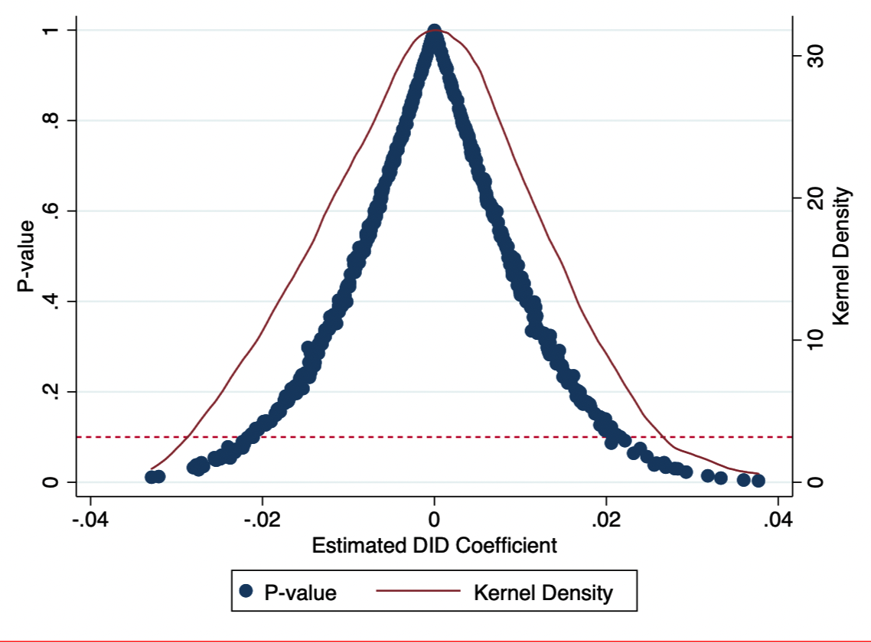
a. Consumption
b. Savings
Figure 5. Placebo test

Slide 39
Table 8 Placebo test (event year: 2015 period: 2013-2016)
 | (1) Consumption | (2) Saving
Public_Retired*Post | 0.010 | 0.004
 | (0.012) | (0.003)
Public_Retired | -0.189*** | 0.035***
 | (0.012) | (0.003)
Post | 0.022*** | -0.004***
 | (0.007) | (0.001)
Age18_64 | 0.161*** | -0.024***
 | (0.006) | (0.001)
Age>65 | 0.139*** | -0.020***
 | (0.007) | (0.002)
Age<18 | 0.102*** | -0.017***
 | (0.009) | (0.002)
Age of the head of household | -0.001** | -0.000
 | (0.000) | (0.000)
Education of the head of household | 0.014*** | -0.001***
 | (0.001) | (0.000)
House size | 0.002*** | -0.000***
 | (0.000) | (0.000)
Spouse’s age | 0.000*** | -0.000***
 | (0.000) | (0.000)
Spouse’s edu | 0.005*** | 0.000
 | (0.001) | (0.000)
Income | 0.621*** | 0.066***
 | (0.014) | (0.002)
Constant | 4.413*** | 14.269***
 | (0.168) | (0.026)
Year fixed | Yes | Yes
Observations | 15,781 | 15,781
R-squared | 0.777 | 0.392

Slide 40
5. Conclusions and Implications
The 2017 pension reform in Taiwan reduced pension benefits for both retired and current public employees but did not affect private-sector employees.
Our findings indicate that the reform significantly influenced the consumption and savings behavior of retirees.
But, it had no statistically significant impact on current public employees, which suggests that the reform, which was intended to improve the sustainability of the pension system, may have strengthened its credibility among current public employees.

Slide 41
5. Conclusions and Implications
Our empirical results yield important policy implications.
  Although ensuring the sustainability of pension systems is crucial in view of population aging, governments must also consider the impact of pension reforms on retirees’ consumption and overall welfare.
  We find younger cohorts of current public employees did not increase their savings to offset the expected reduction in pension wealth after the reform. This lack of proactive savings behavior might pose a risk to their future retirement security.
  Our results suggest that retired and current public employees have both been affected by the benefit cuts. If governments struggle to accurately predict longevity risks, policy makers might need to consider shifting to defined contribution pension plans, either in part or in full, to enhance financial sustainability.

Slide 42
Overall, our evidence suggests that pension benefit cuts do not have a severe impact on current and retired public employees’ households in part because the Taiwanese government increased retirement benefits and salaries in 2018 to mitigate the negative effects.
Our findings offer valuable insights for policymakers worldwide as they navigate the challenges of public-sector pension reform.

Slide 43
Thank you

