Slide 1
Impact of Wildfire and Air Pollution on Mortality Risk
Kara Clark, FSA, MAAA
September | 2025

Slide 2
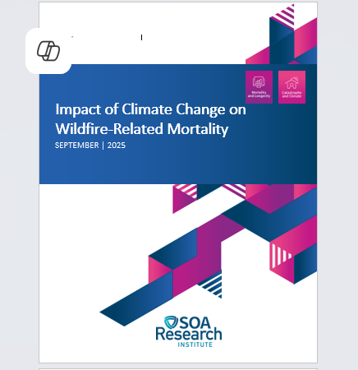
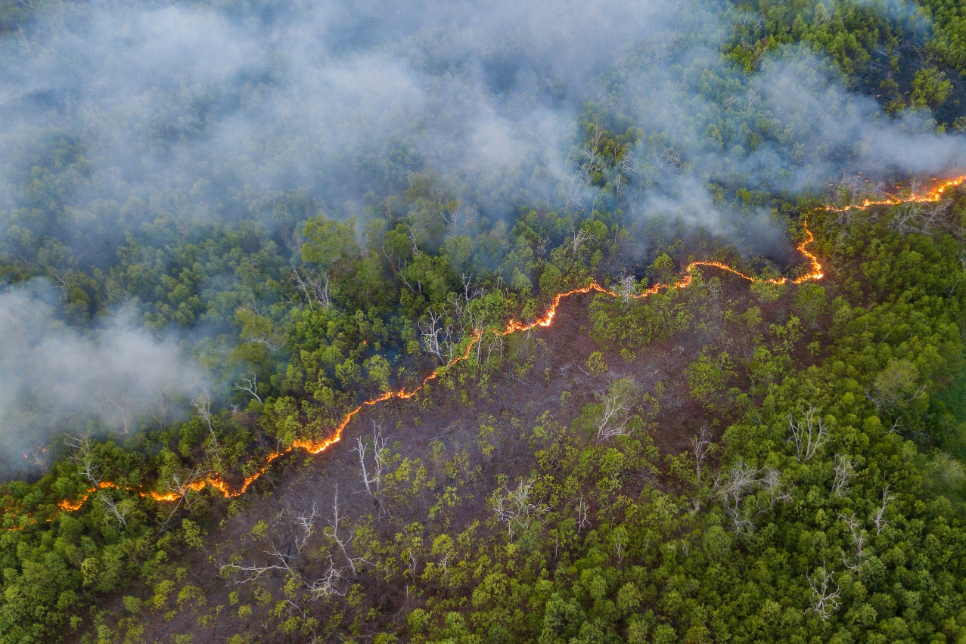
Wildfires are reshaping mortality in a warming world.
2

Slide 3

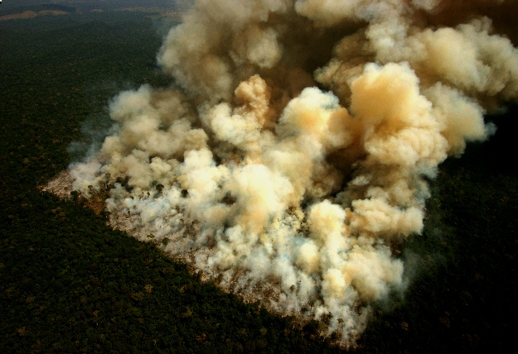
Wildfires cause harm through both direct and indirect means.
Direct: burns, trauma, acute smoke inhalation (rare but highly visible)
Indirect: chronic exposure to pollutants ->
long-term health risks
Indirect mortality far outweighs direct deaths.
3

Slide 4
Modeling wildfire-related mortality faces structural and data challenges.
Attribution difficulty: Pollutants disperse across states and borders
Data granularity: Data sets may be state-level, masking local hotspots and valley/urban exposures
Cumulative effects: Mortality often reflects multi-year pollution histories, not single fire seasons
Data gaps: Sparse historical pollution records and volatile CDC death certificate data limit calibration
Interaction effects: Models rarely capture combined climate stressors
(e.g., heat + pollution) that amplify risk
Wildfire mortality is indirect, delayed, and dispersed – making it a moving target for actuarial modeling.
4

Slide 5


Mortality databases show complementary strengths and weaknesses.
CDC: granular, based on death
certificates->but volatile, patchy
GBD: modeled estimates, smoother
and more reliable for trend analysis
The modeling framework depends on GBD, validated against CDC.
5

Slide 6


Wildfire and pollution data together clarify exposure patterns.
Wildfire data: U.S. National Interagency Fire Center (1992-2023) – counts & area burned, normalized by land area
Air pollution data: Copernicus Atmospheric Monitoring Service (CAMS) –PM_{2.5}, PM₁₀, organic matter, black carbon
6

Slide 7
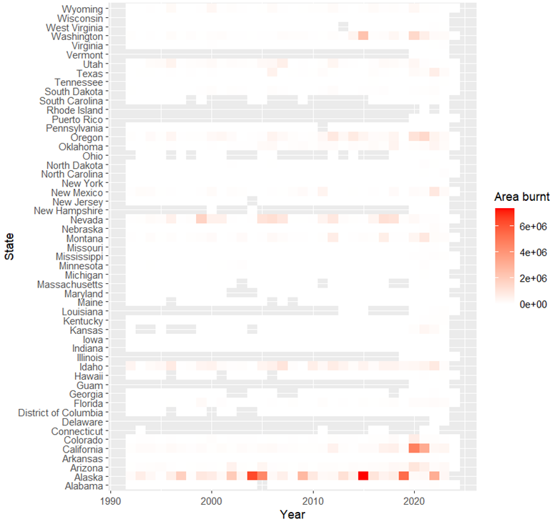
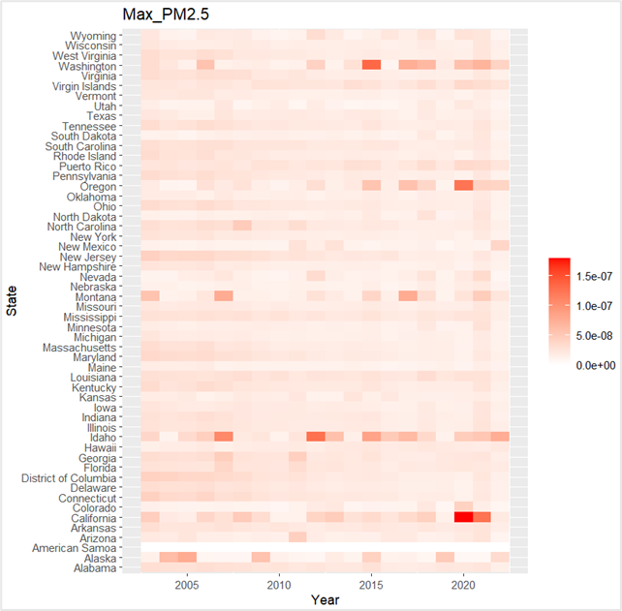
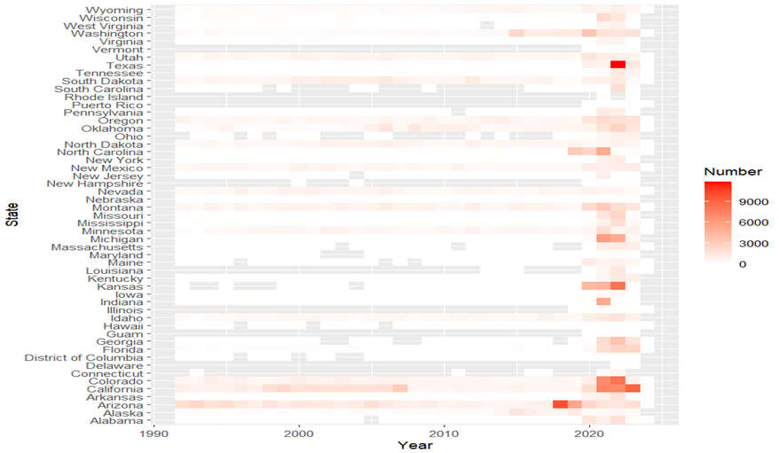
Recent trends show increases in wildfires and air pollution elements.
Number of wildfires by state by year
Area burned by state by year
PM_{2.5} by state by year
2017+ shows clear increases in both wildfire frequency and scale.
7

Slide 8
Mortality tracks pollution levels rather than wildfire activity alone.
Analysis found weak or even negative correlations between wildfire variables and mortality.
Stronger positive correlations appeared with air pollution metrics (PM_{2.5}, PM₁₀), especially in the 55+ age group.
Pollution exposure lingers and disperses, explaining mortality patterns better than fire activity measures.
Highlights the importance of pollutant-level data for actuarial and mortality modeling.
Wildfire smoke travels widely – pollutant concentrations,
not burn count or acreage, drive health outcomes.
8

Slide 9

Three modeling approaches offer unique strengths and limits.
Climate Lee-Carter: actuarial, short-term calibration with climate inputs
Prevalence scenarios: intuitive, long-term morbidity-to-mortality linkage
WHO AirQ+: epidemiological, scenario-based excess death estimates.
9

Slide 10
The Climate Lee-Carter model isolates pollution effects, but calibration results vary widely across states.
Model fit differs greatly: some states (e.g. CA) may calibrate smoothly with a handful of pollution variables; others (e.g., AK) require lagged, multi-year exposures
Cumulative pollution over several years often explains mortality trends better than single-year concentrations
Declines in mortality sometimes demand 3+ consecutive years of improved air quality, while increases can appear after only 1-2 years of elevated exposure
No single specification works nationwide – calibration must be tailored to each state’s pollution and mortality dynamics
Pollution-driven mortality is cumulative, local, and resistant to one-size-fits-all models.
10

Slide 11
Prevalence scenarios link exposure to chronic disease.
Air pollution contributes to higher prevalence of chronic conditions (e.g., cardiovascular, respiratory, neurological, cancers)
Mortality is then estimated by applying fixed death rates to projected prevalence scenarios
Approach aligns with morbidity modeling practices familiar to actuaries
Pollution-driven morbidity today sets the stage for mortality tomorrow.
11

Slide 12
WHO AirQ+ models link concentration to excess deaths.
Based on a Health Impact Function (HIF): Links pollutant concentrations, population exposure, baseline mortality, and concentration-response risk estimates.
Inputs: pollutant levels (PM2.5, ozone, etc.), demographic breakdowns, mortality rates, and epidemiological beta coefficients
Outputs: attributable fraction (share of deaths due to pollution) and estimated excess mortality
Pollution-Concentration->Relative Risk->Attributable Fraction->Excess Deaths
12

Slide 13

Interdisciplinary collaboration can contribute to a deeper understanding of these linkages.
Wildfire-pollution-mortality linkages are measurable but complex
Existing models highlight gaps and uncertainties
More detailed, local, and long-term data needed
Progress will benefit from collaboration: actuaries, epidemiologists, atmospheric scientists, and other related disciplines
13

