Slide 1
Challenges of China’s Pension System and Potential Solutions
Reporter: Nana Ding (Chair) Supervisor： Runhuan Feng and Zaigui Yang

Slide 2
1 Introduction
The social security system serves as a foundational element of modern state governance. Pension policy is a central component of this system.
A well-structured pension system supports economic growth through three key mechanisms:
  Functions as an automatic stabilizer that smoothens economic
  Facilitates financial market development
  Enhances labor market efficiency by improving the allocation of human capital.
China's pension system comprises three main pillars:
  Basic pension(first pillar): established through mandatory legislation
  Enterprise annuity(second pillar): are voluntarily established by employers and employees
  Personal pension(third pillar): voluntarily contributed to by individuals
The coordinated development of these three pillars helps address varied and multi-tiered retirement demands.

Slide 3
1 Introduction
However, China's three-pillar enterprise pension system currently suffers from severe structural imbalances.
  Three pillars of the pension system are developing unevenly.
    Coverage: 6.86% of participants in the basic pension are enrolled in enterprise annuities
    Funding scale: the first pillar accounts for about 92.1% of the system; the second pillar represents merely 7.9%; the third pillar remains sluggish and negligible.
  Coordination mechanisms between the pillars are underdeveloped
The basic pension system is facing multiple challenges.
  Significantly increased the fiscal burden.
    2018 :¥535.54 billion; 2023: ¥773.14 billion
  Regional imbalances: coexisting as both "massive surpluses” and "severe deficits”
Implementing a nationally unified pooling mechanism for the basic pension insurance could help alleviate these structural challenges.

Slide 4
1 Introduction
Nationally unified pooling mechanism for the basic pension
Coordinated adjustment(2022)——A transitional mechanism toward a fully national pooling pension system.
  Reallocation of surplus and shortfall in pension funds on the basis of existing provincial-level pooling.
  It has enhanced the utilization efficiency of pension funds and lightened the fiscal burden of subsidies.
  It still presents several limitations:
    Failed to address deeper structural issues
    Also led to unintended consequences, including “reverse redistribution” and moral hazard.
Implementing a fully unified national collection and distribution (UCD) system is essential to address the aforementioned challenges. However, existing research has yet to reach a consensus on the pathway toward such a system.

Slide 5
1 Introduction
Contributions of this paper
  The contributions of this paper are threefold.
    First, it introduces a concrete UCD scheme that not only elevates the pooling level but also incorporates incentive-compatible mechanisms.
    Second, This paper combines the design of a UCD system for the BPEE with the development of a multi-pillar pension insurance system. The proposed model reduces the fiscal burden on the first pillar without increasing contribution burdens on employers or individuals, while simultaneously expanding coverage, scale, and benefit adequacy of the second and third pillars.
    Third, the proposed system supports the implementation of delayed retirement policies by strengthening incentives for workers to postpone retirement.

Slide 6
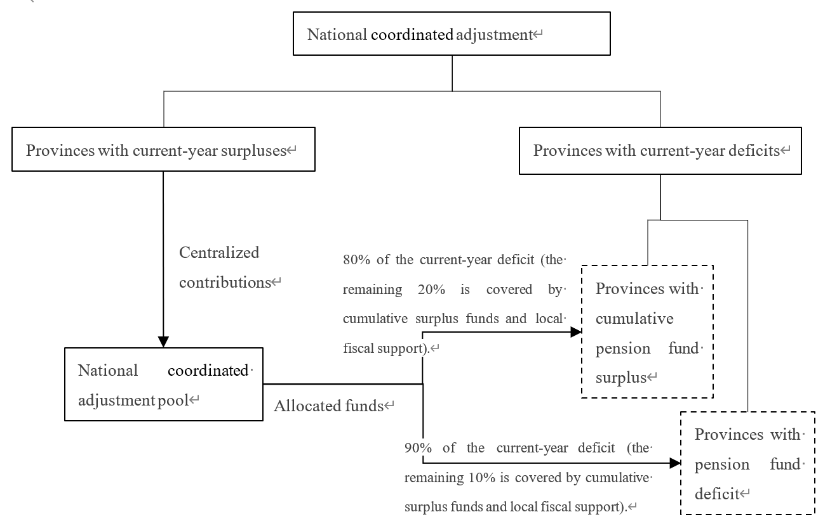
2 Institutional Context and Literature Review
2.1 Current System of China’s BPEE
  Figure 1. National Coordinated Adjustment Mechanism for the BPEE

Slide 7
2 Institutional Context and Literature Review
2.2 Issues in the Current System
  First, the coordinated adjustment mechanism may lead to equity concerns in practice.
    the mechanism does not ultimately address structural funding gaps
    Moreover, it has led to unintended instances of “reverse redistribution”.
  Second, the implementation of the coordinated adjustment mechanism may induce moral hazard among local governments.
  The adjustment mechanism has failed to address deeper structural issues, such as pension inequality, the challenges of transferring pension benefits for interprovincially mobile workers.

Slide 8
2 Institutional Context and Literature Review
2.3 Literature Review
Table 1 Existing Proposals for National Pooling of the BPEE
Proposal Type | Key Features
Gradual Transition | Gradually reduce the weight of the provincial average wage to 0 in pension calculation, while increasing that of the national average wage.
 | Advantages: Lower resistance to reform. Disadvantages: Resistance to parameter adjustments at each stage; difficult to control transition costs.
Immediate Implementation | Directly link pension benefits to the national average wage, removing the provincial wage factor.
 | Advantages: Rapid implementation; improves benefits for retirees in low-income regions. Disadvantages: Generates strong redistributive effects; likely faces opposition from higher-income regions.
Central + Local Pensions | Combine a uniform central basic pension with a supplementary local pension reflecting regional economic conditions.
 | Advantages: Balances national uniformity with regional economic disparities. Disadvantages: Does not fully resolve the portability of pension benefits for mobile workers.
Small Pooling + Large Accounts | Convert the pooling account into the first pillar, while shifting individual accounts to the second pillar merged with enterprise annuities.
 | Advantages: Reduces fiscal pressure on the system. Disadvantages: Fails to address fairness concerns in UCD; limited progress toward overall integration.

Slide 9
3 The UCD System
3.1 Scheme Design for the Basic Pension Insurance for Enterprise Employees(BPEE)
  To facilitate the prompt implementation of a fully UCD system, the initial benefit benchmark will be set at the level of the province with the lowest overall average wage, with provisions for gradual increases in subsequent phases.
  During the transition period, contributions from other provinces that exceed the national standard will be retained at the local level to ensure that pension benefits for current retirees remain unchanged.
  After the transition, contributions from newly enrolled employees in these provinces that surpass the national standard will be allocated to develop the second and third pillars of the pension system.
  This approach enhances the financial sustainability of the BPEE fund without increasing the contribution burden on employers or individuals, reduces fiscal pressure, and maintains pension benefit levels for existing retirees.

Slide 10
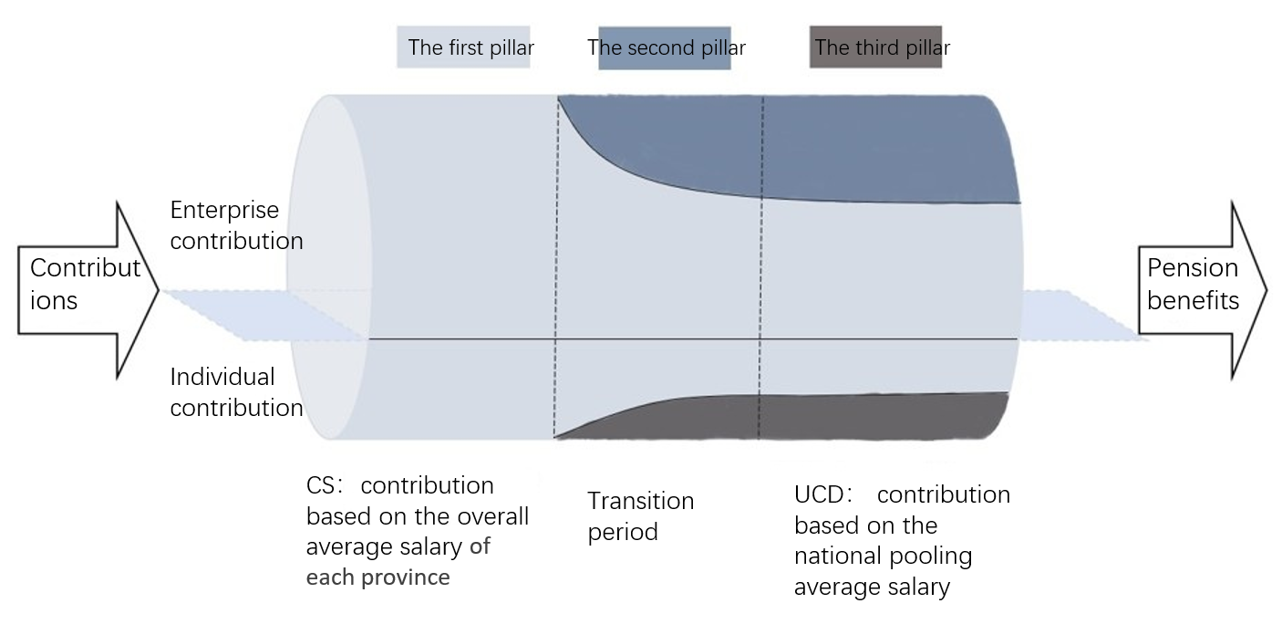
3 The UCD System
3.1 Scheme Design for the Basic Pension Insurance for Enterprise Employees(BPEE)

Slide 11
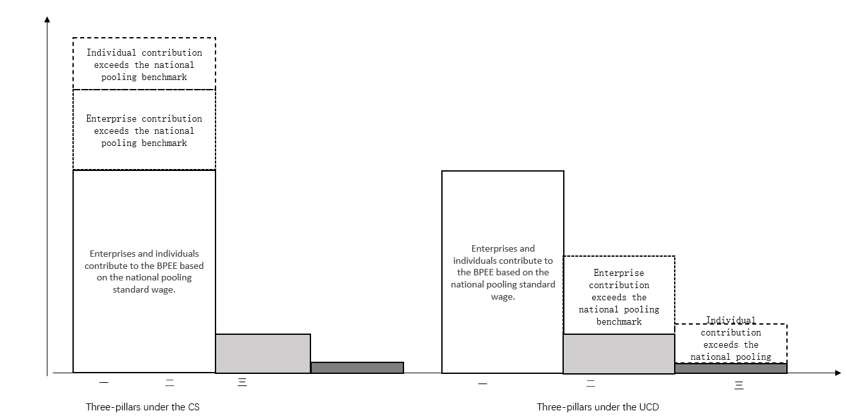
3 The UCD System
3.1 Scheme Design for the Basic Pension Insurance for Enterprise Employees(BPEE)

Slide 12
3 The UCD System
3.1 Scheme Design for the Basic Pension Insurance for Enterprise Employees(BPEE)
(1) Nationwide Unified Average Wage and Standardized Wage by Age under the National Pooling System
  The nationwide unified average wage is determined based on the lowest provincial overall average wage from the previous year.
  The age-specific average wages of employees in the province with the lowest overall average wage serve as the standardized wage benchmarks by age for all insured workers under the UCD system.
  Enterprises and employees make contributions based on these standardized wages. The BPEE system is centrally managed and funded, with the central government assuming ultimate financial responsibility.

Slide 13
3 The UCD System
3.1 Scheme Design for the Basic Pension Insurance for Enterprise Employees(BPEE)
  (2) Allocation of Contributions Above the UCD Level to Enterprise Annuities and Individual Pensions
    During the transition period, contributions from other provinces exceeding this standard will be retained locally to ensure that current pension benefit levels remain unchanged.
    After the transition, new contributions above the national standard in these provinces will be directed toward developing the second pillar and the third pillar of the pension system.
    Regarding pension benefit calculation:
      Existing retirees will continue to receive pensions under the original standards.
      For active employees, their historical contributions will be reconciled based on the national unified standard wage. Amounts exceeding this standard will be retained by provincial governments.
      New enrollees will contribute to the basic pension insurance based entirely on the national unified standard wage. Enterprise and employee contributions exceeding this level will be allocated to mandatory enterprise annuities and personal pensions, respectively.

Slide 14
3 The UCD System
3.2 Advantages of Implementing the UCD
  The adoption of a UCD system for BPEE would effectively address several shortcomings of the current system.
    Mitigation of Moral Hazard among Local Governments
    Prevention of “Reverse Redistribution”
    Reduction in Fiscal Burden
    Promotion of Balanced Development across All Three Pillars
    Enhanced Portability and Equity

Slide 15
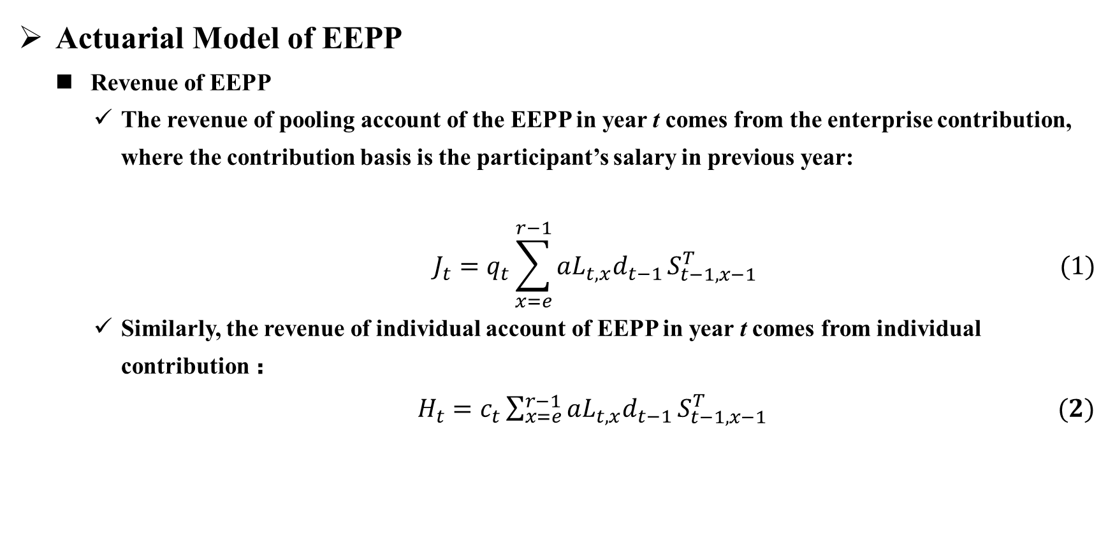
4 Actuarial Model
Actuarial Model of EEPP
  Revenue of EEPP
    The revenue of pooling account of the EEPP in year t comes from the enterprise contribution, where the contribution basis is the participant’s salary in previous year:
$$J_{t}=q_{t}\sum_{x=e}^{r−1}{aL_{t,x}d_{t−1}}S_{t−1,x−1}^{T} (1)$$
    Similarly, the revenue of individual account of EEPP in year t comes from individual contribution ：
  $H_{t}=c_{t}\sum_{x=e}^{r−1}{aL_{t,x}d_{t−1}}S_{t−1,x−1}^{T} (2)$

Slide 16
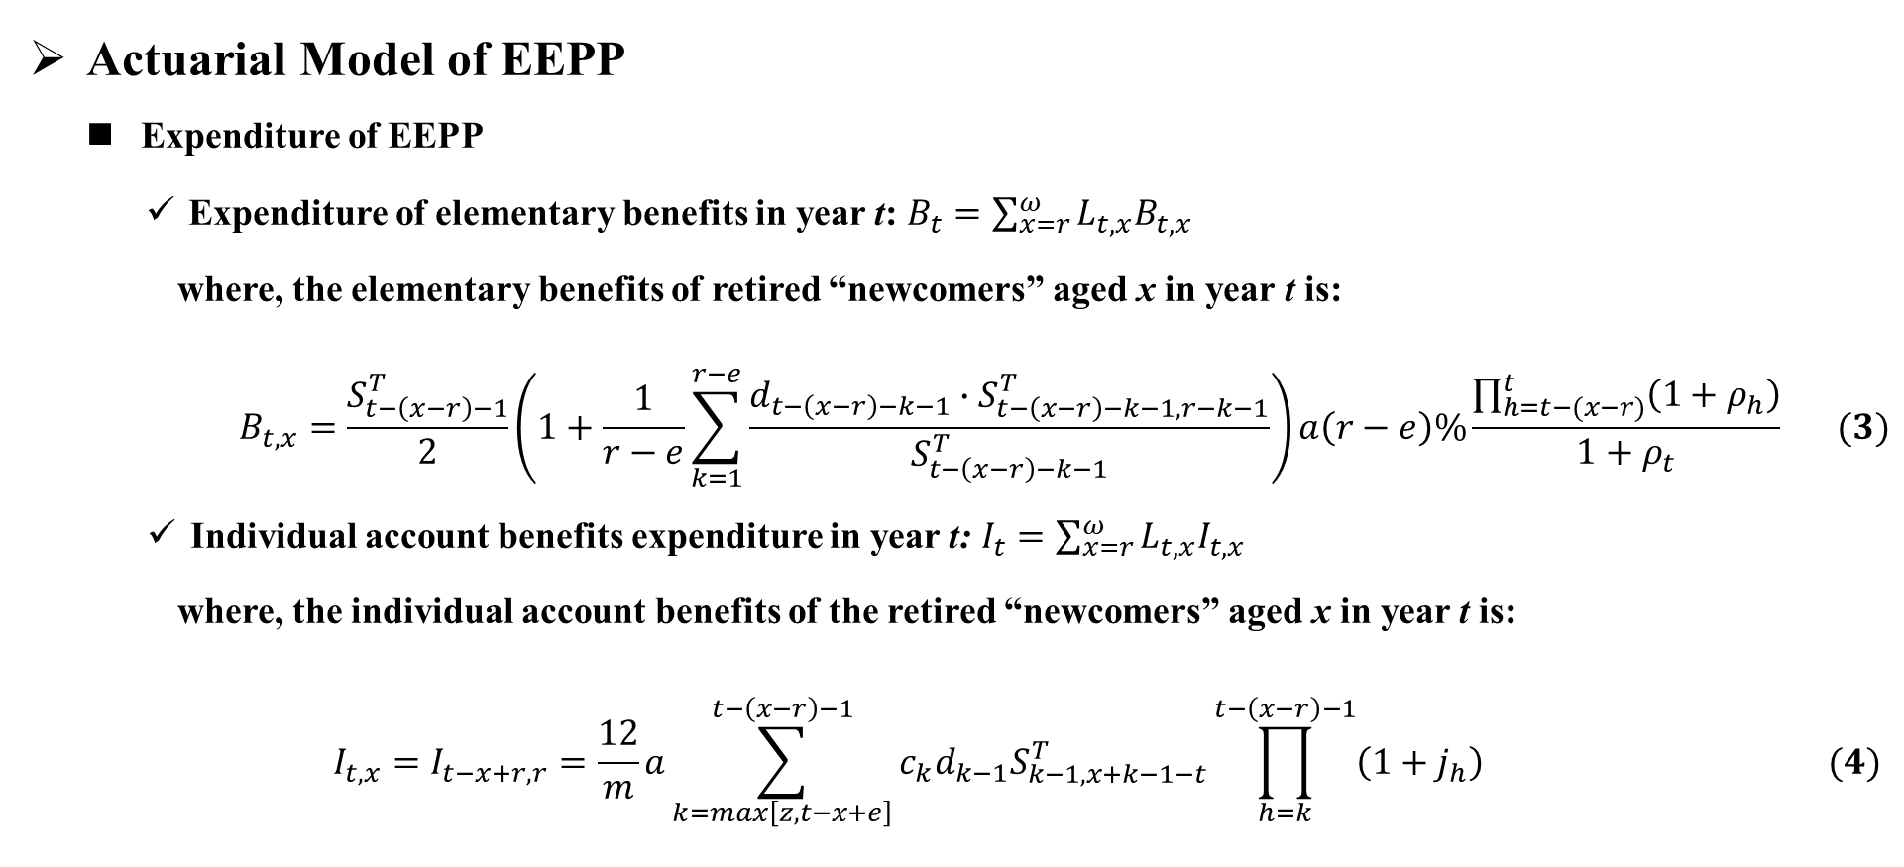
4 Actuarial Model
Actuarial Model of EEPP
  Expenditure of EEPP
    Expenditure of elementary benefits in year t:$B_{t}=\sum_{x=r}^{ω}{L_{t,x}B_{t,x}}$
  where, the elementary benefits of retired “newcomers” aged x in year t is:
$$B_{t,x}=\frac{S_{t−\left(x−r\right)−1}^{T}}{2}\left(1+\frac{1}{r−e}\sum_{k=1}^{r−e}{\frac{d_{t−\left(x−r\right)−k−1}∙S_{t−\left(x−r\right)−k−1,r−k−1}^{T}}{S_{t−\left(x−r\right)−k−1}^{T}}}\right)a\left(r−e\right)\%\frac{\prod_{h=t−(x−r)}^{t}{\left(1+ρ_{h}\right)}}{1+ρ_{t}} (3)$$
    Individual account benefits expenditure in year t:$I_{t}=\sum_{x=r}^{ω}{L_{t,x}I_{t,x}}$
  where, the individual account benefits of the retired “newcomers” aged x in year t is:
$$I_{t,x}=I_{t−x+r,r}=\frac{12}{m}a\sum_{k=max\left[z,t−x+e\right]}^{t−\left(x−r\right)−1}{c_{k}d_{k−1}S_{k−1,x+k−1−t}^{T}\prod_{h=k}^{t−\left(x−r\right)−1}{\left(1+j_{h}\right)}} (4)$$

Slide 17
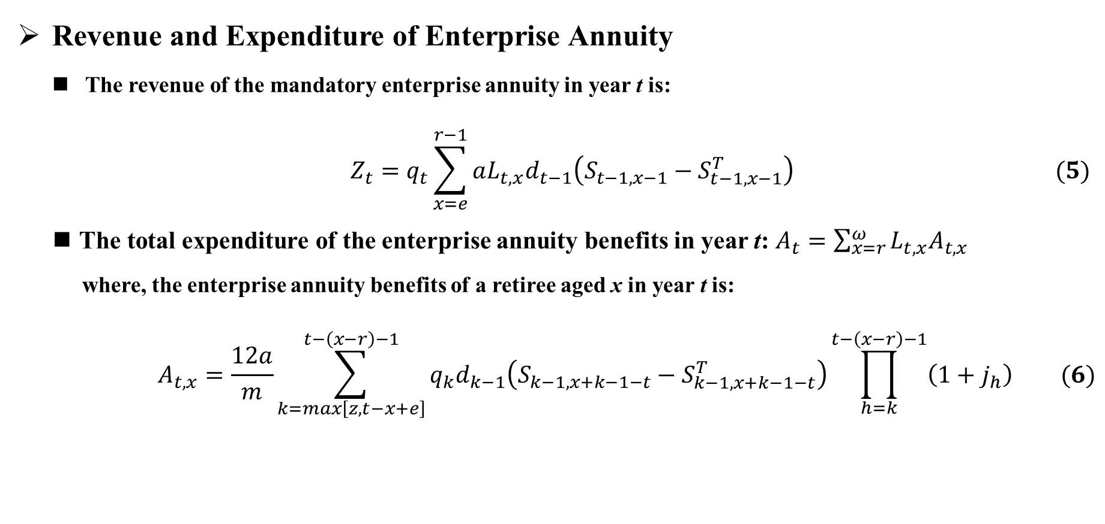
4 Actuarial Model
Revenue and Expenditure of Enterprise Annuity
  The revenue of the mandatory enterprise annuity in year t is:
  $$Z_{t}=q_{t}\sum_{x=e}^{r−1}{aL_{t,x}d_{t−1}\left(S_{t−1,x−1}−S_{t−1,x−1}^{T}\right)} (5)$$
  The total expenditure of the enterprise annuity benefits in year t: $A_{t}=\sum_{x=r}^{ω}{L_{t,x}A_{t,x}}$
    where, the enterprise annuity benefits of a retiree aged x in year t is:
$$A_{t,x}=\frac{12a}{m}\sum_{k=max\left[z,t−x+e\right]}^{t−\left(x−r\right)−1}{q_{k}d_{k−1}\left(S_{k−1,x+k−1−t}−S_{k−1,x+k−1−t}^{T}\right)\prod_{h=k}^{t−\left(x−r\right)−1}{\left(1+j_{h}\right)}} (6)$$

Slide 18
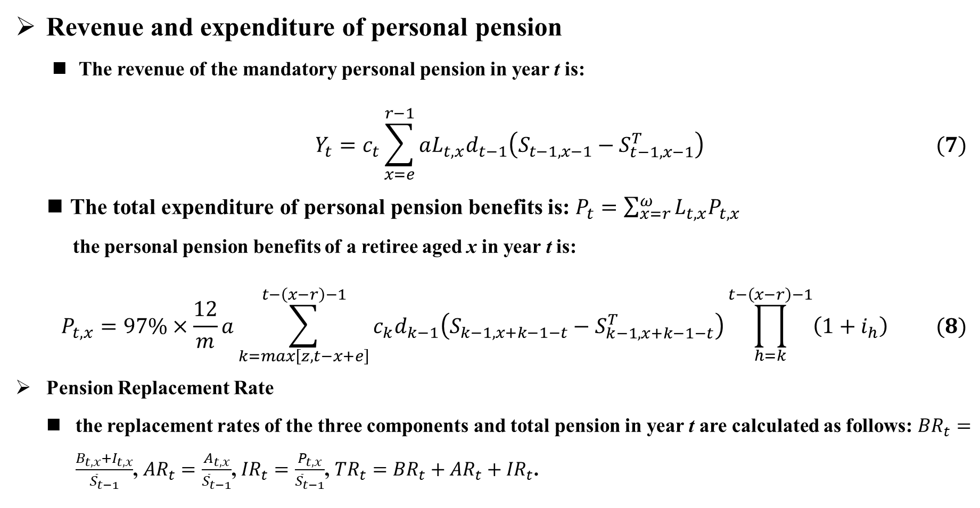
4 Actuarial Model
Revenue and expenditure of personal pension
  The revenue of the mandatory personal pension in year t is:
$$Y_{t}=c_{t}\sum_{x=e}^{r−1}{aL_{t,x}d_{t−1}\left(S_{t−1,x−1}−S_{t−1,x−1}^{T}\right)} (7)$$
  The total expenditure of personal pension benefits is: $P_{t}=\sum_{x=r}^{ω}{L_{t,x}P_{t,x}}$
    the personal pension benefits of a retiree aged x in year t is:
$$P_{t,x}=97\%×\frac{12}{m}a\sum_{k=max\left[z,t−x+e\right]}^{t−\left(x−r\right)−1}{c_{k}d_{k−1}\left(S_{k−1,x+k−1−t}−S_{k−1,x+k−1−t}^{T}\right)\prod_{h=k}^{t−\left(x−r\right)−1}{\left(1+i_{h}\right)}} (8)$$
Pension Replacement Rate
  the replacement rates of the three components and total pension in year t are calculated as follows: ${BR}_{t}=\frac{B_{t,x}+I_{t,x}}{{\overline{S}}_{t−1}}$, ${AR}_{t}=\frac{A_{t,x}}{{\overline{S}}_{t−1}}$, ${IR}_{t}=\frac{P_{t,x}}{{\overline{S}}_{t−1}}$, ${TR}_{t}={BR}_{t}+{AR}_{t}+{IR}_{t}$.

Slide 19
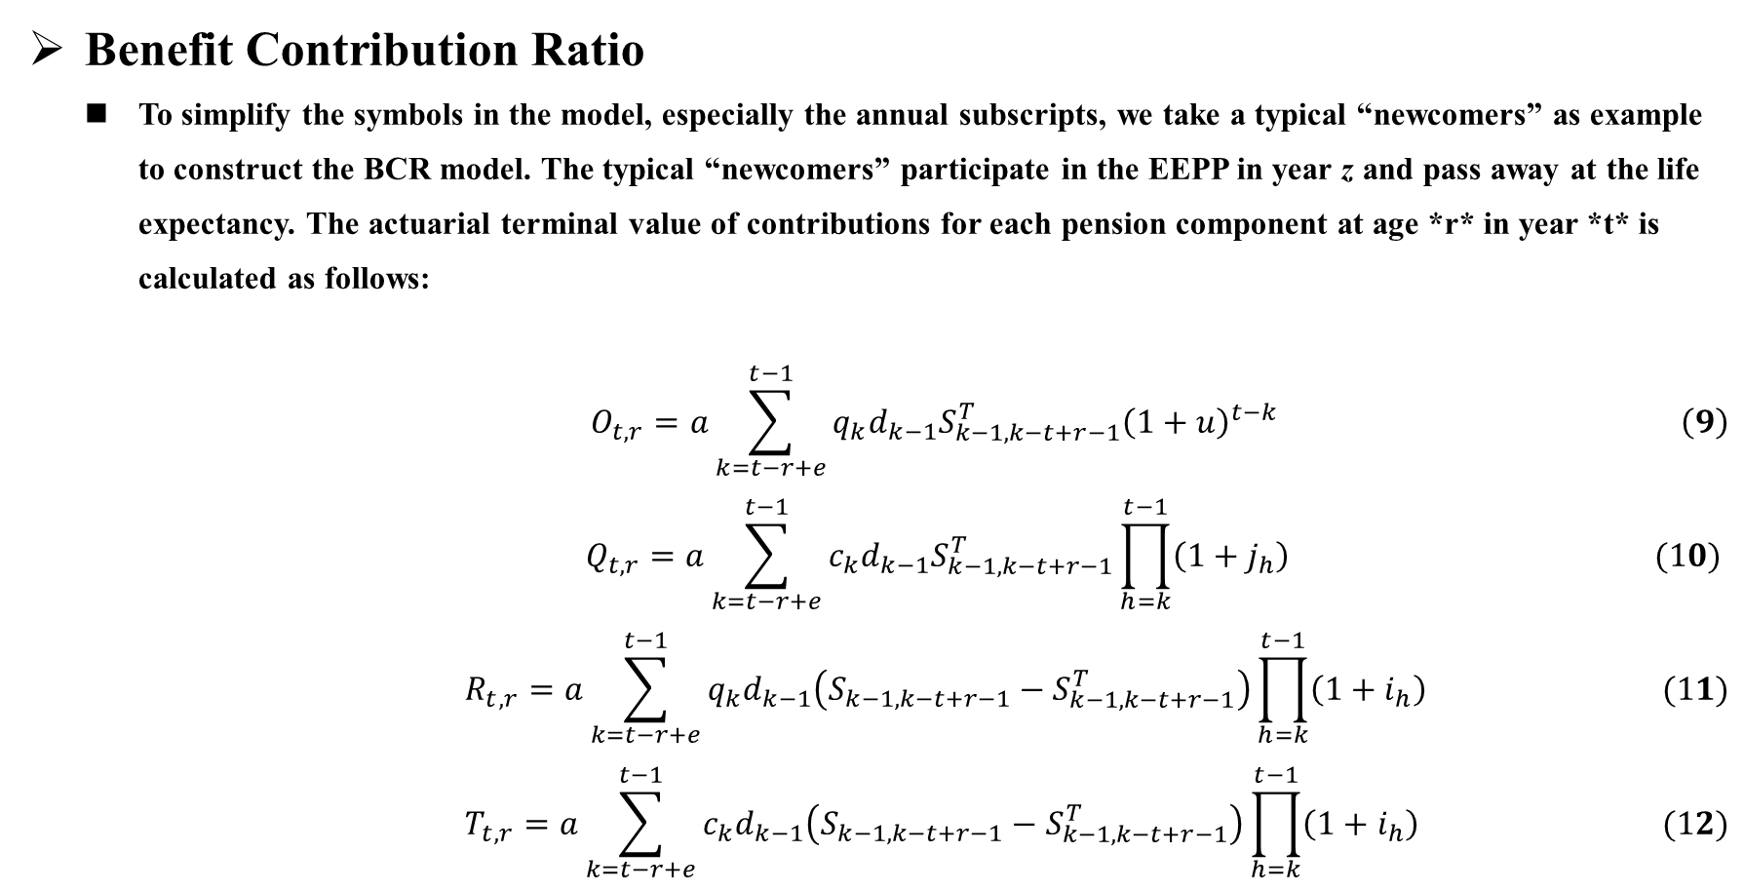
4 Actuarial Model
Benefit Contribution Ratio
  To simplify the symbols in the model, especially the annual subscripts, we take a typical “newcomers” as example to construct the BCR model. The typical “newcomers” participate in the EEPP in year z and pass away at the life expectancy. The actuarial terminal value of contributions for each pension component at age *r* in year *t* is calculated as follows:
  $$O_{t,r}=a\sum_{k=t−r+e}^{t−1}{q_{k}d_{k−1}S_{k−1,k−t+r−1}^{T}{\left(1+u\right)}^{t−k}} \left(9\right)$$
  $$Q_{t,r}=a\sum_{k=t−r+e}^{t−1}{c_{k}d_{k−1}S_{k−1,k−t+r−1}^{T}\prod_{h=k}^{t−1}{\left(1+j_{h}\right)}} (10)$$
$$R_{t,r}=a\sum_{k=t−r+e}^{t−1}{q_{k}d_{k−1}\left(S_{k−1,k−t+r−1}−S_{k−1,k−t+r−1}^{T}\right)\prod_{h=k}^{t−1}{\left(1+i_{h}\right)}} (11)$$
$$T_{t,r}=a\sum_{k=t−r+e}^{t−1}{c_{k}d_{k−1}\left(S_{k−1,k−t+r−1}−S_{k−1,k−t+r−1}^{T}\right)\prod_{h=k}^{t−1}{\left(1+i_{h}\right)}} (12)$$

Slide 20
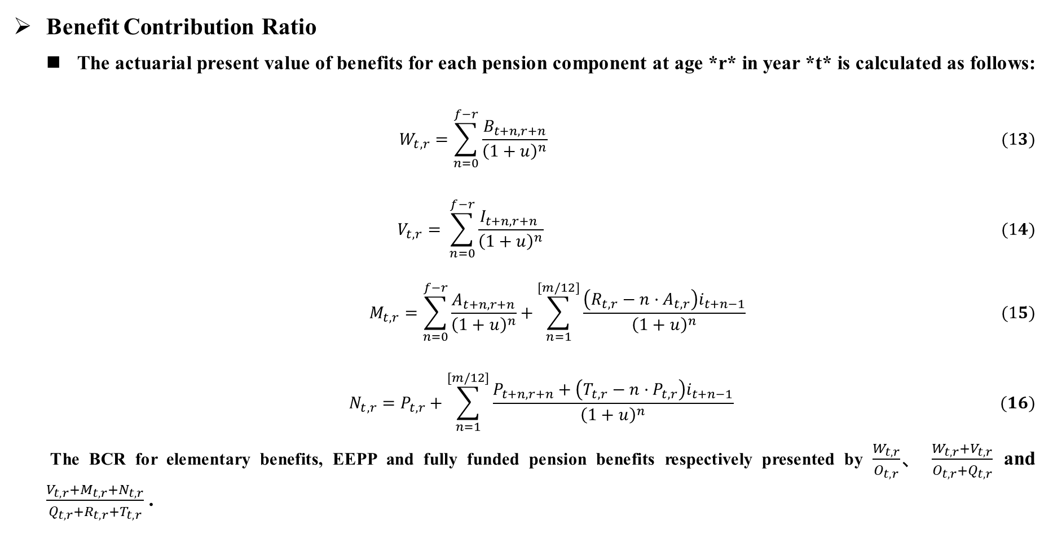
4 Actuarial Model
Benefit Contribution Ratio
  The actuarial present value of benefits for each pension component at age *r* in year *t* is calculated as follows:
$$W_{t,r}=\sum_{n=0}^{f−r}{\frac{B_{t+n,r+n}}{{\left(1+u\right)}^{n}}} (13)$$
$$V_{t,r}= \sum_{n=0}^{f−r}{\frac{I_{t+n,r+n} }{{\left(1+u\right)}^{n}}} (14)$$
$$M_{t,r}=\sum_{n=0}^{f−r}{\frac{A_{t+n,r+n}}{{\left(1+u\right)}^{n}}}+\sum_{n=1}^{[m/12]}{\frac{\left(R_{t,r}−n·A_{t,r}\right)i_{t+n−1}}{{\left(1+u\right)}^{n}}} (15)$$
$$N_{t,r}=P_{t,r}+\sum_{n=1}^{[m/12]}{\frac{P_{t+n,r+n}+\left(T_{t,r}−n·P_{t,r}\right)i_{t+n−1}}{{\left(1+u\right)}^{n}}} (16)$$
The BCR for elementary benefits, EEPP and fully funded pension benefits respectively presented by $\frac{W_{t,r}}{O_{t,r}}$、 $\frac{W_{t,r}+V_{t,r}}{O_{t,r}+Q_{t,r}}$ and $\frac{V_{t,r}+M_{t,r}+N_{t,r}}{Q_{t,r}+R_{t,r}+T_{t,r}}$ .

Slide 21
5 Actuarial Basis
Other parameters setting
parameters | parameter settings/Value Retrieval Method
Basis of elementary benefits | The elementary benefits under the UCD are calculated based on the average of the national pooling average salary and the participant’s indexed average contribution salary.
growth rate of seniority salary | 1.68%
Bookkeeping interest rate | 1997-2014: 3.27%； the average of actual return rates from 2015 to 2023, which is 4.15%, is used as the bookkeeping interest rate for each year of the forecast period.
Investment return rate | 6.17%
Salary growth rate | The salary growth rate in 2023 and earlier is consistent with the average salary index of urban employees in the corresponding years, as recorded in the China Labor Statistics Yearbook. The salary growth rate will be 6.6% from 2024 to 2025, 5.7% from 2026 to 2030, and 4.8% thereafter.

Slide 22
5 Actuarial Basis
Parameters setting
parameters | parameter settings/Value Retrieval Method
Basis of elementary benefits | The elementary benefits under the UCD are calculated based on the average of the national pooling average salary and the participant’s indexed average contribution salary.
growth rate of seniority salary | 1.68%
Bookkeeping interest rate | 1997-2014: 3.27%； the average of actual return rates from 2015 to 2023, which is 4.15%, is used as the bookkeeping interest rate for each year of the forecast period.
Investment return rate | 6.17%
Salary growth rate | The salary growth rate in 2023 and earlier is consistent with the average salary index of urban employees in the corresponding years, as recorded in the China Labor Statistics Yearbook. The salary growth rate will be 6.6% from 2024 to 2025, 5.7% from 2026 to 2030, and 4.8% thereafter.

Slide 23
5 Actuarial Basis
Other parameters setting
Other parameters | parameter settings
Entry age | 20 years old
Retirement age | 52-65
payment months | In accordance with the provisions of Document Guo Fa [2005] No. 38
enterprise contribution rate | 2019：20%； 2019 and beyond：16%
compliance rate | 70%。
contribution persistence rate | 85%
Number of participants in each year | Cohort Component Method The total number of participants in a certain year =the urban population with labor age in the year × the employment rate × the coverage rate of the public pension system for urban employees× the proportion of enterprise employee participants to urban employee participant.

Slide 24
6 Projection Results
Comparing the revenue and expenditure of three pillars under the UCD and CS
  Revenue of the three pillars
    The revenues of EEPP, mandatory enterprise annuity, and personal pension under the UCD account for 80.3%, 13.1%, and 6.6% of the total revenue of the three pillars, respectively.
    Assuming that the three proportions in the total pension fund remain unchanged:
      The revenue of EEPP under the UCD accounts for 74%(=92.1%×80.3%)
      The enterprise annuity fund revenue accounts for 20%(=92.1%×13.1%+7.9%)
      The personal pension fund revenue accounts for 6.1%(=92.1%×6.6%)
    The latter two are significantly higher than the proportion of the second and third pillars to the EEPP under CS. Implementing the UCD can reduce the proportion of EEPP, free up about 18.1% of space for the development of the second and third pillars.

Slide 25
6 Projection Results
Comparing the revenue and expenditure of three pillars under the UCD and CS
  Expenditure of the three pillars
  Table 2 Expenditure of three pillars under UCD and that of EEPP under CS (in trillion yuan)
 |  | UCD |  |  | CS | Expenditure Ratio of EEPP under UCD to that under CS | Proportion of EEPP expenditure to total pension expenditure under UCD
year | Age Range | EEPP | Enterprise Annuity | Personal Pension | EEPP
2029 | 52 | 0.11 | 0.02 | 0.01 | 0.14 | 78.0% | 81.1%
2032 | 52-55 | 0.51 | 0.08 | 0.04 | 0.65 | 78.0% | 81.1%
2035 | 52-58 | 1.05 | 0.17 | 0.07 | 1.34 | 78.0% | 81.1%
2038 | 52-61 | 2.14 | 0.38 | 0.17 | 2.74 | 78.1% | 79.7%
2041 | 52-64 | 3.81 | 0.71 | 0.32 | 4.88 | 78.1% | 78.8%
2044 | 52-67 | 5.69 | 1.09 | 0.49 | 7.28 | 78.1% | 78.3%
2047 | 52-70 | 7.82 | 1.52 | 0.69 | 10.00 | 78.2% | 78.0%
2050 | 52-73 | 10.19 | 2.01 | 0.91 | 13.03 | 78.2% | 77.7%

Slide 26
6 Projection Results
Pension Replacement Rate of three pillars under the UCD and CS
Table 3 PRR for retired “newcomers” of different ages in 2050（%）
Retirement age | Entry year | UCD |  |  |  |  | CS
 |  | Elementary Benefits | Individual account benefits | Enterprise annuity benefits | Personal pension benefits | Total pension | Elementary Benefits | Individual account benefits | EEPP
52 | 2018 | 16.80 | 7.61 | 5.29 | 2.55 | 32.24 | 21.83 | 9.51 | 31.34
53 | 2017 | 17.38 | 8.44 | 5.81 | 2.77 | 34.39 | 22.58 | 10.54 | 33.13
54 | 2016 | 17.96 | 8.97 | 6.36 | 3.01 | 36.30 | 23.34 | 11.23 | 34.57
55 | 2015 | 18.55 | 9.36 | 6.98 | 3.27 | 38.17 | 24.10 | 11.71 | 35.81
56 | 2014 | 19.15 | 10.08 | 7.55 | 3.53 | 40.30 | 24.87 | 12.60 | 37.47
57 | 2013 | 19.75 | 10.85 | 8.24 | 3.83 | 42.67 | 25.64 | 13.56 | 39.21
58 | 2012 | 20.35 | 11.71 | 8.83 | 4.09 | 44.97 | 26.42 | 14.60 | 41.02
59 | 2011 | 20.96 | 12.70 | 9.58 | 4.42 | 47.66 | 27.21 | 15.81 | 43.02
60 | 2010 | 21.57 | 13.87 | 10.30 | 4.75 | 50.49 | 28.00 | 17.22 | 45.22
61 | 2009 | 22.19 | 14.86 | 11.13 | 5.12 | 53.31 | 28.80 | 18.44 | 47.24
62 | 2008 | 22.81 | 16.17 | 12.19 | 5.59 | 56.77 | 29.60 | 20.04 | 49.64
63 | 2007 | 23.44 | 17.76 | 13.28 | 6.09 | 60.58 | 30.41 | 21.98 | 52.39
64 | 2006 | 24.08 | 19.55 | 14.68 | 6.72 | 65.03 | 31.22 | 24.19 | 55.42
65 | 2005 | 24.71 | 21.62 | 16.42 | 7.50 | 70.25 | 32.05 | 26.76 | 58.80

Slide 27
6 Projection Results
Benefit Contribution Rate of three pillars under the UCD and CS
Table 4 BCR of “newcomers” retiring at different age in 2050
Retirement age | UCD |  |  | CS
 | Pay-as-you-go pension | Fully funded pension | Total pension | Pay-as-you-go pension | Fully funded pension | EEPP
52 | 2.61 | 3.20 | 2.84 | 2.72 | 2.88 | 2.77
53 | 2.53 | 3.40 | 2.86 | 2.63 | 3.09 | 2.76
54 | 2.45 | 3.51 | 2.85 | 2.54 | 3.16 | 2.71
55 | 2.37 | 3.57 | 2.81 | 2.46 | 3.15 | 2.65
56 | 2.29 | 3.65 | 2.79 | 2.38 | 3.19 | 2.60
57 | 2.21 | 3.72 | 2.77 | 2.30 | 3.23 | 2.55
58 | 2.13 | 3.81 | 2.74 | 2.22 | 3.27 | 2.51
59 | 2.06 | 3.90 | 2.72 | 2.15 | 3.34 | 2.47
60 | 1.99 | 4.01 | 2.71 | 2.07 | 3.43 | 2.44
61 | 1.92 | 4.10 | 2.69 | 2.00 | 3.46 | 2.40
62 | 1.84 | 4.22 | 2.68 | 1.93 | 3.55 | 2.37
63 | 1.78 | 4.38 | 2.68 | 1.86 | 3.66 | 2.35
64 | 1.71 | 4.54 | 2.68 | 1.79 | 3.80 | 2.33
65 | 1.64 | 4.72 | 2.70 | 1.72 | 3.95 | 2.32

Slide 28
7 Further discussion
7.1 Impact of Delayed Retirement
Table 5 Proportion of the Three Pension Pillars Under the UCD and CS in the Context of Delayed Retirement
Retirement Year | Ratio of the total pension expenditure under UCD to the EEPP under CS | Expenditure Ratio of EEPP under UCD to that under CS | Proportion of EEPP expenditure to total pension expenditure under UCD
2033 | 0.91 | 70.9% | 78.3%
2034 | 0.96 | 74.5% | 78.0%
2035 | 0.97 | 75.8% | 78.2%
2036 | 0.98 | 76.4% | 78.2%
2037 | 0.98 | 76.7% | 78.2%
2038 | 0.99 | 77.0% | 78.2%
2039 | 0.99 | 77.2% | 78.2%
2040 | 1.00 | 77.5% | 77.2%
2041 | 1.01 | 77.7% | 76.6%
2042 | 1.02 | 77.8% | 76.2%
2043 | 1.03 | 77.9% | 75.9%
2044 | 1.03 | 78.0% | 75.7%
2045 | 1.03 | 78.0% | 75.4%
2046 | 1.04 | 78.1% | 75.3%
2047 | 1.04 | 78.1% | 75.2%
2048 | 1.04 | 78.1% | 75.2%
2049 | 1.03 | 77.3% | 75.3%
2050 | 1.04 | 78.2% | 74.9%

Slide 29
7 Further discussion
7.1 Reducing the Bookkeeping interest rate and the investment return rate
Table 6 Minimum Retirement Age at Which the UCD Outperforms the CS Under Different Combinations of j and i
j | i | PPR | BCR
2.75% | 2.75% | 64 | \
 | 3.45% | 61 | \
 | 4.15% | 57 | 61
 | 5.16% | 52 | 53
3.45% | 3.45% | 62 | \
 | 4.15% | 58 | 63
 | 5.16% | 53 | 54
4.15% | 4.15% | 59 | 64
 | 5.16% | 54 | 55

Slide 30
8 Concluding remarks
The scale of revenue and expenditure of EEPP under the UCD is decreased compared to that under the CS, and enhances the central pooling payment capacity.
An increase in the proportion of revenue and expenditure of the second and third pillar under the UCD can improve the current situation of "one-pillar dominant".
The PRR and BCR of total pension under the UCD is always higher than that of EEPP under the CS.
The fully funded BCR increases with the retirement age, encouraging participants to delay retirement.
Further analysis reveals that:
  Delayed retirement will further reduce the proportion of the EEPP within the total pension expenditure under the UCD.
  Both the PPR and the BCR of the total pension under the UCD decrease as the investment return rate declines.
  The more the investment return rate exceeds the bookkeeping interest rate, the shorter the period of delaying retirement necessary for the UCD to show superiority over the CS.
  The bookkeeping interest rate being lower than the investment return rate is beneficial in encouraging the public to participate in enterprise annuity and personal pension.

Slide 31
8 Concluding remarks
To successfully implement the UCD for the EEPP, strengthen enterprise annuity and personal pension, develop the three-pillar, and promote the implementation of delaying retirement policy, the Chinese government can take the following measures.
  Firstly, it is necessary to increase the investment return rate through market-oriented operations and various methods.
  Secondly, the bookkeeping interest rate should not be set higher than the investment return rate in order to develop and strengthen the second and third pillar pension.
  Thirdly, implementing the UCD plan for EEPP can reduce the central government's expenditure obligations, narrow the funding gap for EEPP, and alleviate the financial burden of government subsidies.
  Fourth, it is better to integrate the original voluntary enterprise annuity and personal pension into the mandatory systems established under the UCD, and adopt an automatic joining mechanism.

Slide 32
Thank You!
I appreciate your feedback and questions.
Email: nding@email.cufe.edu.cn

