Slide 1
Basis Risk and Pension Schemes
Andrew Hunt
Longevity 12
Chicago, USA
September 2016

Slide 2
Agenda
Basis risk – Level vs. trend
Reference and sub-population models
Parameter and model risk
Projections and consequences

Slide 3
Basis risk – Level and trend
Basis risk has been the subject to much practical and academic study in recent years
  Plat (2009)
  Coughlan et al (2011)
  Li and Hardy (2011)
  Cairns et al (2013)
  Haberman et al (2015)
Many of the studies indicate that basis risk is manageable within index-based hedging solutions
However, it is often still given as a reason for the slow development of traded longevity-risk markets
Much of the confusion around basis risk comes from different authors talking about different concepts

Slide 4
Basis risk – Level and trend
Basis
  How mortality rates differ in Population B compared with Population A (the reference population)
  Comprises of
    Level basis: The best-estimate of differences in mortality rates in a given base year between the populations
    Trend basis: The best-estimate of differences in the evolution of mortality rates in the two population after the base year
    E.g., mortality rates in Population B were 5% higher at all ages than in Population A, and improve 1% p.a. slower
  Basis is known or estimable, and can be allowed for in the construction of suitable hedges

Slide 5
Basis risk – Level and trend
Basis risk
  Risk / uncertainty in the measurement of the basis between Populations A and B
  Comprises of
    Level basis risk: Measurement uncertainty in the estimation of the level basis
    Trend basis risk: Measurement uncertainty in the trend basis plus stochastic risk in the differential evolution of mortality in the two populations
  Basis risk is inherently stochastic and cannot be hedged using indices on the reference population

Slide 6
Reference and sub-population models
Context of my research has been pension schemes in the UK
  In this case, the reference population is the national population and we are interested in the behaviour of mortality in a sub-population of the reference
  Sub-population typically relatively small (less than 5,000 lives) and have relatively short observation periods (c. 10 years)
Longevity risk transactions to date for these schemes have almost entirely been on an indemnification basis (no basis risk)

Slide 7

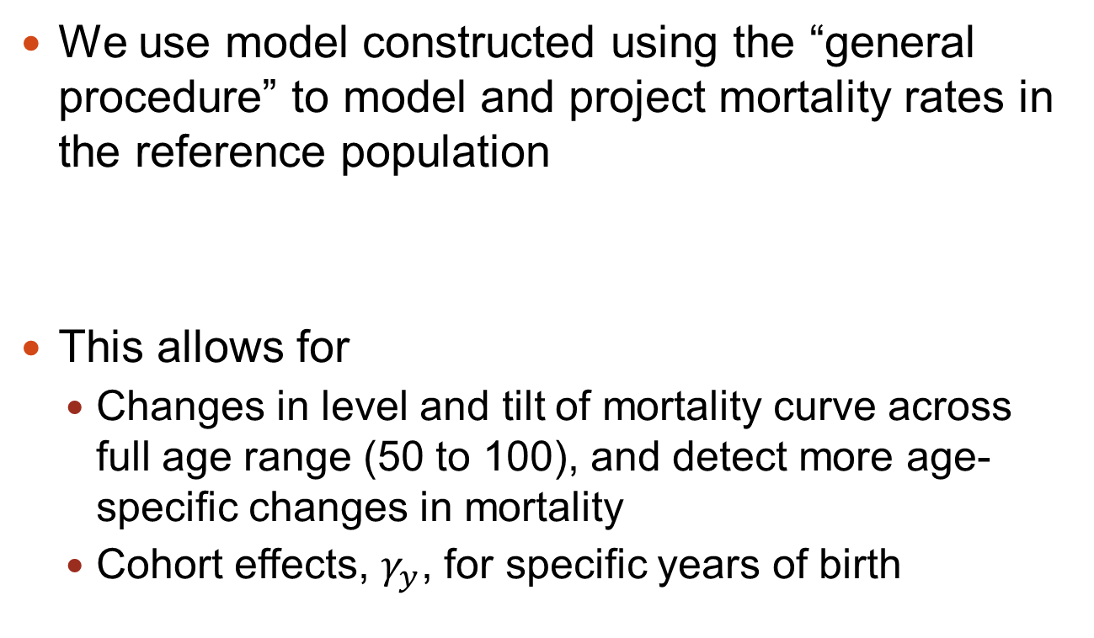
Reference and sub-population models
We use model constructed using the “general procedure” to model and project mortality rates in the reference population
This allows for
  Changes in level and tilt of mortality curve across full age range (50 to 100), and detect more age-specific changes in mortality
  Cohort effects, $γ_{y}$, for specific years of birth

Slide 8
Reference and sub-population models
We use data from the CMI Self-Administered Pension Scheme (SAPS) survey as the sub-population
  Survey collects data from large (over 500 member) pension schemes in the UK every three years
  Up to 60k male and 40k female deaths p.a.
  Data available from 2000, ages 60 to 90
To test our model, we have also rescaled this to size of more typical UK pension scheme

Slide 9

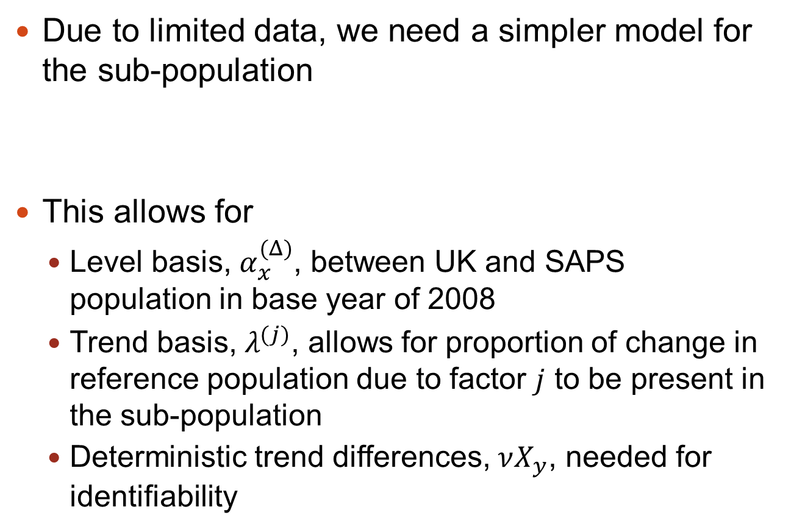
Reference and sub-population models
Due to limited data, we need a simpler model for the sub-population
This allows for
  Level basis, $α_{x}^{(Δ)}$, between UK and SAPS population in base year of 2008
  Trend basis, $λ^{(j)}$, allows for proportion of change in reference population due to factor $j$ to be present in the sub-population
  Deterministic trend differences, $νX_{y}$, needed for identifiability

Slide 10
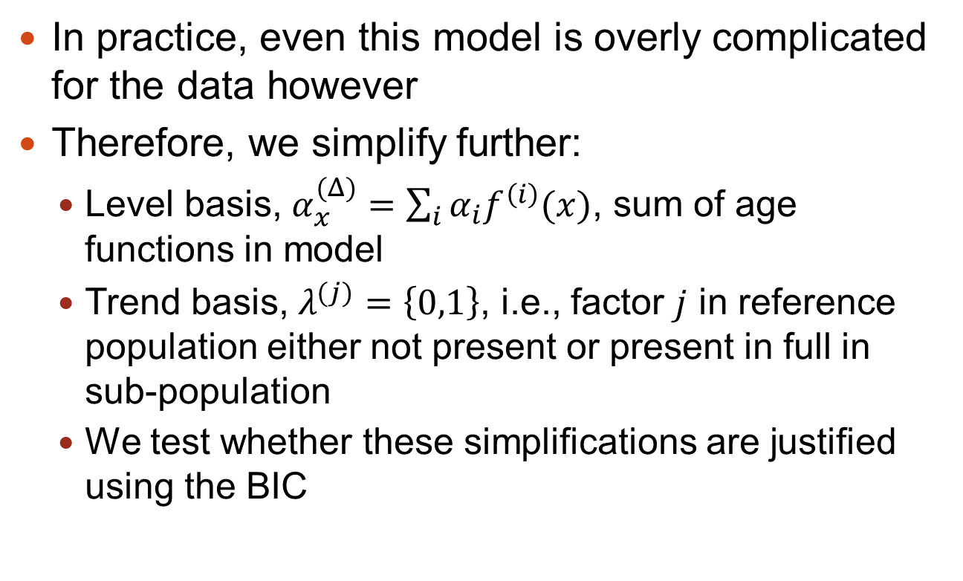
Reference and sub-population models
In practice, even this model is overly complicated for the data however
Therefore, we simplify further:
  Level basis, $α_{x}^{(Δ)}=\sum_{i}{α_{i}f^{\left(i\right)}(x)}$, sum of age functions in model
  Trend basis, $λ^{(j)}=\left\{0,1\right\}$, i.e., factor $j$ in reference population either not present or present in full in sub-population
  We test whether these simplifications are justified using the BIC

Slide 11
Reference and sub-population models
Level basis

Slide 12
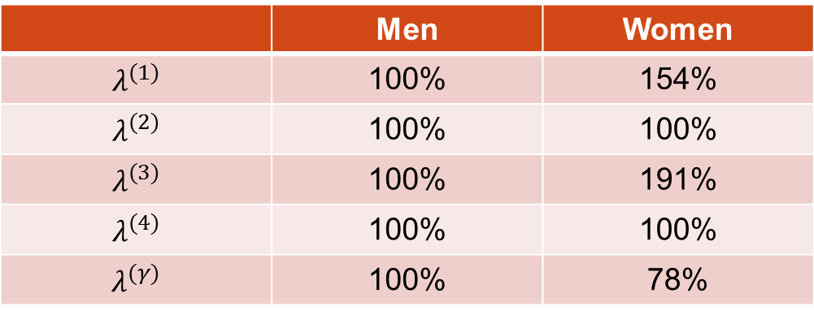
Reference and sub-population models
Trend basis
  We find no trend differences between the national and SAPS populations for men
  We find women in the SAPS population experience faster general falls in the level of mortality and around age 80, but smaller cohort effects
 | Men | Women
$$λ^{(1)}$$ | 100% | 154%
$$λ^{(2)}$$ | 100% | 100%
$$λ^{(3)}$$ | 100% | 191%
$$λ^{(4)}$$ | 100% | 100%
$$λ^{(γ)}$$ | 100% | 78%

Slide 13
Parameter and model risks
Parameter uncertainty is core of basis risk, but is often overlooked
Consider two populations
  A has population 1,000,000
  B has population 10,000
Estimate mortality rates in each population:
  A: 2% at age, error = ± 0.01%
  B: 3% at age, error = ± 0.17%
  Possible to determine statistically significant differences
Estimate improvement rates in each population:
  A: 2.5% in year, error = ± 1.4%
  B: 1.5% in year, error = ± 11.5%
  Not possible to determine whether improvement rates are statistically different

Slide 14
Parameter and model risks
We allow for parameter uncertainty and model risk by using Koissi et al (2006) bootstrapping technique to generate new death counts, and re-estimate same models
Level basis risk

Slide 15
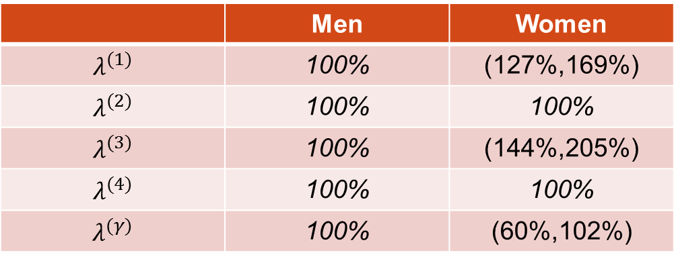
Parameter and model risks
First stage in estimating parameter risk allows for same simplifications as previously
However, parameters set to equal 0% or 100% appear to have no parameter uncertainty
 | Men | Women
$$λ^{(1)}$$ | 100% | (127%,169%)
$$λ^{(2)}$$ | 100% | 100%
$$λ^{(3)}$$ | 100% | (144%,205%)
$$λ^{(4)}$$ | 100% | 100%
$$λ^{(γ)}$$ | 100% | (60%,102%)

Slide 16
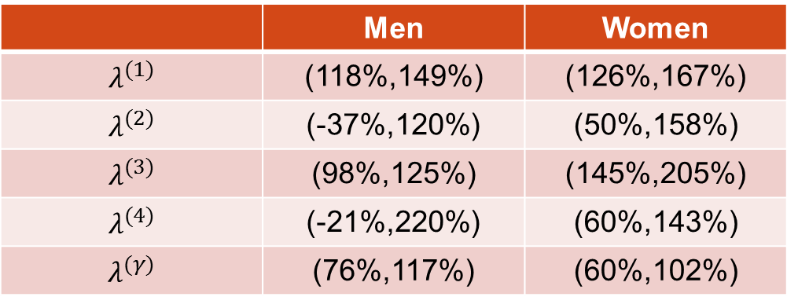
Parameter and model risks
Second stage is to remove simplifications
Parameter uncertainty is important and the core of trend basis risk
 | Men | Women
$$λ^{(1)}$$ | (118%,149%) | (126%,167%)
$$λ^{(2)}$$ | (-37%,120%) | (50%,158%)
$$λ^{(3)}$$ | (98%,125%) | (145%,205%)
$$λ^{(4)}$$ | (-21%,220%) | (60%,143%)
$$λ^{(γ)}$$ | (76%,117%) | (60%,102%)

Slide 17
Parameter and model risks
We then test the bootstrapped samples to see what simplifications are justified
In majority of cases, we arrive at the same set of simplifications (e.g., no trend basis risk for men)
  But not all, however
Whether we allow for basis or not with respect to come factors is not robust to small changes in the data

Slide 18
Parameter and model risk
So far, model estimated using SAPS data
  Far greater data volumes than available for any individual pension scheme
If we have trouble estimating basis risk in such large population, what hope is there for individual pension schemes?

Slide 19

Parameter and model risk
Typical graph showing what simplification is used for $λ^{(j)}$ as SAPS data rescaled to smaller populations
  Below c. 200,000 lives, unable to estimate any difference between national and scheme improvements
  Below c. 5,000 lives, unable to robustly determine whether mortality is improving at all

Slide 20
Projections and consequences
Project mortality in reference population and use model to map this to mortality in the sub-population
  Allows for parameter uncertainty and model risk in the sub-population
  Does not allow for any stochastic process risk in sub-population improvements

Slide 21
Projections and consequences
Systematic risk in reference population accounts for majority of uncertainty in projected annuity values
However, basis risk is significant even in this incomplete analysis
Different set of simplifications

Slide 22
Projections and consequences
Important to differentiate between basis and basis risk
Basis is, in principal measureable
  Level basis often measured via experience analysis
  However, this often using simple A/E across all ages rather than more sophisticated age-specific approach
  Trend basis may be measureable between very large populations, but for most practical circumstances, accept null hypothesis of no trend basis

Slide 23
Projections and consequences
Basis risk is somewhere between a known unknown and an unknown unknown
  Level basis risk is measureable but often this is overlooked or overly simplified
  Trend basis risk can be approximated using various models (such as this one), but these probably understate true impact

Slide 24
Projections and consequences
Insurers are well placed to measure and hold basis risks:
  Level basis can be measured more accurately using tools widely available to actuaries
  Level basis risk can be diversified by writing more business
  Trend basis may be measureable in large portfolios (though likely to be small as sub-population tend to reference)
  Trend basis risk cannot properly me measured or hedged but should be held and capital provided to back it
This provides opportunities for capital markets to provide hedging instruments for systematic changes in reference population so insurers can focus on their competitive advantage in managing basis risks

Slide 25
References
Cairns, A. J. G., Dowd, K., Blake, D., Coughlan, G. D., 2013. Longevity hedge effectiveness: A decomposition. Quantitative Finance 14 (2), 217–235.
Continuous Mortality Investigation, 2014c. Working Paper 76 – Analysis of the mortality experience of pensioners of self-administered pension schemes for the period 2006 to 2013.
Haberman, S., Kaishev, V. K., Millossovich, P., Villegas, A. M., Baxter, S. D., Gaches, A. T., Gunnlaugsson, S., Sison, M., 2014. Longevity basis risk: A methodology for assessing basis risk. Tech. rep., Cass Business School, City University London and Hymans Robertson LLP.
Hunt, A., Blake, D., 2014. A general procedure for constructing mortality models. North American Actuarial Journal 18 (1), 116–138.
Koissi, M., Shapiro, A., Hognas, G., 2006. Evaluating and extending the Lee-Carter model for mortality forecasting: Bootstrap confidence interval. Insurance: Mathematics and Economics 38 (1), 1–20.
Li, J. S.-H., Hardy, M. R., 2011. Measuring basis risk in longevity hedges. North American Actuarial Journal 15 (2), 177–200.
Plat, R., 2009. Stochastic portfolio specific mortality and the quantification of mortality basis risk. Insurance: Mathematics and Economics 45 (1), 123–132.
Russolillo, M., Giordano, G., Haberman, S., 2011. Extending the Lee-Carter model: A three-way decomposition. Scandinavian Actuarial Journal 2011 (2), 96–117.
Villegas, A. M., Haberman, S., 2014. On the modeling and forecasting of socioeconomic mortality differentials: An application to deprivation and mortality in England. North American Actuarial Journal 18 (1), 168–193.

