Slide 1
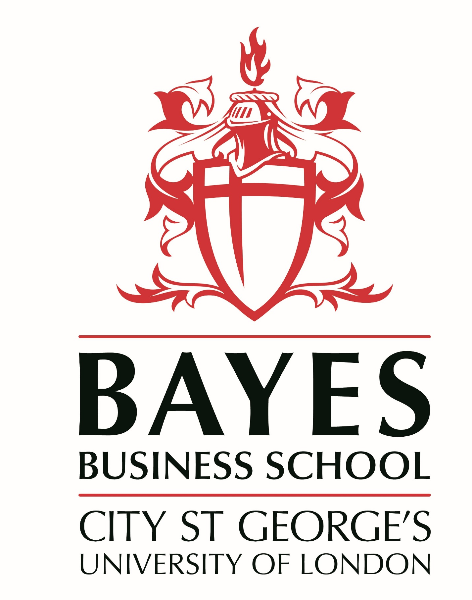
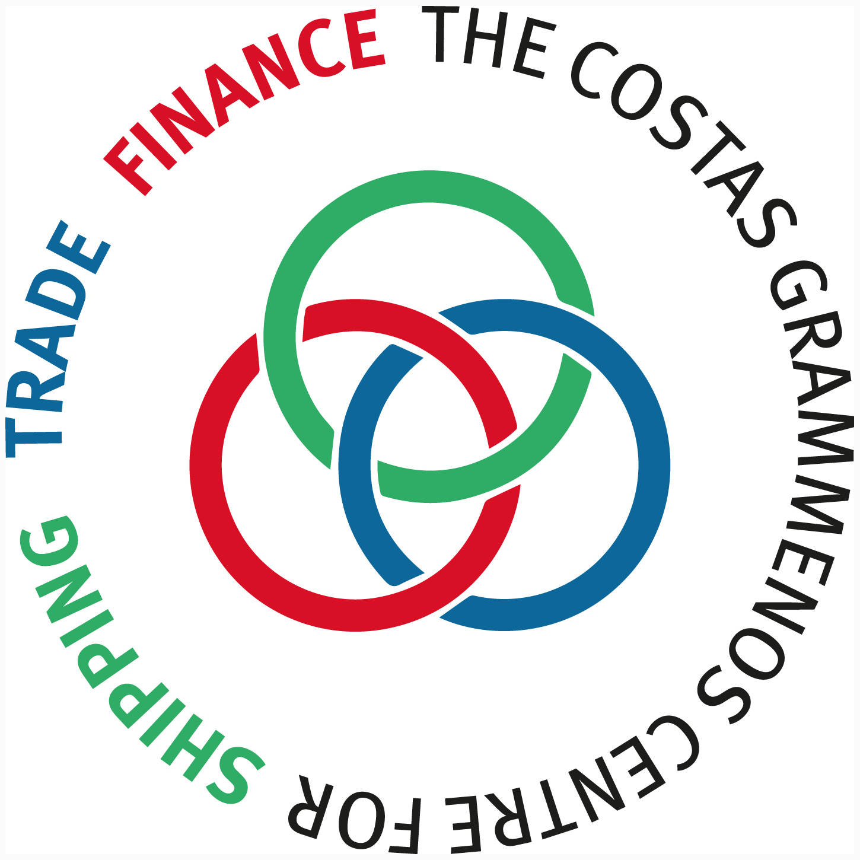
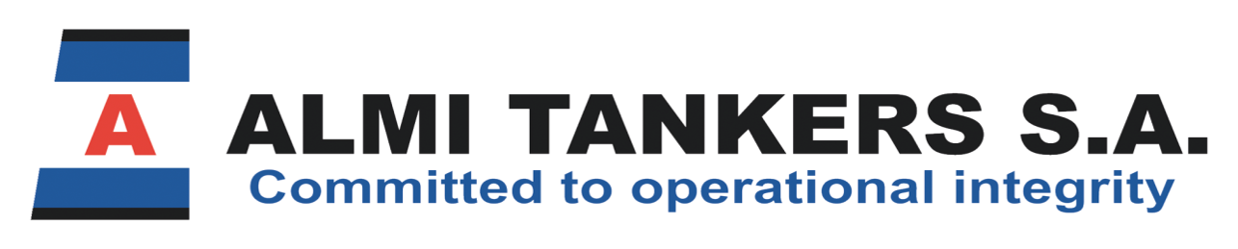
5th Athens Triennial Meeting
Building Trust & Partnerships with our Stakeholders:
The Advantages of a Robust ESG Culture
Michael Fostiropoulos
The Costas Grammenos Centre
for Shipping, Trade and Finance

Slide 2
What is ESG?
Environmental (environmental sustainability of the operations of a business and how to minimise one’s environmental footprint)
Social (from human rights to the treatment and well-being of employees, suppliers and customers)
Governance (how organisations are managed including risk management and business ethics)
Let’s define Culture as:
“The way we do things around here when no-one is watching”
ESG Culture – What do we mean?
A corporate culture sensitive to sustainability with initiatives supporting every one of its aspects: Environmental, Social, Governance.
The advent of the ESG-era calls for companies that were not set up with these aspects in mind, to develop a coherent ESG Strategy and adopt an ESG lens throughout their structure and operations, i.e. to identify, assess, prioritise, manage and publicly report on the progress of their related initiatives.

Slide 3
‘Stakeholder capitalism is driven by mutually beneficial relationships between companies and their employees, customers, suppliers and communities on which they rely to prosper. In today’s globally interconnected world, a company must create value for and be valued by its full range of stakeholders in order to deliver long term value for its shareholders. Make no mistake, the fair pursuit of profit is still what animates markets; and long-term profitability is the measure by which markets will ultimately determine your company’s success.’
Larry Fink, Chairman and CEO of BlackRock
Source: ‘How to integrate ESG into your organization’s DNA’ Andrea Barrack, Walid Hejazi and Susan McGeachie, Rotman Management Magazine, Spring 2024 Issue

Slide 4
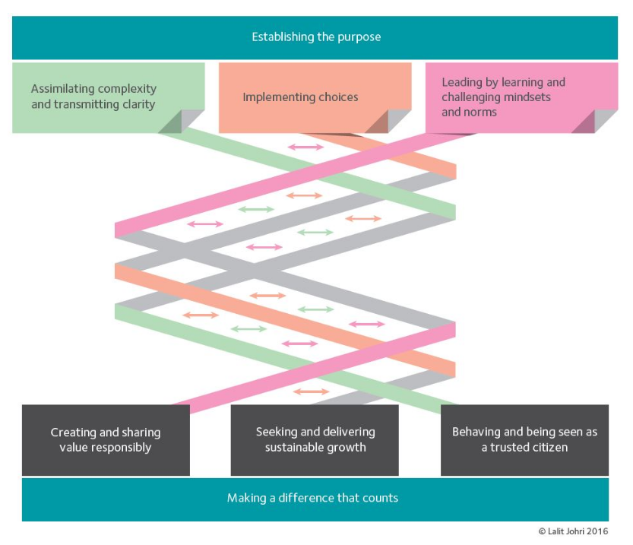
How do we link long term profitability with ESG initiatives?
Source: http://www.sbs.ox.ac.uk/programmes/execed/amlp/programme-content-and-structure

Slide 5
Stakeholders - including
Seafarers and office employees
Charterers
Banks and Investors
Insurers
Vendors/Suppliers
Flag States
Regulators
Worldwide ‘Local’ Community
The younger generations, the so-called Milenials and GenZs that are twice as likely to use an ESG lens when making their investment decisions. (Andrea Barrack, Walid Hejazi and Susan McGeachie)
Source: ‘How to integrate ESG into your organization’s DNA’, Andrea Barrack, Walid Hejazi and Susan McGeachie, Rotman Management Magazine, Spring 2024 Issue

Slide 6
Zero Incident – Trajectory
Zero Incident = Safety Excellence
Zero Incident Trajectory
Truly excellent safety organizations don't just get to zero; they know exactly how to duplicate and improve their success.
Strategy
Process Indicator
Zero
Culture
Source: Captain Anuj Gupta, Team Lead Operator Interface and Marine Advocacy, International Marine Transportation Ltd.
Notes:
S32 Sx9 Captain Anuj began by stressing the importance of developing a safety culture that will allow shipping companies to consistently repeat or duplicate their record of safety excellence. He pointed out that to achieve the goal of Zero Incidents we should stop just focusing on zero as a target because this can be interpreted in many different ways and instead focus on developing the corporate culture that will allow us to not just achieve zero incidents once but that will result in a consistently excellent safety record in the long run.
Notes by Captain Anuj:
“A newly hired safety professional asked the CEO of his organization what was expected of him and the answer he got was "excellence." When he asked the CEO to elaborate, the CEO replied, "When you get to zero accidents come back and see me."
It seems that the term "excellence," as it applies to safety, commonly is misunderstood and poorly defined. So, what is excellence in safety performance? Is it simply a vacuum in which there are no accidents? Is it a short-term success? How will we recognize it when we see it? How can we achieve it if we don't understand what it truly is?
First, it is important to realize that "zero accidents" or any improvement in accident frequency or severity is a lagging indicator of safety. It is a result and not the process that produces it. It can be achieved through excellent performance but it also can be achieved by luck or a normal variation in accident occurrence. It may even be accomplished by suppressing reporting through intimidation or artificial stimuli such as bonus and incentive programs. Also, since most organizations qualify the term to include a certain classification of accident such as "zero recordables" or "zero lost-time accidents," it can be manipulated in reporting practices and post-accident management.
There are three elements missing from many views of safety excellence that absolutely are critical to a true understanding and definition of the term: strategy, process indicators and culture.
Strategy – A definition of safety excellence that does not include the strategy to achieve it is a game without a game plan or a war without battle plans. Wanting to win is desirable, but victory without strategy is extremely rare.
Most organizations substitute goals or improvement targets for safety strategy. They define the desired results but not the process that will produce them. Underlying such thinking often is a naïve assumption that the current safety efforts are sufficient to produce excellence if utilized with more enthusiasm or motivation. The truth is, most safety efforts are producing a high percentage of what they ultimately are capable of achieving, and further improvement without better processes will be very limited.
Some organizations set improvement goals and buy off-the-shelf safety processes in hopes of achieving them. This can be an improvement over simply hoping to produce better results with no new processes. The thought is that the organization can continue current efforts and add another process to get even better results.
The most common problem with this approach goes back to the lack of an overall safety strategy. Exactly how will the new program or process supplement the existing efforts? Will it fill in a gap or create redundancy? Will it clarify or confuse the average employee trying to use it to improve safety? If the new program does not fit well into the overall safety strategy, it is uncertain how, or if, it will produce further improvements. Many organizations also put too much faith in the new program and feel they have purchased the magic solution to all their safety problems. Few new programs or processes are more than additional tools in the safety toolbox and disappoint those expecting magical results.
Process Indicators – Too much of safety is an attempt to manage with only lagging indicators. Many organizations attempt to develop leading indicators for safety in an effort to become more proactive. This direction toward more metrics generally is good, but limited. It is not simply more metrics, but better ones that we need.
Lagging indicators basically are "accountability" metrics. They tell us if we are doing better, worse or about the same. They do not tell us how to improve; this is the purpose of process indicators. If we have a strategy that involves process to produce results, we can measure how well we are working our processes, then determine if they are impacting the lagging indicators. In other words, we can measure if we are working our plan and measure whether or not our plan is working.
Excellence is not just about producing results; good process metrics can help us understand how good results are produced.
Culture – If approached correctly, a safety culture can be the sustainability tool of excellence. Culture not only influences its members' decisions and practices in the here and now, it impacts individual habits and the decisions and practices of future members as well. It truly can become "the way we do things around here" and "what we do when no one is watching." These common practices can be maintained through generations with little outside management necessary. However, without an overall safety strategy that is well understood by the culture and without process metrics to help the culture continuously measure and improve, most safety cultures fail to reach, much less sustain, excellent safety performance.
Many approaches to improving safety culture also focus on the characteristics of the culture rather than the capabilities. Excellent safety cultures are "can-do" cultures with the vision and tools to continuously improve. They have a strategy and metrics to keep them on track. They develop the characteristics of success as a by-product rather than a precursor of their performance
If your organization desires to achieve safety excellence, you must first develop a deep understanding of what excellence is. Deming called such an understanding "profound knowledge." It not only is a performance goal, but a definition of what excellence is and a process to achieve the goal. It also must have process metrics that facilitate understanding of how excellence is achieved. Excellence cannot be defined simply in terms of short-term results. The definition of excellence cannot inadvertently include results produced by luck and normal variation. Truly excellent safety organizations don't just get to zero; they know exactly how to duplicate and improve their success.”

Slide 7

Why invest in developing such a culture?
Peter Drucker

Slide 8
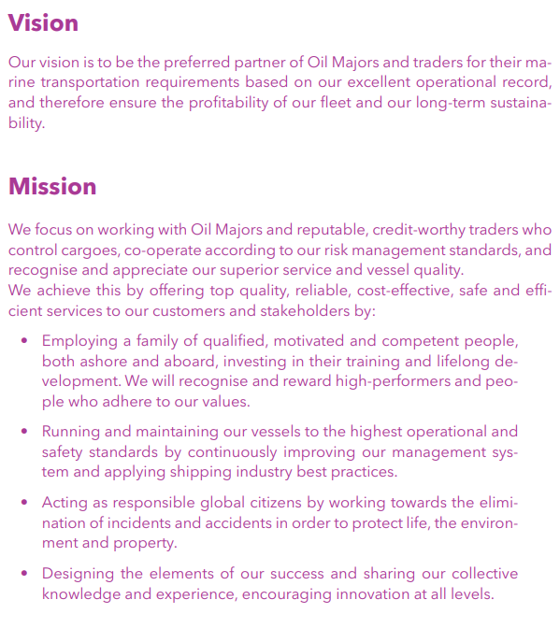
How to build such a culture?
Company’s Purpose
Company’s Vision and Mission
Aim to deliver above expectations
Values and Behaviours
Source: www.almitankers.gr

Slide 9
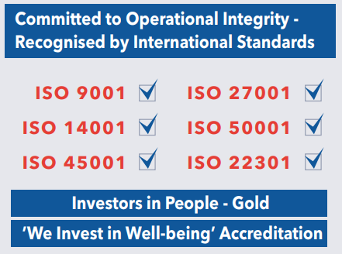
How to build such a culture?
Have a robust system and policies
in place regarding Safety
ISO Certifications:
  Quality Assurance
  Health & Safety at Work
  Environmental Management
  Energy Efficiency
  Cyber Security
  Business Continuity
Investors in People (IIP) Standard
‘We Invest in Well-being’ Accreditation
Source: www.almitankers.gr

Slide 10
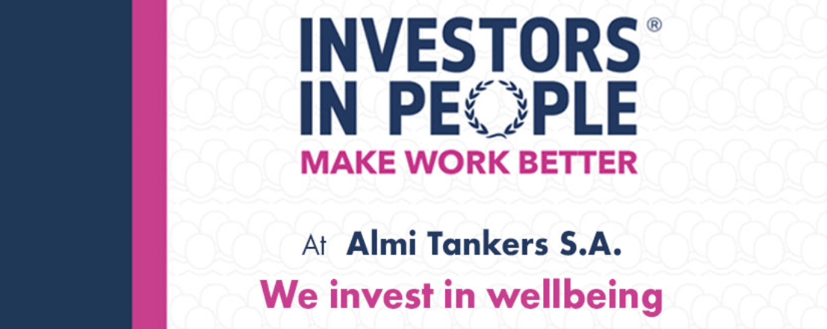
Almi Tankers gained the ‘Investors in People – We invest in Wellbeing’ accreditation following an assessment conducted in June 2023 by Investors in People International (IIP). As stated by Investors in People “Maintaining a healthy team is not only an ethical priority for organisations but has also been shown to reduce costs, sickness, accidents and absenteeism whilst improving profitability, turnover and staff personnel retention. We assess how the health & wellbeing of your organisation is performing against our employee wellbeing framework, and we advise and support you on how to improve over time. Our wellbeing framework will help you identify where you are at in your wellbeing journey; by looking into the areas of physical, social and psychological wellbeing.”
Source: www.almitankers.gr

Slide 11
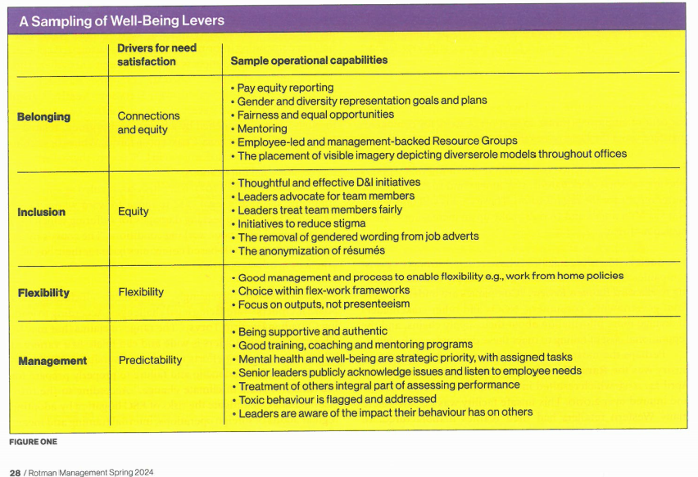
Source:’ How to integrate ESG into your organization’s DNA’, Andrea Barrack, Walid Hejazi and Susan McGeachie, Rotman Management Magazine, Spring 2024 Issue

Slide 12
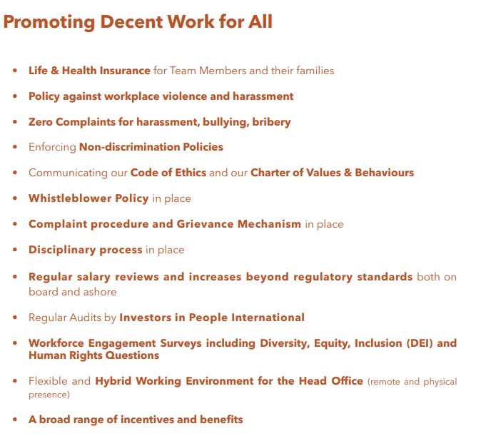
Source: www.almitankers.gr

Slide 13
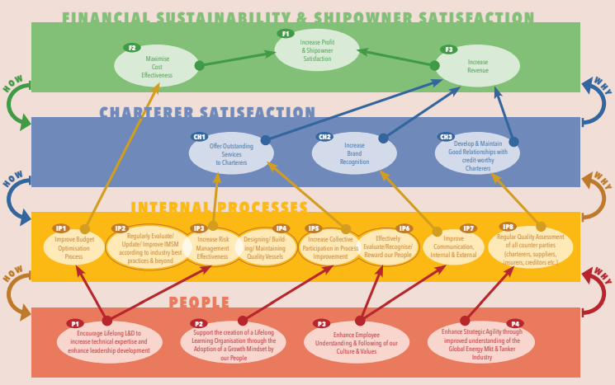
Executing our Strategy: The Balanced Scorecard
Source: www.almitankers.gr

Slide 14
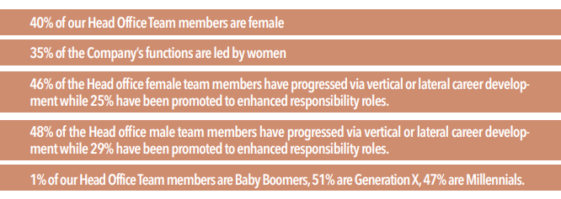
Drivers of a Robust ESG Culture
Proactively adopting mechanisms to minimise environmental impact
Leading with new technologies on board vessels
Designing Stricter Environmental Policies than Legislation
Promoting Good Health & Well-being
Collective Participation in Strategic Planning
Strengthening Global Partnerships for Sustainable Development
Bottom-up approach
Giving Back to the Community
Carefully Selecting Partners
Equal opportunity employer
Source: www.almitankers.gr

Slide 15
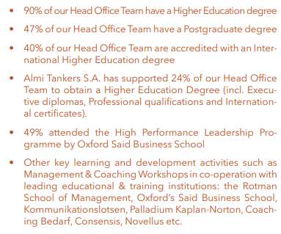
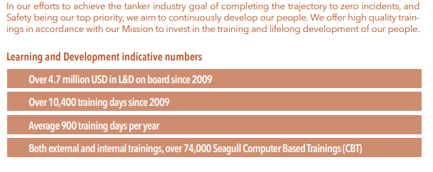
Helping our People Grow – Building a Lifelong Learning Organisation - We Invest in Knowledge
Ashore
Aboard
Navigational Skills Assessment Program (NSAP Ocean 1-2-3-4-5 for all Masters, Ocean Operational Level for our Junior Officers). The vision of the Navigation Skills Assessment Program (NSAP)® is to reduce catastrophic maritime incidents by addressing mariner competency and knowledge and use of technology.
Source: www.almitankers.gr

Slide 16
Advantages
Safety!
“Using data going back over four years, HiLo confirmed that Almi Tankers was found to have around 25% fewer high impact incidents than other tankers in the HiLo database. The company was found to perform exceedingly well especially in navigation, operating with vastly less risk in collisions, allisions, and groundings.”
HiLo is a risk management platform that helps ship operators proactively prevent incidents and accidents. It assesses companies’ operational data to understand where operators are most exposed to risk and compares company performance against anonymised data from 2,500 vessels to a 98% level of accuracy.
Source: www.almitankers.gr

Slide 17

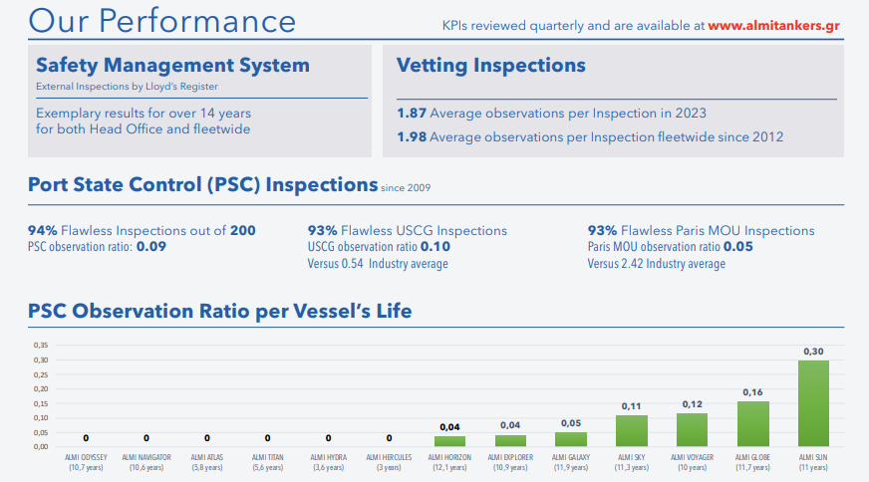
Performance
Source: www.almitankers.gr

Slide 18
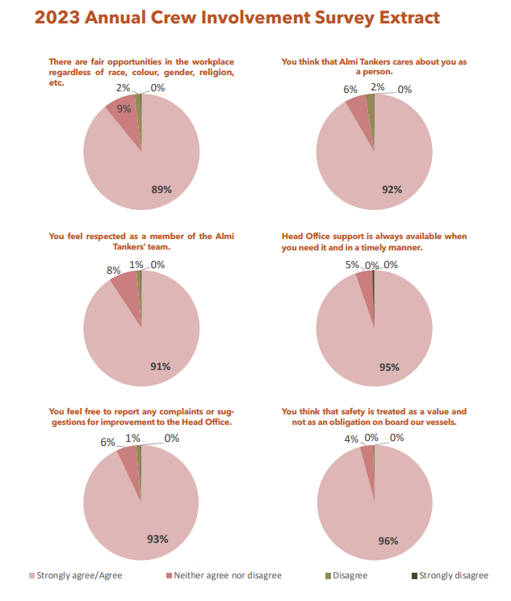
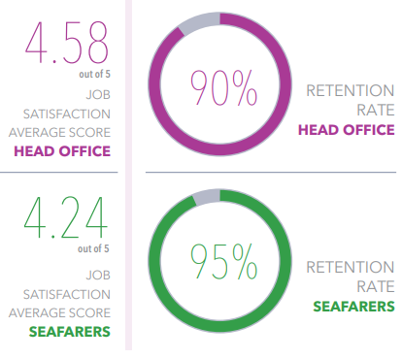
Advantages
Source: www.almitankers.gr

Slide 19
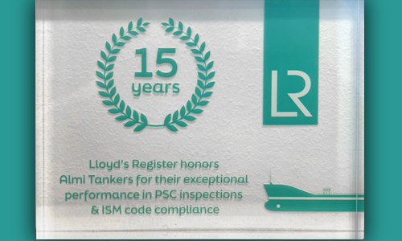

Co-operation with top charterers
Lower loan rates – Green loans
Lower insurance premiums
Acknowledgement by the industry
Minimising our Environmental Impact
Contributing to the UN Sustainability Goals
Source: www.almitankers.gr

Slide 20
Doughnut Economics by Kate Raworth
The essence of the Doughnut: a social foundation of well-being that no one should fall below and an ecological ceiling of planetary pressure that we should not go beyond. Between the two lies a safe and just space for all.
Source: ‘Doughnut Economics, Seven Ways to Think Like a 21st-Century Economist’, Kate Raworth, Cornerstone 2018

Slide 21
What are the 7 principles of Doughnut Economics?
1. Change the goal: The first principle highlights the need for humanity to shift the goal away from the relentless pursuit of economic growth measured as ‘GDP’, to one of meeting the needs of all within the means of the living planet. The goal should be the Doughnut, which represents the ‘safe and just space’ for humanity.
2. See the big picture: Principle two is about recognising that economies, societies, and the natural environment are interdependent systems. We need to take a step back and view the economy not as a self-contained system existing independently of the living world, but one that is embedded within society and the natural environment.
3. Nurture human nature: As the doughnut economics model places a ‘social foundation’ at the core of the inner ring, human values and needs are established as hugely important, rightly acknowledging them as a central focus to ensure that all of humanity can thrive.
4. Get savvy with systems: In another sustainable leadership blog, we highlighted how sustainability managers need decision-making skills to understand frameworks and solve issues. The fourth principle of doughnut economics proposes something similar. We must engage with doughnut economics to better understand different economic and environmental perspectives and make informed decisions.
5. Design to distribute: This principle recognises that inequality is a design failure and encourages us to design economies and societies to radically reduce inequalities. This means designing economies to be more distributive of value to those who help generate it and building a society which thrives on mutual benefit and accessibility for everyone.
6. Create to regenerate: Principle six is about harnessing the potential of regenerative design to reshape the harmful degenerative designs of past products and services into processes which give back. Through ‘create to regenerate’, new strategies that better support the planet can be developed and executed, with the goal of creating a circular, not linear, economy.
7. Be agnostic in terms of growth: The 7th and final principle of doughnut economics summarises the purpose of the model which is to shake off our addiction to economic growth and strive for growth in forms greater than monetary output, such as sustainable progress, environmental benefits, and wellbeing for all.
Source: ‘Doughnut Economics, Seven Ways to Think Like a 21st-Century Economist’,
Kate Raworth, Cornerstone 2018

Slide 22
Thank you
www.almitankers.gr

