Slide 1
Risk analysis in tokenization of life insurance
Chi-Tao Li, Tzuling Lin, Cary Chi-Liang Tsai

Slide 2
Research Background
Insurance market plays a vital role in the global economy.
Traditional insurance faces key issues:
  Lack of pricing transparency
  Low trust among participants
  Operational inefficiencies
Digital technologies are transforming the industry:
  Big Data, AI, Blockchain (Zhang et al., 2015; Treleaven et al., 2017)

Slide 3
Blockchain and P2P Insurance
Blockchain features:
  Decentralization, transparency, automated execution
Benefits:
  Fraud reduction, efficient claims, trust mechanisms
P2P Insurance:
  Shared risk, no central insurer, smart contracts

Slide 4
Challenges of Traditional Insurance
1. High premiums due to extra costs (commissions, admin, etc.)
2. Market power concentrated in insurers
  High-risk individuals excluded
3. Lack of transparency
  Trust issues among consumers

Slide 5
Research Motivation & Objectives
The decentralized P2P insurance model allows participants to share risks among themselves. Each participant acts as both insurer and insured.
Most existing studies have focused on risk-sharing rules under the sharing economy or the formation of P2P insurance contracts using blockchain technology.
Traditional P2P pricing lacks market responsiveness.
This study proposes market-based pricing:
  Prices reflect demand and participant behavior
  Aims for efficiency and adaptability

Slide 6
Literature Review--
Fundamentals of Blockchain
The concept of blockchain was first introduced in the 2008 Bitcoin white paper by Satoshi Nakamoto. The technology combines cryptography, consensus mechanisms, and decentralized networks.
Ethereum Buterin proposed in 2013 later introduced smart contracts, allowing for decentralized applications (DApps). Blockchain enhances transparency, security, and efficiency, especially in finance and insurance.
Consortium (federated) blockchains, a hybrid between public and private chains, allow specific participants to jointly maintain the network. These are suitable for multi-party cooperation, such as supply chain management or medical data sharing (O'Leary, 2017; Zhang and Lin, 2018).
Cosma and Rimo (2024) report that insurers can use smart contracts to automatically verify and pay claims, increasing efficiency and transparency. Combined with IoT devices, they enable real-time data collection and responsiveness.

Slide 7
Literature Review--
Current Landscape of P2P Insurance
Decentralized finance (DeFi) and blockchain enable trust, smart contract-based insurance. Moreover, the growth of the sharing economy further supports DeFi. Blockchain enables transactions in peer-to-peer (P2P) services (Mainelli and Smith, 2015).
P2P insurance was introduced by Friendsurance in 2010. It brings together individuals with similar insurance needs into a social network, where part of the premium is pooled.
Denuit and Robert (2021a) classify P2P insurance into:
1. Autonomous model: e.g., TongJuBao (China, 2015), where participants form a risk pool without insurers, directly sharing risks via civil contracts.
2.Carrier model: e.g., Lemonade (USA, 2015), where customers share group risks and receive refunds after risk settlement—similar to Taiwan’s participating policies.

Slide 8
Automated smart contracts handle policy issuance, ID verification, claims, and dispute resolution, enhancing efficiency and lowering third-party costs (Tasca, 2019).
Blockchain also enables dynamic pricing. Smart contracts linked to external data or IoT can adjust premiums in real time based on risk and demand (Liu et al., 2019).
Real World Assets (RWAs) like real estate, invoices, or vehicles can be tokenized on-chain for insurance purposes. These can serve as collateral, reduce moral hazard, and enhance liquidity. For instance, IoT devices can stream weather or crop data on-chain in agricultural insurance for real-time risk assessment (Xiong et al. (2020)). Even insurance policies themselves can be tokenized for reinsurance or securitization.
Overall, blockchain fosters innovation in product design, underwriting, and claims. It boosts transparency and efficiency (Popovic et al. (2020), and Cosma and Rimo (2024)).

Slide 9
Literature Review--
Market-Based Pricing in Insurance
Traditional insurance pricing is actuarial, slow to adapt to market changes. Studies suggest dynamic pricing based on demand can improve efficiency.
Emms (2008) built a non-life pricing model incorporating randomness in average premiums and exposure size and compared dynamic and deterministic strategies.
Mourdoukoutas et al. (2021) used game theory to derive optimal nonlife insurance premiums in competitive markets and analyzed how stochastic policy counts and claims affect pricing.
Blockchain can support such systems by allowing real-time, transparent premium adjustments. Our study proposes a model incorporating demand variability with a linear relationship to premium levels for better responsiveness.

Slide 10

Methodology—Claim Model
The initial premium for a simple one-year term life insurance policy is defined as $P_{0}=a∙q∙v$, where the claim payment is $a$ and the death probability is $q$; hereafter, for simplicity, we set $v=1$.
For each participant i, the claim payment $w_{i}$ is a random variable, such that:
The total claim amount for N participants is given by:

Slide 11
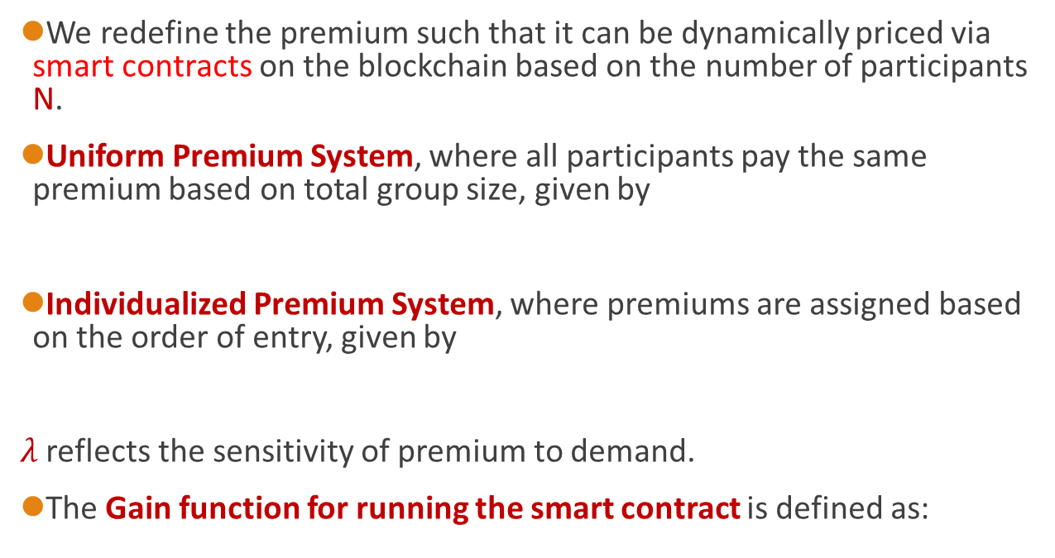
Methodology—Market-Based Premium
We redefine the premium such that it can be dynamically priced via smart contracts on the blockchain based on the number of participants N.
Uniform Premium System, where all participants pay the same premium based on total group size, given by
Individualized Premium System, where premiums are assigned based on the order of entry, given by
$λ$ reflects the sensitivity of premium to demand.
The Gain function for running the smart contract is defined as:

Slide 13
Theoretical Analysis
We adopt two premium systems for analysis. The first is the Uniform Premium System, where a unified premium is set based on the total number of participants willing to join the insurance plan. The second is the Individualized Premium System, which assigns premiums according to the order of enrollment—early entrants enjoy lower premiums, while those who join later must pay higher premiums.

Slide 14
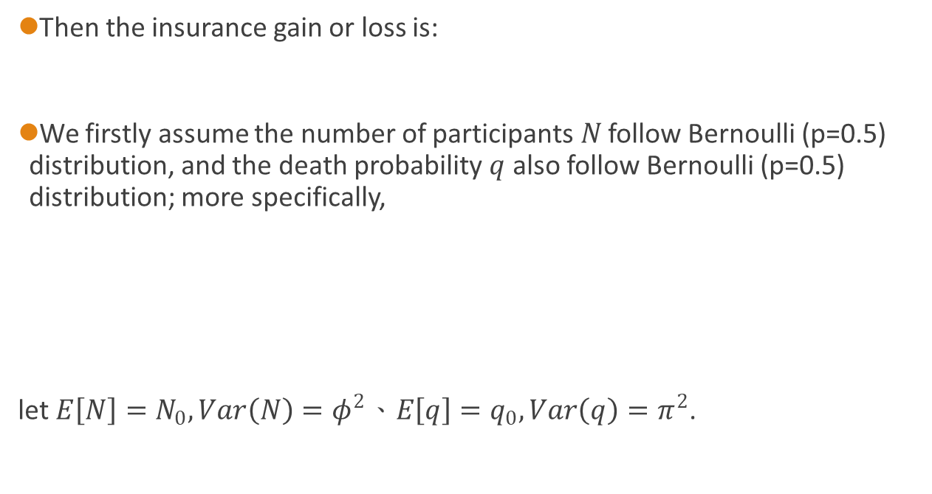
Theoretical Analysis
Uniform Premium System
Then the insurance gain or loss is:
We firstly assume the number of participants$N$ follow Bernoulli (p=0.5) distribution, and the death probability $q$ also follow Bernoulli (p=0.5) distribution; more specifically,
let $E\left[N\right]=N_{0}, Var\left(N\right)=φ^{2}、E\left[q\right]=q_{0}, Var\left(q\right)=π^{2}$.

Slide 16

Then assume that N and q are continuous random variables with$E\left[N\right]=N_{0},Var\left(N\right)=σ_{N}^{2}, E\left[q\right]=q_{0}$和$Var\left(q\right)=σ_{q}^{2}$ and the central moments $E{\left[(X−E[X]\right)}^{k})=μ_{k,X}$, we obtain the following proposition.

Slide 17

Assume $N\sim N(N_{0}, σ_{N}^{2}) and q\sim N(q_{0}, σ_{q}^{2})$, and using the properties $μ_{3}=0 and μ_{4}=$3$σ^{4}$, we obtain the following corollary.
Assume $ln(N)\sim N(N_{0}, σ_{N}^{2}) and ln(q)\sim N(q_{0}, σ_{q}^{2})$, we obtain the following corollary.

Slide 18

Theoretical Analysis
Individualized Premium System
Insurance gain is then:
Then assume that N and q are continuous random variables with $E\left[N\right]=N_{0},Var\left(N\right)=σ_{N}^{2}, E\left[q\right]=q_{0}, Var\left(q\right)=σ_{q}^{2}$, and the central moments $E{\left[(X−E[X]\right)}^{k}]=μ_{k,X}$, we obtain the following proposition:

Slide 20
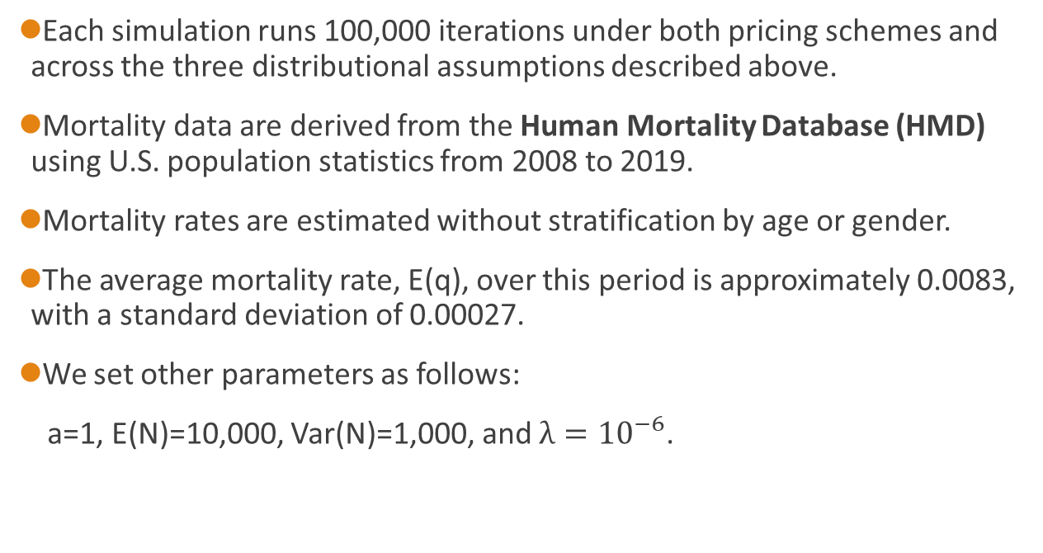
Numerical Illustration and Analyses
Each simulation runs 100,000 iterations under both pricing schemes and across the three distributional assumptions described above.
Mortality data are derived from the Human Mortality Database (HMD) using U.S. population statistics from 2008 to 2019.
Mortality rates are estimated without stratification by age or gender.
The average mortality rate, E(q), over this period is approximately 0.0083, with a standard deviation of 0.00027.
We set other parameters as follows:
a=1, E(N)=10,000, Var(N)=1,000, and $λ={10}^{−6}$.

Slide 21
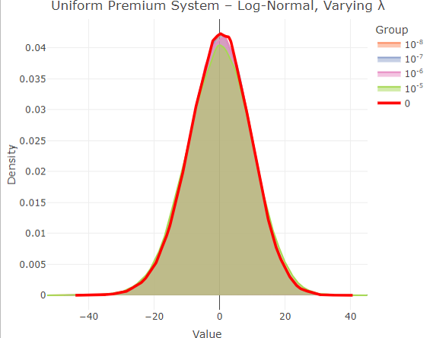
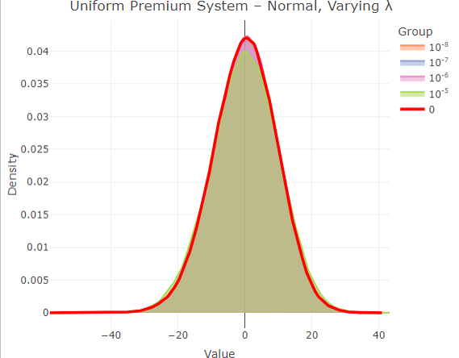
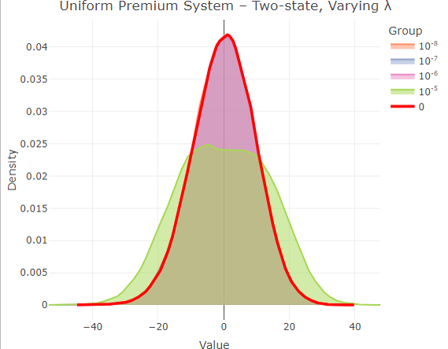
Gain distribution under Uniform Premium System for
three assumptional distributions--log-normal (top-left), Normal (top-right), Bernoulli (bottom)
High price sensitivity produces high risk,
especially in Bernoulli assumption.

Slide 22
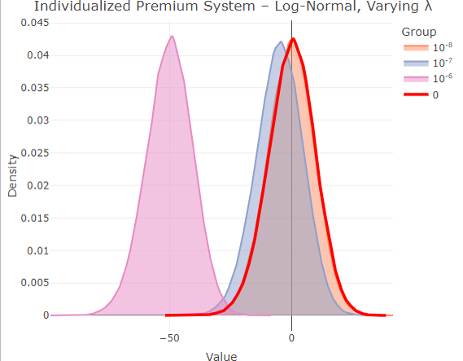
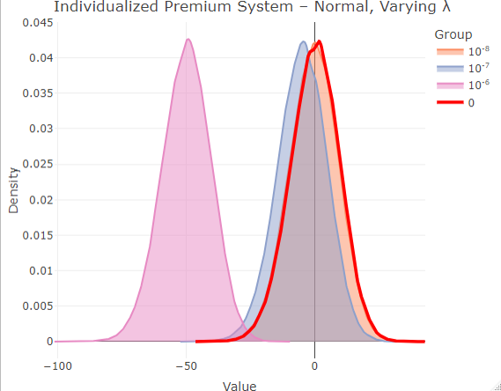

Gain distribution under Individualized Premium System for three assumptional
distributions--log-normal (top-left), Normal (top-right), Bernoulli (bottom)
High price sensitivity deteriorates the financial stability because early participants pay much lower premiums.

Slide 23
In summary, λ plays a critical role in shaping the distribution and risk profile of Gain.
In individualized premium, high λ can significantly deteriorate system stability by reducing average premiums in early stages, especially in high-variance or elastic markets.
Without minimum premium constraints or policy-level safeguards, this system becomes increasingly fragile under aggressive dynamic pricing.

Slide 24
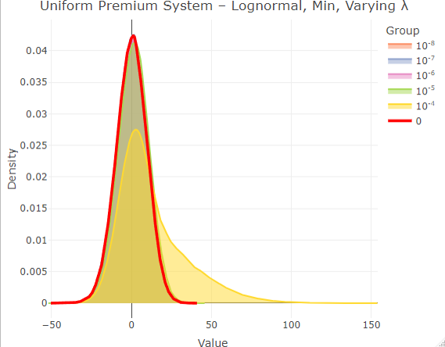
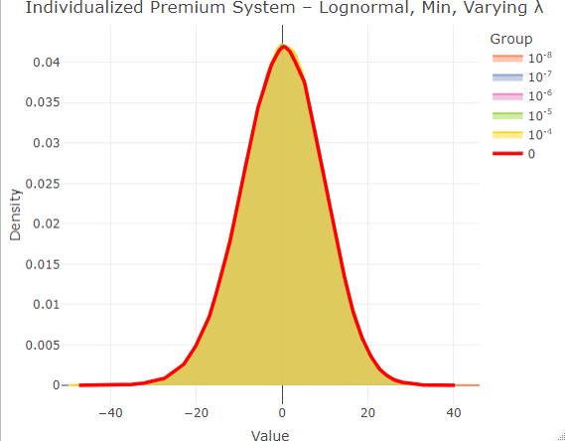
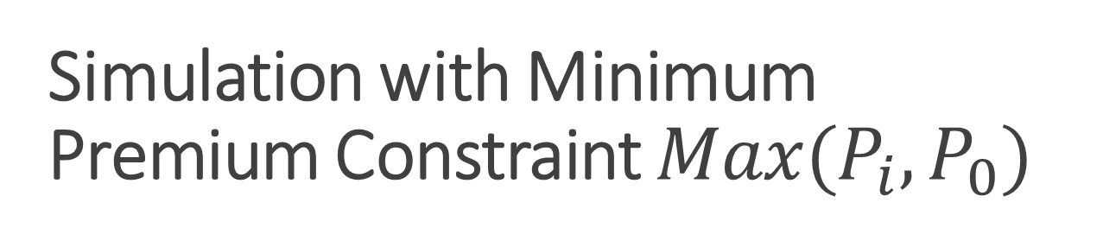
Simulation with Minimum Premium Constraint $Max(P_{i},P_{0})$
In the uniform premium (Left), low λ values result in a symmetric, tightly centered Gain
distribution. As λ increases, the Gain distribution becomes right-skewed with a longer
tail, reflecting upward premium adjustments when demand significantly exceeds expectations.
In the individualized premium (Right), the Gain distributions remain tightly clustered across
all λ values. Compared to the unconstrained case, the introduction of the constraint noticeably
avoids the leftward shift seen in earlier simulations. This indicates improved risk control
and price stability.

Slide 25
The simulation results confirm that λ is a critical parameter in dynamic pricing.
While modest price sensitivity can enhance responsiveness and balance, overly large λ values—particularly under individualized premium—can drive the system toward financial instability.
Introducing a minimum premium floor effectively mitigates the risk of extreme losses and improves resilience, especially in elastic or volatile market environments.

Slide 26
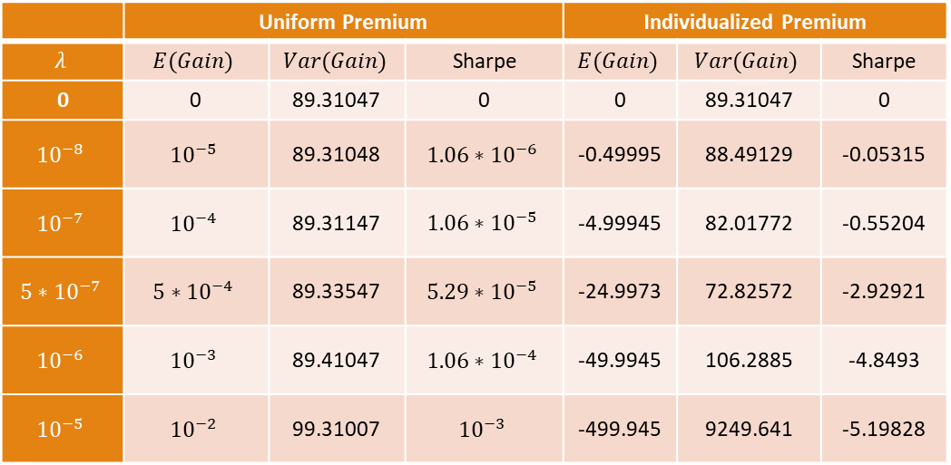

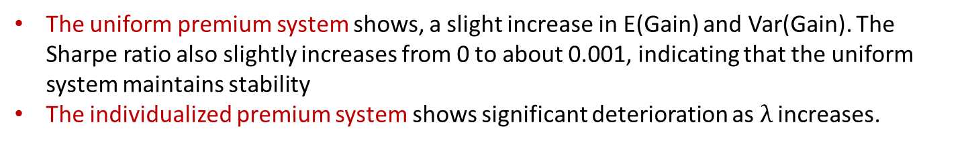
Sensitivity Analysis
Table 1: Sensitivity Analysis of $λ$
 | Uniform Premium |  |  | Individualized Premium
$$λ$$ | $$E(Gain)$$ | $$Var(Gain)$$ | Sharpe | $$E(Gain)$$ | $$Var(Gain)$$ | Sharpe
0 | 0 | 89.31047 | 0 | 0 | 89.31047 | 0
$${10}^{−8}$$ | $${10}^{−5}$$ | 89.31048 | $$1.06∗{10}^{−6}$$ | -0.49995 | 88.49129 | -0.05315
$${10}^{−7}$$ | $${10}^{−4}$$ | 89.31147 | $$1.06∗{10}^{−5}$$ | -4.99945 | 82.01772 | -0.55204
$$5∗{10}^{−7}$$ | $$5∗{10}^{−4}$$ | 89.33547 | $$5.29∗{10}^{−5}$$ | -24.9973 | 72.82572 | -2.92921
$${10}^{−6}$$ | $${10}^{−3}$$ | 89.41047 | $$1.06∗{10}^{−4}$$ | -49.9945 | 106.2885 | -4.8493
$${10}^{−5}$$ | $${10}^{−2}$$ | 99.31007 | $${10}^{−3}$$ | -499.945 | 9249.641 | -5.19828
The uniform premium system shows, a slight increase in E(Gain) and Var(Gain). The Sharpe ratio also slightly increases from 0 to about 0.001, indicating that the uniform system maintains stability
The individualized premium system shows significant deterioration as $λ$ increases.

Slide 27
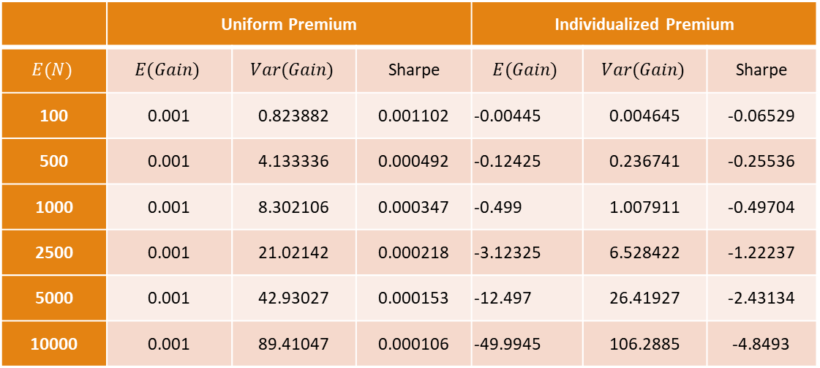

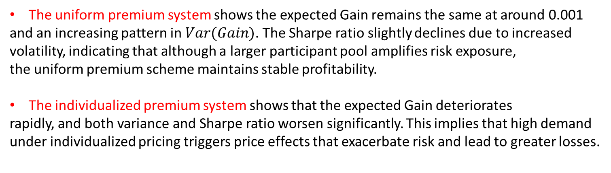
Table 2: Sensitivity Analysis of $E(N)$
 | Uniform Premium |  |  | Individualized Premium
$$E(N)$$ | $$E(Gain)$$ | $$Var(Gain)$$ | Sharpe | $$E(Gain)$$ | $$Var(Gain)$$ | Sharpe
100 | 0.001 | 0.823882 | 0.001102 | -0.00445 | 0.004645 | -0.06529
500 | 0.001 | 4.133336 | 0.000492 | -0.12425 | 0.236741 | -0.25536
1000 | 0.001 | 8.302106 | 0.000347 | -0.499 | 1.007911 | -0.49704
2500 | 0.001 | 21.02142 | 0.000218 | -3.12325 | 6.528422 | -1.22237
5000 | 0.001 | 42.93027 | 0.000153 | -12.497 | 26.41927 | -2.43134
10000 | 0.001 | 89.41047 | 0.000106 | -49.9945 | 106.2885 | -4.8493
The uniform premium system shows the expected Gain remains the same at around 0.001
and an increasing pattern in $Var(Gain)$. The Sharpe ratio slightly declines due to increased
volatility, indicating that although a larger participant pool amplifies risk exposure,
the uniform premium scheme maintains stable profitability.
The individualized premium system shows that the expected Gain deteriorates
rapidly, and both variance and Sharpe ratio worsen significantly. This implies that high demand
under individualized pricing triggers price effects that exacerbate risk and lead to greater losses.

Slide 28
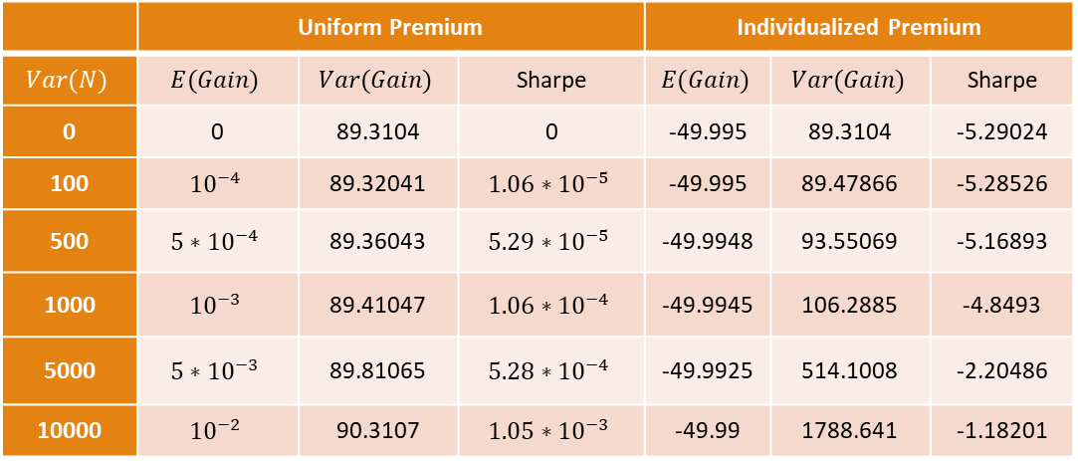

Table 3: Sensitivity Analysis of $Var(N)$
 | Uniform Premium |  |  | Individualized Premium
$$Var(N)$$ | $$E(Gain)$$ | $$Var(Gain)$$ | Sharpe | $$E(Gain)$$ | $$Var(Gain)$$ | Sharpe
0 | 0 | 89.3104 | 0 | -49.995 | 89.3104 | -5.29024
100 | $${10}^{−4}$$ | 89.32041 | $$1.06∗{10}^{−5}$$ | -49.995 | 89.47866 | -5.28526
500 | $$5∗{10}^{−4}$$ | 89.36043 | $$5.29∗{10}^{−5}$$ | -49.9948 | 93.55069 | -5.16893
1000 | $${10}^{−3}$$ | 89.41047 | $$1.06∗{10}^{−4}$$ | -49.9945 | 106.2885 | -4.8493
5000 | $$5∗{10}^{−3}$$ | 89.81065 | $$5.28∗{10}^{−4}$$ | -49.9925 | 514.1008 | -2.20486
10000 | $${10}^{−2}$$ | 90.3107 | $$1.05∗{10}^{−3}$$ | -49.99 | 1788.641 | -1.18201
Under the uniform premium system, the Gain variance remains stable, while the Sharpe
ratio and the expected Gain increases, the overall impact remains limited, suggesting that this
system has a certain degree of resilience to demand uncertainty.
The individualized premium system, although showing a nearly unchanged
expected Gain, displays extreme fluctuations in variance and Sharpe ratio. This reflects
continued vulnerability and persistent negative returns, emphasizing the system’s instability
in the face of uncertain demand.

Slide 29


Table 4: Sensitivity Analysis of $E(q)$
 | Uniform Premium |  |  | Individualized Premium
$$E(q)$$ | $$E(Gain)$$ | $$Var(Gain)$$ | Sharpe | $$E(Gain)$$ | $$Var(Gain)$$ | Sharpe
$${10}^{−4}$$ | 0.001 | 8.099266 | $$3.51∗{10}^{−4}$$ | -49.9945 | 25.04453 | -9.99001
$$5∗{10}^{−4}$$ | 0.001 | 12.09687 | $$2.88∗{10}^{−4}$$ | -49.9945 | 29.03573 | -9.27803
$${10}^{−3}$$ | 0.001 | 17.08937 | $$2.42∗{10}^{−4}$$ | -49.9945 | 34.02067 | -8.57138
$$5∗{10}^{−3}$$ | 0.001 | 56.84937 | $$1.33∗{10}^{−4}$$ | -49.9945 | 73.73827 | -5.82205
$$8∗{10}^{−3}$$ | 0.001 | 86.45937 | $$1.08∗{10}^{−4}$$ | -49.9945 | 103.3375 | -4.91805
$${10}^{−2}$$ | 0.001 | 106.0994 | $$9.71∗{10}^{−5}$$ | -49.9945 | 122.9803 | -4.50821
The uniform premium system maintains a stable expected Gain, showing strong resistance
to increasing mortality risk. However, the variance of Gain rises significantly, and the Sharpe
ratio declines accordingly, indicating erosion in risk-adjusted returns.
Under the individualized premium system, E(Gain) consistently remains the same, with Gain
variance increasing significantly. Despite slight improvements in the Sharpe ratio, values
remain negative, suggesting that even though price increases are triggered by higher
mortality rates, they are insufficient to offset the associated losses.

Slide 30
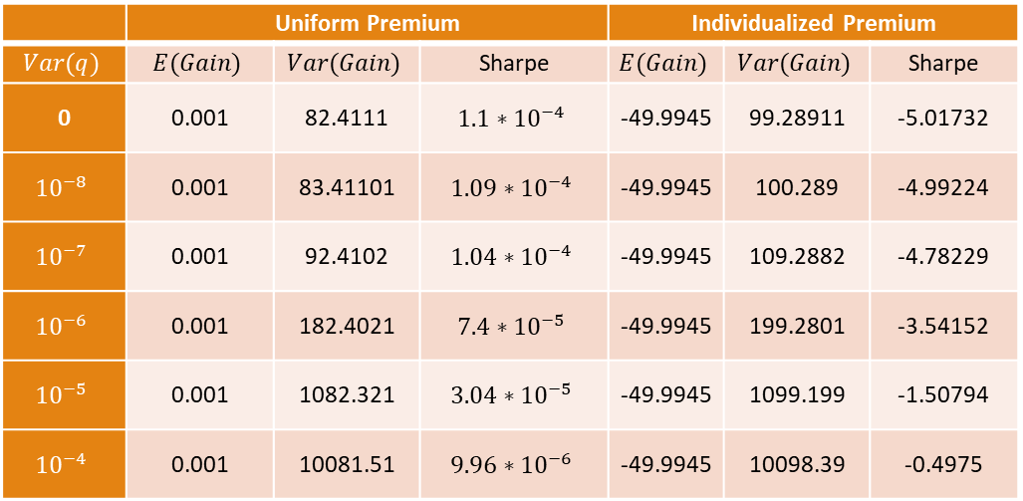

Table 5: Sensitivity Analysis of $Var(q)$
 | Uniform Premium |  |  | Individualized Premium
$$Var(q)$$ | $$E(Gain)$$ | $$Var(Gain)$$ | Sharpe | $$E(Gain)$$ | $$Var(Gain)$$ | Sharpe
0 | 0.001 | 82.4111 | $$1.1∗{10}^{−4}$$ | -49.9945 | 99.28911 | -5.01732
$${10}^{−8}$$ | 0.001 | 83.41101 | $$1.09∗{10}^{−4}$$ | -49.9945 | 100.289 | -4.99224
$${10}^{−7}$$ | 0.001 | 92.4102 | $$1.04∗{10}^{−4}$$ | -49.9945 | 109.2882 | -4.78229
$${10}^{−6}$$ | 0.001 | 182.4021 | $$7.4∗{10}^{−5}$$ | -49.9945 | 199.2801 | -3.54152
$${10}^{−5}$$ | 0.001 | 1082.321 | $$3.04∗{10}^{−5}$$ | -49.9945 | 1099.199 | -1.50794
$${10}^{−4}$$ | 0.001 | 10081.51 | $$9.96∗{10}^{−6}$$ | -49.9945 | 10098.39 | -0.4975
Increasing Var(q) causes the Gain variance in the uniform premium scheme to surge a lot, and
the Sharpe ratio to decrease a lot. While the expected Gain stays stable at 0.001, the rising
volatility significantly undermines the system’s risk-return efficiency.
For the individualized premium system, E(Gain) remains fixed at -49.995, while variance climbs
from 99.22 to 10,098.39 and the Sharpe ratio drops from -5.017 to -0.4975.

Slide 31
In summary, both demand-related parameters N (including its expectation and variance) and mortality-related parameters q (expectation and uncertainty) have meaningful influence on insurance profitability.
The uniform premium system exhibits stability in expected Gain, indicating its advantage in risk pooling and profit consistency. However, its variance is still highly responsive to demand and mortality risks, which leads to deterioration in Sharpe ratios and exposes the system to volatility under extreme conditions.
The individualized premium system consistently yields structural losses in all sensitivity tests. Nonetheless, it demonstrates dynamic pricing responsiveness.

Slide 32
Conclusion
This study investigates the risks and implications of implementing a market-based premium pricing mechanism in a blockchain-enabled P2P insurance model.
Uniform Premium System: Demonstrates greater financial stability under moderate price sensitivity. Expected gains remain stable, and the system shows some resilience even when sensitivity increases.
Individualized Premium System: Provides fairness by reflecting entry order but suffers from financial instability under high sensitivity—early participants pay too little, leading to insufficient premium collection and poor shock resistance.
To mitigate these issues, a minimum premium constraint is introduced. In the uniform system, it significantly improves performance under extreme market changes. In the individualized system, only limited improvements are observed, with structural vulnerabilities remaining.
The price sensitivity parameter (λ) is identified as a crucial determinant of system robustness. While higher λ enhances responsiveness to market signals, it also increases volatility and risk, especially when participant numbers and mortality rates are uncertain.

Slide 33
Thank you for your attention!!

