Slide 1


Extension, Compression, and Beyond
A Unique Classification System for Mortality Evolution Patterns
September, 8th 2015
Martin Genz
Joint work with Matthias Börger and Jochen Ruß
Institute for Finance and Actuarial Sciences and University of Ulm, Germany

Slide 2
Agenda
Key question
Classification of mortality evolutions in the past
  Shortcomings
A new classification framework
  Requirements
  Details
  Application
  Summary

Slide 3
Key question
  Life expectancy increases in many countries.
  But changes in life expectancy (and other typically used statistics) are only a consequence of the underlying change of the age distribution of deaths.
  Key question: How does the shape of these curves change over time?

Slide 4
Classification of mortality evolutions in the past
Shortcomings
  There exists a variety of literature on the question how the age distribution of deaths changes over time. We have identified some shortcomings there:
    Different notions for certain observations have been established but often these scenarios were defined imprecisely, e.g.:
      compression (≈ vertical deformation of the deaths curve)
      extension (≈ horizontal deformation of the deaths curve)
      rectangularization (≈ survival curve becomes more and more rectangular)
      …
    Some of these scenarios were supposed to be mutually exclusive, but there are counterexamples.
    Several often used statistics are insufficient or even misleading.
    Often effects caused by the choice of a certain age range under observation were not considered.
  In our paper, we give some examples for each of these shortcomings.

Slide 5
Classification of mortality evolutions in the past
Shortcomings
  Imprecise scenario definitions:
    E.g., rectangularization is defined by a final state.

Slide 6
Classification of mortality evolutions in the past
Shortcomings
  Exclusiveness of scenarios:
    E.g., compression and shifting mortality are assumed to be opposing scenarios.
    Neither compression nor shifting mortality prevail.
Compression and shifting mortality coexist.

Slide 7
Classification of mortality evolutions in the past
Shortcomings
  Insufficient or misleading statistics:
    Example 1: compression cannot always be detected by an exclusive analysis of M and SD(M+).
    Example 2: compression cannot always be detected with IQR
IQR constant

Slide 8
Classification of mortality evolutions in the past
Shortcomings
  The choice of the age range matters:
    The age range should be chosen depending on the question at hand.
s(65)=1
compression into the higher ages
no compr. within the higher ages

Slide 9
A new classification framework
Requirements
In light of these shortcomings of previous approaches, we postulate that a new classification system should…
  … capture every observed mortality evolution,
  … allow for mixed scenarios,
  … be applicable to different age ranges,
  … build on statistics that can be feasibly calculated and easily interpreted,
  … be extendable by additional components if needed.
Our new approach:
  We use the deaths curve as basis for the framework.
  We define 4 characteristics of the deaths curve for a unique classification of observed mortality evolutions.

Slide 10
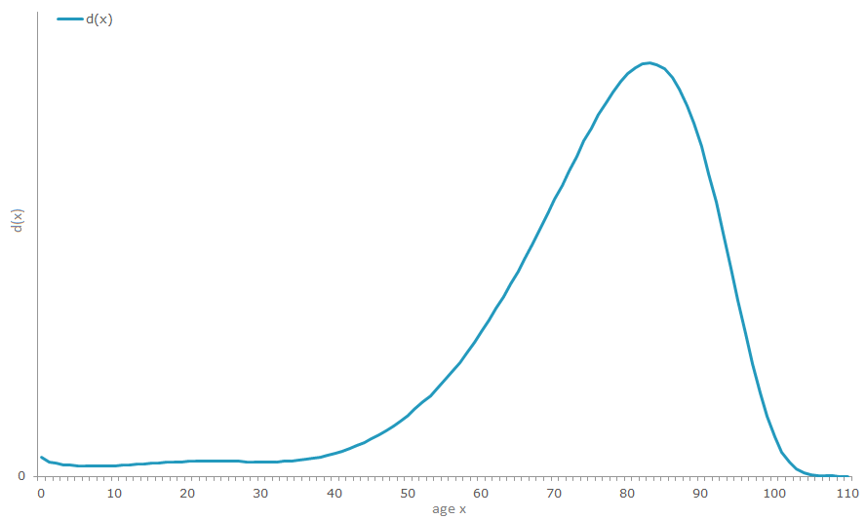
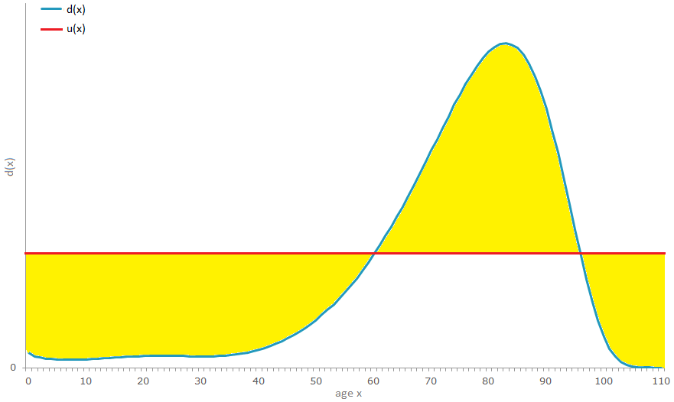
A new classification framework
Details
number of deaths in the modal age at death d(M):
concentration or diffusion
upper bound of the death curve’s support UB:
extension or contraction
degree of inequality DoI:
compression or decompression
modal age at death M:
right or left shift

Slide 11
A new classification framework
Details
Each scenario is defined by a 4-dimensional vector where each component can have three specifications:
  This allows for 3⁴=81 different scenarios (some of which might not be relevant in practice)
  The framework satisfies the requirements:
    Each observed mortality evolution can uniquely be classified in one of those scenarios.
    Pure and mixed scenarios are included.
    The framework can be applied to age ranges starting at any given age up to UB.
    Feasible and easily interpretable statistics are used.
    The framework is extendable by additional statistics if needed.
  In the paper, we discuss different issues in estimating these statistics, e.g. how to estimate UB.
component | attainable states
M | right shift / neutral / left shift
UB | extension / neutral / contraction
DoI | compression / neutral / decompression
d(M) | concentration / neutral / diffusion

Slide 12
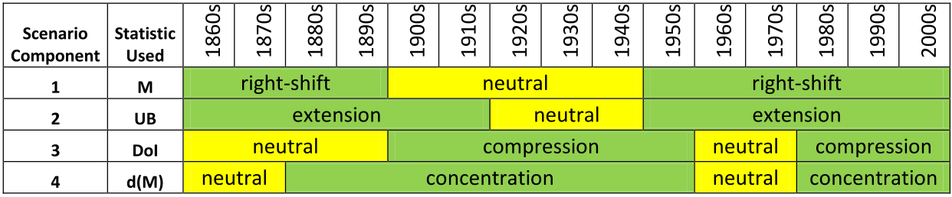
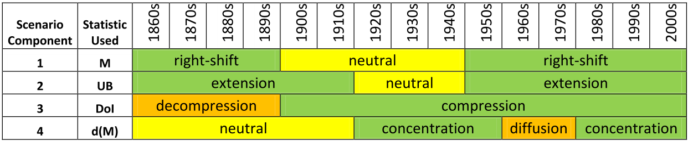
A new classification framework
Example
Application: The mortality evolution of Swedish females
age range 10 to UB:
  Each component of the vector develops independently from the others (no redundant information).
  We observe mixed scenarios (rather the rule than an exception).
age range 60 to UB:
  We observe different scenarios for different age ranges (age range matters).
In the paper, we analyze this application in more detail.

Slide 13
Summary
In the paper, we have…
  … identified shortcomings of previous approaches for classification of mortality scenarios,
  … derived requirements for a new framework,
  … identified 4 central characteristics of the deaths curve,
  … derived a new classification framework based on these characteristics, which
    … builds on clear scenario definitions,
    … provides a unique classification for each mortality evolution,
    … allows for mixed scenarios,
    … is applicable for different age ranges,
  … applied the framework to concrete data.

Slide 14

Thank you for your attention!
Martin Genz (M.Sc.)
  +49 (731) 20 644-264
  m.genz@ifa-ulm.de

