Slide 1
Longevity
The dark side
Sam Gutterman, FSA, FCAS, MAAA, HonFIA
Longevity 12 – Chicago, September 29-30, 2016

Slide 2
Longevity – the dark side
Recent U.S. experience
Factors to consider, focusing on the effects of human behavior and differences between population segments

Slide 3
Recent U.S. mortality experience
Age-adjusted rates |  |  | Heart |  | Chronic Lower | Accidents +
 |  | All causes | Diseases | Cancers | Respiratory | Suicides | Other
 | 2015 | 728.0 | 167.2 | 157.4 | 41.3 | 55.4 | 306.7
 | 2014 | 724.6 | 167.0 | 161.2 | 40.5 | 53.5 | 302.4
 | 2013 | 731.9 | 169.8 | 163.2 | 42.1 | 52.0 | 304.8
 | 2012 | 732.8 | 170.5 | 166.5 | 41.5 | 51.7 | 302.6
 | 2011 | 741.3 | 173.7 | 169.0 | 42.5 | 51.4 | 304.7
 | 2010 | 747.0 | 179.1 | 172.8 | 42.2 | 50.1 | 302.8
 | 2009 | 749.6 | 182.8 | 173.5 | 42.7 | 49.3 | 301.3
 | 2008 | 774.9 | 192.1 | 176.4 | 44.7 | 50.8 | 310.9
 | 2007 | 775.3 | 196.1 | 179.3 | 41.4 | 51.7 | 306.8
 | 2006 | 791.8 | 205.5 | 181.8 | 41.0 | 51.2 | 312.3
 | 2005 | 815.0 | 216.8 | 185.1 | 43.9 | 50.4 | 318.8
 | 2004 | 813.7 | 221.6 | 186.8 | 41.6 | 49.1 | 314.6
 | 2003 | 843.5 | 236.3 | 190.9 | 43.7 | 48.4 | 324.2
 | 2002 | 855.9 | 244.6 | 194.3 | 43.9 | 48.0 | 325.1
 | 2001 | 858.8 | 249.5 | 196.5 | 43.9 | 46.4 | 322.5
 | 2000 | 869.0 | 257.6 | 199.6 | 44.2 | 45.3 | 322.3
Average improvement
2012-15/2008-11 |  | 0.81% | 1.92% | 1.63% | 1.00% | -1.32% | 0.07%
2008-11/2004-07 |  | 1.49% | 3.65% | 1.46% | -0.62% | 0.10% | 0.67%
2004-07/2000-03 |  | 1.76% | 4.14% | 1.61% | 1.14% | -1.82% | 0.82%
Source: NVSR “Deaths: Final Data for 2014” and Rapid Release for 2015
Rate of improvement has recently been in decline overall
  Especially for cardiovascular diseases, the main driver of mortality improvement over the last half century
  Some areas of mortality deterioration or stabilization

Slide 4
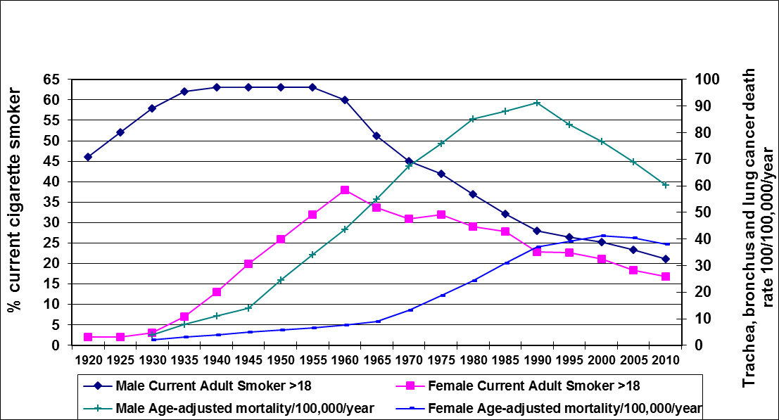
Decrease in smoking prevalence
Decrease in smoking for males over the last 60 years – a significant factor in the reduction in U.S. mortality over the last 25 years
  Although this should continue for one or more decades, its effect will diminish and reduce mortality improvement
The effect of the decrease in smoking for females on their mortality is just recently been observed.
  Although this should continue for awhile, because of lower prevalence, this effect should taper in 20 or 30 years

Slide 5
Obesity – delayed effect
Increase in adult and childhood obesity over last 40 years is well documented – now up to 35.7% for U.S. adults
Although obesity mortality paradox has arisen in certain areas where the effect of obesity on mortality is favorable (e.g., older ages, those with current health conditions)
  Overall should contribute to mortality deterioration in the future
  Possibly with a long lagged effect

Slide 6
Reduction in educational bump effect
Improvement in educational attainment has been shown to improve mortality
source: CPS
The U.S. will reach a steady state educational level through age 74 by 2020
Thus, although mortality has benefited from increasing educational levels for past 50 years
  This boost will be reduced
Age | < High School Diploma
 | 2010 | 2000 | 1990 | 1980 | 1970
25-34 | 11% | 12% | 14% | 14% | 26%
35-44 | 12% | 11% | 12% | 22% | 36%
45-54 | 10% | 11% | 16% | 32% | 42%
55-64 | 10% | 18% | 25% | 50% | 64%
65-74 | 17% | 26% | 34%
75+ | 25% | 35% | 48%
Age | Some College
 | 2010 | 2000 | 1990 | 1980 | 1970
25-34 | 28% | 31% | 41% | 22% | 14%
35-44 | 27% | 34% | 39% | 16% | 11%
45-54 | 27% | 31% | 39% | 12% | 10%
55-64 | 27% | 36% | 41% | 10% | 7%
65-74 | 22% | 37% | 39%
75+ | 19% | 34% | 31%
Age | High School Graduate
 | 2010 | 2000 | 1990 | 1980 | 1970
25-34 | 27% | 31% | 41% | 40% | 44%
35-44 | 29% | 34% | 39% | 41% | 41%
45-54 | 33% | 31% | 39% | 40% | 38%
55-64 | 31% | 36% | 41% | 30% | 21%
65-74 | 35% | 37% | 39%
75+ | 38% | 34% | 31%
Age | College Degree
 | 2010 | 2000 | 1990 | 1980 | 1970
25-34 | 34% | 29% | 24% | 24% | 16%
35-44 | 33% | 27% | 26% | 21% | 13%
45-54 | 29% | 30% | 26% | 16% | 10%
55-64 | 32% | 24% | 20% | 10% | 8%
65-74 | 25% | 18% | 15%
75+ | 19% | 13% | 11%

Slide 7
Cardiovascular – the easy stuff is behind us
Improvements in mortality due to cardiovascular diseases have been the great driver of mortality improvement over the last half century in economically developed countries
  But significant low hanging fruit have been identified (improved diagnostics and treatment of risk factors such as high blood pressure and cholesterol) and to a great extent harvested

Slide 8
Other factors
Inequality
  Mortality improvement of those with lower incomes have been smaller than those with higher income
  Related to higher risk factors, e.g., smoking, obesity, education
Aging
  Mortality improvement at older ages have historically been more difficult to achieve (“age gradient”)
  Increase in frequency of multiple health conditions in the elderly
  Nothing on the horizon that would counter this trend
Marrieds
  Those who are married have traditionally had better mortality experience
  Will this continue as rate of marriage has decreased?
Drug abuse, suicides

Slide 9
Unknown unknowns
Future drivers of favorable mortality improvement will likely emerge
  Enhanced medical treatment, pharmaceuticals, technology breakthroughs, self-driving cars
But there are also possible drivers of unfavorable mortality improvement
  Pandemics, antimicrobial resistance (700,000 per annum globally now; 10m by 2050?), natural and man-made disasters (increasing with future climate change), conflicts/terrorism

Slide 10
Summary
Recently in the U.S., there has been a slowdown in mortality improvement
In the future
  Previous improvement in cardiovascular disease mortality will be tough to duplicate
  Adverse effects of human behavior will be difficult to offset in any case
    Favorable effects of decreasing smoking prevalence will diminish
    Longer exposure to high prevalence of obesity
    Suicides and drug overdoses may be difficult to overcome
    Although some population segments will become increasingly fit, sedentary living may more than offset in other segments
Favorable influences are bound to arise, but it is easy to forget that unfavorable influences may also emerge

