Slide 1
A new framework for longevity index covers
Fourteenth International Longevity Risk and Capital Markets Solutions Conference
Cord-Roland Rinke, Managing Director, Life & Health - Asia and Longevity
Amsterdam, 21st September 2018

Slide 2
Disclaimer
The information provided in this presentation does in no way whatsoever constitute legal, accounting, tax or other professional advice.
While Hannover Rück SE has endeavoured to include in this presentation information it believes to be reliable, complete and up-to-date, the company does not make any representation or warranty, express or implied, as to the accuracy, completeness or updated status of such information.
Therefore, in no case whatsoever will Hannover Rück SE and its affiliated companies or directors, officers or employees be liable to anyone for any decision made or action taken in conjunction with the information in this presentation or for any related damages.
© Hannover Rück SE. All rights reserved.
Hannover Re is the registered service mark of Hannover Rück SE.
2

Slide 3
Overview
Longevity and mortality risk
Framework for index cover
New structure: Weighted covers

Slide 4
Longevity and mortality risk
Who can manage which risk?
Pension scheme
Insurer / Reinsurer
Capital market / Investor
Mortality risk
  Unsystematic
Mortality risk
Mortality risk
  Unsystematic
    Level
    Shape
    Stochastic
Investment risk
  Asset risks
  Inflation (of benefits)
  Systematic
Ancillary benefits
Investment risk
Ancillary benefits
  Spouses
  Special benefits
Mortality risk
  Systematic
    Improvements
    Seasonality
Regulatory changes
Data
4

Slide 5
Longevity and mortality risk
Transfer through ILS solutions
Insurance-linked securities (ILS) are financial instruments whose values are primarily driven by insurance and/or reinsurance loss events
In the narrow sense ILS can be understood as securities whose interest and principal payments are determined by the frequency and/or severity of insurance or reinsurance loss events
ILS involves actuarial structuring, which comprises
  Developing concepts how to reach the required solution for the risk transfer and capital release
  Translating these ideas into a legal documentation, often ISDA based swaps but also RI treaties
  Discussing the draft with parties and moderate the placement process with capital market investors
5

Slide 6
Longevity and mortality risk
Examples of ILS solutions from Hannover Re
Extreme mortality
  Hannover Re’s extreme mortality swap based on an index of publicly available mortality data covering the book of Hannover Re
  Concept was developed in 2013 and since then annual placements took place
  Private placement with a notional of roughly USD 280 mn
  Fully placed in the ILS market
Longevity risk
  Hannover Re’s index cover with NN for annuity liabilities (notional EUR 100 mn)
Transfer of mortality risk in embedded value / value in force transactions
  Several financing transactions were structured by Hannover Re and (partially) transferred to the capital markets
6

Slide 7
Overview
Longevity and mortality risk
Framework for index cover
New structure: Weighted covers

Slide 8
Framework for index cover
Overview
Issue bond / derivative with return linked to mortality improvements
Building block approach: Select cohort bands
Transfer systematic mortality trend risk
  Changes in country specific health system
    e.g. times of austerity
  Disruptive medical progress
  Population wide lifestyle changes
Public data source
  Office for National Statistics (ONS)
  Life & Longevity Markets Association (LLMA)
  Human Mortality Database (HMD)
8

Slide 9
Framework for index cover
Example of basic terms
ISDA based OTC Swap paying quarterly a risk premium as fixed leg
Duration of 5/10 years with a potential pay-out only at the end of the transaction
  Calculation of pay-out based on publicly available data and a simple pre-determined calculation algorithm
Envisaged annualized expected loss of around 5%
Partial collateralisation at the beginning which will move according to the development of the underlying risk
  Margin calls at annual calculation dates are possible
9

Slide 10
Framework for index cover
Cash flow
At inception
  Buyer purchases bond/derivative at nominal value
In between
  Interest payment of e.g. Libor plus risk spread
At maturity
  Final settlement as full or partial pay out depending on the value of the index
100%
attachment
point
Final repayment
% of nominal value
50%
detachment
point
0%
Index value at maturity
10

Slide 11
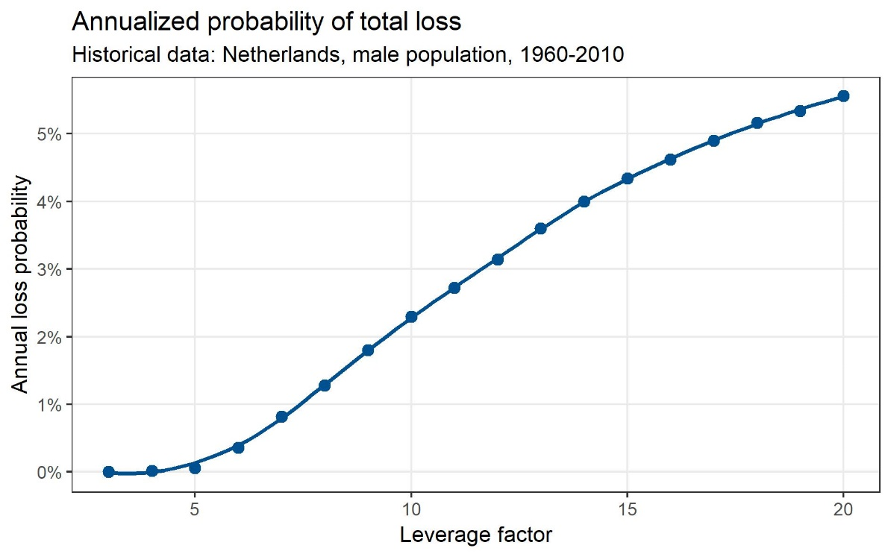
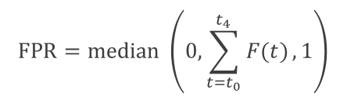



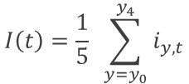
Framework for index cover
Calculation
Improvement for cohort 𝑦 in year 𝑡
$$i\left(y,t\right)=1−\frac{m_{y,t}}{m_{y−1,t−1}}$$
Annual Index value
$$I\left(t\right)=\frac{1}{5} \sum_{y=y_{0}}^{y_{4}}{i_{y, t}}$$
Annual payment rate
$F\left(t\right)=L ∙ \left(I\left(t\right) −R\right)$,
with leverage $L$ and reference value $R$
Final payment rate
$$FPR=median \left(0,\sum_{t=t_{0}}^{t_{4}}{F(t)},1\right)$$
11
Notes:
Reference value: historical average = 1.12%

Slide 12
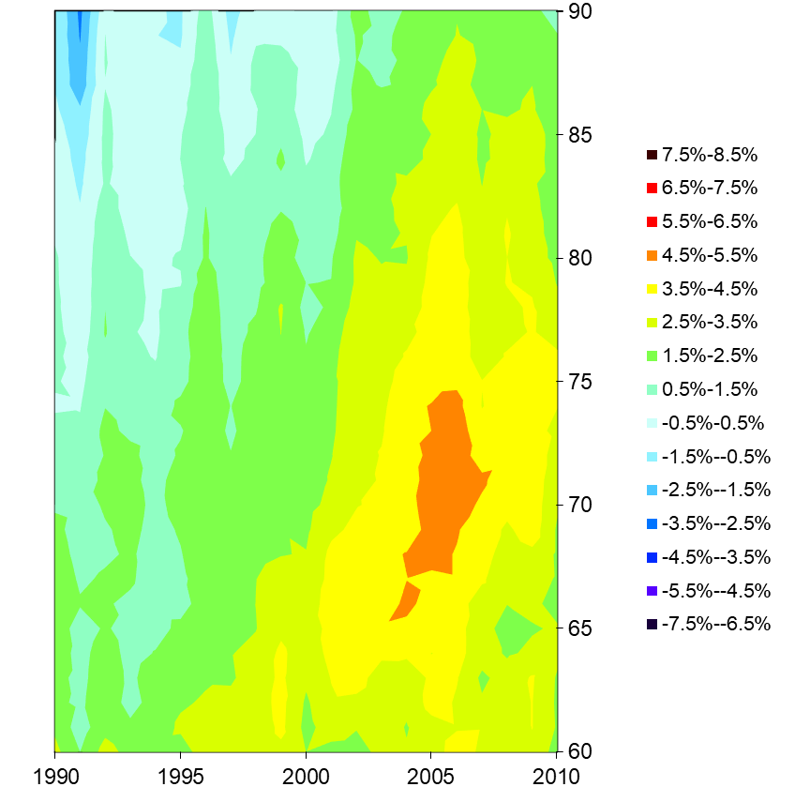
Framework for index cover
Overview
Basic structure
  Buy cover for improvement risk in specific
  After runtime end one can buy
Mortality improvements
Netherlands,
Male 1990-2010
1915
cohort risk diamond
1910
connecting cohort risk diamond
1915
1920
1925
1930
1935
1940
1945
12

Slide 13
Overview
Longevity and mortality risk
Framework for index cover
New structure: Weighted covers

Slide 14

New structure: Weighted covers
Version B
Impact of improvements
What is the impact of a single improvement, e.g. male, age 70 in 2019?
Age
74
Expected benefit
  Change in mortality for age 70 in all later years (2019 and beyond)
73
72
  Every cohort of age 69 or younger in 2018 will eventually reach age 70 in 2019 or later
71
70
  Change survival probability in “upper-right triangle”
69
  Hence, change in expected benefit for all later cohorts and ages 70+
68
Time
2018
2019
2020
2021
2022
2023
Impact of improvement on estimated benefit depends on position.
14

Slide 15
New structure: Weighted covers
Impact of improvements
Adjust weights to enhance coverage of hedge
age
  Least impact for latest improvements
  Impact of other improvements depend on position within diamonds
time
15

Slide 16
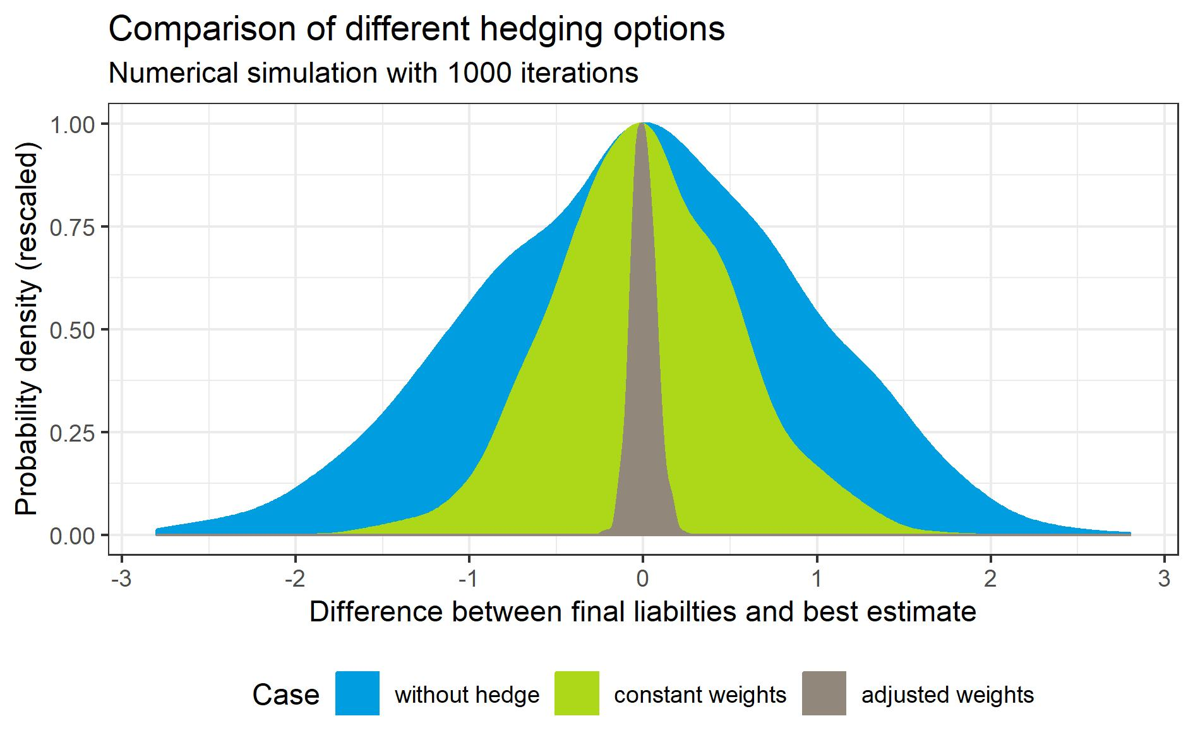
New structure: Weighted covers
Results from simulation
With equal weights:
~50% reduction in volatility
With adjusted weights
>90% reduction in volatility
16
Notes:
Remark: This picture has been calculated for a two-sided option, i.e., the value of the hedge is allowed to move in both directions. This is a slightly different structure then previously described.
The scale on the x-Axis is arbitrary.

Slide 17
New structure: Weighted covers
Building block approach
Mortality improvements
Netherlands,
Male 1990-2010
To cover benefits until death:
Include further diamonds to optimize fit to expected future benefits
1915
1910
Building block approach:
Possibility to optimize cover for risk capital reduction
1915
1920
1925
1930
1935
1940
1945
17

Slide 18
A new framework for longevity index covers
Summary
Index covers provide flexible tool for systematic risk transfer
Value dependent on mortality improvements from public source
Transfer in form of ILS derivative or bond structure possible
Building block approach: Custom combination of standardized cohort risk diamonds
Next level: Use weighted index to enhance fit for risk capital reduction
18

Slide 19


Contact
Cord-Roland Rinke
Managing Director,
L&H Asia and Longevity
Tel: +49 511 5604-1658
cord-roland.rinke@hannover-re.com
Patrick Horstmann
Senior Marketing Actuary,
Insurance-Linked Securities
Tel: +49 511 5604-2531
patrick.horstmann@hannover-re.com
Karl-Wiechert-Allee 50
30625 Hannover
http://www.hannover-re.com
19

