Slide 1
A Simulation Study on the Bias and Standard Error in Estimating Life Expectancy for Small Populations
20th International Longevity Risk and Capital Markets
Solutions Conference
September 8, 2025
Hsin-Chung Wang, Aletheia University
Jack C. Yue, National Chengchi University

Slide 2
Outline
Motivation
Methodology-2 graduation methods and some indexes
Comparison of Life Expectancy at Birth (LE0) in life tables for different combined age groups—18 counties/cities real data in Taiwan
Simulation-Under 4 reference population and 7 death scenarios respectively.
MSE, MAPE, SE, RSE ➔ Stability
95% CI ➔ Reliability
Mean, Median ➔ Central tendency
Bias ➔ Accuracy
Conclusion

Slide 3
Motivation

Slide 4
Geographic inequalities in life expectancy among Taiwan’s Townships/Districts
Regional variation in life expectancy with the degree of urban development.
EX: LE0 in Taipei City, Taitung County, Hualien County, Nantou County, and Yunlin County from 1998 to 2022.
LE0 for males in Taipei City has remained at least 8 years higher than that of males in Taitung County for 25 years.

Slide 5
Many townships have small populations but high overall mortality.
EX: Male Population (2016-18 Average)
There are 65 Townships /Districts with populations between 5,000 and 10,000 and 58 Townships / Districts populations less than 5,000.
Population | 0-5,000 | 5,001-50,000 | 50,000-100,000 | 100,000-300,000 | 300,000+
Number of Counties | 0 | 1 | 2 | 10 | 9
Number of Townships/Disticts | 58 | 241 | 43 | 26 | --
Note:1.22 counties and 368 townships in Taiwan
2.The division of administrative regions in Taiwan is mainly based on governance convenience, including electoral population, to determine the scope of government authority, responsibility attribution, jurisdiction of residents, and fiscal acquisition.

Slide 6
Taiwan now publishes abridged life tables only for the whole country and for 18 larger counties and cities.
Among the 368 townships in Taiwan, 244 exhibit mortality rates exceeding the national average.
Even within the same county or city, there are still substantial differences in mortality rates among townships and districts.
EX: 30 of Kaohsiung City's 38 administrative districts had death rates exceeding the national average.
-However, neighboring townships or regions might possess significantly different socioeconomic characteristics, and their age-specific occurrence rate curves may also differ. (Next Slide)
There are too many age groups with zero deaths in a small area, and the mortality rate curve fluctuates too much.
EX: There are only 347 male residents in Wuqiu Township, Kinmen, and the average annual death toll (2007-18) is only 1.6.

Slide 7
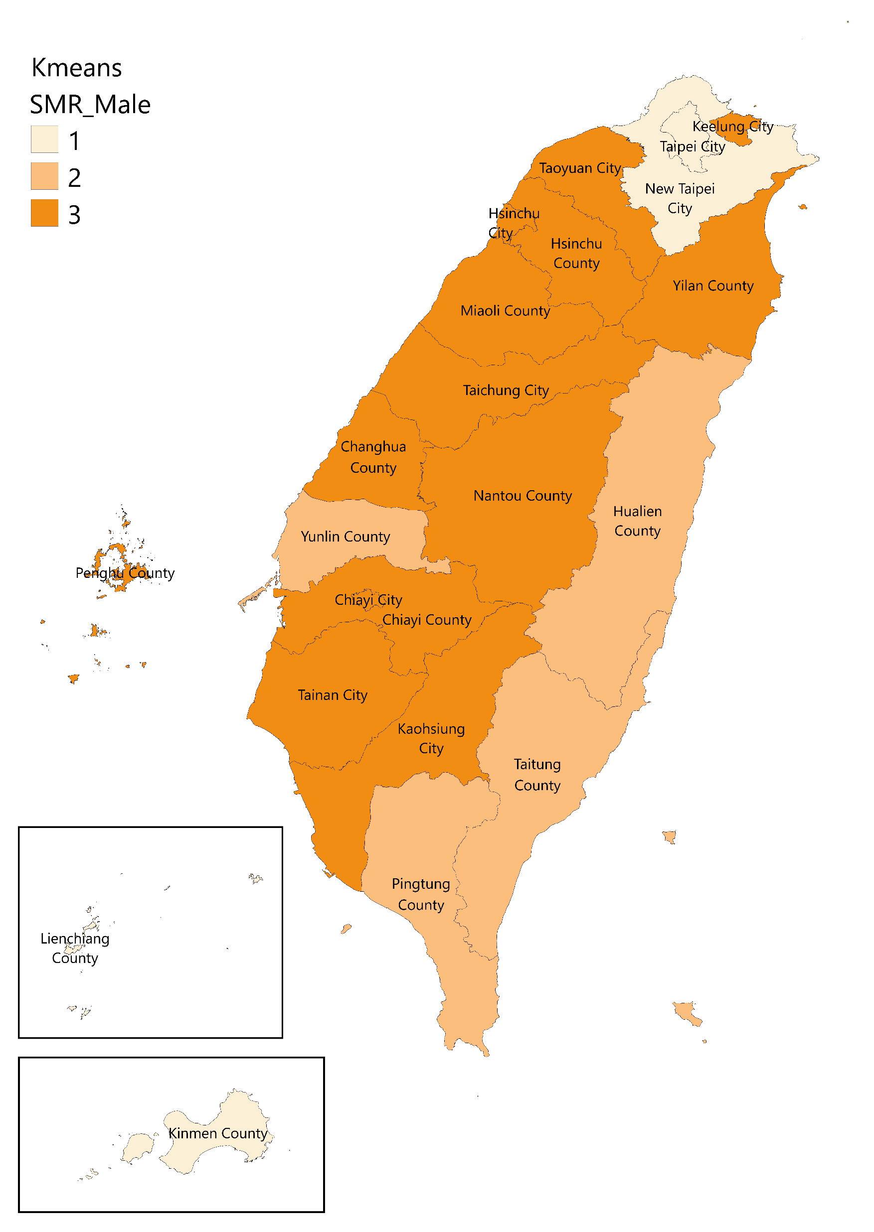
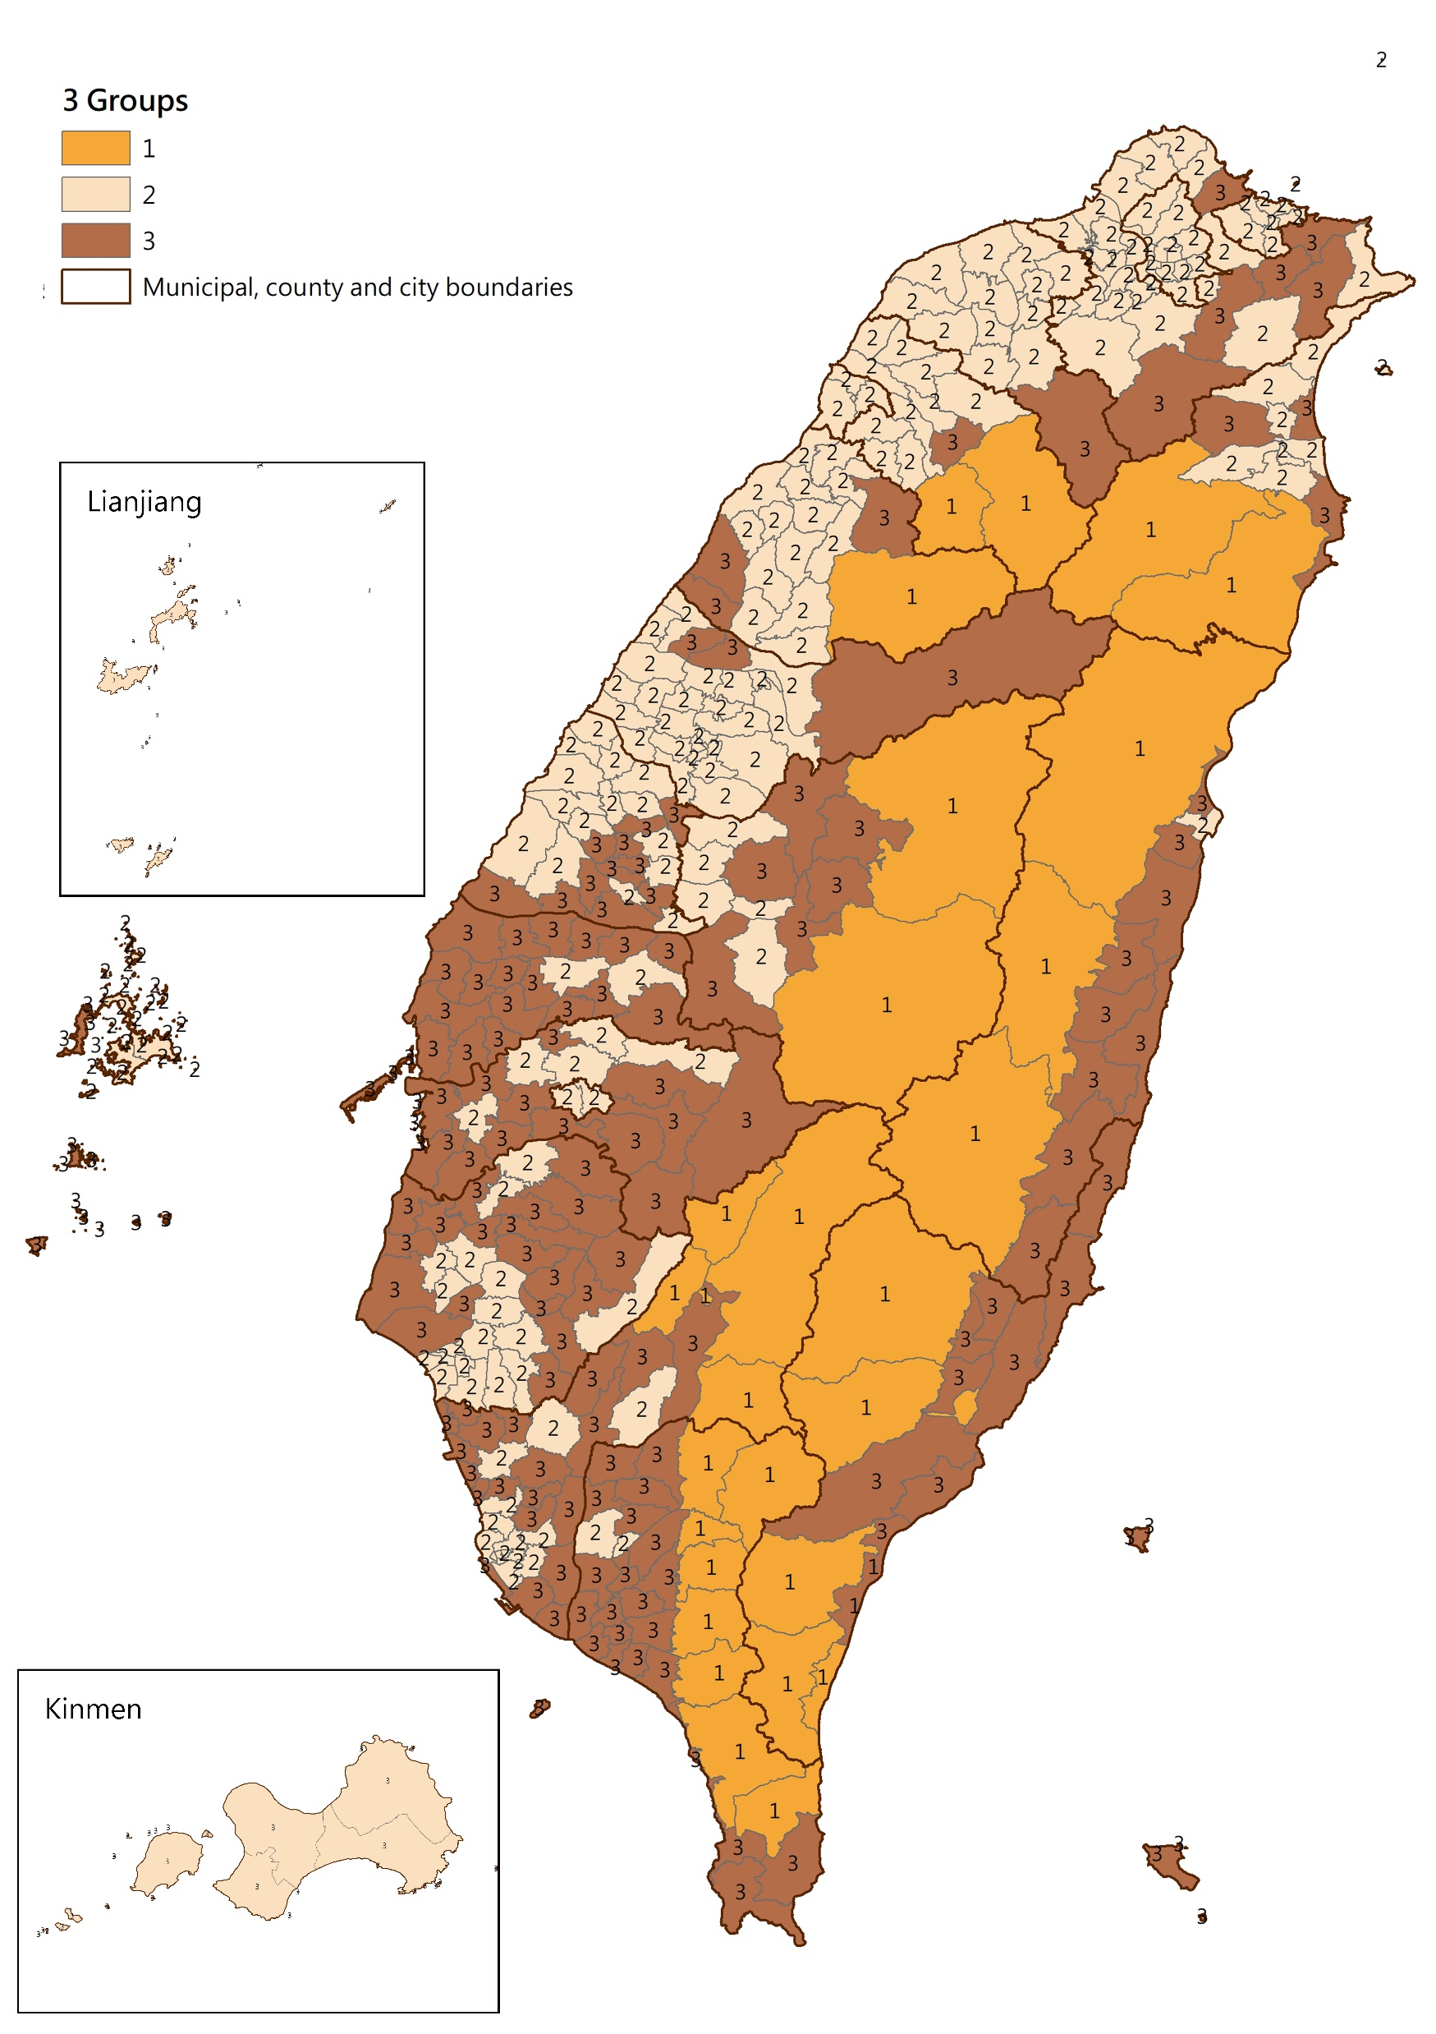
Taiwan Map
Counties/cities( left panel), and townships( right panel) are divided into 3 Groups based on Standard Mortality Ratio(SMR) by K-Means.
From right panel map, it can be observed that even the townships in the same county are divided into different groups.

Slide 8
How to solve the missing data problem ?
General Methods :
1.Combining data across years or age groups
2. Replace death rates from larger geographic units, substituting zero cells with small positive values
3.Standard regression analyses that model relationships between death rates and population demographic and socioeconomic characteristics
4.Graduation techniques that smooth crude mortality rates
5. With principal component methods that capture typical age patterns of mortality to estimate small-area death rates
6. Tracts with acceptable age patterns of mortality served as models from which to borrow information for tracts with missing age-specific death counts.

Slide 9
Our Past Study: Too few deaths in a period make life expectancy estimates unstable. The idea of increasing sample size can be used in small area estimations
1.We propose using SMR or SDR as the indexes, and K-means is an appropriate clustering method for our analysis.
2.Lee (2003) heterogeneity index could be used to determine whether the reference populations is suitable for small populations.
--We found that selecting a homogeneous reference population can reduce estimation errors
3.Combine with graduation Method.
--Whitter ratio method is suitable for small population than the partial standard mortality ratio (PSMR)
(Next Slide shows we suggested reference population and graduation methods for 28 townships in Taiwan)
In this study, we use simulations to suggest the minimum population needed to calculate life expectancy at birth (LE0) for Taiwan’s townships.

Slide 10
Townships/Disticts | Reference Population |  | Graduation Method
Taipei Songshan District | Taipei City or 7 Groups | Group 5 | Whittaker
Taipei Wanhua District | 5 Groups | Group 5 | Whittaker
NewTaipei Banqiao District | 5 Groups | Group 3 | Whittaker
NewTaipei Shiding District | 3 Groups | Group 3 | PSMR
Taoyuan Zhongli District | 3 Groups or Taoyuan City | Group 2 | Whittaker
Taoyuan Fuxing District | 5 Groups | Group 2 | Whittaker
Taichung Xitun District | 7 Groups | Group 5 | Whittaker
Taichung Heping District | 5 Groups | Group 1 | Whittaker
Tainan Anping District | Tainan City or 3 Groups | Group 2 | Whittaker
Tainan Beimen District | 3 Groups | Group 3 | Whittaker
Kaohsiung Xinxing District | 3 Groups | Group 2 | Whittaker
Kaohsiung Maolin District | Kaohsiung City or 3 Groups | Group 1 | Whittaker
Yilan Datong Township | 3 Groups | Group 1 | Whittaker
Xinzhu Wufeng Township | 5 Groups | Group 4 | Whittaker
Miaoli Shitan Township | Miaoli County or 5 Groups | Group 5 | Whittaker/ PSMR
Zhanghua Tianwei Township | 7 Groups | Group 2 | Whittaker
Nantou Guoxing Township | 7 Groups | Group 1 | Whittaker
Yunlin Taixi Township | 5 Groups | Group 1 | Whittaker
Chiayi Alishan Township | 5 Groups | Group 2 | Whittaker
Pingtung Majia Township | 3 Groups | Group 1 | Whittaker
Taitung Daren Township | 5 Groups | Group 2 | Whittaker
Hualian Fengbin Township | Hualian County or 7 Groups | Group 1 | Whittaker
Penghu Qimei Township | Penghu County or 7 Groups | Group 2 | Whittaker
Jilong Nuannuan District | 5 Groups | Group 5 | Whittaker
Xinzhu Xiangshan District | 5 Groups | Group 5 | Whittaker
Chiayi West District | Chiayi City or 5 Groups | Group 5 | PSMR/Whittaker
Lianjiang Dongyin Township | 5 Groups | Group 3 | Whittaker
Jinmen Wuqiu Township | 5 Groups | Group 3 | Whittaker

Slide 11
Methodology

Slide 12
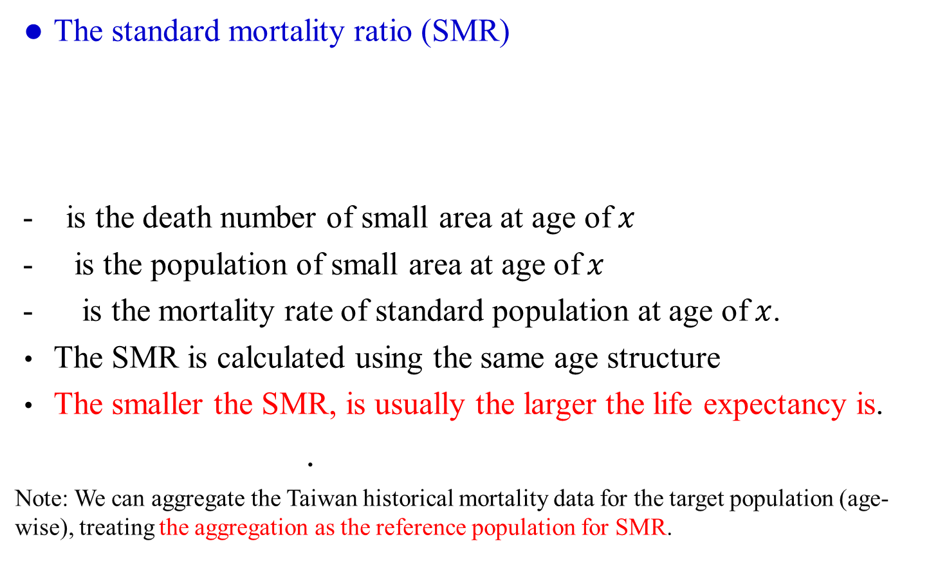
Indexes
The standard mortality ratio (SMR)
- is the death number of small area at age of$x$
- is the population of small area at age of$x$
- is the mortality rate of standard population at age of$x$.
The SMR is calculated using the same age structure
The smaller the SMR, is usually the larger the life expectancy is.
.
Note: We can aggregate the Taiwan historical mortality data for the target population (age-wise), treating the aggregation as the reference population for SMR.

Slide 13
The Whittaker method is to minimize the following objective function, i.e., weighted sum of fit function F and smoothness function S:
and are observed and graduated mortality rates for age x
is the weight for age x
- n is population size
- h and z are the parameters to be decided.
is the z time difference.
The Whittaker ratio is an extended version and we plug into the mortality ratio of small and reference populations for graduation, instead of mortality rates.
Notes:
Whittaker修勻法同時考慮適度性與平滑性其中F即為適度性，S為平滑性選擇讓M式最小化的 即為Whittaker修勻值。
Whittaker修勻也可根據小母體修正，參考年齡別死亡率較為平滑的大母體。先計算小母體與大母體的各年齡死亡率比值，再代M式，得出修勻後的死亡率比值 ，再乘以大母體的年齡別死亡率。在修勻前將死亡率比值異常的點以SMR取代，這麼做不只參考了SMR的訊息，因為加入Whittaker修勻，更考慮了死亡率在年齡間的變化，這種修勻方法為Whittaker比值法。

Slide 14
The partial SMR: is one way to deal with estimating mortality rates of small populations, by adding information from other (large) population to correct possible bias
- and are observed and graduated mortality rates for age x
and where and are the observed and expected numbers of deaths at age x for the small population
is the estimate of parameter for measuring the heterogeneity (in mortality rates) between the small population and large population.
--Lee, W. (2003), “A Partial SMR Approach to Smoothing Age-specific Rates.” Annals of Epidemiology 13(2), 89-99.

Slide 15
was the estimated value of the heterogeneity parameter via:
Higher value implies more heterogeneity in the rate ratios of the study and the standard populations (or stated differently, more dissimilarity in shape between the two age curves)
Lower value, less rate-ratio heterogeneity (more similarity between the two curves).
When it is zero, i.e. no rate-ratio heterogeneity detected in the data
➔We use it as a criterion for choosing a suitable reference population.

Slide 16
We use MSE, MAPE, SE, and RSE indicators to compare whether the estimated value is stable under different samples.
We also used the 95% CI to measure the precision and reliability of the estimated results, and used the Mean, Median, and Bias to observe central tendency and accuracy.
MAPE (The mean absolute percentage error):
where and are the observed and simulated values for observation i, i = 1, 2, ..., n.
-- Lewis (1982), a prediction with MAPE less than 10 percent is treated as highly accurate, and a MAPE greater than 50 percent is considered inaccurate.
RSE (Relative Standard Error):
RSE=(Standard Error / Estimate) x 100

Slide 17
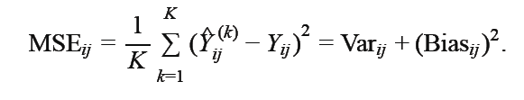


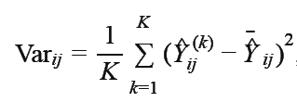

MSE(Mean Square Error):
,
where i=1,…,18, j=1,…,10, k=1,…,1000. the estimation matrix for the kth simulation.

Slide 18
Comparison of Counties/Cities LE0

Slide 19
18 Counties/Cities of Male LE0 in Taiwan
Penghu county has a population of only about 50,000, significantly lower than other counties/cities, but its LE0 is higher than many counties/cities.
Island mortality paradox or estimation error ?
Counties/Cities | 2016-18 Average Population | 2007 | 2008 | 2009 | 2010 | 2011 | 2012 | 2013 | 2014 | 2015 | 2016 | 2017 | 2018
TPE | 1,281,601 | 79.41 | 79.70 | 79.86 | 80.06 | 80.18 | 80.00 | 80.18 | 80.33 | 80.64 | 80.54 | 80.82 | 80.93
NTPE | 1,953,569 | 76.51 | 76.89 | 77.21 | 77.51 | 77.61 | 77.54 | 77.58 | 77.67 | 77.91 | 77.92 | 78.14 | 78.33
TYN | 1,088,419 | 76.01 | 76.36 | 76.72 | 76.84 | 76.92 | 76.91 | 77.10 | 77.22 | 77.49 | 77.46 | 77.73 | 77.86
TXG | 1,373,501 | 75.59 | 75.91 | 76.15 | 76.11 | 76.16 | 76.30 | 76.69 | 77.05 | 77.23 | 77.19 | 77.37 | 77.61
TNN | 941,776 | 74.42 | 74.75 | 75.11 | 75.21 | 75.36 | 75.51 | 75.71 | 76.26 | 76.60 | 76.58 | 76.67 | 76.79
KHH | 1,375,505 | 74.03 | 74.43 | 74.50 | 74.86 | 80.18 | 75.21 | 75.34 | 75.52 | 75.70 | 75.72 | 75.93 | 76.13
Yilan | 231,936 | 74.17 | 74.44 | 74.80 | 75.16 | 75.31 | 75.77 | 75.92 | 76.30 | 76.09 | 76.29 | 76.20 | 76.57
Xinzhu | 282,190 | 75.10 | 75.39 | 75.81 | 75.65 | 75.61 | 75.82 | 76.12 | 76.66 | 76.70 | 76.90 | 77.08 | 77.41
Miaoli | 285,829 | 73.84 | 74.13 | 74.60 | 75.03 | 75.00 | 75.10 | 75.20 | 75.63 | 75.98 | 75.96 | 76.01 | 76.09
Zhanghua | 653,691 | 74.34 | 74.75 | 74.98 | 75.42 | 75.62 | 75.79 | 76.13 | 76.37 | 76.57 | 76.43 | 76.47 | 76.63
Nantou | 256,757 | 73.12 | 73.35 | 73.56 | 74.07 | 74.02 | 74.04 | 74.02 | 74.42 | 74.63 | 74.73 | 75.01 | 75.47
Yunlin | 358,246 | 72.20 | 72.46 | 72.96 | 73.41 | 73.80 | 74.10 | 74.30 | 74.44 | 74.57 | 74.63 | 74.76 | 74.80
Chiayi | 265,814 | 73.10 | 73.60 | 74.12 | 74.25 | 74.58 | 74.66 | 75.01 | 74.80 | 74.83 | 74.63 | 75.17 | 75.35
Pingtung | 424,589 | 71.87 | 72.08 | 72.24 | 72.52 | 72.56 | 72.67 | 72.86 | 73.39 | 73.54 | 73.41 | 73.54 | 73.70
Taitung | 113,476 | 69.38 | 69.89 | 70.06 | 70.69 | 70.64 | 70.72 | 70.86 | 71.11 | 71.23 | 71.02 | 71.50 | 72.05
Hualian | 167,271 | 69.80 | 70.08 | 70.68 | 71.42 | 72.17 | 72.47 | 72.76 | 72.95 | 73.15 | 72.87 | 72.88 | 72.62
Penghu | 53,536 | 75.32 | 75.55 | 75.92 | 76.03 | 75.67 | 75.79 | 76.58 | 76.48 | 76.15 | 75.47 | 76.63 | 77.24
Jilongcity | 185,791 | 74.62 | 75.05 | 75.23 | 75.30 | 75.32 | 75.56 | 75.78 | 76.29 | 76.46 | 76.91 | 76.98 | 76.89
Xinzhucity | 217,961 | 76.51 | 76.90 | 76.74 | 77.14 | 77.36 | 77.43 | 77.27 | 77.54 | 77.82 | 77.81 | 77.94 | 78.20
Chiayicity | 130,933 | 75.57 | 75.97 | 75.86 | 75.99 | 76.19 | 76.68 | 77.12 | 77.26 | 77.00 | 76.57 | 76.69 | 76.90
Sourice: Taiwan Ministry of the Interior abridged life tables

Slide 20
Comparison of LE0 in life tables for different combined age groups
We used real data from Taiwan’s counties and cities to recalculate LE0 under 12 cases, which take into account the effects of differences in the youngest and oldest age groups, as well as the occurrence of zero deaths in several age groups.
Case1: 0,1-4,5-9,…,85+
Case2: 0-4,5-9,…,85+
Cse3: 0,1-4,5-9,…,100+
Cse4: 0-4,5-9,…,100+
Case5: 0-9,10-19,…,70-79,80+
Case6: 0-9,10-19,…,70-79,100+
Case7: 0-29,30-34,…,85+
Case8: 0-29,30-34,…,100+
Case9: 0,1-14,15-19,…,85+
Case10: 0-14,15-19,…,85+
Case11: 0,1-14,15-19,…,100+
Case12: 0-14,15-19,…,100+
( Next Slide)
-EX: When compared to the abridged life table, the life expectancy from the 12 cases in Taipei City differed by an average of about 0.1 years.
➔The smaller the population size, the more likely LE0 will be overestimated.
➔The differences among various cases in calculating LE0 are not much difference.

Slide 21
 | case 1 | case 2 | case 3 | case 4 | case 5 | case 6 | case 7 | case 8 | case 9 | case 10 | case 11 | case 12
TPE | 0.16 | 0.22 | -0.03 | 0.04 | 0.12 | -0.06 | 0.19 | 0.01 | -0.03 | 0.16 | 0.01 | 0.20
NTPE | 0.28 | 0.33 | 0.15 | 0.20 | 0.33 | 0.18 | 0.34 | 0.20 | 0.15 | 0.28 | 0.23 | 0.37
TYN | 0.24 | 0.26 | 0.10 | 0.11 | 0.02 | -0.02 | 0.19 | 0.05 | 0.10 | 0.24 | 0.12 | 0.26
TXG | 0.31 | 0.36 | 0.16 | 0.21 | 0.34 | 0.16 | 0.32 | 0.17 | 0.16 | 0.31 | 0.22 | 0.37
TNN | 0.17 | 0.22 | 0.04 | 0.08 | 0.26 | 0.06 | 0.17 | 0.03 | 0.04 | 0.17 | 0.11 | 0.24
KHH | 0.20 | 0.25 | 0.09 | 0.15 | 0.20 | 0.09 | 0.25 | 0.15 | 0.09 | 0.20 | 0.18 | 0.29
Yilan | 0.40 | 0.40 | 0.26 | 0.27 | 0.41 | 0.23 | 0.32 | 0.19 | 0.27 | 0.41 | 0.30 | 0.43
Xinzhu | 0.43 | 0.48 | 0.27 | 0.33 | 0.52 | 0.27 | 0.47 | 0.31 | 0.27 | 0.42 | 0.35 | 0.51
Miaoli | 0.31 | 0.35 | 0.13 | 0.17 | 0.40 | 0.09 | 0.25 | 0.07 | 0.13 | 0.31 | 0.20 | 0.38
Zhanghua | 0.29 | 0.29 | 0.16 | 0.16 | 0.41 | 0.13 | 0.22 | 0.08 | 0.16 | 0.29 | 0.17 | 0.31
Nantou | 0.42 | 0.44 | 0.30 | 0.32 | 0.45 | 0.28 | 0.35 | 0.23 | 0.31 | 0.42 | 0.38 | 0.49
Yunlin | 0.16 | 0.20 | 0.04 | 0.09 | 0.25 | 0.09 | 0.11 | -0.01 | 0.04 | 0.15 | 0.13 | 0.25
Chiayi | 0.36 | 0.40 | 0.21 | 0.24 | 0.43 | 0.15 | 0.23 | 0.08 | 0.22 | 0.37 | 0.29 | 0.44
Pingtung | 0.16 | 0.22 | 0.08 | 0.14 | 0.21 | 0.08 | 0.11 | 0.03 | 0.07 | 0.16 | 0.20 | 0.28
Taitung | 0.54 | 0.58 | 0.53 | 0.57 | 0.48 | 0.54 | 0.64 | 0.62 | 0.54 | 0.56 | 0.64 | 0.66
Hualian | -0.22 | -0.13 | -0.21 | -0.12 | -0.34 | -0.21 | -0.09 | -0.08 | -0.21 | -0.22 | -0.04 | -0.05
Penghu | 0.95 | 0.95 | 0.74 | 0.74 | 0.93 | 0.60 | 0.99 | 0.78 | 0.74 | 0.94 | 0.70 | 0.91
Jilongcity | 0.02 | 0.06 | 0.01 | 0.05 | -0.08 | -0.10 | 0.05 | 0.03 | -0.01 | 0.01 | 0.09 | 0.11
Xinzhucity | 0.29 | 0.35 | 0.24 | 0.30 | 0.18 | 0.22 | 0.36 | 0.31 | 0.25 | 0.29 | 0.33 | 0.38
Chiayicity | 0.37 | 0.40 | 0.25 | 0.29 | 0.37 | 0.24 | 0.38 | 0.27 | 0.27 | 0.37 | 0.35 | 0.46

Slide 22
Simulation

Slide 23
Simulation Assumptions
1.We calculate LE0 by five-year age groups life table, ranging from age 0 to 85+ (i.e., 0,1-4, 5-9, 10-14, … , 85+, total 19 groups).
2. We considered different population sizes (1,000; 2,000; 3,000; 4,000; 5,000; 100,000; 200,000; 300,000; 500,000; and 1,000,000) and simulated the random number of deaths using a Poisson distribution. Each simulation consisted of 1,000 repetitions.
3.Reference populations:
We applied the K-means clustering method to the SMR index and divided the 368 townships into three groups.
Suppose that the male mortality rates and the population structure follow 2009-2018:
1). Taiwan Population (368 Counties: Population over 11,672K)
2). Group1: Mountainous and Remote Areas (27 townships : about 94K)
3). Group2: Metropolitan Areas(191 townships : about 9,241K)
4). Group3: Non-Metropolitan Area (150 townships : about 2,262K)

Slide 24
4. Suppose that there are 7 real scenarios for the mortality ratio S_{x} between the small and reference populations( )
1) Original : No mortality ratio assumption S_{x} =1.
2) Population: Under 1,000 (3 Twp.)
3) Population: 1,001-3,000 (6 Twp.)
4) Population: 3,001-5,000 (3 Twp.)
5) Population: 5,001-30,000 (8 Twp.)
6) Population: 30,001-50,000 (2 Twp.)
7) Population: Over 50,000 (6 Twp.)
Note:
1.We selected 2 administrative districts from each of the six metropolitan areas, including Taipei City, and one township from each of the remaining counties and cities, yielding a total of 28 township/districts.
2. Four reference population were considered, and the average age-specific mortality rates were calculated for each township district under 7 scenarios. These rates were then compared with those of the reference population.

Slide 25
Various scenarios are designed to evaluate the effect of different LE0 calculation.
The first scenario indicate that the mortality rates of the small and reference populations is equal.
The population less than 5,000 scenario are unstable.

Slide 26
Count of 0 deaths
Scenario 1: Original: No mortality ratio assumption
Among the 19 age groups of the 4 reference populations, the number of deaths in the age group with 0 is less than 5, and the population must be more than 10,000.

Slide 27
Scenario 2: Population: Under 1,000 (3 Twp.)
Among the 19 age groups of the four reference populations, the number of deaths in the age group with 0 is less than 5, and the population must be more than 50,000.

Slide 28
Scenario 3: Population: 1,001-3,000 (6 Twp.)
Among the 19 age groups of the four reference populations, the number of deaths in the age group with 0 is less than 5, and the population must be more than 100,000.

Slide 29
Scenario 4: Population: 3,001-5,000 (3 Twp.)
Among the 19 age groups of the four reference populations, the number of deaths in the age group with 0 is less than 5, and the population must be more than 50,000.

Slide 30
Scenario 5: Population: 5,001-30,000 (8 Twp.)
Among the 19 age groups of the four reference populations, the number of deaths in the age group with 0 is less than 5, and the population must be more than 50,000.

Slide 31
Scenario 6: Population: 30,001-50,000 (2 Twp.)
Among the 19 age groups of the four reference populations, the number of deaths in the age group with 0 is less than 5, and the population must be more than 50,000.

Slide 32
Scenario 7: Population: Over 50,000 (6 Twp.)
Among the 19 age groups of the four reference populations, the number of deaths in the age group with 0 is less than 5, and the population must be more than 50,000.

Slide 33
Comparing different scenarios with the same population size
With a population of 50,000 or more, fewer than five age groups have zero deaths across all scenarios.

Slide 34
MAPE of Mortality Rates:
EX: Taiwan Population Structure (368 Counties: above 1,1672K)
For populations below 50,000 scenarios, all MAPEs exceed 50%.
The larger the population, the smaller the error between the simulated mortality rate and the assumed mortality rate.
Even with larger populations, the simulated mortality rates in scenarios where the number of deaths in too many age groups is zero still have large errors compared to the assumed mortality rates. Note. --- means mape >50%
 | 50,000 | 100,000 | 200,000 | 300,000 | 500,000 | 1,000,000
Original: No mortality ratio assumption | 37 | 26 | 19 | 16 | 13 | 9
Scenario 1:Population: Under 1,000 (3 Twp.) | --- | --- | --- | --- | --- | ---
Scenario 2:Population: 1,001-3,000 (6 Twp.) | --- | --- | --- | --- | --- | ---
Scenario 3:Population: 3,001-5,000 (3 Twp.) | --- | --- | --- | --- | --- | ---
Scenario 4:Population: 5,001-30,000 (8 Twp.) | 28 | 20 | 15 | 12 | 10 | 7
Scenario 5:Population: 30,001-50,000 (2 Twp.) | 36 | 26 | 19 | 16 | 13 | 10
Scenario 6:Population: Over 50,000 (6 Twp.) | 38 | 28 | 20 | 17 | 14 | 11

Slide 35
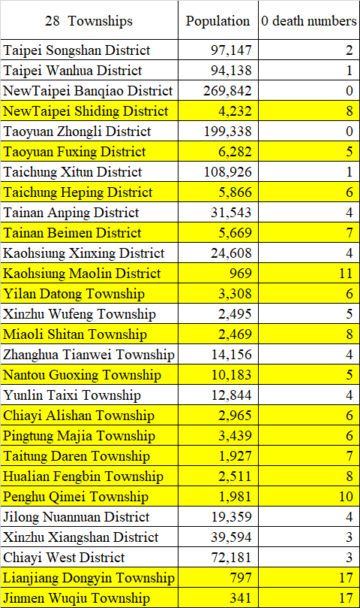
In practice, among the 19 age groups in 28 townships, 16 townships had more than 5 age groups with zero deaths.
➔It seems that in townships with a population of over 10,000, there are no more than five age groups with zero deaths.
Too many age groups with zero deaths will affect the accuracy of simulated mortality rates.
➔Can these situations make LE0 estimates unstable?

Slide 36
Bias of simulated Mortality
Ex. Original: No mortality ratio assumption
The bias decreases as the population size increases, but increases as the population ages

Slide 37
MSE of simulated Mortality Rates:( Unit: 10⁻⁴ )
The MSE decreases as the sample size increases.
Once the sample size becomes sufficiently large, the MSE stabilizes and no longer decreases substantially.(5 hundred thousand or 1 million)
Reference Population 1: Taiwan Population Structure (368 Counties: above 1,1672K)
 | 1K | 2K | 3K | 4K | 5K | 10K | 50K | 100K | 200K | 300K | 500K | 1,000K
Original | 11.35 | 5.54 | 3.78 | 2.80 | 2.28 | 1.14 | 0.11 | 0.11 | 0.06 | 0.04 | 0.02 | 0.01
Scenario 1 | 13.76 | 7.04 | 4.61 | 3.51 | 2.75 | 1.41 | 0.12 | 0.14 | 0.07 | 0.05 | 0.03 | 0.01
Scenario 2 | 14.81 | 7.43 | 5.04 | 3.76 | 2.96 | 1.48 | 0.30 | 0.15 | 0.08 | 0.05 | 0.03 | 0.01
Scenario 3 | 14.25 | 7.06 | 4.72 | 3.51 | 2.81 | 1.42 | 0.28 | 0.14 | 0.07 | 0.05 | 0.03 | 0.01
Scenario 4 | 12.95 | 6.28 | 4.30 | 3.16 | 2.60 | 1.30 | 0.13 | 0.13 | 0.06 | 0.04 | 0.03 | 0.01
Scenario 5 | 11.63 | 5.79 | 3.85 | 2.87 | 2.33 | 1.16 | 0.12 | 0.12 | 0.06 | 0.04 | 0.02 | 0.01
Scenario 6 | 10.47 | 5.25 | 3.50 | 2.56 | 2.09 | 1.05 | 0.10 | 0.10 | 0.05 | 0.03 | 0.02 | 0.01
Reference Population 2: Mountainous and Remote Areas (27 townships : about 94K)
 | 1K | 2K | 3K | 4K | 5K | 10K | 50K | 100K | 200K | 300K | 500K | 1,000K
Original | 23.46 | 11.75 | 7.98 | 5.89 | 4.83 | 2.41 | 0.24 | 0.24 | 0.12 | 0.08 | 0.05 | 0.02
Scenario 1 | 26.66 | 13.02 | 8.70 | 6.52 | 5.27 | 2.68 | 0.52 | 0.26 | 0.13 | 0.09 | 0.05 | 0.03
Scenario 2 | 24.18 | 12.02 | 8.16 | 6.10 | 4.84 | 2.42 | 0.23 | 0.24 | 0.12 | 0.08 | 0.05 | 0.02
Scenario 3 | 22.97 | 11.74 | 7.72 | 5.75 | 4.61 | 2.32 | 0.23 | 0.23 | 0.12 | 0.08 | 0.05 | 0.02
Scenario 4 | 20.51 | 10.52 | 7.06 | 5.24 | 4.24 | 2.11 | 0.18 | 0.21 | 0.10 | 0.07 | 0.04 | 0.02
Scenario 5 | 19.26 | 9.68 | 6.28 | 4.69 | 3.86 | 1.94 | 0.39 | 0.19 | 0.10 | 0.06 | 0.04 | 0.02
Scenario 6 | 17.11 | 8.53 | 5.72 | 4.22 | 3.45 | 1.73 | 0.35 | 0.18 | 0.09 | 0.06 | 0.03 | 0.02

Slide 38
MSE of simulated Mortality Rates:( Unit: 10⁻⁴ )
The MSE decreases as the sample size increases.
Once the sample size becomes sufficiently large, the MSE stabilizes and no longer decreases substantially.(5 hundred thousand or 1 million)
Reference Population 3: Metropolitan Areas(191 townships : about 9241K)
 | 1K | 2K | 3K | 4K | 5K | 10K | 50K | 100K | 200K | 300K | 500K | 1,000K
Original | 11.10 | 5.67 | 3.71 | 2.82 | 2.23 | 1.10 | 0.22 | 0.11 | 0.06 | 0.04 | 0.02 | 0.01
Scenario 1 | 13.96 | 7.09 | 4.67 | 3.51 | 2.82 | 1.44 | 0.12 | 0.14 | 0.07 | 0.05 | 0.03 | 0.01
Scenario 2 | 15.11 | 7.69 | 5.05 | 3.80 | 3.07 | 1.54 | 0.17 | 0.15 | 0.08 | 0.05 | 0.03 | 0.02
Scenario 3 | 14.44 | 7.17 | 4.86 | 3.62 | 2.89 | 1.44 | 0.17 | 0.14 | 0.07 | 0.05 | 0.03 | 0.01
Scenario 4 | 13.00 | 6.56 | 4.35 | 3.29 | 2.59 | 1.31 | 0.14 | 0.13 | 0.06 | 0.04 | 0.03 | 0.01
Scenario 5 | 11.99 | 5.94 | 3.93 | 2.95 | 2.34 | 1.17 | 0.12 | 0.12 | 0.06 | 0.04 | 0.02 | 0.01
Scenario 6 | 10.66 | 5.36 | 3.58 | 2.69 | 2.14 | 1.06 | 0.21 | 0.11 | 0.05 | 0.04 | 0.02 | 0.01
Reference Population 4: Non-Metropolitan Area (150 townships : about 2262K)
 | 1K | 2K | 3K | 4K | 5K | 10K | 50K | 100K | 200K | 300K | 500K | 1,000K
Original | 12.20 | 5.98 | 4.02 | 3.00 | 2.39 | 1.21 | 0.11 | 0.12 | 0.06 | 0.04 | 0.02 | 0.01
Scenario 1 | 13.76 | 6.91 | 4.60 | 3.51 | 2.76 | 1.42 | 0.28 | 0.14 | 0.07 | 0.05 | 0.03 | 0.01
Scenario 2 | 14.04 | 7.01 | 4.63 | 3.47 | 2.78 | 1.39 | 0.13 | 0.14 | 0.07 | 0.05 | 0.03 | 0.01
Scenario 3 | 13.40 | 6.58 | 4.41 | 3.33 | 2.63 | 1.33 | 0.26 | 0.13 | 0.07 | 0.04 | 0.03 | 0.01
Scenario 4 | 11.99 | 6.01 | 4.00 | 3.00 | 2.42 | 1.21 | 0.24 | 0.12 | 0.06 | 0.04 | 0.02 | 0.01
Scenario 5 | 10.78 | 5.45 | 3.63 | 2.73 | 2.17 | 1.10 | 0.22 | 0.11 | 0.05 | 0.04 | 0.02 | 0.01
Scenario 6 | 9.74 | 4.99 | 3.29 | 2.47 | 1.95 | 0.99 | 0.09 | 0.10 | 0.05 | 0.03 | 0.02 | 0.01

Slide 39
Life Expectancy at Birth (LE0)
Median of Life Expectancy at Birth
EX: Original: No mortality ratio assumption
Small population size gave higher estimate of LE0.

Slide 40
SD(Standard Deviation) of Life Expectancy at Birth
Small population size gave higher standard deviation of LE0.
Population over 500,000, the SD of LE0 begins to decline significantly
EX: Original: No mortality ratio assumption

Slide 41
The IQR (Interquartile Range):
The IQR decreases as the sample size increases.
The IQR gradually decreases when the sample size is above 50,000 means
more stable estimates with less variability.
EX: Original: No mortality ratio assumption

Slide 42
Except for the reference population of Mountainous and Remote Areas (27 townships: about 94K), the IQR gradually decreases when the sample size is above 50,000, which means the estimate is more stable.
EX: Scenario 1:Population: Under 1,000 (3 Twp.)

Slide 43
Scenario 2-6: The IQR gradually decreases when the sample size is above 50,000
EX: Scenario 2:Population: 1,001-3,000 (6 Twp.)

Slide 44
Mean of LE0
The error of the mean is approximately 0.2-0.88 years for a population of 3,000, 0.05-0.13 years for a population 50,000,and 0-0.14 years for a population of 500,000.
Reference Population 1: Taiwan Population Structure (368 Counties: above 1,1672K)
 | Reference Population | 1K | 2K | 3K | 4K | 5K | 10K | 50K | 100K | 200K | 300K | 500K | 1,000K
Original | 77.28 | 77.93 | 78.18 | 77.84 | 77.56 | 77.53 | 77.27 | 77.25 | 77.25 | 77.27 | 77.27 | 77.28 | 77.29
Scenario 1 | 73.08 | 73.94 | 73.60 | 73.37 | 73.22 | 73.15 | 73.04 | 72.95 | 72.96 | 72.94 | 72.94 | 72.94 | 72.94
Scenario 2 | 69.09 | 69.86 | 69.52 | 69.35 | 69.26 | 69.21 | 69.10 | 69.05 | 69.01 | 69.04 | 69.04 | 69.02 | 69.03
Scenario 3 | 70.79 | 71.71 | 71.37 | 71.20 | 71.08 | 70.95 | 70.83 | 70.72 | 70.76 | 70.75 | 70.74 | 70.74 | 70.74
Scenario 4 | 73.89 | 74.57 | 74.58 | 74.27 | 74.08 | 74.10 | 73.94 | 73.86 | 73.88 | 73.87 | 73.88 | 73.89 | 73.89
Scenario 5 | 77.30 | 77.92 | 78.06 | 77.87 | 77.58 | 77.55 | 77.30 | 77.24 | 77.27 | 77.29 | 77.28 | 77.30 | 77.30
Scenario 6 | 78.97 | 79.32 | 80.02 | 79.62 | 79.40 | 79.25 | 79.06 | 78.90 | 78.93 | 78.94 | 78.95 | 78.97 | 78.97
Reference Population 2: Mountainous and Remote Areas (27 townships : about 94K)
 | Reference Population | 1K | 2K | 3K | 4K | 5K | 10K | 50K | 100K | 200K | 300K | 500K | 1,000K
Original | 66.17 | 66.59 | 66.74 | 66.73 | 66.49 | 66.42 | 66.27 | 66.22 | 66.17 | 66.17 | 66.18 | 66.17 | 66.17
Scenario 1 | 69.72 | 70.34 | 70.65 | 70.32 | 70.18 | 69.92 | 69.82 | 69.70 | 69.65 | 69.66 | 69.65 | 69.65 | 69.64
Scenario 2 | 69.30 | 69.80 | 69.85 | 69.78 | 69.72 | 69.59 | 69.39 | 69.30 | 69.28 | 69.27 | 69.27 | 69.27 | 69.27
Scenario 3 | 70.17 | 70.59 | 70.76 | 70.72 | 70.66 | 70.43 | 70.32 | 70.15 | 70.15 | 70.13 | 70.13 | 70.14 | 70.13
Scenario 4 | 73.47 | 73.73 | 74.23 | 73.99 | 73.92 | 74.00 | 73.62 | 73.47 | 73.46 | 73.47 | 73.46 | 73.46 | 73.47
Scenario 5 | 76.87 | 76.87 | 77.57 | 77.75 | 77.67 | 77.57 | 77.14 | 76.87 | 76.86 | 76.88 | 76.86 | 76.87 | 76.87
Scenario 6 | 78.58 | 78.35 | 79.13 | 79.40 | 79.50 | 79.42 | 78.80 | 78.62 | 78.59 | 78.59 | 78.58 | 78.58 | 78.58

Slide 45
Mean of LE0
Reference Population 3: Metropolitan Areas(191 townships : about 9241K)
 | Reference Population | 1K | 2K | 3K | 4K | 5K | 10K | 50K | 100K | 200K | 300K | 500K | 1,000K
Original | 78.18 | 78.80 | 79.30 | 78.84 | 78.51 | 78.53 | 78.15 | 78.14 | 78.15 | 78.16 | 78.17 | 78.17 | 78.18
Scenario 1 | 73.13 | 74.32 | 73.70 | 73.51 | 73.33 | 73.17 | 73.07 | 73.02 | 73.00 | 72.98 | 72.98 | 72.99 | 72.98
Scenario 2 | 69.07 | 69.89 | 69.57 | 69.39 | 69.24 | 69.12 | 69.10 | 69.02 | 69.03 | 69.02 | 69.02 | 69.01 | 69.01
Scenario 3 | 70.77 | 71.40 | 71.37 | 71.24 | 71.05 | 70.95 | 70.82 | 70.76 | 70.73 | 70.74 | 70.74 | 70.74 | 70.73
Scenario 4 | 73.91 | 74.69 | 74.58 | 74.22 | 74.19 | 74.04 | 73.92 | 73.87 | 73.87 | 73.88 | 73.88 | 73.89 | 73.88
Scenario 5 | 77.29 | 77.83 | 78.19 | 77.83 | 77.59 | 77.47 | 77.30 | 77.23 | 77.25 | 77.28 | 77.28 | 77.29 | 77.29
Scenario 6 | 78.97 | 79.44 | 79.82 | 79.66 | 79.50 | 79.30 | 79.03 | 78.92 | 78.92 | 78.96 | 78.96 | 78.97 | 78.97
Reference Population 4: Non-Metropolitan Area (150 townships : about 2262K)
 | Reference Population | 1K | 2K | 3K | 4K | 5K | 10K | 50K | 100K | 200K | 300K | 500K | 1,000K
Original | 74.51 | 75.22 | 75.28 | 74.80 | 74.78 | 74.64 | 74.50 | 74.45 | 74.46 | 74.49 | 74.50 | 74.50 | 74.50
Scenario 1 | 72.88 | 73.61 | 73.36 | 73.30 | 73.12 | 72.92 | 72.84 | 72.76 | 72.76 | 72.74 | 72.74 | 72.74 | 72.74
Scenario 2 | 68.97 | 69.76 | 69.47 | 69.17 | 69.04 | 69.08 | 68.96 | 68.93 | 68.91 | 68.92 | 68.92 | 68.92 | 68.92
Scenario 3 | 70.81 | 71.42 | 71.31 | 71.13 | 70.98 | 70.86 | 70.78 | 70.72 | 70.74 | 70.73 | 70.74 | 70.73 | 70.73
Scenario 4 | 73.94 | 74.57 | 74.55 | 74.36 | 74.11 | 74.09 | 73.89 | 73.89 | 73.89 | 73.89 | 73.90 | 73.90 | 73.91
Scenario 5 | 77.31 | 78.15 | 78.15 | 77.74 | 77.61 | 77.50 | 77.31 | 77.24 | 77.25 | 77.27 | 77.30 | 77.30 | 77.31
Scenario 6 | 78.95 | 79.30 | 79.82 | 79.65 | 79.39 | 79.25 | 79.05 | 78.90 | 78.90 | 78.92 | 78.93 | 78.94 | 78.95

Slide 46
Histogram of LE0
EX: Original Scenario: No mortality ratio assumption. Reference Population: Taiwan Population (368 Counties: Population above 1,1672K)
The distribution of the values ​​in the histogram for all scenarios and four reference population are roughly symmetrical and close to normal, indicating that the estimate is stable and has no significant deviation.

Slide 47
SD(Standard Deviation) of LE0:
For life expectancy estimation, achieving a standard deviation below 1 year requires a population of at least 50,000. To reach a generally accepted stability of 0.3 years, a population of 500,000 or more is typically needed.
Reference Population 1: Taiwan Population Structure (368 Counties: above 1,1672K)
 | 1K | 2K | 3K | 4K | 5K | 10K | 50K | 100K | 200K | 300K | 500K | 1,000K
Original | 5.00 | 4.09 | 3.31 | 2.68 | 2.48 | 1.58 | 0.70 | 0.49 | 0.34 | 0.29 | 0.22 | 0.15
Scenario 1 | 5.48 | 4.15 | 3.36 | 2.71 | 2.48 | 1.75 | 0.78 | 0.55 | 0.39 | 0.33 | 0.25 | 0.18
Scenario 2 | 5.00 | 3.69 | 3.01 | 2.53 | 2.24 | 1.57 | 0.71 | 0.51 | 0.35 | 0.29 | 0.22 | 0.16
Scenario 3 | 4.81 | 3.53 | 2.88 | 2.44 | 2.19 | 1.50 | 0.65 | 0.46 | 0.33 | 0.27 | 0.21 | 0.15
Scenario 4 | 4.88 | 3.76 | 3.06 | 2.47 | 2.22 | 1.48 | 0.69 | 0.47 | 0.34 | 0.27 | 0.22 | 0.15
Scenario 5 | 4.95 | 4.05 | 3.42 | 2.86 | 2.39 | 1.59 | 0.68 | 0.49 | 0.34 | 0.27 | 0.22 | 0.16
Scenario 6 | 5.00 | 4.46 | 3.57 | 2.99 | 2.47 | 1.62 | 0.70 | 0.50 | 0.35 | 0.29 | 0.23 | 0.16
Reference Population 2: Mountainous and Remote Areas (27 townships : about 94K)
 | 1K | 2K | 3K | 4K | 5K | 10K | 50K | 100K | 200K | 300K | 500K | 1,000K
Original | 4.90 | 3.68 | 3.01 | 2.59 | 2.36 | 1.57 | 0.70 | 0.48 | 0.35 | 0.29 | 0.22 | 0.16
Scenario 1 | 6.49 | 4.89 | 3.96 | 3.42 | 3.06 | 2.05 | 0.93 | 0.65 | 0.46 | 0.37 | 0.29 | 0.20
Scenario 2 | 4.78 | 3.82 | 3.12 | 2.64 | 2.37 | 1.58 | 0.72 | 0.50 | 0.35 | 0.29 | 0.22 | 0.16
Scenario 3 | 5.06 | 3.83 | 3.28 | 2.78 | 2.55 | 1.71 | 0.71 | 0.52 | 0.36 | 0.30 | 0.23 | 0.16
Scenario 4 | 4.86 | 3.89 | 3.33 | 2.83 | 2.67 | 1.70 | 0.72 | 0.51 | 0.36 | 0.29 | 0.23 | 0.16
Scenario 5 | 4.85 | 4.13 | 3.83 | 3.45 | 3.17 | 1.93 | 0.77 | 0.55 | 0.39 | 0.31 | 0.24 | 0.17
Scenario 6 | 4.72 | 4.22 | 3.95 | 3.69 | 3.45 | 2.12 | 0.81 | 0.57 | 0.40 | 0.34 | 0.25 | 0.18

Slide 48
SD(Standard Deviation) of LE0:
Reference Population 3: Metropolitan Areas(191 townships : about 9241K)
 | 1K | 2K | 3K | 4K | 5K | 10K | 50K | 100K | 200K | 300K | 500K | 1,000K
Original | 5.04 | 4.39 | 3.47 | 2.94 | 2.47 | 1.60 | 0.69 | 0.49 | 0.36 | 0.29 | 0.23 | 0.16
Scenario 1 | 5.59 | 4.04 | 3.28 | 2.81 | 2.47 | 1.73 | 0.79 | 0.54 | 0.38 | 0.32 | 0.25 | 0.17
Scenario 2 | 5.05 | 3.69 | 2.90 | 2.62 | 2.24 | 1.58 | 0.71 | 0.50 | 0.35 | 0.29 | 0.23 | 0.15
Scenario 3 | 4.68 | 3.67 | 2.84 | 2.44 | 2.14 | 1.49 | 0.66 | 0.46 | 0.33 | 0.26 | 0.21 | 0.15
Scenario 4 | 4.80 | 3.80 | 3.02 | 2.51 | 2.19 | 1.54 | 0.67 | 0.48 | 0.34 | 0.27 | 0.21 | 0.15
Scenario 5 | 4.91 | 4.09 | 3.50 | 2.73 | 2.31 | 1.60 | 0.69 | 0.48 | 0.34 | 0.28 | 0.22 | 0.16
Scenario 6 | 4.98 | 4.35 | 3.81 | 3.14 | 2.55 | 1.62 | 0.71 | 0.51 | 0.35 | 0.29 | 0.22 | 0.16
Reference Population 4: Non-Metropolitan Area (150 townships : about 2262K)
 | 1K | 2K | 3K | 4K | 5K | 10K | 50K | 100K | 200K | 300K | 500K | 1,000K
Original | 4.92 | 3.85 | 2.99 | 2.47 | 2.22 | 1.50 | 0.67 | 0.48 | 0.34 | 0.28 | 0.21 | 0.16
Scenario 1 | 5.93 | 4.40 | 3.47 | 3.01 | 2.68 | 1.87 | 0.84 | 0.58 | 0.43 | 0.35 | 0.26 | 0.19
Scenario 2 | 5.17 | 3.83 | 3.11 | 2.76 | 2.39 | 1.67 | 0.74 | 0.53 | 0.37 | 0.31 | 0.24 | 0.16
Scenario 3 | 4.71 | 3.60 | 2.94 | 2.45 | 2.17 | 1.56 | 0.67 | 0.48 | 0.33 | 0.28 | 0.22 | 0.15
Scenario 4 | 4.82 | 3.74 | 2.98 | 2.52 | 2.16 | 1.50 | 0.67 | 0.48 | 0.34 | 0.28 | 0.21 | 0.15
Scenario 5 | 4.95 | 4.04 | 3.39 | 2.71 | 2.40 | 1.56 | 0.70 | 0.48 | 0.34 | 0.28 | 0.22 | 0.15
Scenario 6 | 4.92 | 4.28 | 3.59 | 3.01 | 2.58 | 1.62 | 0.72 | 0.49 | 0.34 | 0.29 | 0.22 | 0.16

Slide 49
RSE (Relative Standard Error ) of LE0:( Unit: % )
For life expectancy estimates, we choose RSE threshold values below 5% are generally considered reliable.(population size :3,000)
Note: A small population may have a low RSE but a large SD.
Reference Population 1: Taiwan Population Structure (368 Counties: above 1,1672K)
 | 1K | 2K | 3K | 4K | 5K | 10K | 50K | 100K | 200K | 300K | 500K | 1,000K
Original | 6.41 | 5.24 | 4.25 | 3.46 | 3.20 | 2.04 | 0.90 | 0.63 | 0.44 | 0.37 | 0.28 | 0.20
Scenario 1 | 7.41 | 5.64 | 4.58 | 3.70 | 3.39 | 2.40 | 1.07 | 0.76 | 0.53 | 0.45 | 0.34 | 0.25
Scenario 2 | 7.15 | 5.31 | 4.34 | 3.66 | 3.24 | 2.27 | 1.03 | 0.74 | 0.51 | 0.42 | 0.32 | 0.23
Scenario 3 | 6.71 | 4.94 | 4.04 | 3.43 | 3.09 | 2.12 | 0.92 | 0.66 | 0.47 | 0.38 | 0.29 | 0.21
Scenario 4 | 6.54 | 5.04 | 4.11 | 3.34 | 2.99 | 2.00 | 0.93 | 0.64 | 0.46 | 0.37 | 0.29 | 0.20
Scenario 5 | 6.36 | 5.19 | 4.39 | 3.69 | 3.08 | 2.06 | 0.88 | 0.63 | 0.44 | 0.36 | 0.28 | 0.20
Scenario 6 | 6.30 | 5.58 | 4.48 | 3.77 | 3.12 | 2.04 | 0.89 | 0.63 | 0.44 | 0.37 | 0.29 | 0.20
Reference Population 2: Mountainous and Remote Areas (27 townships : about 94K)
 | 1K | 2K | 3K | 4K | 5K | 10K | 50K | 100K | 200K | 300K | 500K | 1,000K
Original | 7.36 | 5.51 | 4.51 | 3.89 | 3.56 | 2.36 | 1.05 | 0.72 | 0.53 | 0.43 | 0.33 | 0.24
Scenario 1 | 9.22 | 6.92 | 5.63 | 4.87 | 4.37 | 2.94 | 1.33 | 0.94 | 0.66 | 0.54 | 0.42 | 0.29
Scenario 2 | 6.85 | 5.47 | 4.47 | 3.78 | 3.41 | 2.27 | 1.04 | 0.72 | 0.51 | 0.42 | 0.32 | 0.22
Scenario 3 | 7.16 | 5.42 | 4.64 | 3.94 | 3.62 | 2.44 | 1.02 | 0.74 | 0.52 | 0.42 | 0.33 | 0.23
Scenario 4 | 6.59 | 5.24 | 4.50 | 3.83 | 3.61 | 2.31 | 0.98 | 0.70 | 0.49 | 0.40 | 0.32 | 0.22
Scenario 5 | 6.31 | 5.32 | 4.92 | 4.44 | 4.08 | 2.51 | 1.00 | 0.72 | 0.51 | 0.41 | 0.32 | 0.22
Scenario 6 | 6.03 | 5.33 | 4.98 | 4.64 | 4.35 | 2.70 | 1.03 | 0.73 | 0.50 | 0.43 | 0.32 | 0.23

Slide 50
RSE (Relative Standard Error ) of LE0:( Unit: % )
Reference Population 3: Metropolitan Areas(191 townships : about 9241K)
 | 1K | 2K | 3K | 4K | 5K | 10K | 50K | 100K | 200K | 300K | 500K | 1,000K
Original | 6.39 | 5.54 | 4.40 | 3.74 | 3.14 | 2.05 | 0.88 | 0.63 | 0.45 | 0.37 | 0.29 | 0.20
Scenario 1 | 7.52 | 5.49 | 4.46 | 3.83 | 3.37 | 2.37 | 1.08 | 0.74 | 0.52 | 0.43 | 0.34 | 0.24
Scenario 2 | 7.22 | 5.31 | 4.18 | 3.79 | 3.23 | 2.28 | 1.03 | 0.72 | 0.51 | 0.42 | 0.33 | 0.22
Scenario 3 | 6.56 | 5.14 | 3.98 | 3.44 | 3.02 | 2.10 | 0.93 | 0.65 | 0.47 | 0.37 | 0.30 | 0.21
Scenario 4 | 6.43 | 5.09 | 4.07 | 3.38 | 2.95 | 2.08 | 0.91 | 0.65 | 0.46 | 0.37 | 0.28 | 0.20
Scenario 5 | 6.31 | 5.23 | 4.50 | 3.52 | 2.98 | 2.07 | 0.90 | 0.62 | 0.44 | 0.36 | 0.28 | 0.21
Scenario 6 | 6.27 | 5.45 | 4.78 | 3.95 | 3.22 | 2.05 | 0.91 | 0.65 | 0.44 | 0.36 | 0.28 | 0.20
Reference Population 4: Non-Metropolitan Area (150 townships : about 2262K)
 | 1K | 2K | 3K | 4K | 5K | 10K | 50K | 100K | 200K | 300K | 500K | 1,000K
Original | 6.54 | 5.11 | 4.00 | 3.30 | 2.97 | 2.01 | 0.90 | 0.64 | 0.46 | 0.38 | 0.28 | 0.21
Scenario 1 | 8.06 | 6.00 | 4.74 | 4.12 | 3.68 | 2.56 | 1.15 | 0.80 | 0.59 | 0.48 | 0.36 | 0.26
Scenario 2 | 7.42 | 5.51 | 4.50 | 4.00 | 3.45 | 2.42 | 1.07 | 0.77 | 0.53 | 0.44 | 0.34 | 0.24
Scenario 3 | 6.59 | 5.04 | 4.13 | 3.45 | 3.06 | 2.20 | 0.94 | 0.68 | 0.47 | 0.40 | 0.31 | 0.21
Scenario 4 | 6.47 | 5.02 | 4.01 | 3.41 | 2.92 | 2.03 | 0.90 | 0.65 | 0.46 | 0.38 | 0.28 | 0.20
Scenario 5 | 6.33 | 5.17 | 4.36 | 3.50 | 3.10 | 2.02 | 0.90 | 0.62 | 0.44 | 0.37 | 0.28 | 0.20
Scenario 6 | 6.20 | 5.36 | 4.51 | 3.80 | 3.26 | 2.04 | 0.91 | 0.63 | 0.44 | 0.36 | 0.28 | 0.20

Slide 51
95% CI of LE0
Considering the error within 1 year, the sample size is at least 500,000.
Reference Population 1: Taiwan Population Structure (368 Counties: above 1,1672K)
 | 3K |  |  |  | 5K |  |  |  | 500K
 | LCI | Median | UCI | Width | LCI | Median | UCI | Width | LCI | Median | UCI | Width
Original | 72.19 | 77.70 | 84.92 | 12.73 | 73.16 | 77.41 | 82.16 | 9.00 | 76.86 | 77.29 | 77.71 | 0.85
Scenario 1 | 66.62 | 73.35 | 79.80 | 13.18 | 68.11 | 73.24 | 77.76 | 9.65 | 72.45 | 72.94 | 73.40 | 0.95
Scenario 2 | 63.62 | 69.34 | 75.18 | 11.56 | 64.78 | 69.22 | 73.56 | 8.78 | 68.60 | 69.03 | 69.45 | 0.85
Scenario 3 | 65.70 | 71.20 | 76.96 | 11.26 | 66.53 | 70.98 | 75.17 | 8.64 | 70.35 | 70.74 | 71.16 | 0.81
Scenario 4 | 68.65 | 74.11 | 80.34 | 11.69 | 69.82 | 74.07 | 78.54 | 8.72 | 73.48 | 73.89 | 74.31 | 0.83
Scenario 5 | 71.80 | 77.64 | 85.11 | 13.31 | 73.20 | 77.48 | 82.51 | 9.31 | 76.86 | 77.30 | 77.72 | 0.86
Scenario 6 | 73.77 | 79.32 | 87.76 | 13.99 | 74.65 | 79.23 | 84.61 | 9.96 | 78.53 | 78.97 | 79.42 | 0.89
Reference Population 2: Mountainous and Remote Areas (27 townships : about 94K)
 | 3K |  |  |  | 5K |  |  |  | 500K
 | LCI | Median | UCI | Width | LCI | Median | UCI | Width | LCI | Median | UCI | Width
Original | 60.94 | 66.57 | 72.91 | 11.97 | 62.02 | 66.40 | 71.19 | 9.17 | 65.74 | 66.17 | 66.58 | 0.84
Scenario 1 | 62.87 | 70.15 | 78.37 | 15.50 | 64.12 | 69.94 | 75.70 | 11.58 | 69.07 | 69.65 | 70.23 | 1.16
Scenario 2 | 64.10 | 69.64 | 76.44 | 12.34 | 65.35 | 69.51 | 74.44 | 9.09 | 68.84 | 69.27 | 69.70 | 0.86
Scenario 3 | 64.64 | 70.68 | 77.59 | 12.95 | 65.67 | 70.39 | 75.61 | 9.94 | 69.68 | 70.14 | 70.59 | 0.91
Scenario 4 | 68.23 | 73.75 | 81.20 | 12.97 | 69.44 | 73.87 | 79.55 | 10.11 | 73.01 | 73.47 | 73.91 | 0.90
Scenario 5 | 71.26 | 77.36 | 87.41 | 16.15 | 72.62 | 77.28 | 85.31 | 12.69 | 76.39 | 76.87 | 77.33 | 0.94
Scenario 6 | 72.90 | 78.92 | 88.82 | 15.92 | 74.25 | 79.01 | 87.60 | 13.35 | 78.10 | 78.58 | 79.09 | 0.99

Slide 52
95% CI of LE0
Reference Population 3: Metropolitan Areas(191 townships : about 9241K)
 | 3K |  |  |  | 5K |  |  |  | 500K
 | LCI | Median | UCI | Width | LCI | Median | UCI | Width | LCI | Median | UCI | Width
Original | 72.95 | 78.57 | 86.21 | 13.26 | 74.00 | 78.14 | 83.83 | 9.83 | 77.74 | 78.17 | 78.61 | 0.87
Scenario 1 | 66.95 | 73.58 | 79.86 | 12.91 | 68.22 | 73.02 | 78.01 | 9.79 | 72.51 | 72.99 | 73.46 | 0.95
Scenario 2 | 63.80 | 69.31 | 74.97 | 11.17 | 64.61 | 69.01 | 73.44 | 8.83 | 68.57 | 69.02 | 69.45 | 0.88
Scenario 3 | 65.85 | 71.23 | 77.16 | 11.31 | 66.88 | 70.75 | 75.19 | 8.31 | 70.33 | 70.74 | 71.14 | 0.81
Scenario 4 | 68.72 | 74.09 | 80.59 | 11.87 | 69.82 | 73.87 | 78.26 | 8.44 | 73.49 | 73.88 | 74.31 | 0.82
Scenario 5 | 71.69 | 77.62 | 84.82 | 13.13 | 73.12 | 77.23 | 82.28 | 9.16 | 76.88 | 77.29 | 77.71 | 0.83
Scenario 6 | 73.57 | 79.31 | 87.99 | 14.42 | 75.04 | 78.91 | 84.69 | 9.65 | 78.53 | 78.97 | 79.40 | 0.87
Reference Population 4: Non-Metropolitan Area (150 townships : about 2262K)
 | 3K |  |  |  | 5K |  |  |  | 500K
 | LCI | Median | UCI | Width | LCI | Median | UCI | Width | LCI | Median | UCI | Width
Original | 68.87 | 74.77 | 80.79 | 11.92 | 70.25 | 74.70 | 78.82 | 8.57 | 74.09 | 74.50 | 74.93 | 0.84
Scenario 1 | 65.93 | 73.44 | 79.67 | 13.74 | 67.40 | 73.09 | 77.65 | 10.25 | 72.22 | 72.74 | 73.24 | 1.02
Scenario 2 | 62.86 | 69.26 | 75.13 | 12.27 | 64.11 | 69.14 | 73.53 | 9.42 | 68.44 | 68.92 | 69.38 | 0.94
Scenario 3 | 65.24 | 71.12 | 76.85 | 11.61 | 66.57 | 70.86 | 75.04 | 8.47 | 70.31 | 70.74 | 71.15 | 0.84
Scenario 4 | 68.87 | 74.30 | 80.31 | 11.44 | 69.88 | 74.02 | 78.40 | 8.52 | 73.51 | 73.90 | 74.30 | 0.79
Scenario 5 | 71.41 | 77.65 | 84.14 | 12.73 | 72.68 | 77.53 | 82.30 | 9.62 | 76.89 | 77.30 | 77.73 | 0.84
Scenario 6 | 73.56 | 79.39 | 88.08 | 14.52 | 74.61 | 79.17 | 84.59 | 9.98 | 78.51 | 78.94 | 79.38 | 0.87

Slide 53
Conclusion
Small population size gave higher estimate of LE0.
Small populations have low RSE but large SD
For the reliable estimate of life expectancy at birth (LE0) in Taiwan's townships, we suggest the minimum population size is 3,000.
For accurate and stable estimates, we recommend using a homogeneous reference population and a sample size of at least 50,000 before applying the graduation method. Ideally, a sample size of 500,000 will reduce the standard deviation to under 0.3 years.
If there are too many age groups with a death count of 0 will underestimation of the standard error. We suggest combine data across years or age groups.

Slide 54
Thank you for your attention.

