Slide 1
Hedging and Valuation of Longevity Swap with Counterparty Risk
Min-Teh Yu
National Tsing Hua University
20025/08/24 (preliminary, do not distribute)

Slide 2
What is longevity risk?
Developed countries are experiencing aging phenomenon due to low fertility rates and rising longevity
If the insured or the pension participants live longer than expected, the life insurance company and the pension sponsors have to pay more than expected
Notes:
壽險業或退休基金等金融機構因為準備金或是保費收取不均衡 發生財務給付不足而導致倒閉

Slide 3
A Case of longevity risk?
The Central States Pension Fund, one of the largest pension funds in the US, filed an application to cut participant benefits, which was effective July 1 2016, as it "projects" it will become officially insolvent by 2025

Slide 4
Hedging Longevity Risk
Reinsurance
Longevity Bond
Longevity Swap
Dowd et al. (2006) indicate:
    the first generation of longevity securities is bond-based such as EIB longevity bond
    the second generation is derivatives-based, usually in the form of a longevity swap or forward
Notes:
名目本金有十七億英鎊

Slide 5
Solution 1 –Reinsurance
Prudential Financial and Rothesay Life have announced their sixth major longevity reinsurance transaction since 2011, with a $1.2 billion deal covering liabilities associated with 22,500 pensioners, across eight pension plans
The longevity reinsurance deal sees Prudential assuming the longevity risk for $1.2 billion (about £960 million) of UK pensioner liabilities from Rothesay Life, the UK’s fourth largest writer of annuities.
Insurance capacity is insufficient on a global basis

Slide 6
Solution 2 –Longevity Bond
In 2004, European Investment Bank (EIB) issued the first longevity-linked bond, but was withdrawn later due to the insufficient demand
The failure of the EIB longevity bond was mainly resulted from three defects: basis risk, capital strain, and transparency
(Biffis and Blake, 2009)
Notes:
Capital strain 資本市場緊縮
Transparency 指數編列方式致使透明度不足

Slide 7
Solution 3 –Longevity Swap
Longevity swaps, in contrast to longevity bonds, can be customized and therefore can meet the need of both hedgers and hedge suppliers
Longevity risk is recognized barely related to capital market risk
(Blake, 2011)
Notes:
原本用於長壽風險避險的金融工具大多是透過再保險的方式
隨著全球保險業的承保能量不足 且長壽風險與資本市場風險的相關性比較小 所以大家開始發現到可以使用longevity swap這種避險的工具

Slide 8
Solution 3 –Longevity Swap
· Index-based
· Indemnity-based
Preset Rate
Fixed
Payer
Floating
Payer
Realized Index Rate
Preset Rate
Fixed
Payer
Floating
Payer
Realized Longevity Rate
of Life Insurance
Notes:
Index : 給一個特定的生存率的指數
Indemnity : 給fixed payer 實際發生的生存率乘以名目本金

Slide 9
The First Longevity Swap
The first publicly announced longevity swap took place in April 2007, which Swiss Re agreed to assume the longevity risk of ₤1.7 billion pension annuity contracts written by Friends’ Provident (a UK life insurer), in exchange for an predetermined premium.

Slide 10
Capital Market Longevity Swap
Capital Market Longevity Swap
Preset Rates
Life
Insurance
Investment
Bank
Realized Longevity Rates

Slide 11
Another Longevity Swap
The world’s first capital market longevity swap was executed in July 2008. Canada Life hedged ₤500 million of its UK-based annuity book with JP Morgan. The longevity risk was transferred to investors, including hedge funds and insurance-linked securities fund.
More than 131 transactions were declared since the first disclosure in 2008.
Hedging of longevity risk has become a concern in the life insurance industry
Notes:
目前已知有超過30筆的longevity swap的契約
對壽險業而言 長壽風險的避險可以說是越來越重要

Slide 12
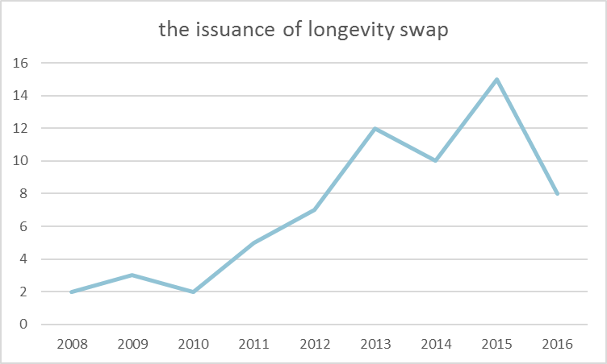
Longevity Swaps
· Figure 3. shows the issuance of longevity swap has been increasing and peaked in 2015. We could imply that the market of longevity swap is still growing.
Notes:
2015年有15筆這樣交易紀錄, 我們透過這個圖也可以到longevity swap的數量有逐年上升的趨勢

Slide 13
Some Recent Longevity Swaps
Sponsor | Provider | Solution | Size | Date
Unnamed defined benefit pension scheme | Zurich / SCOR | Longevity swap & reinsurance | £300 million | Jan 2017
Canadian Bank Note Company, Limited | Canada Life Assurance | Longevity swap & reinsurance | $35 million | Nov 2016
AXA France | RGA Re | Longevity swap & reinsurance | €1.3 billion | Nov 2016
Unnamed defined benefit pension scheme | Zurich / Pacific Life Re | Longevity swap & reinsurance | £50 million | Oct 2016
Two Pirelli pension plans | Zurich / Pacific Life Re | Longevity swap & reinsurance | £600 million | Aug 2016
Astra Zeneca | Deutsche Bank / Abbey Life | Pensioner bespoke longevity swap | £2.5 billion | Dec 2013
Carillion | Deutsche Bank / Abbey Life | Pensioner bespoke longevity swap | £1 billion | Dec 2013
Aegon | Société Générale CIB / SCOR | Longevity swap to capital market investors and reinsurers | €1.4 billion | Dec 2013
BMW | Deutsche Bank / Abbey Life | Pensioner bespoke longevity swap | £3 billion | Feb 2010
Canada Life (UK arm) | JP Morgan | Pensioner bespoke longevity swap | £0.5 billion | Sep 2008

Slide 14
Literature Review
Dowd et al. (2006, JRI) investigates longevity swaps in some detail, and suggests how their premiums and might be determined in an incomplete market.
Dawson et al. (2010, JRI) estimate the value of longevity derivatives following the framework of Dowd et al.
Cairns et al. (2014, QF) argue that the correlation between the value of liabilities and the value of hedging instrument makes good proxy as a measure of hedge effectiveness.

Slide 15
Literature Review
Biffis et al. (2016, JRI) provide a framework to quantify the trade-off between the exposure to counterparty risk in longevity swaps and the cost of credit enhancement strategies such as collateralization. They provide several numerical examples showing how different collateralization rules shape longevity swap rates
The literature uses a reduced-form approach in which the counterparty default risk is assumed to be determined exogenously.
We develop a Merton-type structural model that can explicitly take into account of stochastic mortality and interest rate, and the counterparty default risk is endogenously determined.
Notes:
Cairns 它們在2014年的文獻中提到 負債價值及避險工具價值的相關性會是衡量這個避險工具避險有效性的一個很好的衡量指標
那我們認為說 透過structural model 我們不用只是給一個相關性 我們可以獨立建立liability的model來進行評價 而且可以看到在不同的面向下 交易對手的資產風險及財務狀況 對於這個longevity swap價值的影響

Slide 16
Longevity Swap Valuation
H(t) is predetermined, expected longevity rates
π is the spread or risk premium.
S(t) is the actual experienced longevity rate of the life insurer
(1+π)H(t)
Life
Insurer
Investment
Bank
S(t)

Slide 17
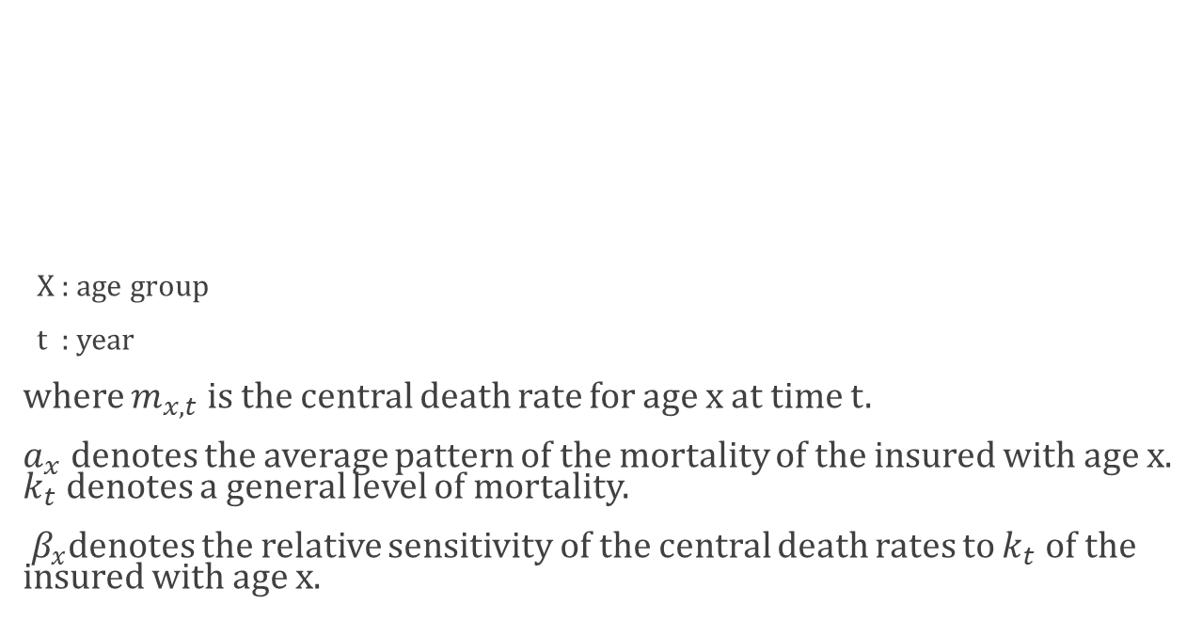
Lee-Carter Mortality Model
X : age group
t : year
where $m_{x,t}$ is the central death rate for age x at time t.
$a_{x}$ denotes the average pattern of the mortality of the insured with age x. $k_{t}$ denotes a general level of mortality.
$β_{x}$denotes the relative sensitivity of the central death rates to $k_{t}$ of the insured with age x.
$$\ln{m_{x,t}}= a_{x}+β_{x}k_{t}+ε_{x,t}$$
$$m_{x,t}=e^{a_{x}+β_{x}k_{t}+ε_{x,t}}$$

Slide 18
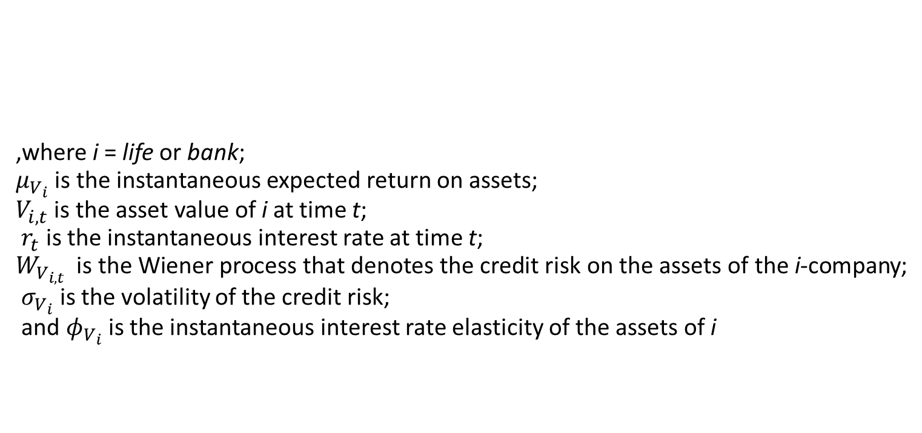
Dynamics of Asset Value
,where i = life or bank;
$μ_{V_{i}}$ is the instantaneous expected return on assets;
$V_{i,t}$ is the asset value of i at time t;
$r_{t}$ is the instantaneous interest rate at time t;
$W_{V_{i,t}}$ is the Wiener process that denotes the credit risk on the assets of the i-company;
$σ_{V_{i}}$ is the volatility of the credit risk;
and $φ_{V_{i}}$ is the instantaneous interest rate elasticity of the assets of i
Notes:
Follow 段老師和俞老師的process

Slide 19

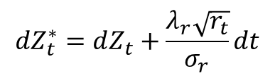




Interest Rate Process
Follow Cox et al. (1985)
$$dr_{t}=κ\left(h−r_{t}\right)+σ_{r}\sqrt{r_{t}}dZ_{t}$$
$$dr_{t}=κ^{∗}\left(h^{∗}−r_{t}\right)+σ_{r}\sqrt{r_{t}}dZ_{t}^{∗}$$
$$h^{∗}=\frac{κh}{κ+λ_{r}}$$
$${dZ}_{t}^{∗}=dZ_{t}+\frac{λ_{r}\sqrt{r_{t}}}{σ_{r}}dt$$
,where
$$κ^{∗}=κ+λ_{r}$$
$λ_{r}$ denotes the market price of interest rate risk
$Z_{t}^{∗}$ is a Wiener process under Q
Notes:
我們follow cox et al. 在1985年提出的這個利率的process 可以幫助我們避免利率出現負值
在風險中立的測度下我們可以寫成第二個式子

Slide 20
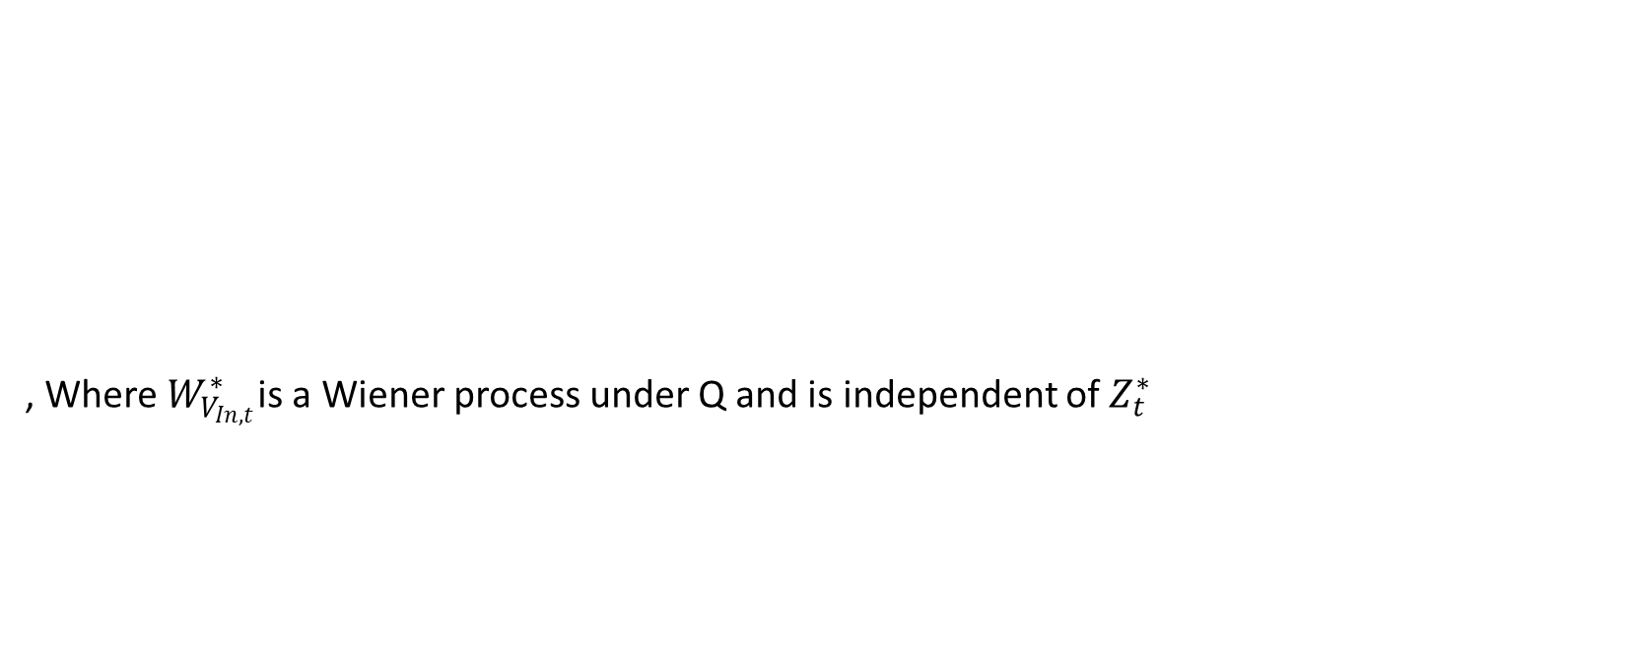
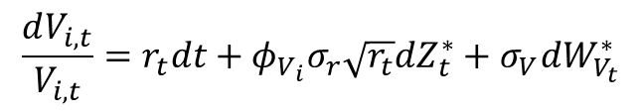
Stochastic Asset Process
, Where $W_{V_{In,t}}^{∗}$is a Wiener process under Q and is independent of $Z_{t}^{∗}$
$$\frac{dV_{i,t}}{V_{i,t}}=r_{t}dt+φ_{V_{i}}σ_{r}\sqrt{r_{t}}dZ_{t}^{∗}+σ_{V_{ }}dW_{V_{t}}^{∗}$$

Slide 21
Dynamics of Liabilities
Following Norberg (2002), the liability of a life insurance could be described as the present value of the contingent claims
The liability of the life insurer would be
Notes:
壽險公司的主要負債來源是他的責任準備金 那我們認為壽險公司主要的業務有兩塊 死亡險和生存險
根據Norberg 在2002年提出的第一式，前段是保險公司未來要付出的死亡險保險金的現值 後段是生存險保險金的現值

Slide 22
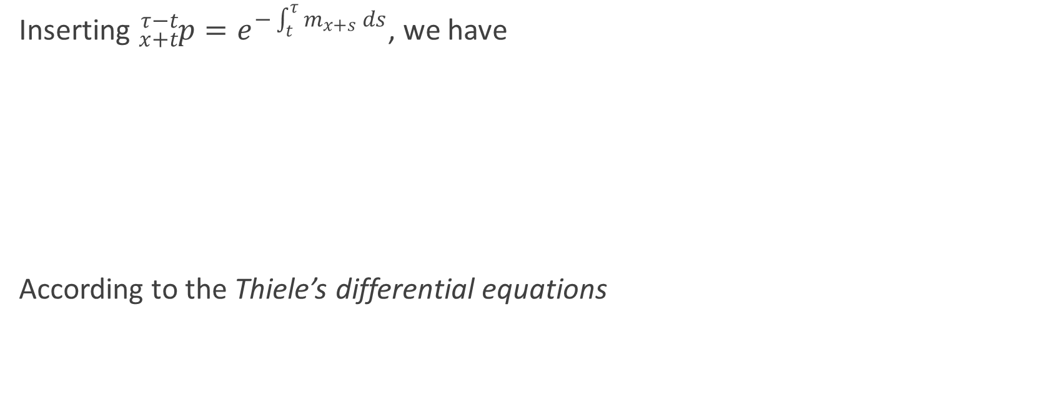
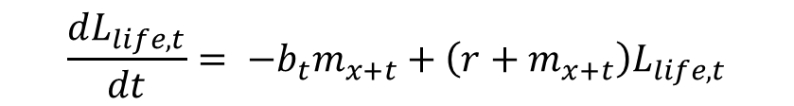
Dynamics of Liabilities
Inserting ${}_{x+t}^{τ−t}p=e^{−\int_{t}^{τ}{m_{x+s} ds}}$, we have
According to the Thiele’s differential equations
$$\frac{dL_{life,t}}{dt}= −b_{t}m_{x+t}+\left(r+m_{x+t}\right)L_{life,t}$$
Notes:
根據Norberg使用 thiele’s differential equation整理過後 我們可以把壽險公司的負債動態用這個式子表示

Slide 23
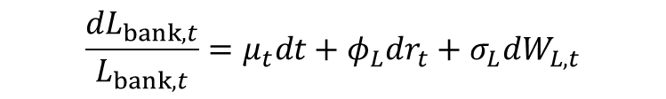
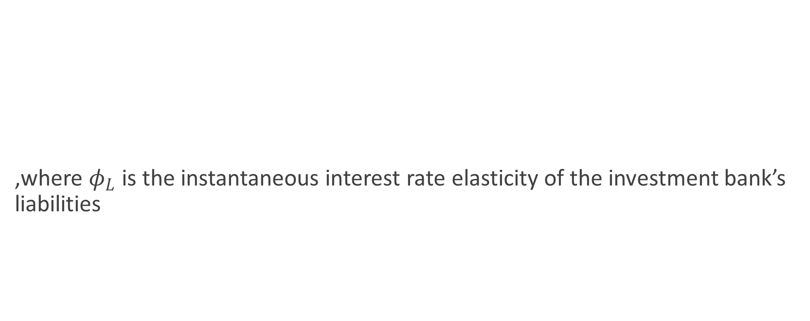

Dynamics of Liabilities
,where $φ_{L}$ is the instantaneous interest rate elasticity of the investment bank’s liabilities
$$\frac{dL_{bank,t}}{L_{bank,t}}=μ_{t}dt+φ_{L}dr_{t}+σ_{L}dW_{L,t}$$
$$\frac{dL_{bank,t}}{L_{bank,t}}=r_{t}dt+φ_{L}σ_{r}\sqrt{r_{t}}dZ_{t}^{∗}+σ_{L}dW_{L,t}^{∗}$$

Slide 24
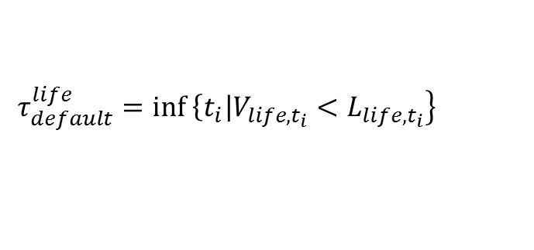


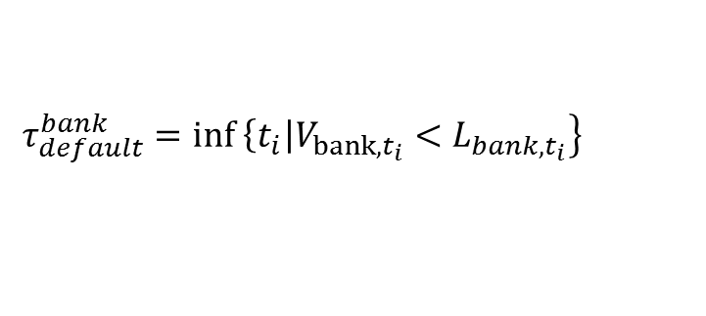
Termination of Longevity Swap
Stopping time
Swap is terminated when one party is insolvent!
$$τ_{default}^{life}=\inf\left. \left\{t_{i}\right|V_{life,t_{i}}<L_{life,t_{i}}\right\}$$
$$τ_{default}^{bank}=\inf\left. \left\{t_{i}\right|V_{bank,t_{i}}<L_{bank,t_{i}}\right\}$$
$$τ_{default}=min\left\{τ_{default}^{life} , τ_{default}^{bank}\right\}$$
$$τ^{∗}=min\left\{τ_{default} , T\right\} .$$

Slide 25
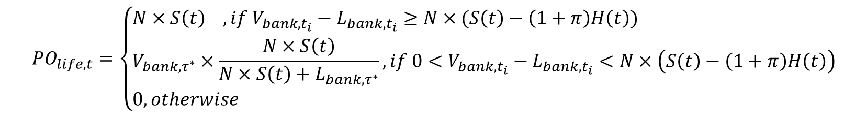
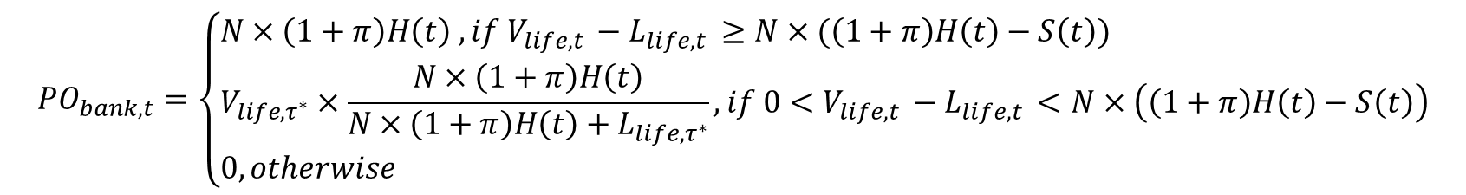
Payoffs of Longevity Swap

Slide 26
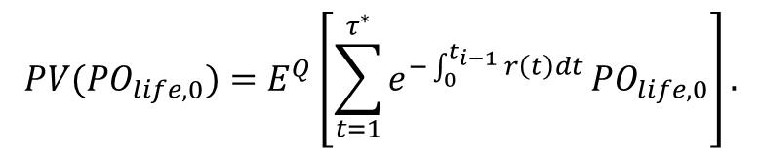

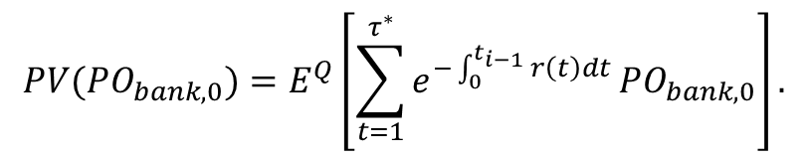
Spread/Price of Longevity Swap
$${PV(PO}_{life, 0})=E^{Q}\left[\sum_{t=1}^{τ^{∗}}{e^{−\int_{0}^{t_{i−1}}{r\left(t\right)dt}}}{PO}_{life, 0}\right].$$
$${PV(PO}_{bank, 0})=E^{Q}\left[\sum_{t=1}^{τ^{∗}}{e^{−\int_{0}^{t_{i−1}}{r\left(t\right)dt}}}{PO}_{bank, 0}\right].$$
π = $\frac{E^{Q}\left[\sum_{t=1}^{τ^{∗}}{e^{−\int_{0}^{t_{i−1}}{r\left(t\right)dt}}}{PO}_{life, 0}\right]}{E^{Q}\left[\sum_{t=1}^{τ^{∗}}{e^{−\int_{0}^{t_{i−1}}{r\left(t\right)dt}}}{PO}_{bank, 0}\right]}−1$
Notes:
Follow Dowd 及Dawson它們的作法，我們可以用壽險公司得到的現值去除以投資銀行收到的現值減去一 就得到spread

Slide 27
Numerical Analysis
Take the first capital market longevity swap for example
Canada Life has a total asset value of C$ 203,695
million and a total liability value of C$ 192,611
million
JP Morgan has a total asset value of $2,351,698 M
and a total liability value of $2,104,125 M

Slide 28
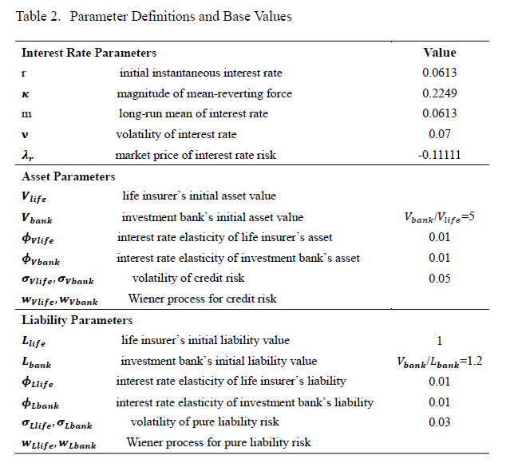

Slide 29
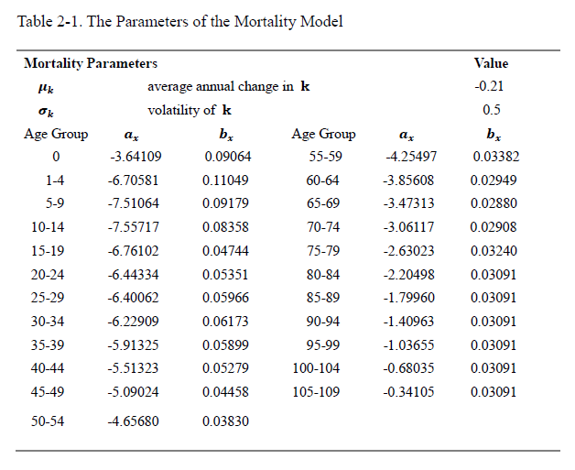
Notes:
St , Ht= ?

Slide 30
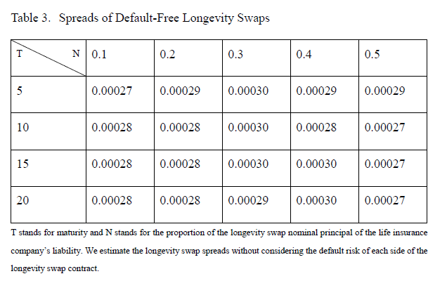

Slide 31
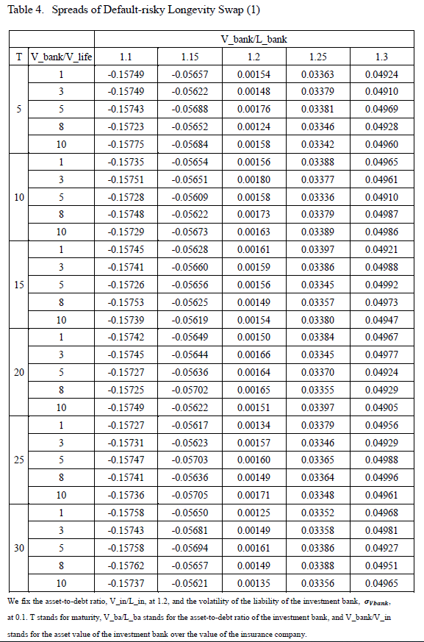

Slide 32
Numerical Analysis Result 1
Table 3
Default-free spreads are in the range of 2.7 bp to 3.0 bp for the longevity swaps with alternative nominal amounts and maturities.
Table 4 Default-Risky spreads
Spreads decrease substantially with IB leverages but not with relative size of IB and swap maturities

Slide 33
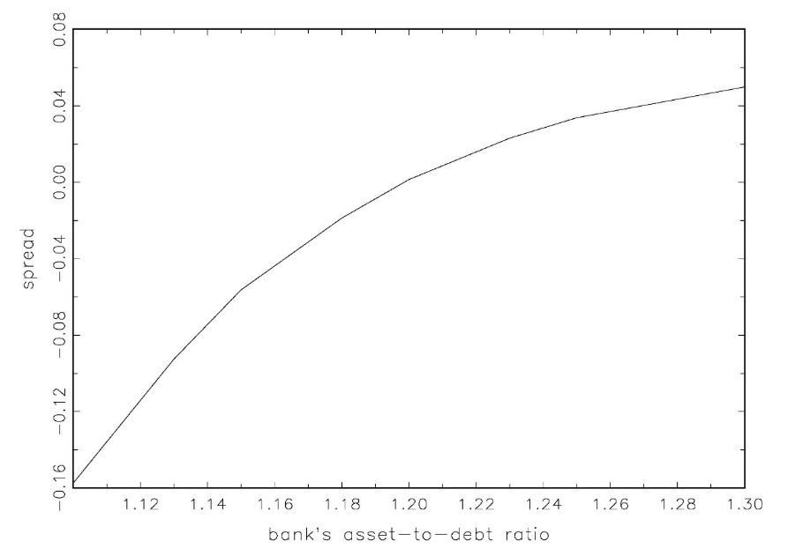
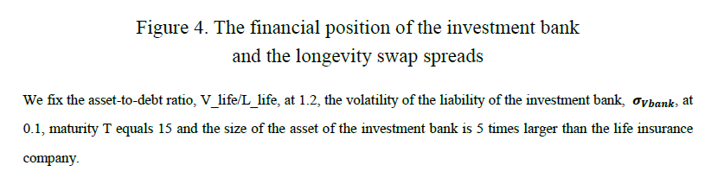

Slide 34
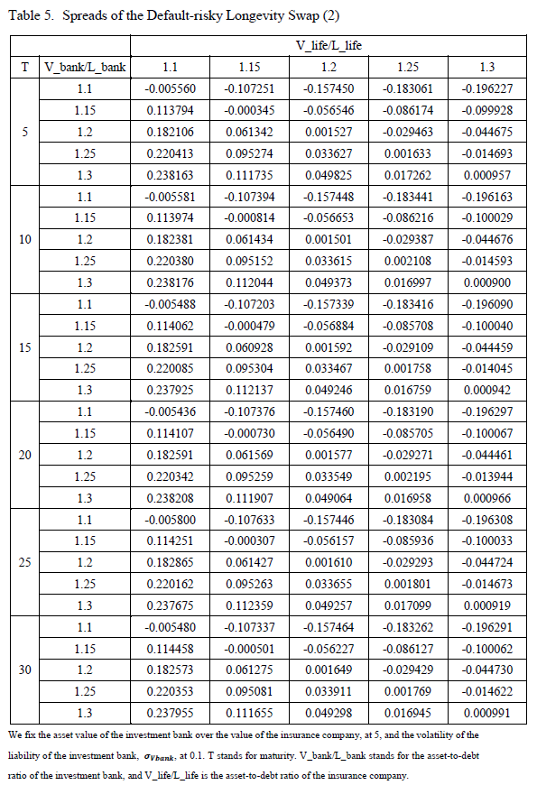

Slide 35
Numerical Analysis Result 2
Table 5 Default-Risky spreads
Spreads decrease significantly with IB leverages but increase with insurance company’s leverages, and do not change with swap maturities.
Table 6-7-8 Default-Risky spreads
Spreads decrease significantly with IB leverages and its asset risk, and are negative in most cases.
Spreads increase significantly with insurance company’s leverages, but decrease with IB’s asset risk.

Slide 36
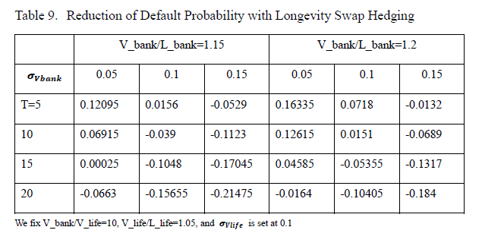

Slide 37
Numerical Analysis Result 3
Table 9
Hedging effect or reduction of default risk is more effective in cases with low-leverage and low-asset- risk IB.
Hedging could be ineffective when IB has high leverage and asset risk.

Slide 38
Summary
This paper develops a Merton-type structural model with stochastic interest rates and mortality rates to value longevity swaps.
We compute the spreads of longevity swaps using the Monte Carlo simulation to show how spreads and hedging effectiveness of the longevity swap change with key variables in the model.
Endogenous counterparty default risk
Notes:
我們develop一個獨立考慮利率風險與資產風險的model 可以觀察在不同面向下 壽險公司財務狀況及投資銀行財務狀況與投資銀行的資產風險對spread的影響
根據我們的數值分析 在這邊可以得到一些小結論
當投資銀行的資本負債比上升也就是財務狀況較佳時 spread也會隨之上升
當投資銀行對壽險公司的資產規模上升時 spread較無明顯的差異
投資銀行的資產風險是一個非常重要影響避險有效性非常重要的因素，特別是在投資銀行的財務結構較弱的狀況下

Slide 39
THANK YOU FOR YOUR ATTENTION

Slide 40
Numerical Analysis Result 3
When the nominal principal increases, the spread
would also increase, because the life insurer is more likely to default on the contract than the investment bank.
Table 9
Hedging effect, Reduction of default risk,

Slide 41
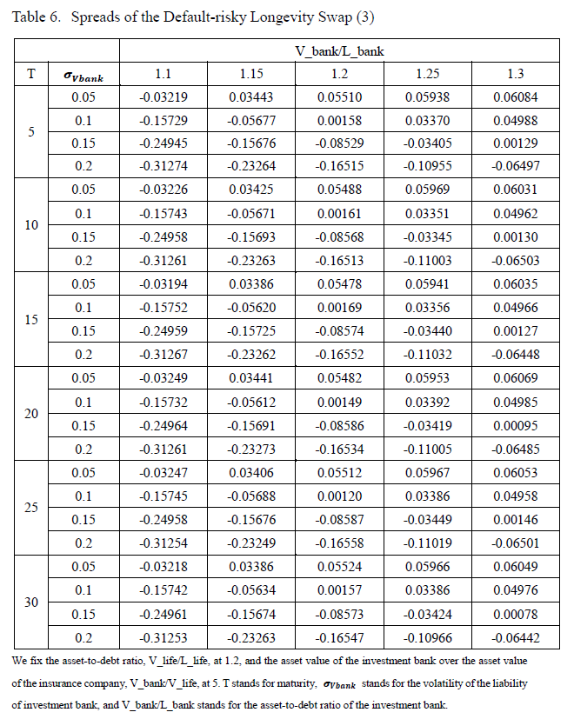

Slide 42
Numerical Analysis Result
When the longevity rate increases, the spread
rises
When the longevity rate decreases, the spread
decreases as well since the longevity risk of the
life insurance company is lower

Slide 43
Numerical Analysis Result
When the interest rate rises, the spread of the
longevity swap also rises.
When the volatility of the interest rate increases,
the spread of the longevity swap decreases

Slide 44
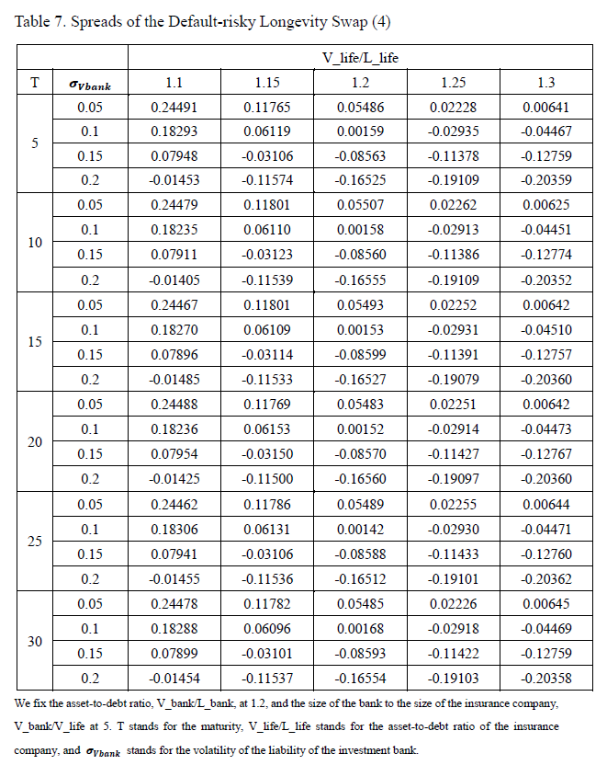

Slide 45
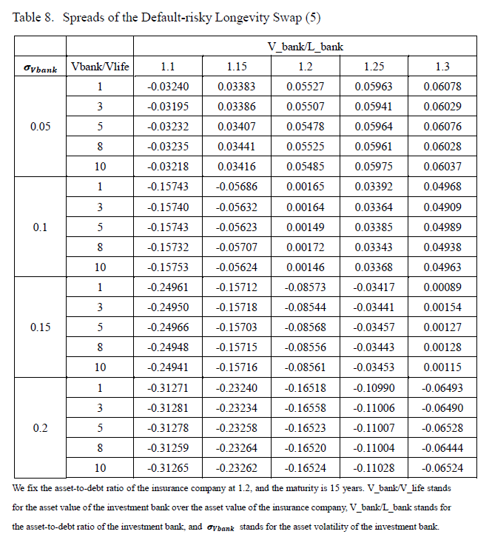

Slide 46
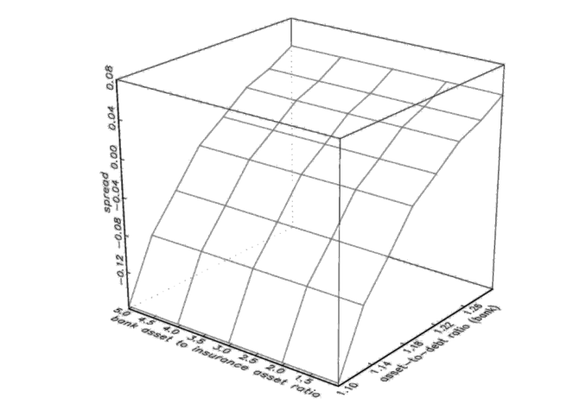
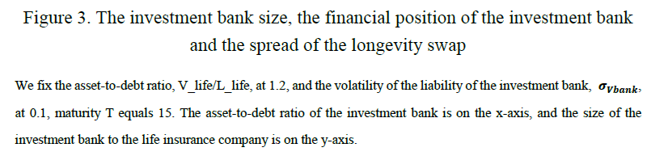

Slide 47
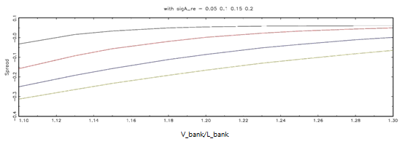
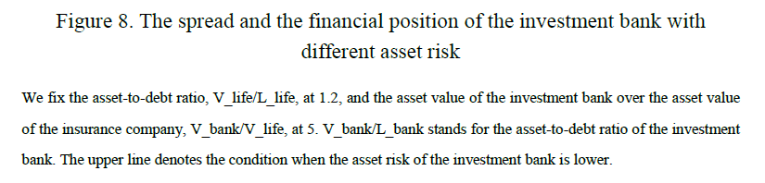

Slide 48
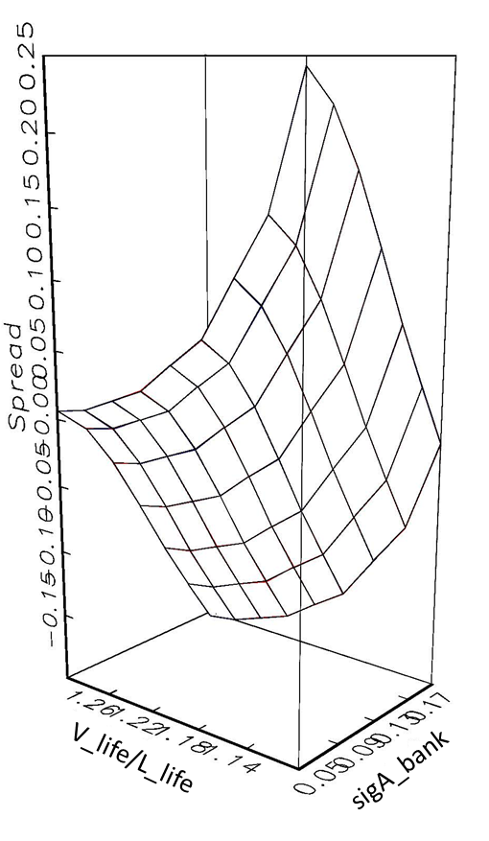
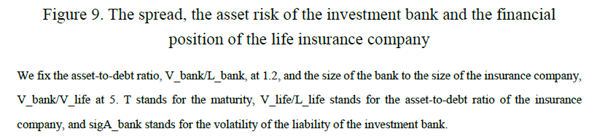

Slide 49
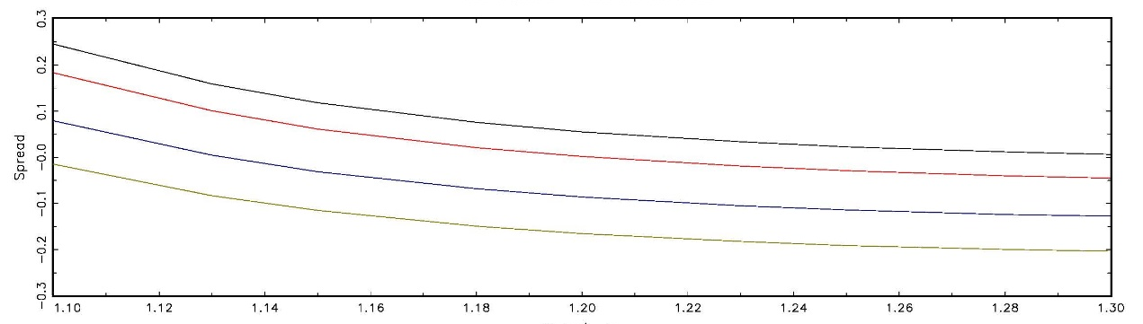
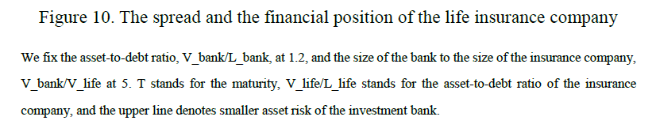

Slide 50
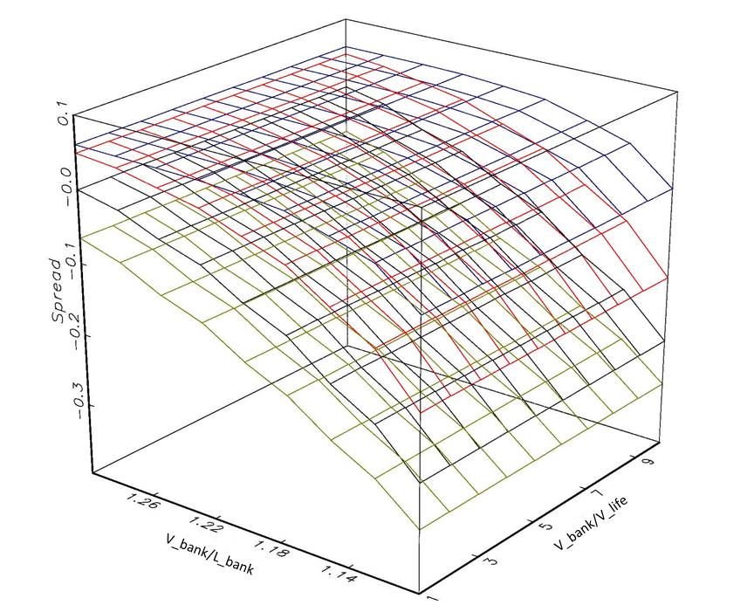
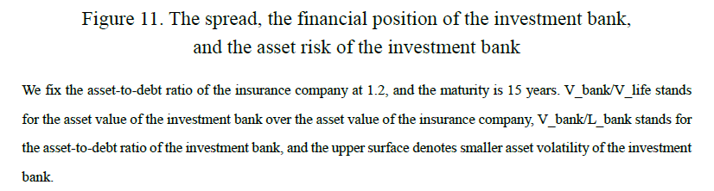

Slide 51
Outline
Introduction
  What is longevity risk?
  How do we deal with longevity risk?
    Bond
    Reinsurance
    Swap
Valuation
  Interest Rate Swap
  Longevity Swap
  Lee-Carter Mortality Model
  Valuation of Longevity Swap
Numerical Analysis Results
Summary
Questions

Slide 52
Solution 1 –Longevity Bond
Bond Holders
Floating S(t)
EIB
BNP
Interest Rate Swap
Issue Price
Mortality Swap
Partner Re.

Slide 53
Solution 2 –Reinsurance
Life
Insurance
Company
Reinsurance
premium
Policy
Holder
Reinsurance
A share of claims

Slide 54
Interest Rate Swap Valuation
LIBOR
Intel
Microsoft
5%
Floating Payer
Fixed Payer

Slide 55
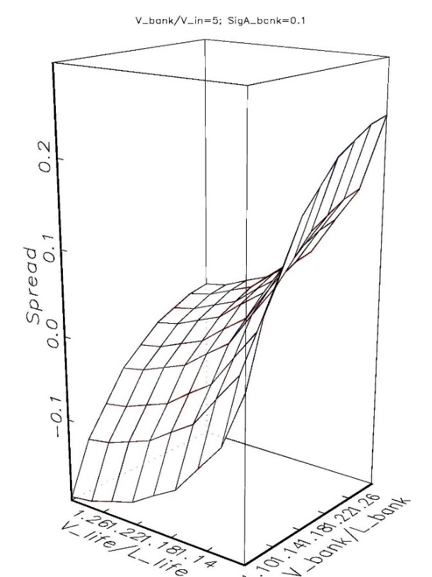
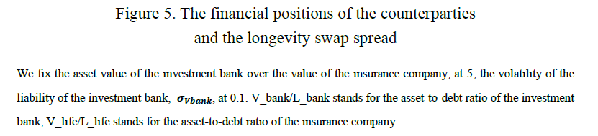

Slide 56
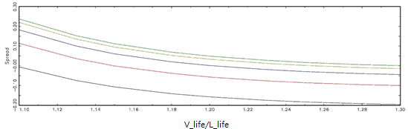
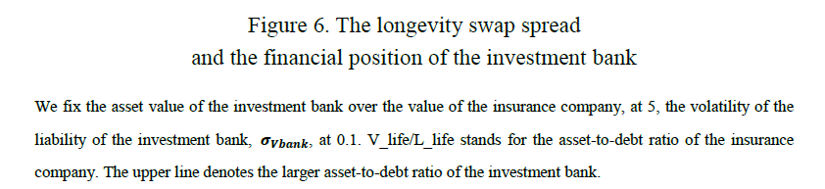

Slide 57
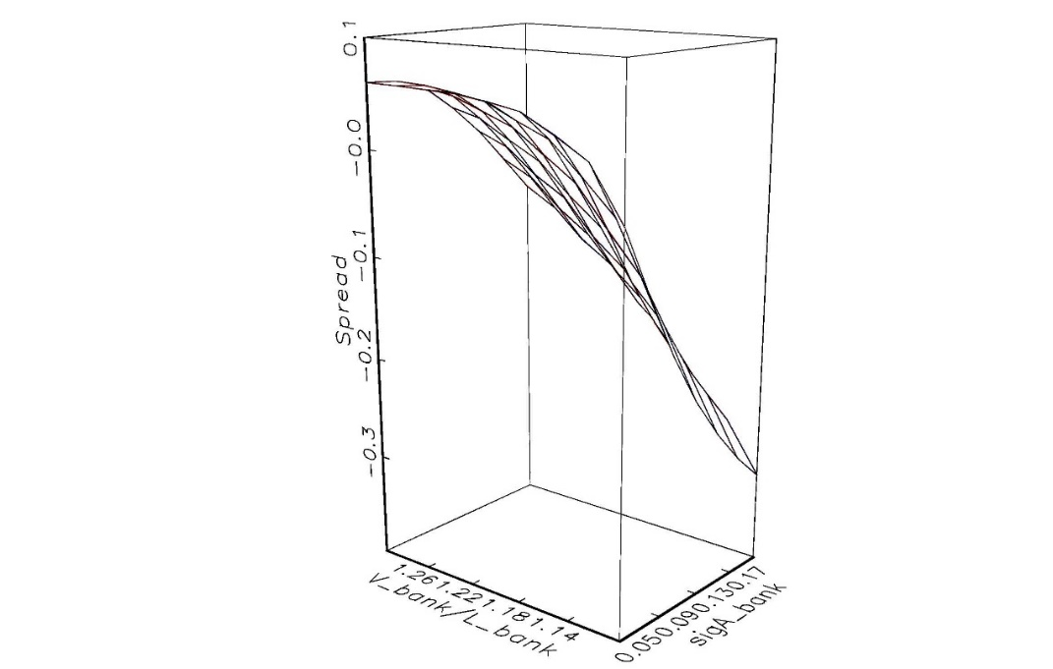
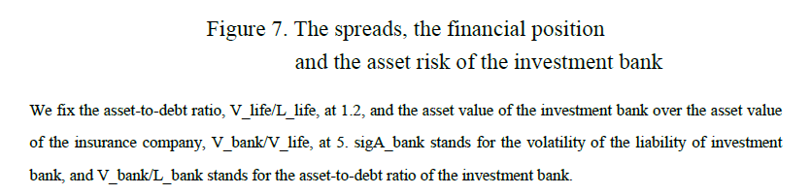

Slide 58
Reduction of Default Rate with Longevity Swap Hedging
 | V_in/L_in
 | 1.1 | 1.2 | 1.3
T=10 | 0.2998% | 1.1302% | 2.4905%
T=20 | 0.502% | 2.7989% | 3.141%
T=30 | 0.6251% | 1.7036% | 3.0104%
We set V_bank/V_in=5, V_bank/L_bank=1.2, $σ_{Vbank}$=0.1
the asset-to-debt ratio of the insurance company is 1.2 and maturity equals to 30 years, the default probability falls approximately 1.70%.
We could generally observe that longevity swap indeed help lower the default risk of the insurance company.
Notes:
可以看到做了longevity swap有助於壽險公司本身的違約風險下降
譬如說在壽險公司資產負債比1.2時 30年期的longevity swap可以幫助壽險公司的違約機率下降1.7個percent左右

Slide 59
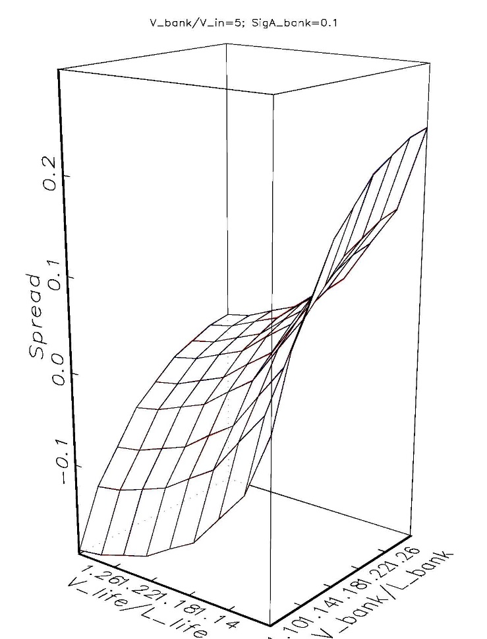
Numerical Analysis Result
When the asset-to-debt ratio of the insurance company is low, the counterparty would ask for a much higher spread than when the insurance company has a higher asset-to-debt ratio
When an insurance company has a weak financial position and the cost of engaging a longevity contract is high, a longevity swap may not be a suitable instrument to mitigate the longevity risk
Notes:
固定投資銀行的資產風險0.1 投資銀行對壽險公司的資產規模五倍時
可以看到 當壽險公司本身有較好的財務狀況時 投資銀行的財務狀況對spread的影響比起…微小
當壽險公司的財務狀況較弱的時候 投資銀行的財務狀況就會較為劇烈的影響spread上升

Slide 60
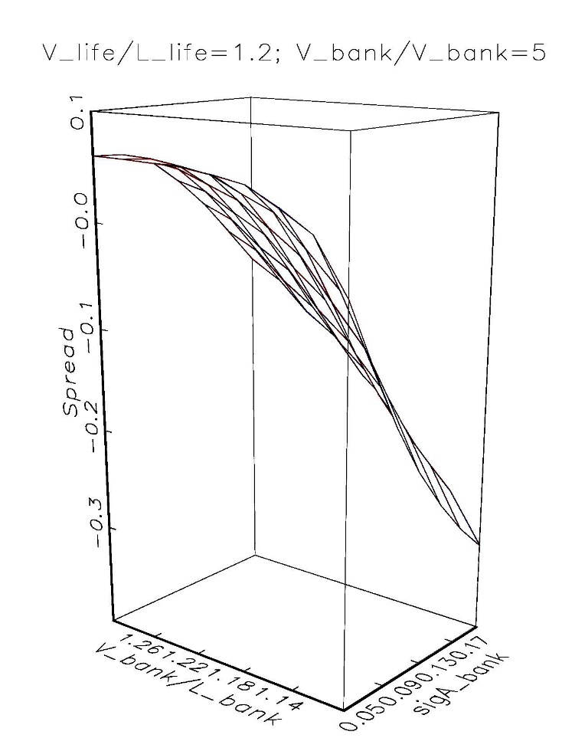
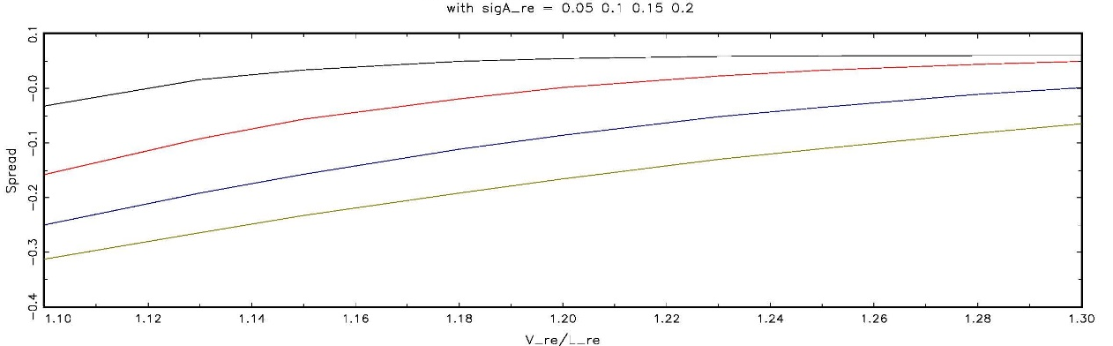
Numerical Analysis Result
When the asset-to-debt ratio is lower, the more the volatility of the asset of the investment bank influences the spread
The weaker is the financial position of the investment bank, the more careful the insurance company should be about the investment bank’s asset portfolio
Notes:
固定壽險公司的資產負債比1.2 投資銀行資產對壽險公司資產在五倍時
當投資銀行具有較強的財務結構 資產風險對spread的影響就比較小
當投資銀行的財務結構較弱時 資產風險影響spread就會十分劇烈
左圖最上方的線是投資銀行資產風險較小時(0.05) 最下方的線是投資銀行的資產風險較大時(0.2)
可以觀察到當投資銀行的財務狀況較弱時 投資銀行的資產風險對spread會有較為劇烈的影響

Slide 61
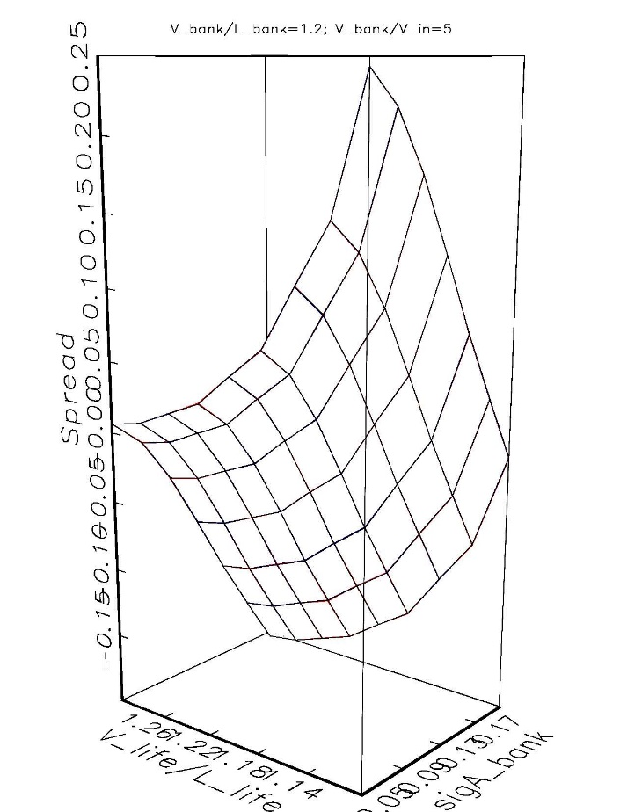
Numerical Analysis Result
When the financial position of the insurance company is weak, the spread surges as the volatility of the asset of the investment company declines
When the financial position of the insurance company is weak, the spread is so large that the cost of engaging a longevity swap contract may not be a wise hedging solution
Notes:
固定投資銀行的資產負債比在1.2 投資銀行對壽險公司資產規模5倍時
觀察壽險公司財務狀況及投資銀行資產風險對spread的影響
當壽險公司財務狀況較弱時, 投資銀行的資產風險如果降低, 會導致有非常高的spread產生
當我自己壽險公司財務狀況較弱時 交易對手的資產風險就很重要 避險基本上是仰賴交易對手進行 避險的效果就會受到影響

Slide 62
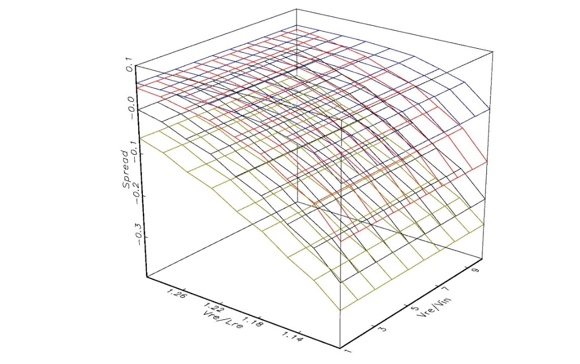
Numerical Analysis Result
When the volatility of the asset value of the investment company is higher, the lower the spread is
The volatility of the asset value of the investment bank affects the spread less when the financial position of the investment bank is strong
When engaging a longevity swap contract with an investment bank, which has a lower asset-to-debt ratio, the insurance company should be more careful of the financial structure of the investment bank
Notes:
固定壽險公司資產負債比在1.2
投資銀行對壽險公司的資產規模 影響spread較小
投資銀行的財務狀況較強時 投資銀行的資產風險對spread的影響就較小 當投資銀行的財務狀況較弱時 投資銀行的資產風險對spread的影響就較大

Slide 63
Questions
When the life insurance company has a weaker financial position, ceteris paribus, the spread is (higher/lower)
If the asset risk of the investment bank is higher, ceteris paribus, the spread is (higher/lower)
When the actual longevity rate the life insurance company experienced decreases, ceteris paribus, the spread is (higher/lower)

