Slide 1
Longevity 14, Amsterdam 20 Sept. 2018
Longevity: Past, Present, Future
James W. Vaupel
AXA Professor of Longevity Research
University of Southern Denmark

Slide 2
The frontier of survival
The life expectancy revolution
95
Australia
90
Netherlands
Switzerland
85
Sweden
Iceland
80
Japan
New Zealand
75
Life expectancy in years
Norway
70
Germany
65
60
55
50
45
Year
1840
1860
1880
1900
1920
1940
1960
1980
2000
2020

Slide 4
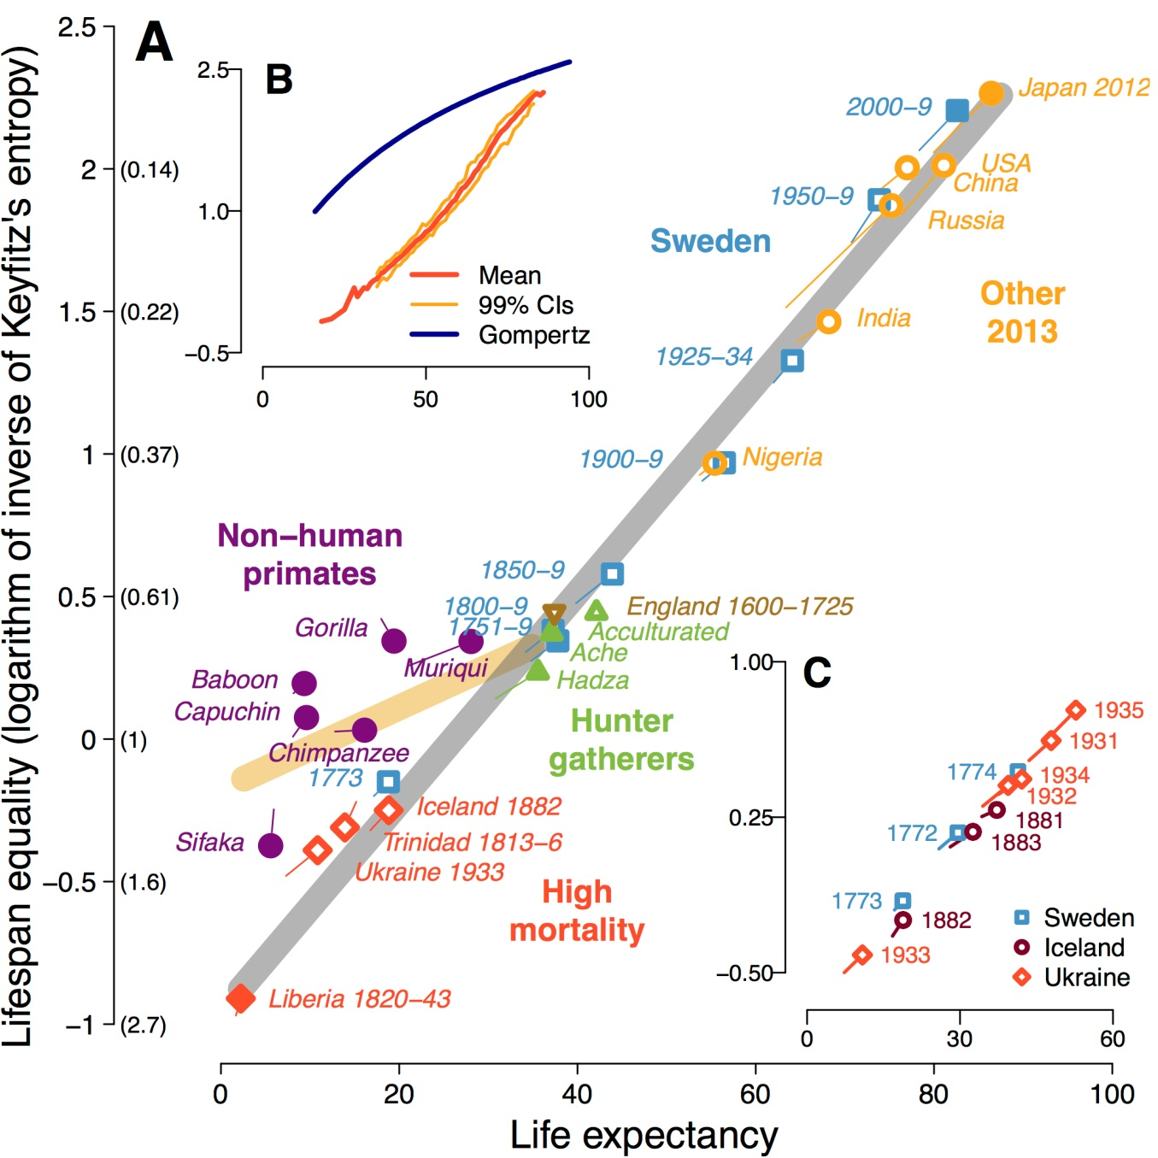
Colchero, …, Vaupel PNAS 2016
Emergence of Longevous Populations

Slide 5
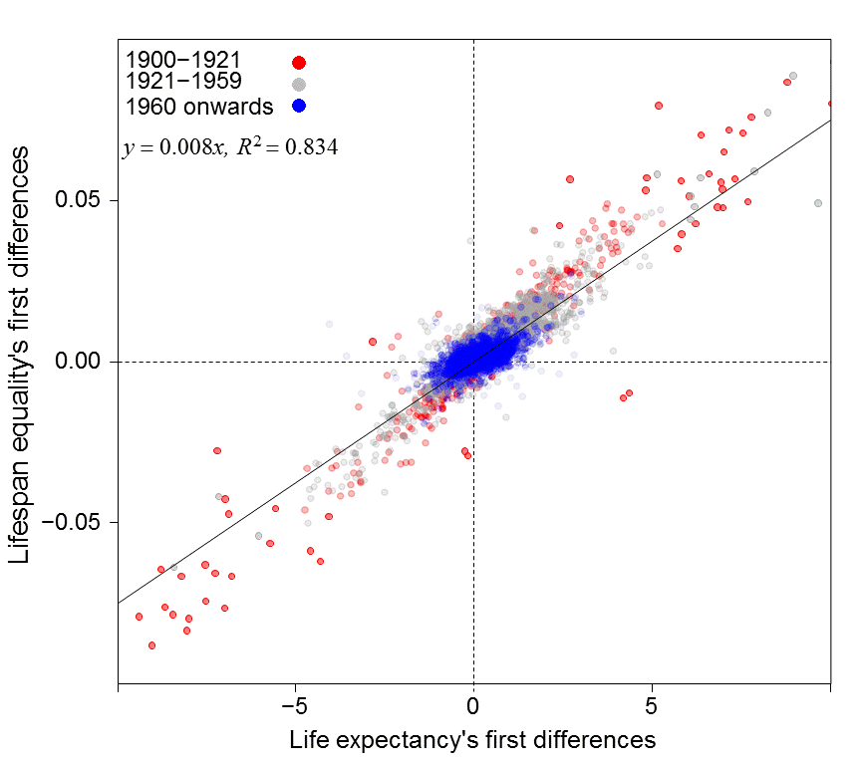
Section
Aburto, Basellini, Kjærgaard, Vaupel—in progress
Annual Changes—Life Expectancy vs. Lifespan Equality

Slide 7
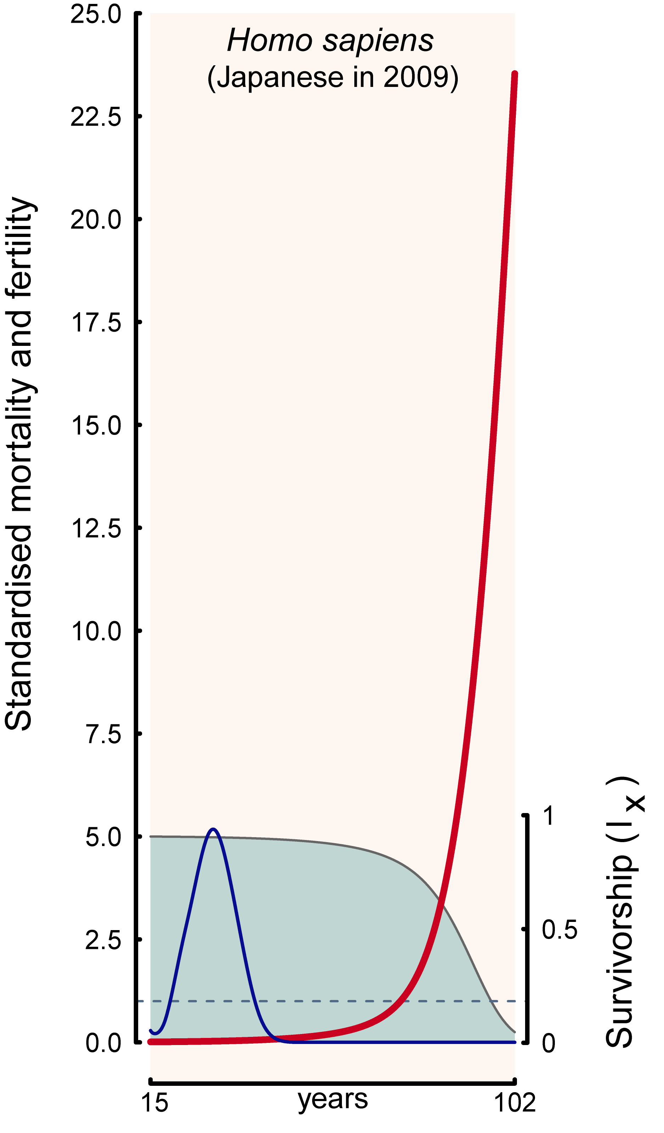

Slide 8
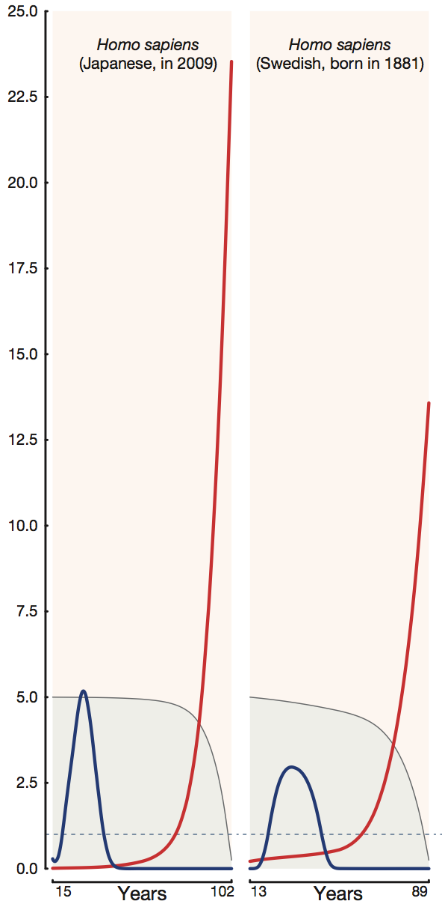
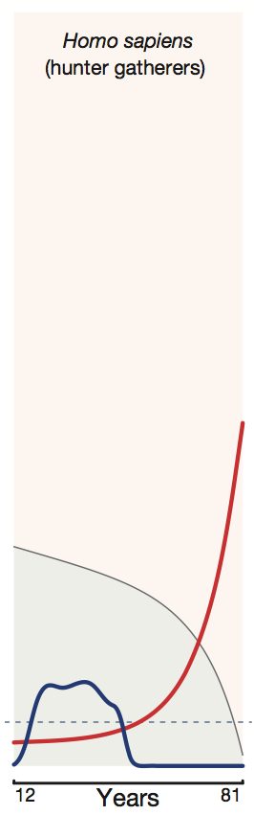
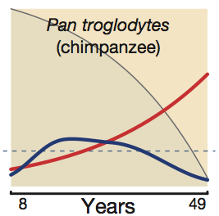
Humans & chimpanzees
Standardized mortality & fertility

Slide 9
The emergence of longevity
Hunter-gatherers
1
Hunter-gatherer, lowest mortality
Sweden, 1750-2010, 10 year intervals
0.1
Annual probability of death
0.01
0.001
0.0001
0
20
40
60
80
Age
Notes:
9

Slide 10
The frontier of survival
The postponement of senescence in Germany 1970-2014
65 = 55
1970
10%
2014
Mortality
1%
0.2%
50
55
55.4
65
80
Age

Slide 11
Oldest Age at which at least 50% of a Birth Cohort is Still Alive Christensen, Doblhammer, Rau & Vaupel Lancet 2009, extended
Year of Birth:
2000
2010
2015
France
102
105
107
100
103
105
Germany
Japan
105
107
110
Data are ages in years. Baseline data were obtained from the Human Mortality
Database and refer to the total population of the respective countries.

Slide 12
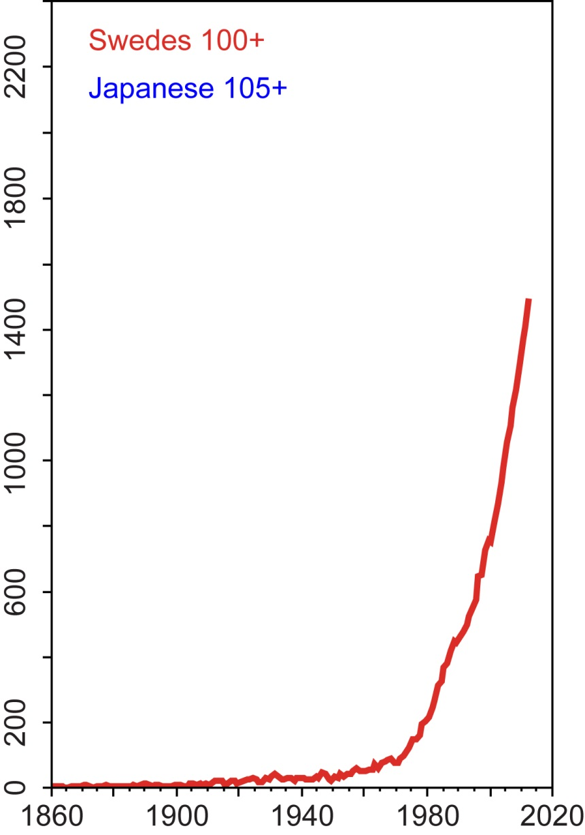

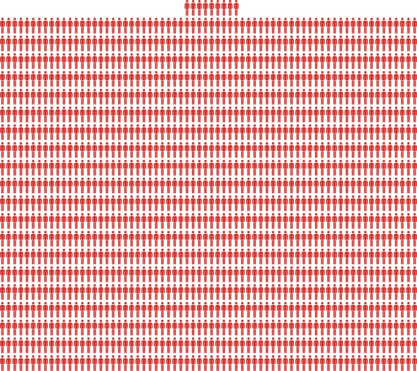
The explosion of centenarians
The frontier of survival
1860
5
Number of females aged 100+ or 105+
2010
1369
Year

Slide 13
Trends over time in e100 for female cohorts between 1800 and 1900

Slide 14
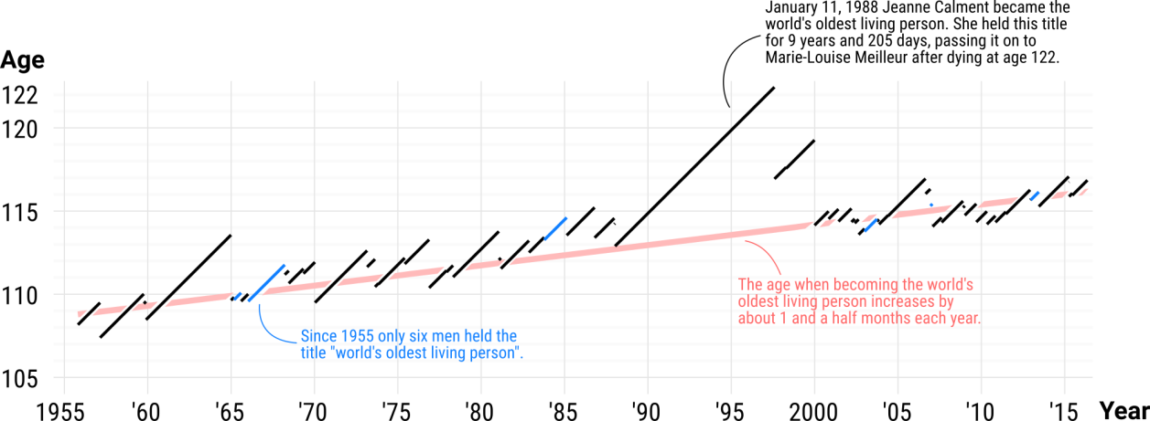
Lenart and Vaupel, Nature, 2017
Graph by Jonas Schoeley
Linearly increasing age of world’s oldest person

Slide 16
The Future Will Be Different from the Past
In next decade or two, progress against
cancer and dementia and in developing
genotype-specific therapies
Then progress in regenerating and eventually rejuvenating tissues and organs
Accompanied by progress in
replacing deleterious genes
Aided by nanotechnologies (nanobots)
Perhaps in a decade or two, probably later, progress in slowing the rate of aging (as opposed to further postponing aging).

Slide 17
Discussion: Forecasting Longevity
Expert judgment
Analyzing causes of death
Analyzing risk factors
Extrapolation

Slide 18
The two big uncertainties
1. Survival after age 100
--Will e(100) increase?
Analyze data at ages>100
Model mortality plateaus
--Have we reached the limit to longevity?
Analyze data on exceptional lifespans
Study other species
2. Biomedical breakthroughs of unprecedented impact

Slide 19
Thank you

Slide 20
Key publications
James W. Vaupel and Hans Lundström (1994) “Longer Life Expectancy? Evidence from Sweden of Reductions in Mortality Rates at Advanced Ages” in David A. Wise (editor) Studies in the Economics of Aging, U. of Chicago Press, pp. 79-94. This chapter presented the twin discoveries about the advancing frontier of human survival that Vaupel made in 1992 based on Swedish data compiled for him by Hans Lundström at Statistics Sweden. Unfortunately the research was presented in 1992 to a group of health and labor economists who did not understand the significance of the discoveries and the research was published in 1994 in a rather obscure book of the proceedings of the 1992 workshop.
An article by Vaupel et al. in Science introduced a much wider audience to the research breakthroughs: J.W. Vaupel et al. (1998) “Biodemographic Trajectories of Longevity”, Science 280, pp. 855-860.
Jim Oeppen and James W. Vaupel (2002) “Broken Limits to Life Expectancy”, Science 296, pp. 1029-1031. Although demographers knew that life expectancy was tending to increase in most countries, it was not realized until this article was published that an astonishing regularity underlay the progress: in the populations doing best, life expectancy has increased from a bit over 45 for Swedish women in 1840 to more than 87 for Japanese women today. The rise has been linear—3 months per year.
James W. Vaupel (2010) “Biodemography of Human Ageing”, Nature 464, pp. 536-542. This comprehensive review describes Vaupel’s discoveries and their implications for research and for society.
James W. Vaupel (2005) “The Biodemography of Aging” in L.J. Waite (editor) Aging, Health, and Public Policy: Demographic and Economic Perspectives, Population Council, New York, pp. 48-62 (Population and Development Review; 30, 2004, Suppl.). This is an earlier account by Vaupel of his research; the material in it is a lightly-edited transcript of impromptu remarks Vaupel made to a group of students.
James R. Carey,…, James W. Vaupel (1992) “Slowing of Mortality Rates at Older Ages in Large Medfly Cohorts”, Science 258, pp. 457-461.
James W. Curtsinger,…, James W. Vaupel (1992) “Biodemography of Genotypes: Failure of the Limited Lifespan Paradigm in Drosophila melanogaster”, Science 258, pp. 461-463.
.

Slide 21
Key publications continued
James W. Vaupel, Annette Baudisch et al. (2004) “The Case for Negative Senescence”, Theoretical Population Biology 65, pp. 339-351.
Annette Baudisch and James W. Vaupel (2012) “Getting to the Root of Aging”, Science 338, pp. 618-619. This short article summarizes why Hamilton was wrong: senescence is not inevitable.
Owen R. Jones,…, James W. Vaupel (2014) “Diversity of Ageing across the Tree of Life”, Nature 505, 169-173.
Ralf Schaible,…, James W. Vaupel (2015) “Constant Mortality and Fertility over Age in Hydra”, PNAS December 2015.
Fernando Colchero,…, James W. Vaupel (2016) “The Emergence of Longevity”, PNAS
Adam Lenart and James W. Vaupel (2017) “Problematic Limits to Human Lifespan”, Nature.
.
A fuller list of Vaupel’s publications can be found at user.demogr.mpg.de/jwv. This website provides electronic access to most of his articles. The website also provides access to several non-technical descriptions, published in the Lancet and elsewhere, of Vaupel and his research.

