Slide 1

Medically Underwritten Annuities
How alternative product design can lead to better outcomes for the insurer and consumer
Mark Flint, SCOR
Head of Product Development, Longevity
Han Yan, SCOR
Senior Research Actuary, Longevity
8 September 2025
Longevity 20 Conference

Slide 2
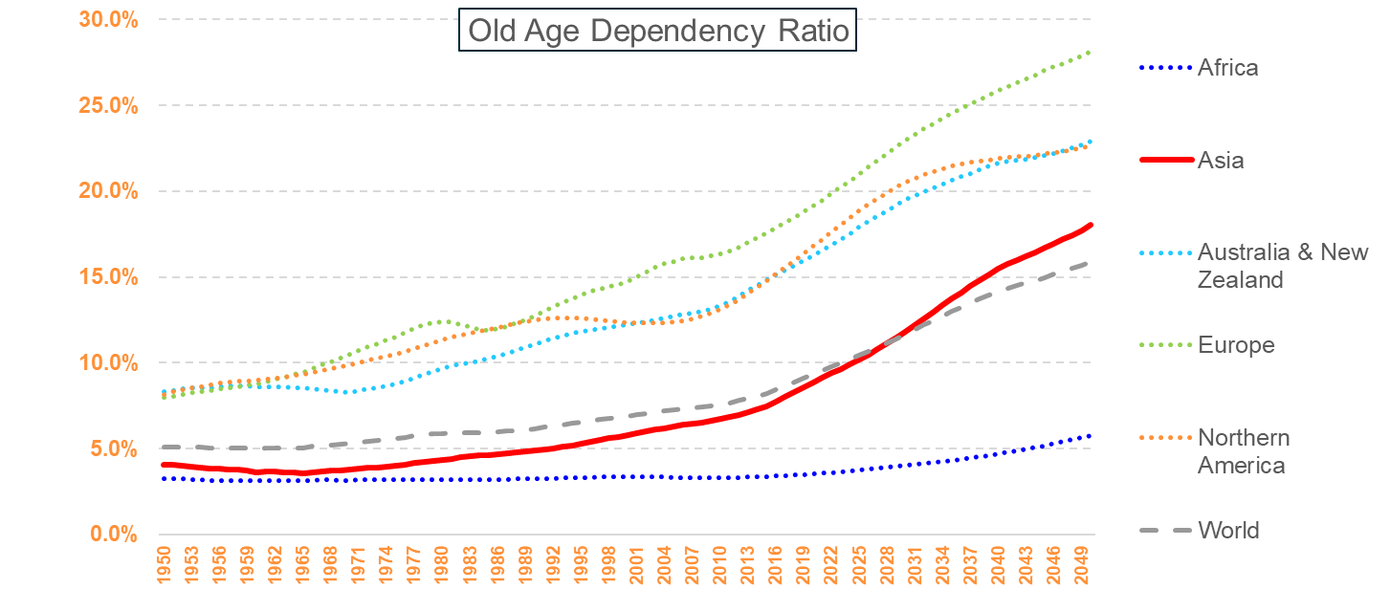
Retirement Market
Demographic change
Source: Allianz Pension Report 2020, The Silver Swan
Proportion of over 65s is growing rapidly in Asia.

Slide 3
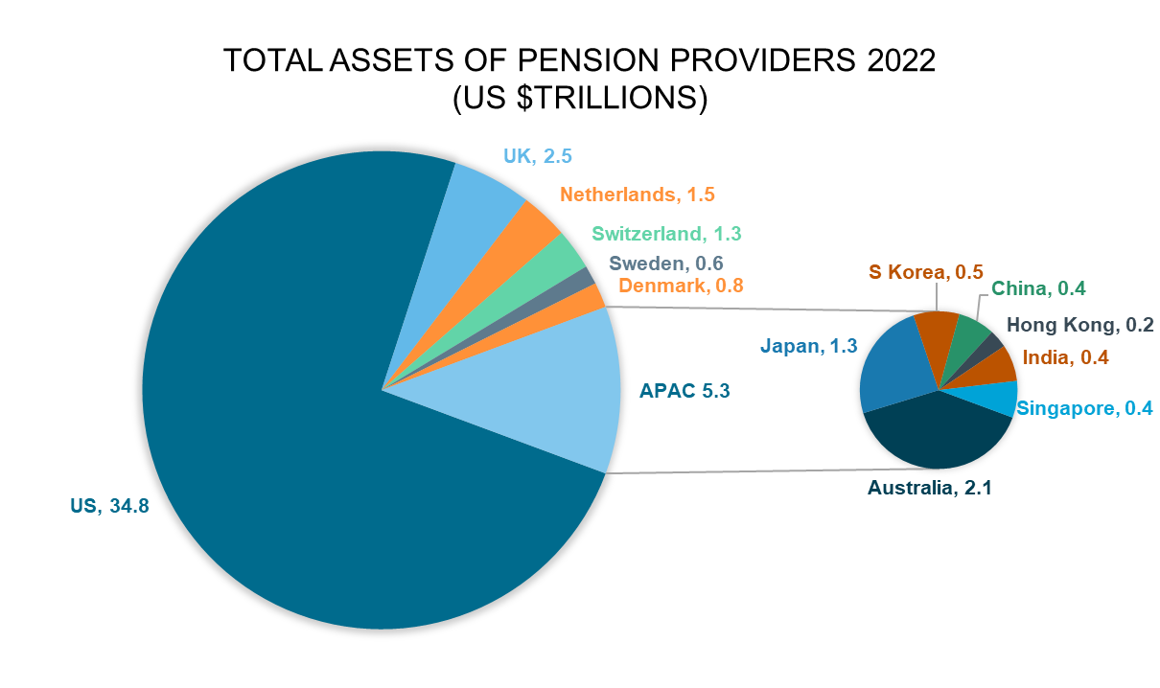
Retirement Market
Market size by jurisdiction
Source: OECD Report: Pension Markets in Focus 2024
Pension assets in APAC region is over US$5.3 trillion in 2022

Slide 4
Retirement Products
Insurance Provision
Government’s role
Varying amounts of longevity risk and asset risk cover by product for life
Annuities – guaranteed income
Drawdown – expected income from a pot of investments
Longevity Credits
Annuities
Tontine
Income Riders
Drawdown
Longevity risk transfer is an important aspect of insurance provision

Slide 5
Medically Underwritten Annuities
Benefits
Should a sick 65-year-old buy an annuity?
  Asset and longevity risk covered
  Better financial planning tool – medical and care cost at higher ages
  Medical underwriting increases attractiveness
For insurers…
  Higher demand than traditional annuity
  Product differentiation
  Minimise anti-selection risk
MUA is attractive to individuals and insurers

Slide 6
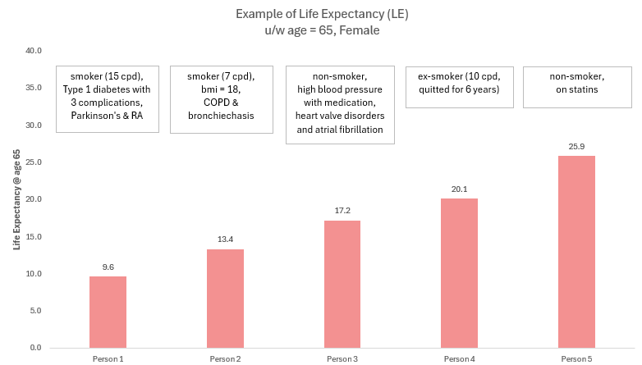
Medically Underwritten Annuities
Life Expectancy (LE) spread
Individual’s lifestyle and/or health information matters!
At age 65, life expectancy can be more than double between two individuals.
LE directly links to annuity payout!
LE and annuity value varies greatly among pensioners by lifestyle and/or health condition

Slide 7
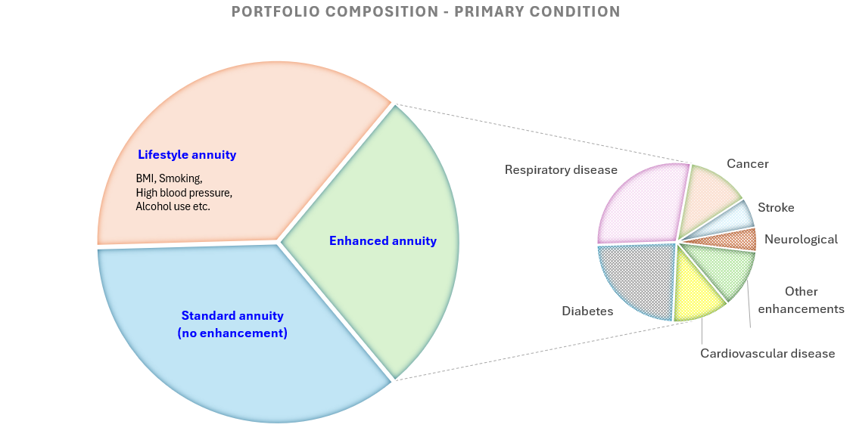
Medically Underwritten Annuities
To replace a picture :
Right click on the picture
Click on « Change Picture » / « From a file... »
Choose your picture (1920x1080px)
Portfolio composition
At retirement age, only 1 in 3 individuals is expected with no annuity enhancement

Slide 8
Medically Underwritten Annuities
To replace a picture :
Right click on the picture
Click on « Change Picture » / « From a file... »
Choose your picture (1920x1080px)
Further price differentiation
Premium size – a proxy to wealth
Location / type of house / average housing price among the residential complex etc.
Companionship
Final LE is determined by both health and non-health related information of an individual

Slide 9

Medically Underwritten Annuities
To replace a picture :
Right click on the picture
Click on « Change Picture » / « From a file... »
Choose your picture (1920x1080px)
What’s needed for pricing
Granular medical database (e.g., SEER)
Literature review of medical papers

Slide 10

Medically Underwritten Annuities
To replace a picture :
Right click on the picture
Click on « Change Picture » / « From a file... »
Choose your picture (1920x1080px)
Prostate cancer q_{x}
Cancer T-stage
Cancer M-stage
PSA level
Duration since diagnose
Cancer N-stage
Gleason score
What’s needed for pricing (cont’d)
Multi-factor modelling
Other considerations – mortality trend, basis of population, co-morbidities etc.
Collect the data from each applicant
$\log{m_{x}}=$ $β_{0}+β_{1}X_{1}…+β_{n}X_{n}$
Pricing requires relevant granular data and advanced modelling technique with considerations

Slide 11
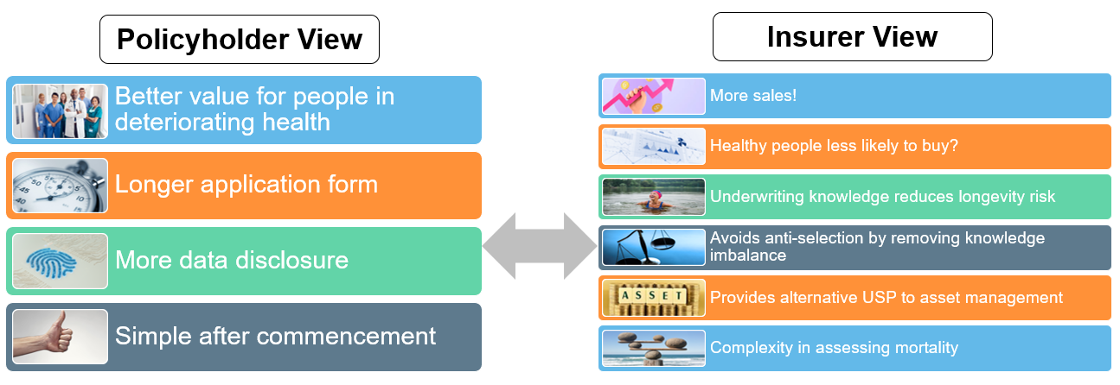


Medically Underwritten Annuities
Pros & Cons of underwriting
SPOLIER ALERT- No one Product will do all 5 well!
Value for money increases sales.
Attractive. Complicated but Reinsurers can help!

Slide 12

Thank You

Slide 13


