Slide 1

AI as Pricing Law
Stefano Iabichino, PhD
Available at: Risk.net and SSRN.com
Contact: Stefano.iabi@gmail.com
This paper represents the personal opinions of the author, and it is not intended to represent the position or opinions of UBS AG or any of its affiliates

Slide 2
Conventional AI in Markets
Neurons: nodes without meaning
Synapses: connections without law
Economic Hallucination
Arbitrage-freedom: an afterthought
Training-set dependent: internally consistent but externally naive
1

Slide 3
Re-imagining AI for Finance
Neurons: encapsulate economic states
Synapses: verify the First Fundamental Theorem of Finance
Finance-Native AI
Arbitrage-freedom: by design
Backward and forward passes; attention-guided
2

Slide 4
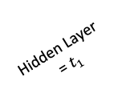
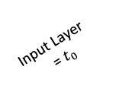
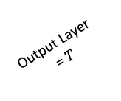
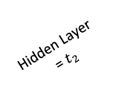
Neural Quantitative Finance
Neurons with Market Semantic
Risk-factor
State 3
Risk-factor
State 2
Risk-factor
State 1
Risk-factor
State 0
Neuron 3
Neuron 2
Neuron 1
Neuron 0
Input Layer
= $t_{0}$
Hidden Layer
= $t_{1}$
Hidden Layer
= $t_{2}$
Output Layer
= $T$
3

Slide 5
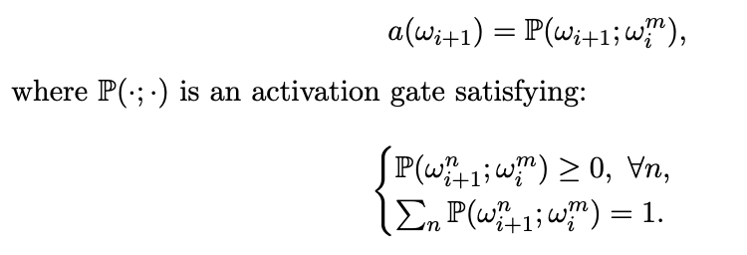
Neural Quantitative Finance
Markovian Activation Functions
de Finetti coherence
Chapman–Kolmogorov dynamics
4

Slide 6

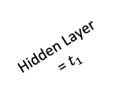
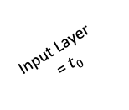
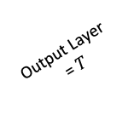
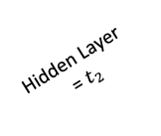
Neural Quantitative Finance
Backward-pass
Asset 1
State 3
Asset 1
State 2
Backward pass
Asset 1
State 1
Numeraire
State 3
Asset 1
State 0
Numeraire
State 2
Numeraire
State 1
Risk-factor
State 3
Numeraire
State 0
Risk-factor
State 2
Risk-factor
State 1
Risk-factor
State 0
Input Layer
= $t_{0}$
Hidden Layer
= $t_{1}$
Hidden Layer
= $t_{2}$
Output Layer
= $T$
5

Slide 7
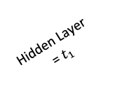
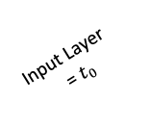
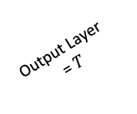
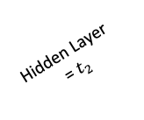
Finance-Native Neural Network
Forward Pass and Neural Paths
Asset 1
State 3
Asset 1
State 2
Forward pass
Asset 1
State 1
Asset 1
State 0
Numeraire
State 1
Risk-factor
State 3
Numeraire
State 0
Risk-factor
State 2
Risk-factor
State 1
Risk-factor
State 0
Neuron 1
Neuron 0
Input Layer
= $t_{0}$
Hidden Layer
= $t_{1}$
Hidden Layer
= $t_{2}$
Output Layer
= $T$
6

Slide 8
Case Study
210 QIS, 800 layers
Attention-guided neural simulation
Bridging QIS and XVA
HVA and Reverse Stress Testing
Strategy Design: forward-looking
7

Slide 9
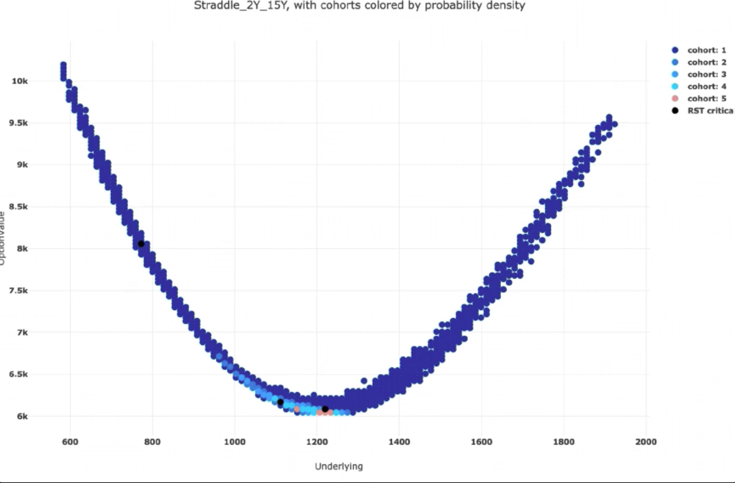
One QIS
8

Slide 10
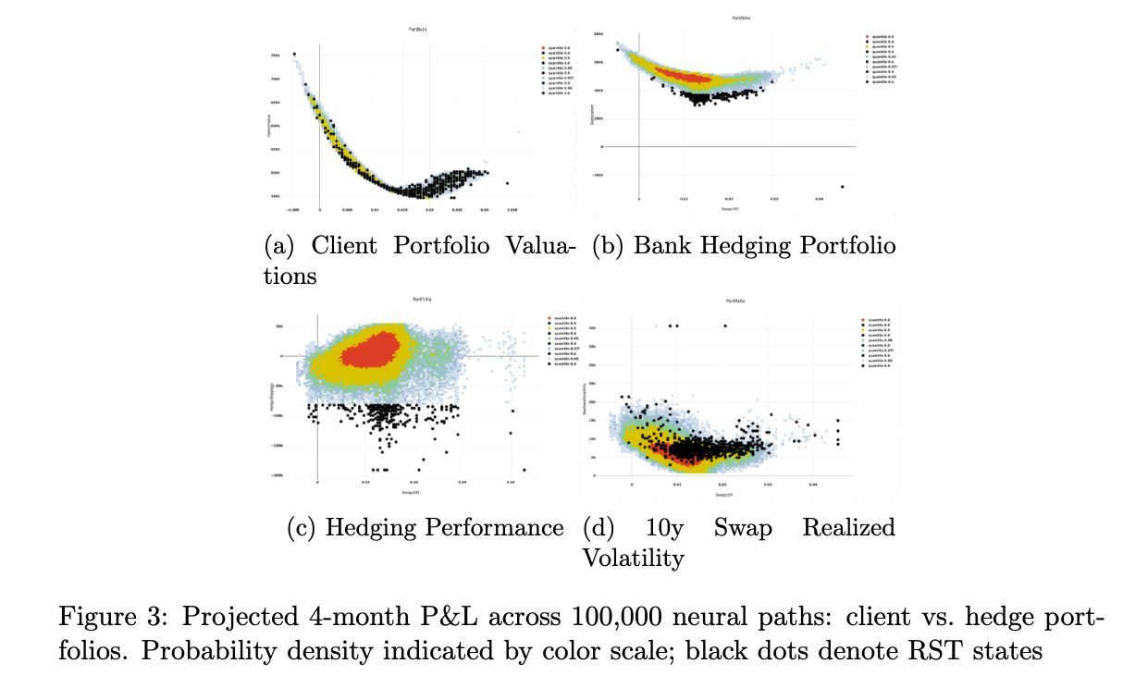
The Entire Portfolio
9

Slide 11
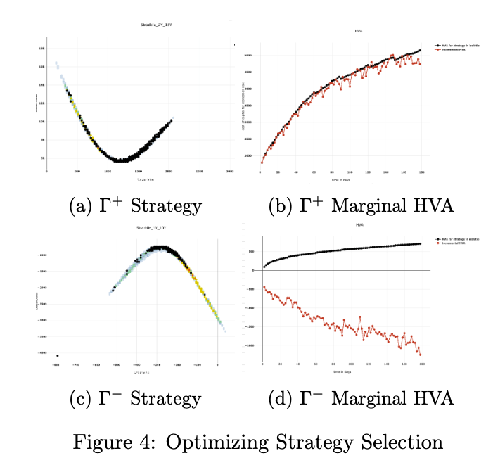
Portfolio Optimization
10

Slide 12
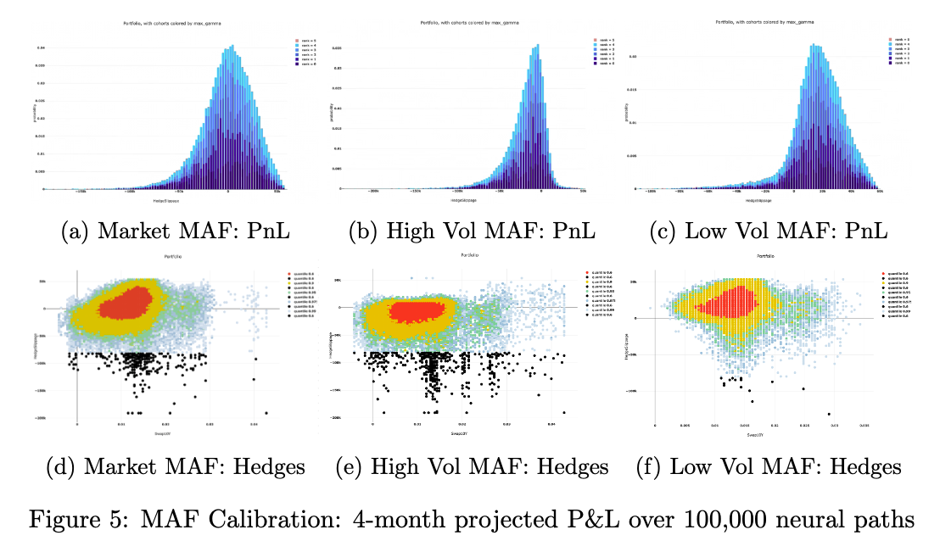
Attention
Focus on the most relevant parts of the input when making a prediction or generating an output.
11

Slide 13
Performance
80 seconds
12

Slide 14

Hardware
13

Slide 15
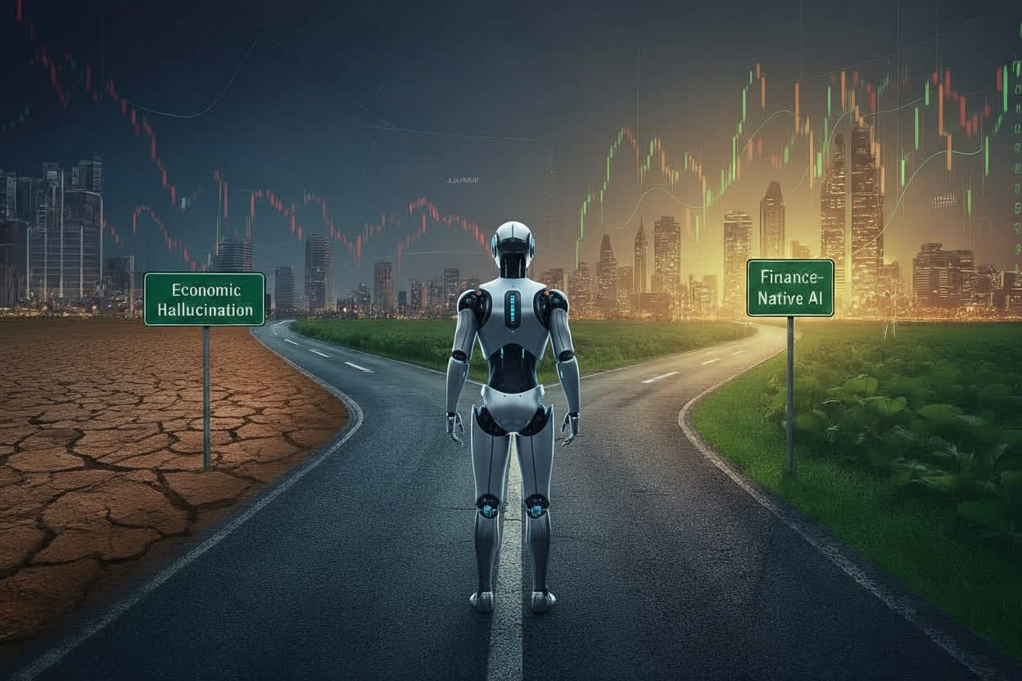
Conclusion
AI as Pricing Law
14

