Slide 1

Paying for long term care insurance: The pros and cons of different payment methods
Les Mayhew
Ben Rickayzen
David Smith

Slide 2

Social care in crisis
  Very few people have prepared for the costs of social or long term care (LTC)
  Most people assume our free NHS will provide - but it won’t unless you quality for state support (at least in England and Wales)!
  Government funding has been squeezed and the introduction of a more generous means testing system has been postponed
We have been investigating a range of new savings products that are designed to suit personal circumstances
Notes:
46% see property wealth as a key part of retirement income planning, with 69% owning a home worth more than their pensions, savings and investments
But 23% of mortgaged over-45s are still worried about paying off their loans: equivalent to 1.02m UK households owing £85,634 each and £87.2bn in total
Having lived in their current home for 21 years on average, 80% of over-45 homeowners want to remain there for as long as they physically can
One in six (16%) expect to need to borrow in retirement – equivalent to 2.12m households – with over half relying on this to stay in their homes
One in three (31%) have or plan to give money to help a child become a first time buyer – adding to pressure on retirement funds
56% expect housing wealth will be needed to pay for care in later life, while 61% see it as a key part of their inheritance planning

Slide 3
Population of England and Wales aged 65+
Population is ageing rapidly – In England and Wales the population aged 75 + will increase from 4.65m to 10.4m between now and 2050 or from 22.6% of the 50+ population to 35.6%

Slide 4
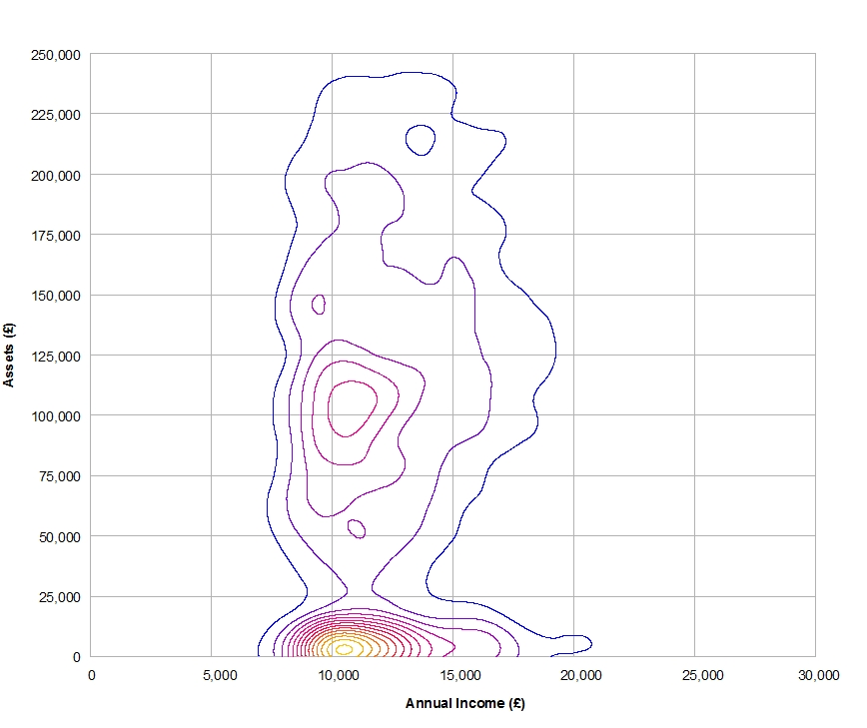
Income-wealth map and product segmentation
£250k
£225k
£200k
£175k
£150k
£125k
£100k
£75k
£50k
£25k
£0k
Key
A= Personal care savings bonds
B= Equity release or
Immediate needs annuities
C= Disability linked annuities
D= Insurance products
E= Self funders
B
Assets
Self-funding E
D
C
A
£0 £5000 £10,000 15,000 £20,000 £25,000 £30,000
Income p.a.
Notes:
SLIDE 6
Before looking at that, let us look at the different income/wealth map in more detail and consider some of the financial solutions.
Contours shows the number of people (individuals in different income wealth brackets) including all assets such as housing wealth. Although we strat off with nothing we all end up and very different places using traditional measures of wealth.
There are essentially 2 populations home owners and non- home owners and two peaks. Interestingly in both cases median income levels are similar £10k to £11 k,
At Cass we have been looking at how people can support themselves and we have proposed and published research on a few of these based on this reality and what can be afforded on this spectrum.
Papers on some of these are here today and at least two have also been published by ILC and can be found on the web site.
Let us consider the target groups and then overlay the proposed means test.
A PCSBs would occupy this space people with low to modest assets and low to average income
B People with housing wealth can draw an income from their home, purchase an INA form the sale of their home, or take their chances
C. People with more substantial occupational pensions that would in the future be able to buy disability linked annuities: These are pensions that go up in value upon assessment for care
D. LTC insurance – narrow range somewhere between bonds buyers and self funders. Problem is that it is expensive and if you die without needing care you lose your premiums. Another alternative – which we proposed several years go are advanced life insurance products which pay out when you need care and not on death.
I could say many more things about each.

Slide 5
How state support tends to crowd out innovative products
£250k
£225k
£200k
£175k
£150k
£125k
£100k
£75k
£50k
£25k
£0k
Key
A= PCSBs
B= Equity release or
Immediate needs annuities
C= Disability linked annuities
D= Insurance products
E= Self fund from income
B
Assets
Self-funding E
D
C
A
£0 £5000 £10,000 15,000 £20,000 £25,000 £30,000
Income p.a.
Our focus is on a type of disability linked annuity which pays on becoming disabled or going into care
Notes:
Let’s overlay the means test.
The means test cuts through quite a few of these market segments and also projection for many people.
So what are the consequences/

Slide 6
Insuring the risk
Many mistakenly believe that the government will pay for their and so historically there has been little demand to save or insure care risk
The market for LTC insurance has all but disappeared – premium costs are high and benefits capped partly due to uncertainties about how long people will live in care
Most people hope for the best but roughly 40k people a year are forced to sell their homes in order to pay for care
Some purchase point of need products such as immediate needs annuities which is one of the few niche markets in this area
Concern over the cost of the premium is a factor and so we propose a new product which has different payments terms depending on preference
Moral hazard that if they save it will be taken away by reduction instate support
Notes:
46% see property wealth as a key part of retirement income planning, with 69% owning a home worth more than their pensions, savings and investments
But 23% of mortgaged over-45s are still worried about paying off their loans: equivalent to 1.02m UK households owing £85,634 each and £87.2bn in total
Having lived in their current home for 21 years on average, 80% of over-45 homeowners want to remain there for as long as they physically can
One in six (16%) expect to need to borrow in retirement – equivalent to 2.12m households – with over half relying on this to stay in their homes
One in three (31%) have or plan to give money to help a child become a first time buyer – adding to pressure on retirement funds
56% expect housing wealth will be needed to pay for care in later life, while 61% see it as a key part of their inheritance planning

Slide 7
Paying for cover
Product is annuity based and is triggered following a needs assessment
Benefits are capped to the policy not the actual cost of care
Based on concept that allows people at different stages of life and with different mixes of assets and income
There will different means of paying for this cover
  Single premium e.g. at point of retirement using accumulated funds
  Regular premium (can be inflation-linked) until care required or death
  Regular premium (can be inflation-linked) until care required or death or a maximum age is reached. We refer to this as the ‘capped’ premium
  Equity release where a percentage of the home is ceded to pay for cover and the house is sold when the person dies or moves into residential care
  A loan is secured on the home and is recovered on the sale of the house when the person dies or moves into residential care

Slide 8
Generic options for a typical persons
Notes:
A Likely to be fairly poor and able to get support from the state
B Typical pensioner on median income unlikely to qualify for state support but would find premium expensive
C Similar to B
D Must be a home owner

Slide 9
Examples of personal factors influencing generic option
Which funding method is best will change through a person’s lifetime and will also depend on
  Income now vs. future income
  Do they have a spouse?
  Do they have children?
  Are their children self-financing?
  How important leaving a bequest is?
  Is there personal attachment to the home?

Slide 10
Modelling pathways to care
We envisage four possible pathways that a policyholder may take
Pathway 1 : The person dies requiring no care
Pathway 2 : Before the person dies they require care to help live in their own home, but never need residential care
Pathway 3 : The person spends time requiring care to help them live in their own home and also spends time in a residential care home
Pathway 4 : The person goes from an independent state to requiring residential care before dying

Slide 11
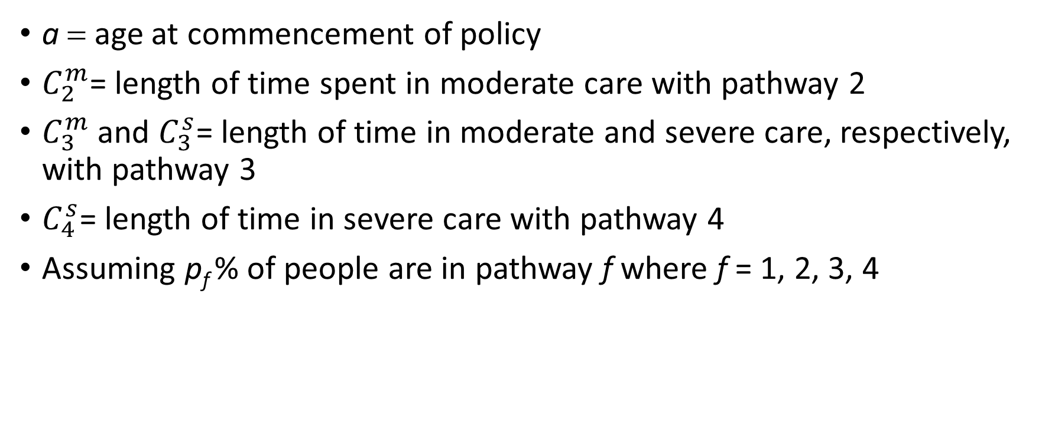
Assumptions/Notation
a = age at commencement of policy
$C_{2}^{m}$= length of time spent in moderate care with pathway 2
$C_{3}^{m}$ and $C_{3}^{s}$= length of time in moderate and severe care, respectively, with pathway 3
$C_{4}^{s}$= length of time in severe care with pathway 4
Assuming p_{f} % of people are in pathway f where f = 1, 2, 3, 4

Slide 12


Illustration of pathway 3
Policy taken out at age a
Person requires care to remain in own home
Person moves into residential care home
Person dies
$$C_{3}^{m}$$
$$C_{3}^{s}$$
a = age at commencement of policy
$C_{3}^{m}$ and $C_{3}^{s}$= length of time in moderate and severe care, respectively, with pathway 3

Slide 13
Assumptions/Notation
Assume everyone has same age specific mortality rate regardless of pathway
Assume annuity is paid continuously
Assume discount rate is i % pa
Assume annuity increases in payment (continuously) at k % pa
Let Y be the current annual annuity paid while needing moderate care (assumed to remain in home)
Let Z be the current annual annuity paid while needing severe care (assumed to move into residential care home)

Slide 14
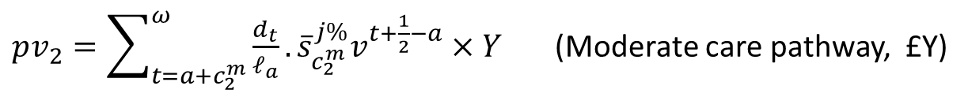

Calculation of benefits
$$pv=p_{1}.0+p_{2}.pv_{2}+p_{3}.pv_{3}+p_{4}.pv_{4}$$
where pv = Present Value, and
$pv_{2}=\sum_{t=a+c_{2}^{m}}^{ω}{\frac{d_{t}}{ℓ_{a}}}.{\overline{s}}_{c_{2}^{m}}^{j\%}v^{t+\frac{1}{2}−a}×Y$ (Moderate care pathway, £Y)
$pv_{3}=\sum_{t=a+c_{3}^{m}+c_{3}^{s}}^{ω}{\frac{d_{t}}{ℓ_{a}}}\left({\overline{s}}_{c_{3}^{m}}^{j\%}×Y×{\left(1+i\right)}^{c_{3}^{s}}+{\overline{s}}_{c_{3}^{s}}^{j\%}×Z\right)×v^{t+\frac{1}{2}−a}$ (Moderate and severe pathway, £Y and £Z)
$pv_{4}=\sum_{t=a+c_{4}^{s}}^{ω}{\frac{d_{t}}{ℓ_{a}}}×{\overline{s}}_{c_{4}^{s}}^{j\%}×Z×v^{t+\frac{1}{2}−a}$ (Severe pathway, £Z)
Where $\frac{1}{1+j}=\frac{1+k}{1+i}⇒j=\frac{1−k}{1+i}$

Slide 15
Scenario assumptions
Inflation = 2% p.a.
Investment Return = 4% p.a.
House Price Inflation = 3.5% p.a.
Mortgage on Home = 4.5% p.a.
Maximum age when premiums cease for capped version = 85
Current value of benefit when cared for at home = £10,000 p.a.
Current value of benefit when in residential care = £25,000 p.a.

Slide 16
Scenario assumptions (cont.)
Care Route | Proportion going via routes | Time Spent in care states (years)
 |  | Home | Residential
No care | 70% | 0 | 0
Only home care | 10% | 4 | 0
Home and residential | 10% | 3 | 2
Only residential care | 10% | 0 | 2

Slide 17
Payment method considered
Payment in advance via one-off lump sum
Regular premium payments (1)
Capped premium (2)
Equity release using the value in the home (3)
Mortgage on home
Notes:
Premiums paid annually in advance until moderate or severe care required or until death if no care required.
Premiums paid up to a maximum age
Not available for ‘joint’ lives. We would need to introduce other variables such as “age gap” for the couple and consider with the permutations who goes into care first etc.

Slide 18
Premiums (£) for selected ages
Age | Single premium | Regular premium | Capped premium | Equity Release | Mortgage on home
50 | 9,298 | 508 | 525 | 10,923 | 7,900
55 | 10,109 | 597 | 625 | 11,621 | 8,780
60 | 10,958 | 713 | 760 | 12,335 | 9,722
65 | 11,831 | 869 | 952 | 13,052 | 10,712
70 | 12,706 | 1,087 | 1,249 | 13,753 | 11,728
75 | 13,546 | 1,400 | 1,773 | 14,409 | 12,727

Slide 19
Conclusions
LTC insurance is unpopular as it forces people to think about events they wish to ignore and premium costs eat into retirement income
However, as society ages, this ignorance will be harder to maintain
While insurance companies may want to focus on net present values it is probably more important to view how cash-flows will affect the lifestyle of the policyholder i.e. we need to consider utility rather than just costs
Making the purchase of long term care insurance as painless as possible is likely to be the way forward

