Slide 1
The Role of Deferred Group-Self Annuitisation (DGSA) Products for Australian Retirees
David Bell & Estelle Liu
20 September 2018

Slide 3
Australian Retirement Environment
Comprehensive Income Products for Retirement (CIPRs)
2010
2014
2016
2017
Feb 2018
May 2018
Super System “Cooper” Review
Financial System “Murray” Inquiry
The Proposed CIPR Framework Discussion Paper
Treasury Laws Amendment (Innovative Superannuation Income Streams) Regulations 2017
DSS Position paper – Means Test Rules for Lifetime Retirement Income Streams
Retirement Income Covenant
Position Paper –
Stage one of the Retirement Income Framework

Slide 4
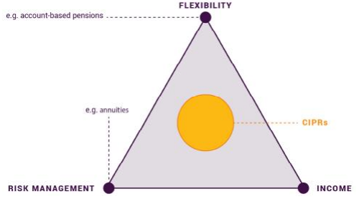
What is CIPR?
Principles-Based Product Requirements
Deliver better income than the status quo, i.e. account-based pension drawing down at minimum rates
Provide in expectation, a stream of broadly constant real income for life
Provide flexibility to access to a lump sum and/or leave a bequest

Slide 5
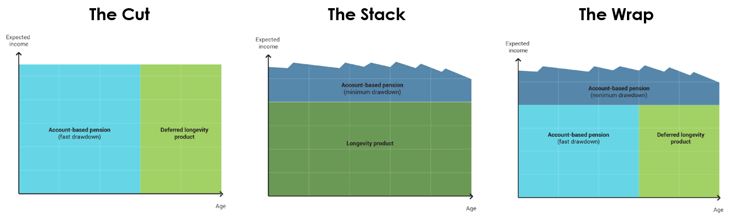
CIPR Structures
Role of DGSA
DGSA type products could potentially play a significant role in CIPRs

Slide 6
DGSA Example
A pooled longevity solution
A member allocates a portion of their retirement savings (approx. 15%) when they retire (65)
It grows for 15 years
When the member reaches age 80, it starts to pay income until death
There are some death benefits (but people who die ‘young’ subsidize the long lived in the pool)

Slide 7
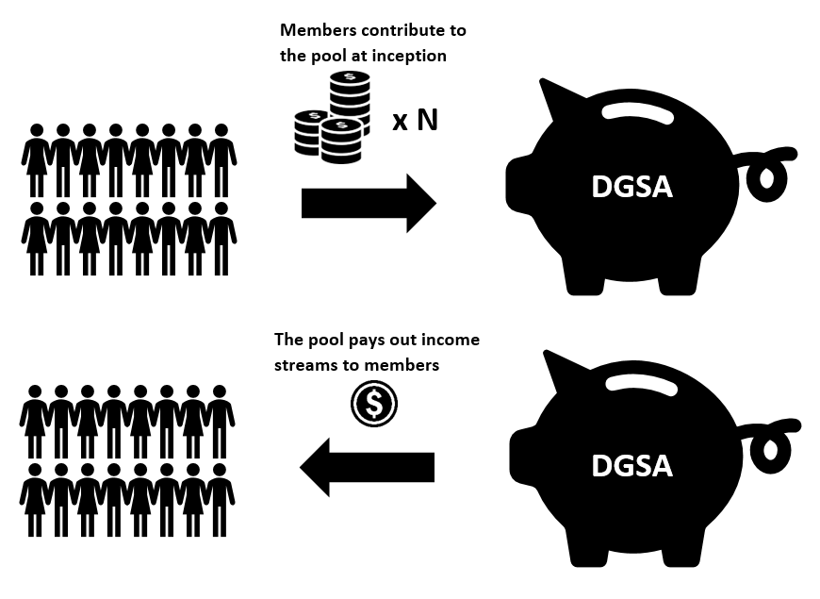
DGSA Illustration
How DGSA works

Slide 8
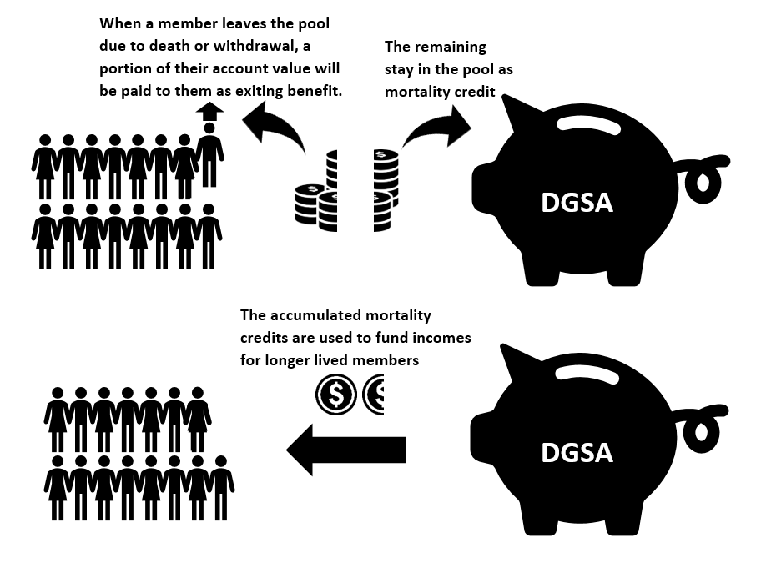
DGSA Illustration
How DGSA works

Slide 9
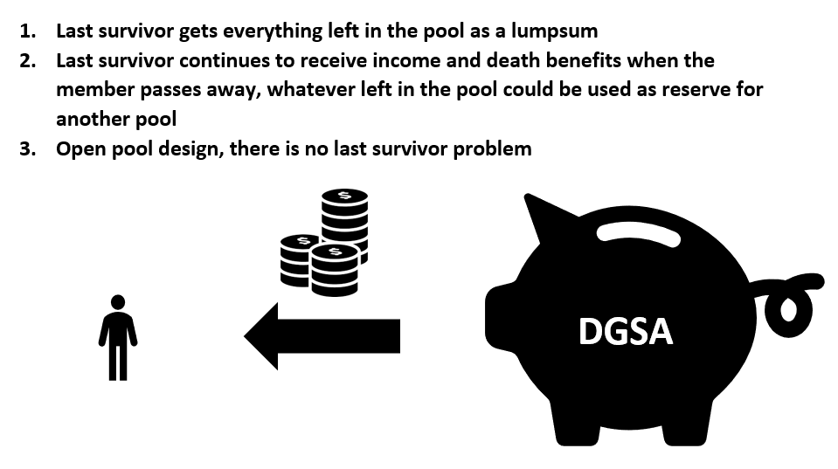
DGSA Illustration
How DGSA works

Slide 10
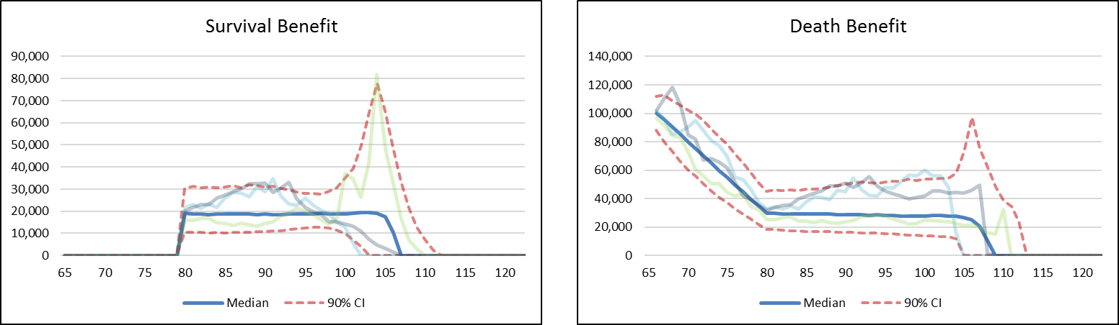
Role of DGSA
A pooled longevity solution
Similar to deferred life annuity except:
  No guarantee
  Can invest in growth assets
  Some death benefits (peace of mind)
  Likely to be cheaper (no capital requirement)

Slide 11
DGSA vs Tontine
Difference between DGSA & Tontine
 | DGSA | Tontine
Total Income Distribution for the Pool | Actuarially priced including capital | Investment return only, does not distribute capital
Income Profile for Individual Members | Broadly constant in expectation | Increasing over time
Income Efficiency | Yes | No
Death Benefits | Yes | No
Product Impairment Risk | Yes | No

Slide 12
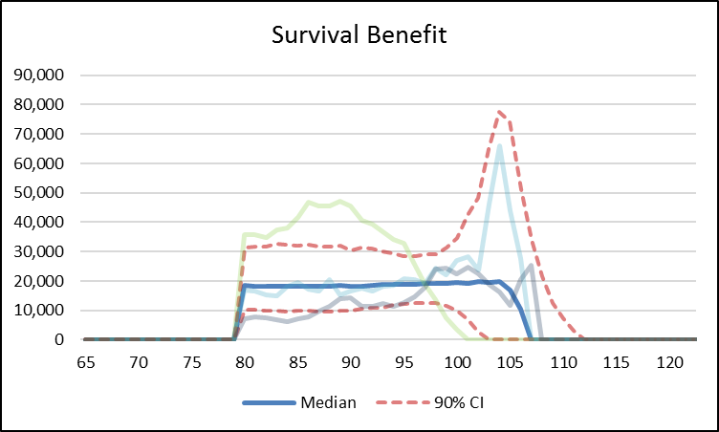
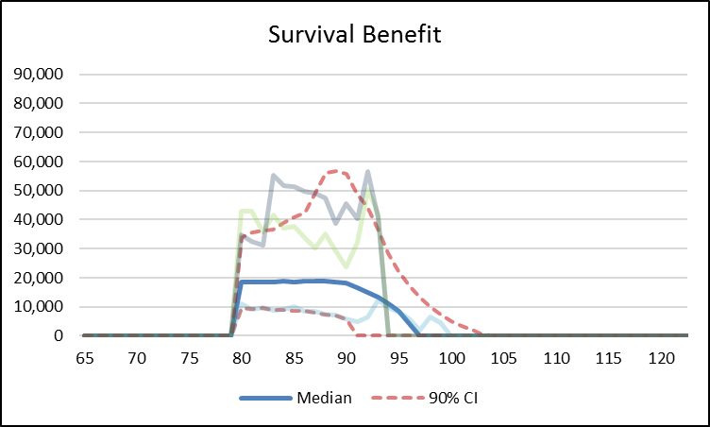
DGSA Design Features
Pool size
Individual longevity risk cannot be diversified in a small pool
(a) pool size = 1,000 (b) pool size = 10

Slide 13
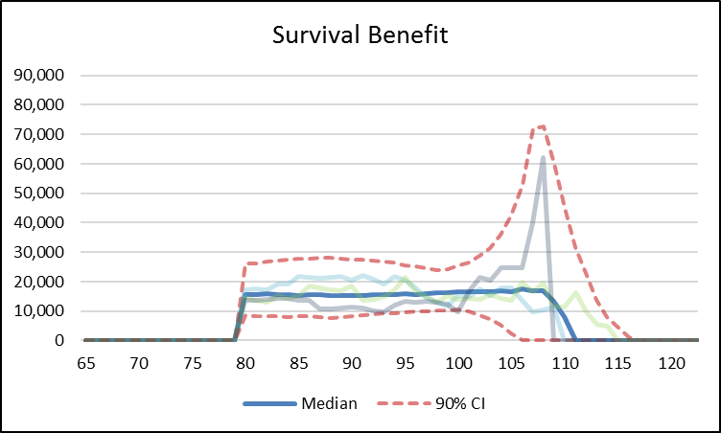
DGSA Design Features
Systematic longevity risk
What if the members in the pool all live longer than expected?
(a) no mortality improvement (b) 20% mortality improvement

Slide 14
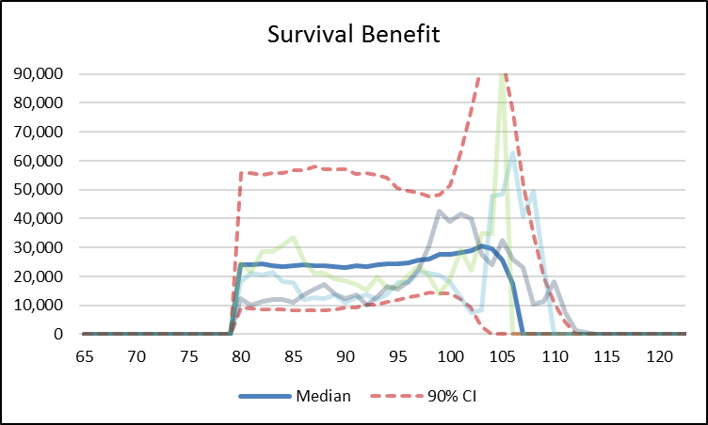
DGSA Design Features
Investment risk
Trade-off between potential upside and variability of income
(a) 50/50 growth/defensive (b) 80/20 growth/defensive

Slide 15
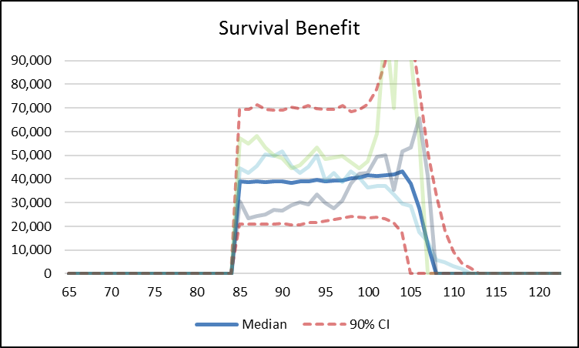
DGSA Design Features
Flexible deferral period
Extent of longevity protection and amount of savings needed to allocate to longevity protection
(a) 15 years deferred (b) 20 years deferred

Slide 16
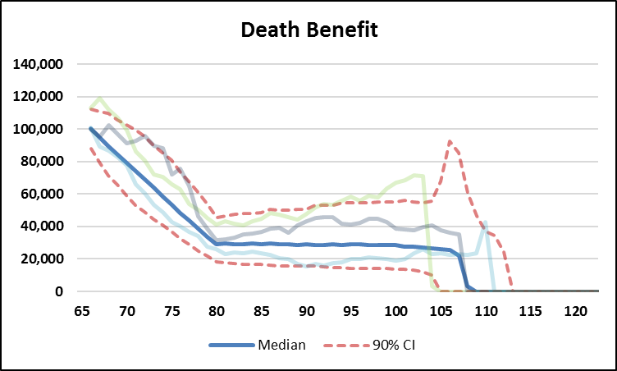
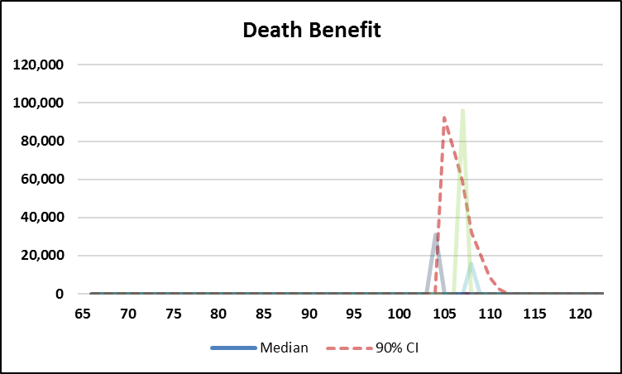
DGSA Design Features
Flexible death benefit
Trade-off between higher income and level of death benefit (peace of mind)
(a) with death benefit (b) without death benefit

Slide 17
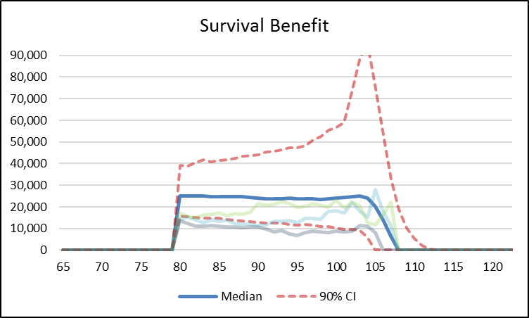
DGSA Design Features
Flexible death benefit
Trade-off between higher income and level of death benefit (peace of mind)
(a) with death benefit (b) without death benefit

Slide 18

DGSA Design Features
How to design the best DGSA with most suitable features for members?
Understanding members’ preferences
Potentially using a utility framework (e.g. MDUF), you could find
  Optimal allocation to DGSA product
  Optimal asset allocation within DGSA
  Optimal deferral period
  Optimal death benefit profile
The Member’s Default Utility Function (MDUF) is an open-architecture metric which represents a sensible set of preferences to assume for default fund members in retirement.

Slide 19
Case Study
DGSA as part of CIPRs
Environment: Australia (including Means-Tested Age Pension)
Members’ situation: Male homeowner single with $500K in superannuation and no other assessable assets
Preferences: MDUF
Candidate products: ABP + Longevity solutions (15 – 20%)
  DLA: Deferred Life Annuity
  DGSA: Deferred Group-Self Annuitisation

Slide 20
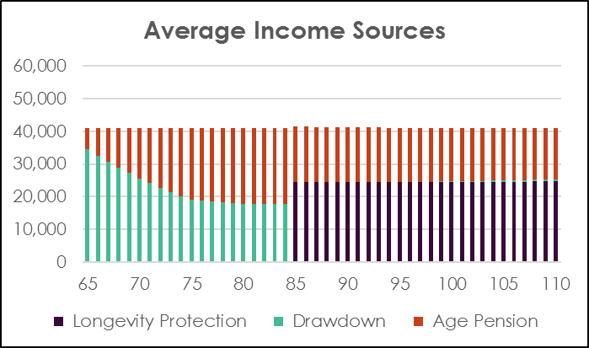
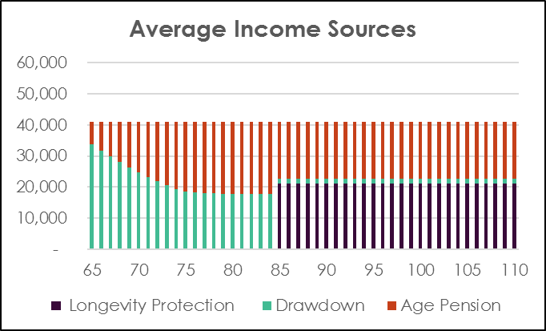
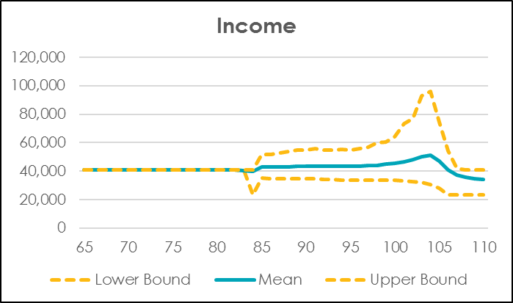
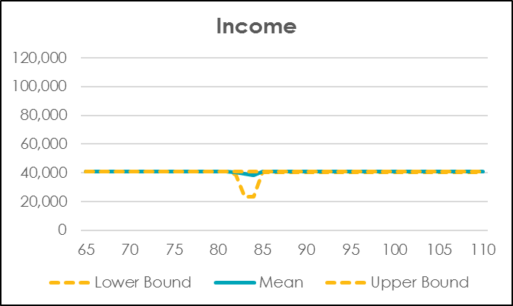
Case Study
DGSA DLA

Slide 21
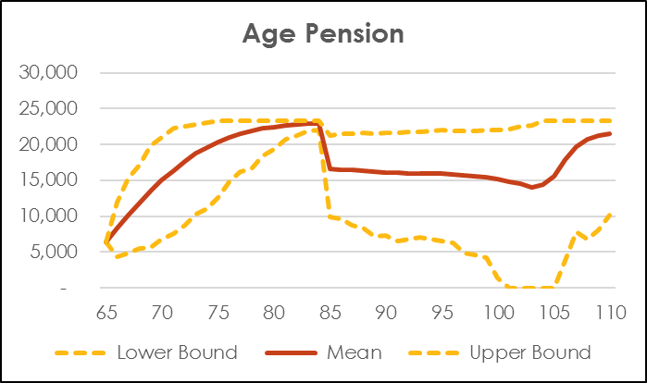
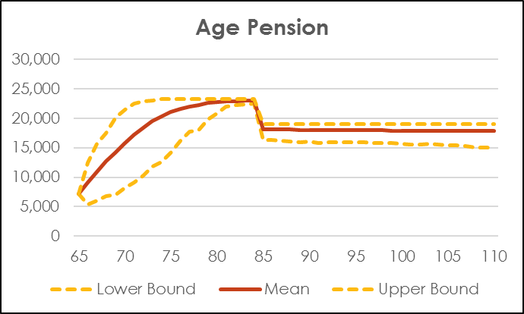
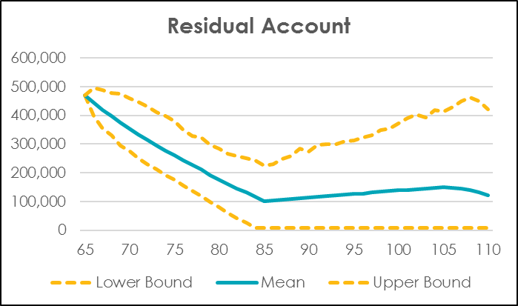
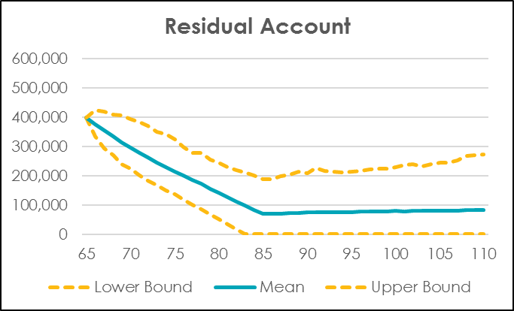
Case Study
DGSA DLA

Slide 22
Case Study
DGSA as part of CIPR
Retirement Strategy | Risk-Adjusted Income | Risk-Adjusted Residual Benefit | MDUF Score | Welfare Gain
85% ABP + 15% DGSA | $40,018 | $26,377 | 6,893 | $17K
80% ABP + 20% DLA | $39,126 | $23,958 | 6,261 | -

Slide 23
Challenges
At a product level
Maintaining a large enough pool size is aided by:
  DGSA as part of default product
  Open pool, multi-cohort framework
  Set up joint pool with other pension funds
Managing the variability of income through:
  Investment downside protection (e.g. portfolio protection strategies)
  Income smoothing mechanism (e.g. intergenerational risk sharing)

Slide 24
DGSA Design Framework
Enhanced Framework
Accumulation Pool
(intergenerational risk sharing)
Single Cohort 25, Male
Single Cohort 25, Female
Pension Pool (mixed cohort)
Single Cohort 65, Male
Single Cohort 66, Male
Single Cohort 67, Male
Single Cohort 70, Female
…

Slide 25
Conclusion
Where are we heading?
There is a role for DGSA type products to play in retirement income solutions
Australian retirement income policies are still evolving & developing
Value-add of DGSA will need to be considered from a holistic point of view taking into account drawdown from account-based pension and interaction with the means-tested Age Pension
Realistic time frame for implementation will be 3+ years

Slide 28
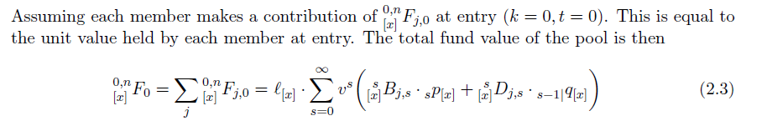
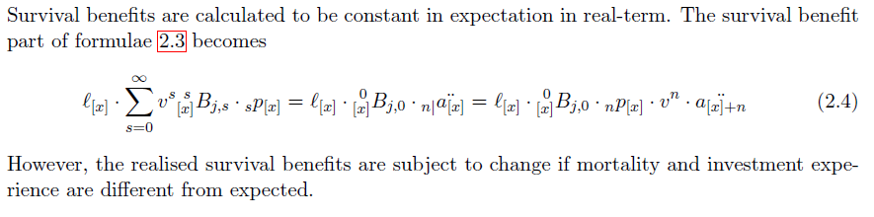
DGSA Design Framework
Basic Framework Illustration
Total fund value
Survival benefits

Slide 29
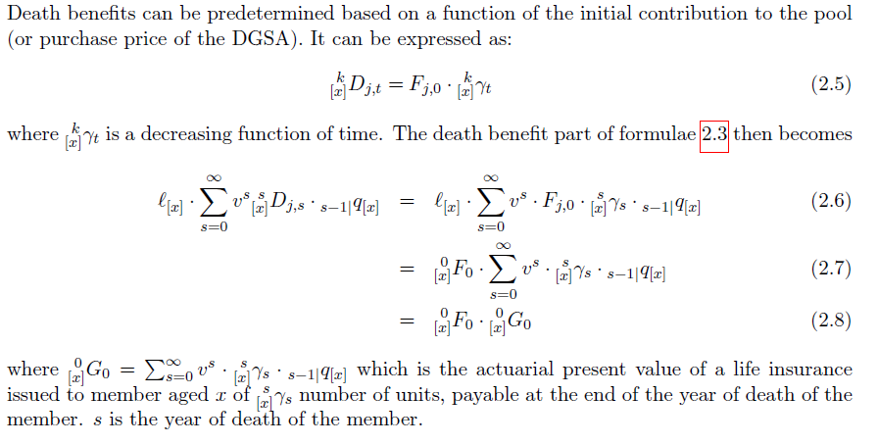
DGSA Design Framework
Basic Framework Illustration
Death benefit: need to satisfy declining capital access schedule (SISR 1994)

Slide 30
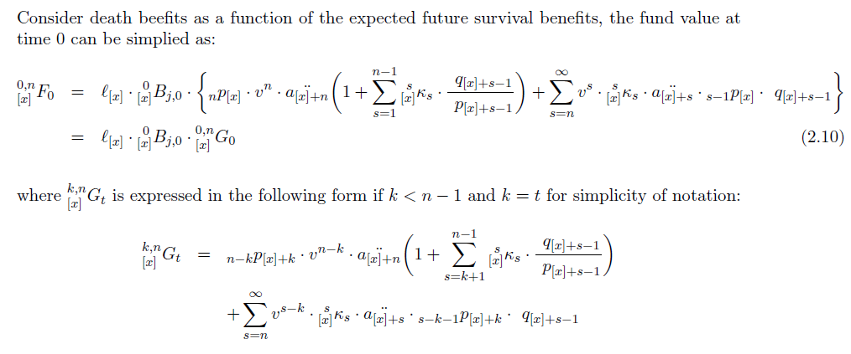
DGSA Design Framework
Basic Framework Illustration
Fund Values

Slide 31
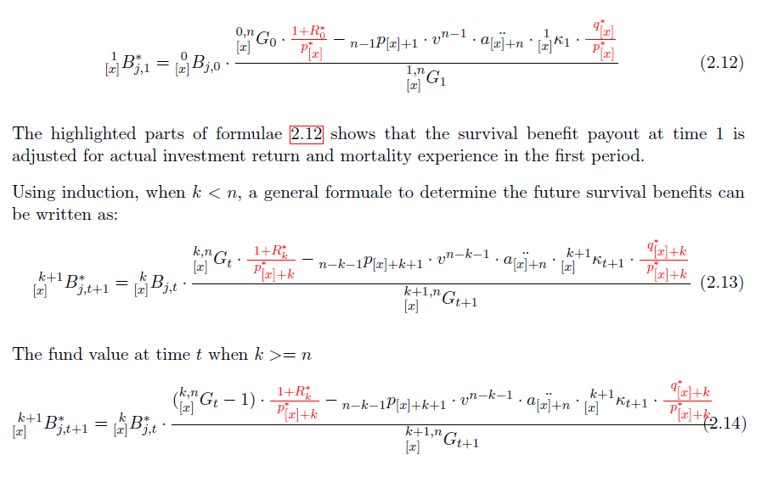
DGSA Design Framework
Basic Framework Illustration
How benefits are determined

