Slide 1
Is the time for Index Based Longevity Hedging here – and the case for capital relief?
Paul Kitson
Head of UK Pensions Consulting, EY
September 2025 – Longevity 20 - Singapore

Slide 2
Agenda
1
2
3
4
A brief history of index-based longevity hedging
Case Study
Why now, and what next
Questions

Slide 3
A (Brief) History of Index Based Longevity Hedging

Slide 4
What are index-based longevity hedges…
A way of hedging longevity exposure based on an index referencing a large population.
It is possible to construct a tailored longevity hedge for a given portfolio of lives using a number of standardised building blocks:
A scaling factor can be applied to the building blocks to allow for socio-economic differences between the hedger portfolio and the index population.
The hedge has a defined Term, Attachment Point, Detachment Point and Payoff.
Has a formulaic commutation payment at the end of the Term based on the impact of longevity improvements observed before and over the Term, projected forward.
Typically structured as a q- or s- forward.
Covers both the impact of longevity on the portfolio during the Term, as well as the impact of future projected longevity changes after the Term, based on observations to the end of the Term.
Country
Age
Gender

Slide 5
They have a number of benefits…
Enable hedging of defined parts of the risk distribution
Provide diversification of structure and counterparty
Can be applied to smaller portfolios
(Although basis risk increases as hedging portfolio size decreases)

Slide 6
Index Based Hedging as an idea has been with us for a while…
Start of market – JP Morgan, LifeMetrics standardised tables launched 2008
Numerous banks offered intermediary structures including Deutsche Bank and Credit Suisse
A number of transactions:
  Lucida – UK BPA Insurer – 2008 / £500m notional / JP Morgan-LifeMetrics
  Pall Scheme – UK Pension Plan – 2011 / £70m notional / JP Morgan-LifeMetrics
  Aegon – Dutch insurer – 2012-15 / A number of transactions with Deutsche Bank & Soc-Gen
  Delta Lloyd – Dutch insurer – 2014 & 2015 / £12bn notional / RGA
  AXA – French insurer – 2014 / £750m notional / Hannover Re
  NN Group – Dutch Insurer – 2017 / £3bn notional / Hannover Re
  Swiss Re - UK vs US Longevity trend difference bond – 2011 / £50m notional / Swiss Re – Kortis Capital

Slide 7
But the market never took off…
  Price not attractive compared to traditional swaps
Investors wanted very short durations that did not work for hedgers
Banking Intermediaries left the market
Regulatory regimes were not supportive
The ‘at-the-money whole of life actual member’ structure was working well

Slide 8



But the market never took off…
  Price not attractive compared to traditional swaps
Investors wanted very short durations that did not work for hedgers
Banking Intermediaries left the market
Regulatory regime was not supportive
Platforms
Entering
Current Focus
TBC
7 - 10 years
The ‘at-the-money whole of life actual member’ hedge was working well

Slide 9
Case study looking at a potential UK Regulatory treatment

Slide 10
Current UK regulatory treatment
Insurance companies:
  Solvency UK (based on Solvency II, but with the ability to deviate)
  Longevity risk captured both in the SCR and Risk Margin
  Traditional longevity hedge typically can remove longevity risk from both the SCR and Risk Margin calculations – subject to a number of requirements on e.g. counterparty, etc.
  Currently no market practice for allowing for an index-based longevity hedge in the SCR, and little ability to impact the Risk Margin.
Pension Plans:
  No explicit longevity risk calculation, although Longevity basis used in liability valuation must be “Prudent”
  Longevity hedging tends therefore to be based on an economic assessment
  Again, no market practice for how you would allow for an index-based longevity hedge.

Slide 11

The modelling work we have undertaken
In order to consider how a longevity hedge could work in practice, we have sought to model how longevity could trend for an insurer’s population compared to the general population of a nation state.
To do this, we fitted an M6 Cairns-Blake-Dowd model to the E&W population (see formulae right).
We fitted an equivalent model to the insurer population, where we modelled the parameters as deviations from those for the first population.
We then stochastically simulated the paths of the parameters for the first population, and the difference parameters for the second population, to generate a funnel of outcomes for both populations.
M6 CBD model for the E&W population:
$logit\left(q_{x,t}\right)=ln\left(\frac{q_{x,t}}{1−q_{x, t}}\right)$
$=κ_{1}\left(t\right)+κ_{2}\left(t\right)∗\left(x−\overline{x}\right)+γ\left(t−x\right)$
For the insurer population:
$logit\left(q_{x,t}\right)=ln\left(\frac{q_{x,t}}{1−q_{x, t}}\right)$
$=λ_{1}\left(t\right)+λ_{2}\left(t\right)∗\left(x−\overline{x}\right)+δ\left(t−x\right)$, where:
  $λ_{i}\left(t\right)=κ_{i}\left(t\right)+ξ_{i}\left(t\right), i=1, 2$
  $δ\left(t−x\right)=γ\left(t−x\right)+ξ_{γ}(t−x)$

Slide 12
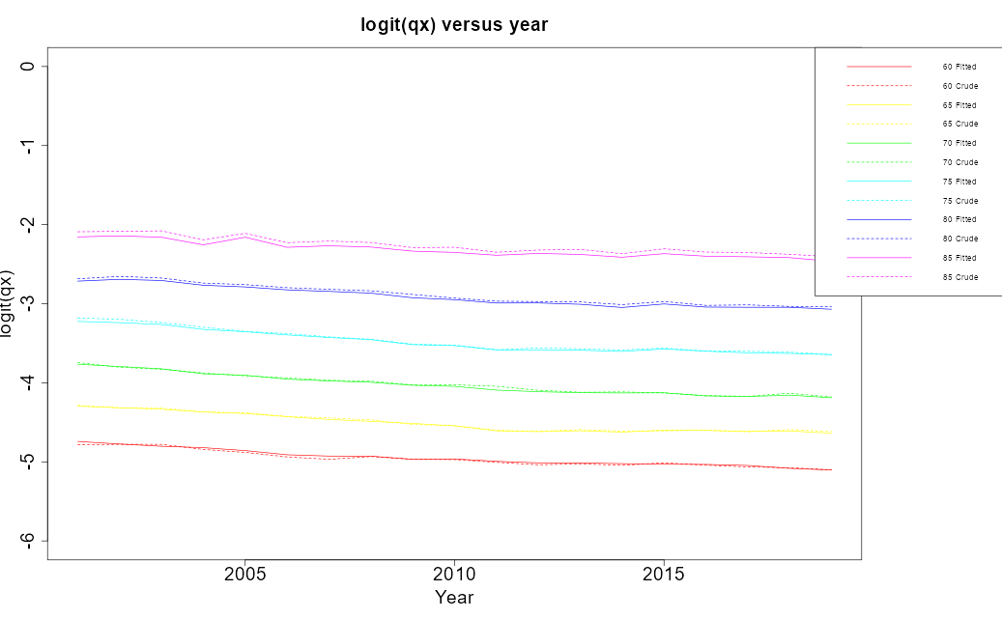
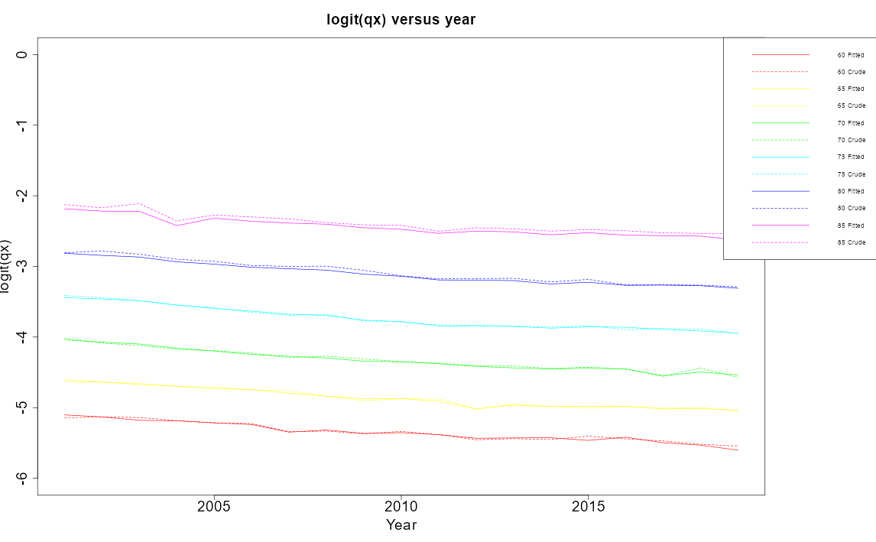
The modelling work we have undertaken
As we are focusing on insuring annuities, we have fitted our death probabilities based on those experienced by ages 60-89.
Index reference pop: England and Wales rates
Hedger portfolio: IMD Deciles 8-10 rates

Slide 13
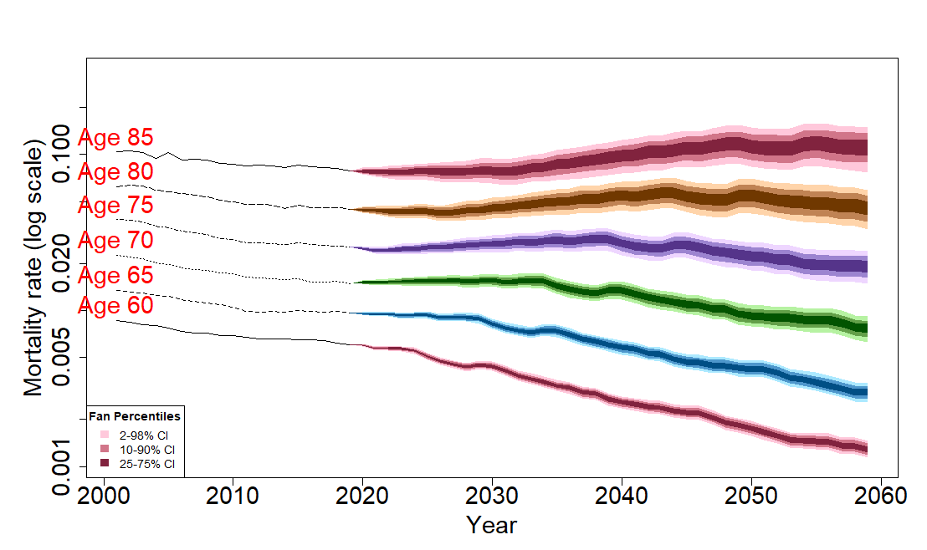
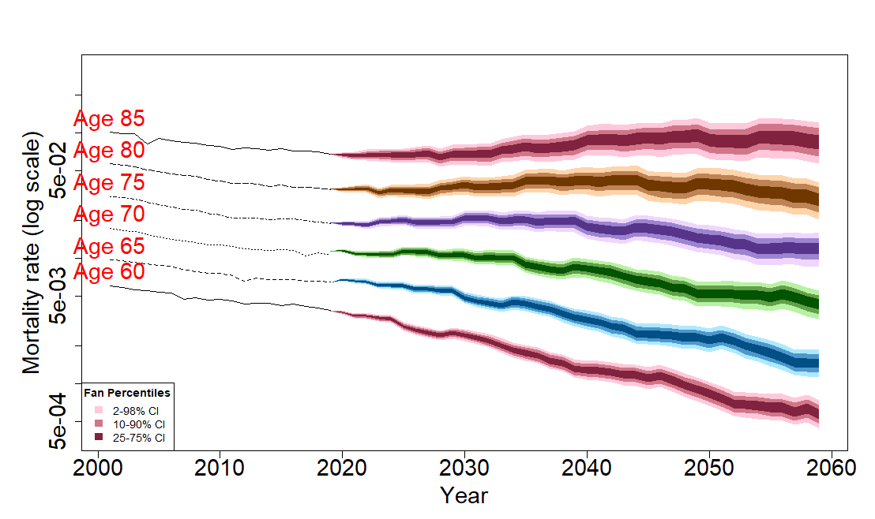
The modelling work we have undertaken
We have then projected the parameters in our models using a random walk and run 1,000 different scenarios to obtain a funnel of outcomes.
Death probability projections – E&W
Death probability projections - insured

Slide 14
The modelling work we have undertaken
The ‘Value’ model
Value best estimate liability assuming (1) no longevity swap and then (2) a value-based longevity swap is in place. Assumes a longevity hedge term of 10 years.
Simulate insurer’s annuity portfolio using proxy model points
For each of the 1,000 simulations:
  Generate survival curves for insurer’s mortality and general population mortality at time 0
  Derive pension cashflows over accumulation period (0 to 10 years)
  Generate new survival curves at time 10 based on updated general population mortality at 10 years
  Derive pension cashflows at commutation point (after 10 years)
  Calculate U(10) - the present value of the synthetic portfolio (general population)
  Calculate V(10) - the present value of the insurer portfolio
  Set attachment point at 60% and detachment point at 80% to determine payout amounts

Slide 15
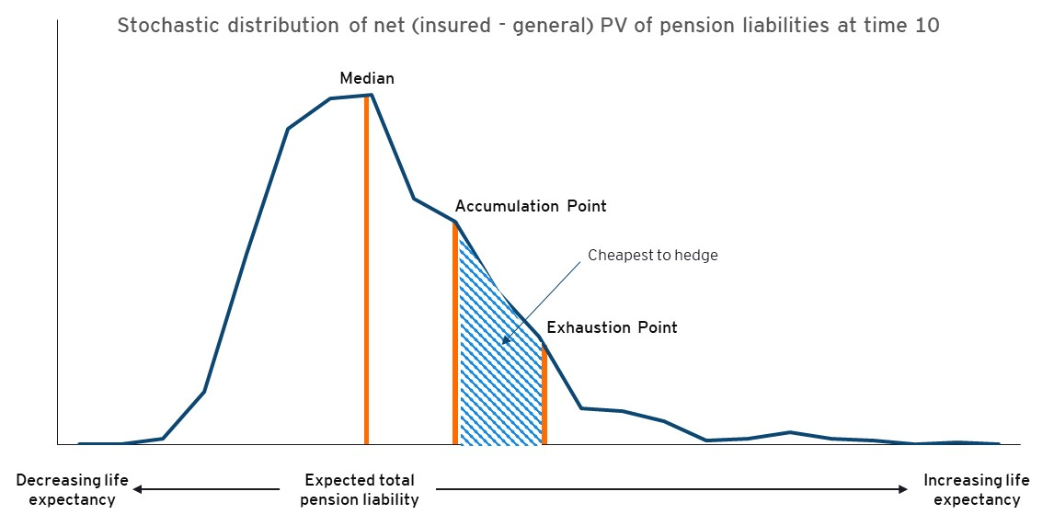
The modelling work we have undertaken

Slide 16
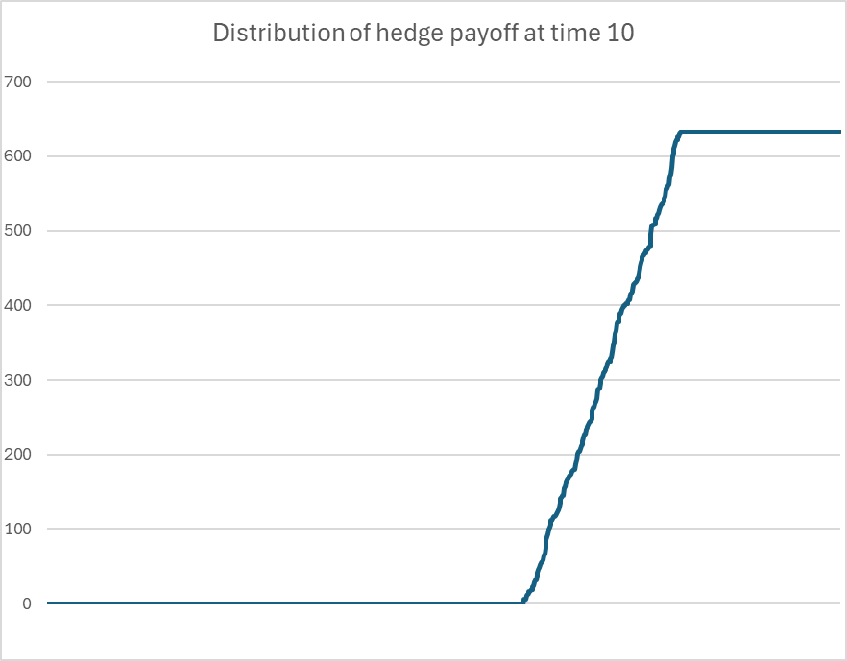
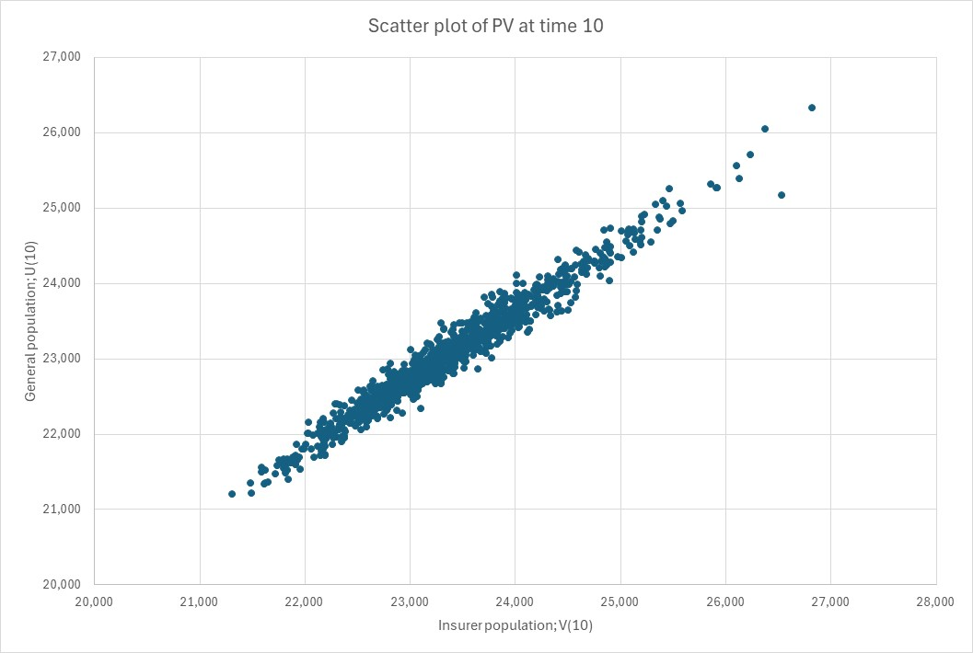
The modelling work we have undertaken
Evaluated the payout under each scenario
Assessed the basis risk under each scenario

Slide 17
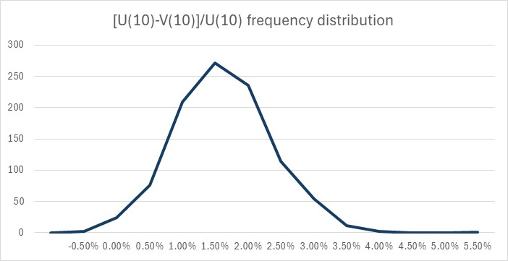
The modelling work we have undertaken
Currently at the stage of evaluating the basis risk under different scenarios.

Slide 18
Next steps of the modelling
Complete Basis Risk Analysis
Look at counterparty risk net of collateralisation
Sensitivity test on a range of economic scenarios
Sensitivity test to different longevity models, e.g. CBD M5 or M7, CMI model, etc
Consider different formulations of the commutation calculation
Consider different insurer portfolios

Slide 19
What could a regulatory logic look like…
Regulatory treatment:
  Recognise the risk hedged – in a consistent way to a traditional longevity hedge
  Add back in: (i) any new risk introduced, (ii) residual risks, or (iii) second order risks not hedged, e.g.
    Basis Risk
    Credit / Default / Counterparty Risk
    Reinvestment / Roll Risk

Slide 20
So, why now and what next?

Slide 21
Why now?
There remains globally Trillions of longevity risk that needs managing
Intermediary and investor interest now better matches hedger requirements
Diversification of structure and counterparty, done appropriately, is positive
Potentially, longevity risk has never been as great as currently
Maturing of Defined Contribution (DC) in several countries puts longevity risk in the hands of those least prepared to manage it
Development of new pension systems in several countries – for example Collective Defined Contribution (CDC) in the UK – could significantly benefit from structures that can manage portions of risk e.g. 70%-90% downside risk.

Slide 22
Conclusion
The use cases for efficiently managing global longevity risk are growing
In particular, as we develop new risk sharing systems and as we transfer longevity risk to individuals new hedging approaches may be needed
Regulation needs to keep pace with this need, and, while protecting the policyholder at all times, be open to considering a balanced treatment in capital and risk margin requirements for index-based longevity transactions.
Footnote – we are interested in collaborating with insurers and reinsurers as part of the case study and would welcome any individual discussions on possible collaboration.

Slide 23
EY | Building a better working world
EY is building a better working world by creating new value for clients, people, society and the planet, while building trust in capital markets.
Enabled by data, AI and advanced technology,
EY teams help clients shape the future with confidence and develop answers for the most pressing issues of today and tomorrow.
EY teams work across a full spectrum of
services in assurance, consulting, tax, strategy and transactions. Fueled by sector insights,
a globally connected, multi-disciplinary network and diverse ecosystem partners, EY teams can provide services in more than 150 countries
and territories.
All in to shape the future with confidence.
EY refers to the global organization, and may refer to one or more, of the member firms of Ernst & Young Global Limited, each of which is a separate legal entity. Ernst & Young Global Limited, a UK company limited by guarantee, does not provide services to clients. Information about how EY collects and uses personal data and a description of the rights individuals have under data protection legislation are available via ey.com/privacy. EY member firms do not practice law where prohibited by local laws. For more information about our organization, please visit ey.com.
[Optional sector or service line descriptor — refer to The Branding Zone]
© 2025 [member firm name].
All Rights Reserved.
XXXXX-XXXGbl
ED MMYY
[Optional environmental statement — refer to The Branding Zone]
[Required legal disclaimer — refer to The Branding Zone]
ey.com

