Slide 1

Mortality models in the age of medical innovation: A fireside chat
Roshan Tajapra
Head of Longevity Research
Kishore Ananda
Best Estimate Lead & Senior Global Pricing Actuary
Monday 8th September 2025

Slide 2
Introduction
Well known mortality forecasting models
Improvement models
Age-Period-Cohort (M3)
CMI APC(O)I
Splines (M4)
Lee-Carter (M1)
Cairns-Blake-Dowd (M5-M8)
National Population Data
Appropriate Parameters
View of Future Mortality
Most models are backward-looking: Is this a safe assumption in 2025?
Model classification as per Cairns et al. (2009)
Notes:
Now let's look at mortality improvements. How does the insurance industry generally set these?
Here we can look to various mortality improvement models. These can be stochastic in nature, such as the APC or Lee-Carter models, or deterministic such as the CMI model.
These models require a substantial amount of past mortality data to be credible so they are generally fitted to national population data.
In general, these models fit a trend to past data, then project that trend forward to generate a view of future mortality rates.

Slide 3
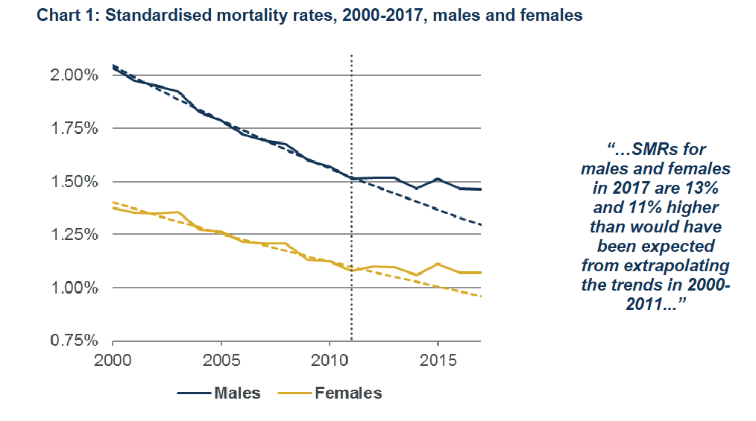
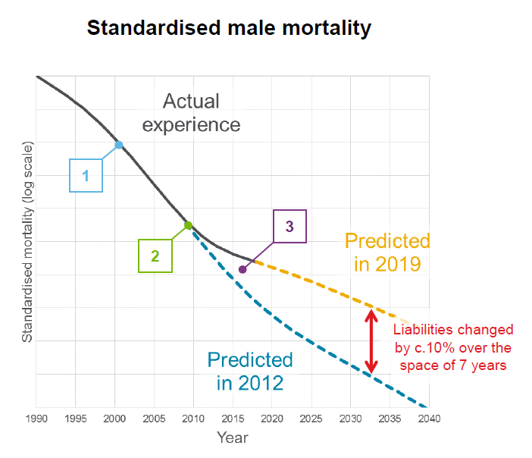
Example 1: Slowdown in UK mortality improvements c2011
Industry model did not account for change in trend until 2016
Sources: CMI_2017 briefing note, CMI WP201

Slide 4
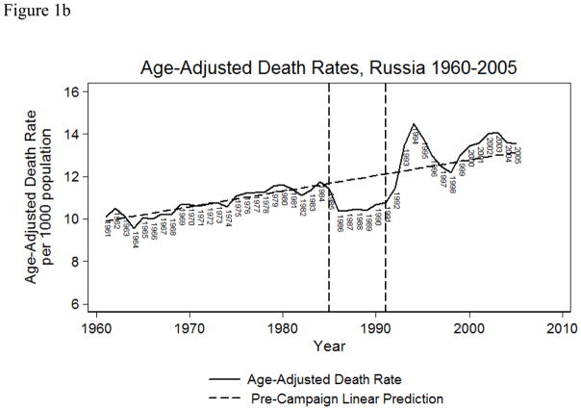
Example 2: Russian mortality trends
Gorbachev Anti-Alcohol Campaign
Source: Bhattacharya et al (2013): The Gorbachev Anti-Alcohol Campaign and Russia’s Mortality Crisis

Slide 5
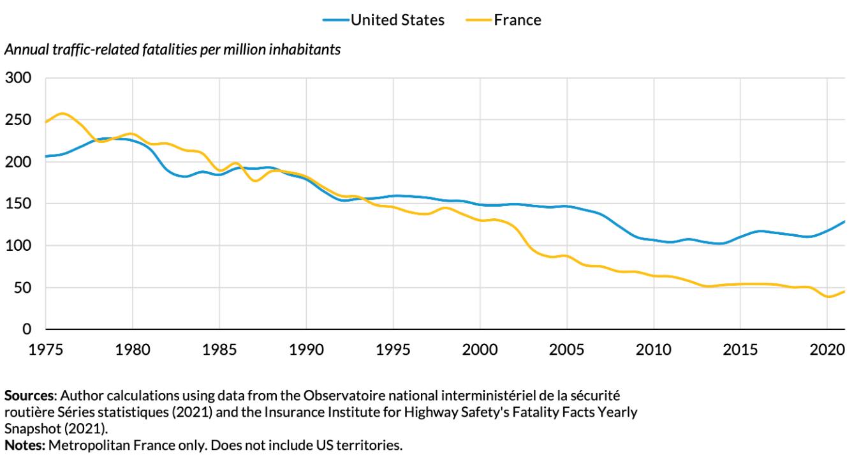
Example 3: French traffic related mortality trends
Introduction of road safety measures
Key Road Safety Measures (1990-2000)
Maximum speed limit in built-up areas set to 50 km/h
Maximum allowable Blood Alcohol Concentration (BAC) lowered to 0.5 g/l
Demerit point system introduced in 1992
Completion of major motorway network construction projects

Slide 6
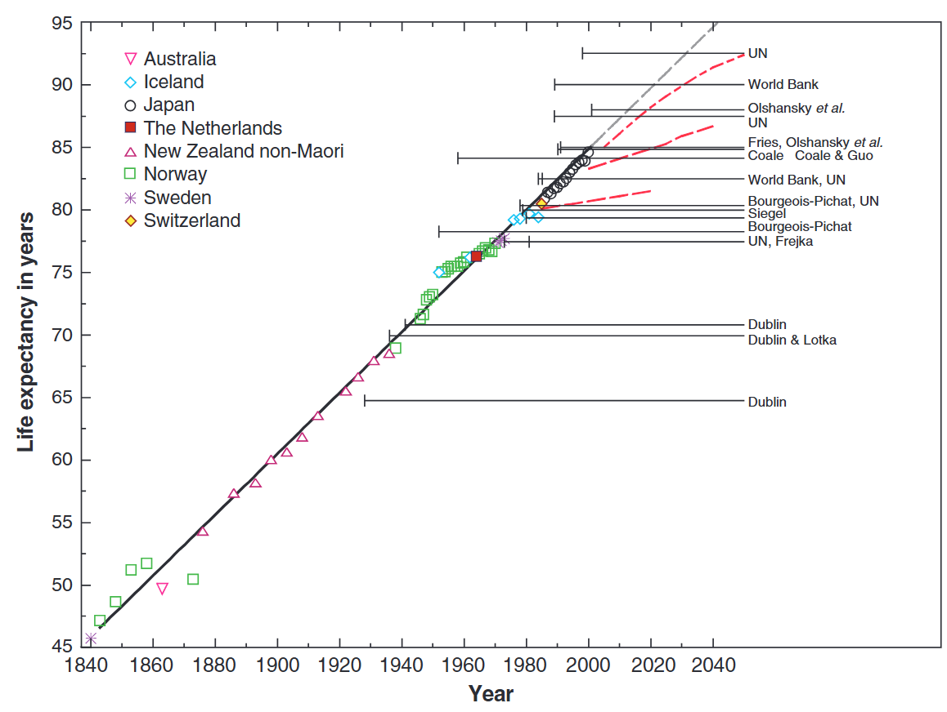
Example 4: Broken limits to life expectancy
Mortality improvements at the oldest ages?
Source: Oeppen & Vaupel (2002): Broken Limits to Life Expectancy

Slide 7



Mortality models in the age of medical innovation
To replace a picture :
Right click on the picture
Click on « Change Picture » / « From a file... »
Choose your picture (1920x1080px)
A Fireside Chat
Roshan Tajapra
            Head of Longevity Research,
            SCOR
Kishore Ananda
            Best Estimate Lead & Senior Global Pricing Actuary,
            SCOR

Slide 8
Discussion topics
To replace a picture :
Right click on the picture
Click on « Change Picture » / « From a file... »
Choose your picture (1920x1080px)
Why is a best estimate mortality trend important?
Looking out at the future, what disruptors are on the horizon?
BE or risk model?
Mortality improvements at the oldest ages – is there a limit to life expectancy?
What are the biggest obstacles to making models more responsive?
What would the ideal best estimate model look like?

