Slide 1


The Importance Of Genetics On Longevity Risk
A Study Based On Half A Million Lives In The UK Biobank Cohort
Peter Banthorpe
SVP, Global Head of Research and Data Analytics
Longevity 14, Amsterdam
21st September 2018

Slide 2
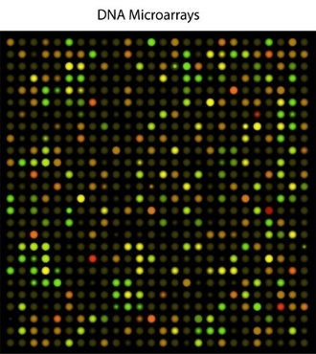
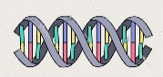
We are at a tipping point for consumer access to genetic data
$22 billion
7 million
600,000
800+
No. 15
…
Genomapp
C G A T
Estimated global market for DNA sequencing in 2025
Consumer genetic tests sold last year
DNA variants measured by 23andMe
Diseases tested for genetic susceptibility
Genetic counsellors are the 15th fastest growing occupation according to US Bureau of Labour Statistics
(2016 to 2026)

Slide 3
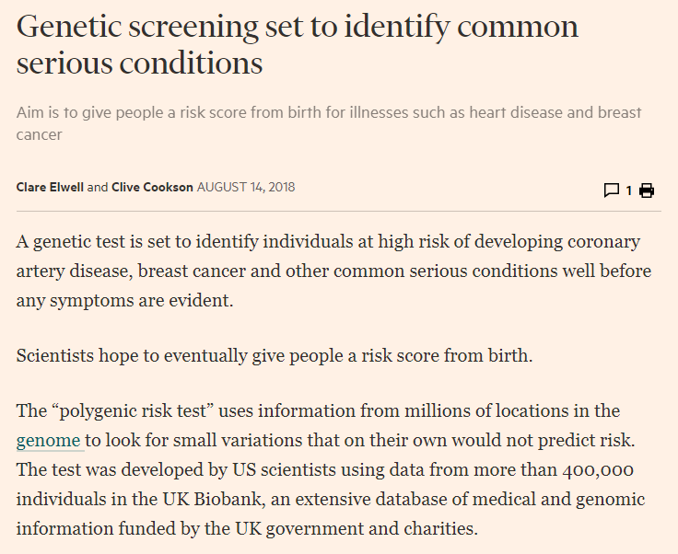
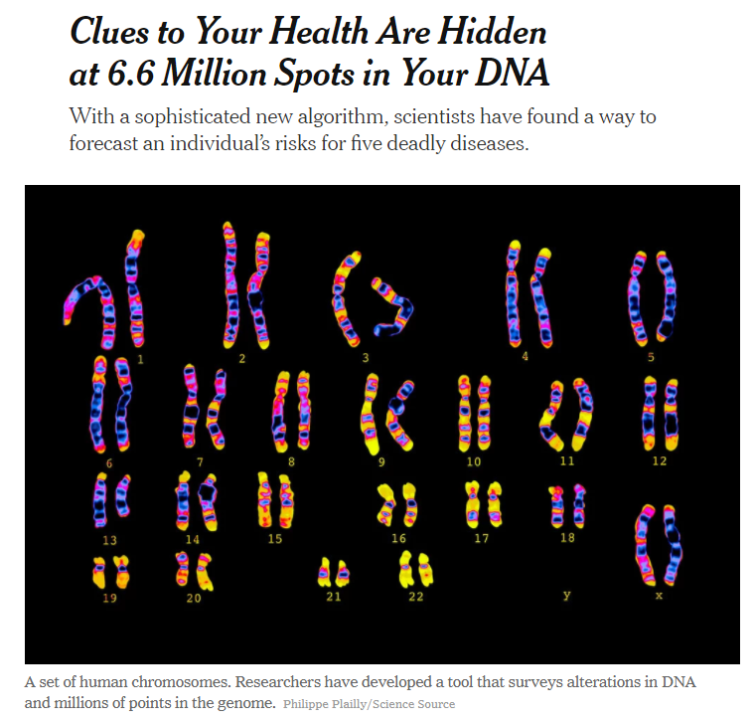
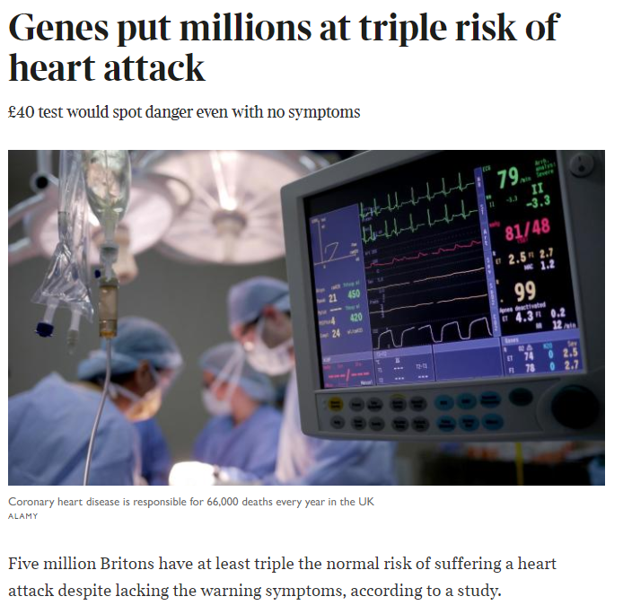
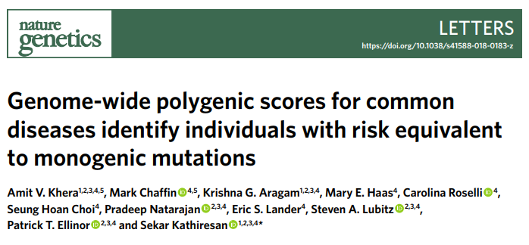


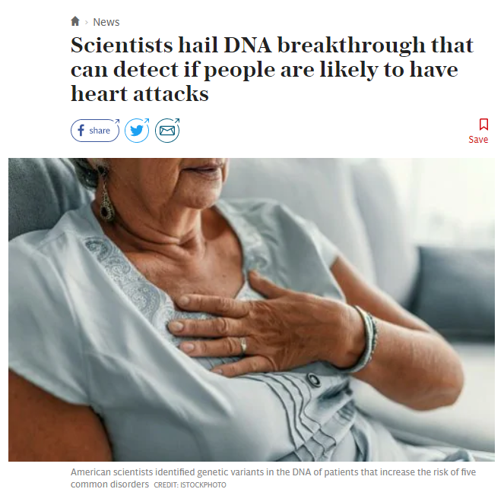

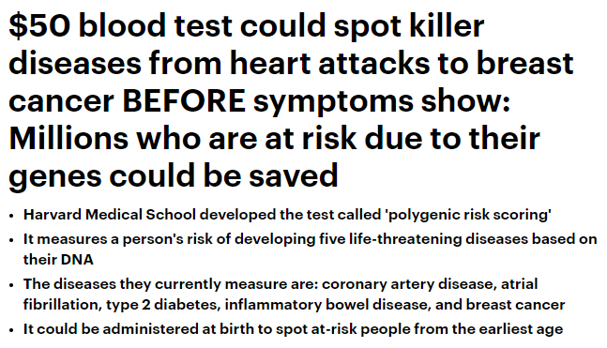
Front Page News – August 2018
Notes:
Study used UKB

Slide 4

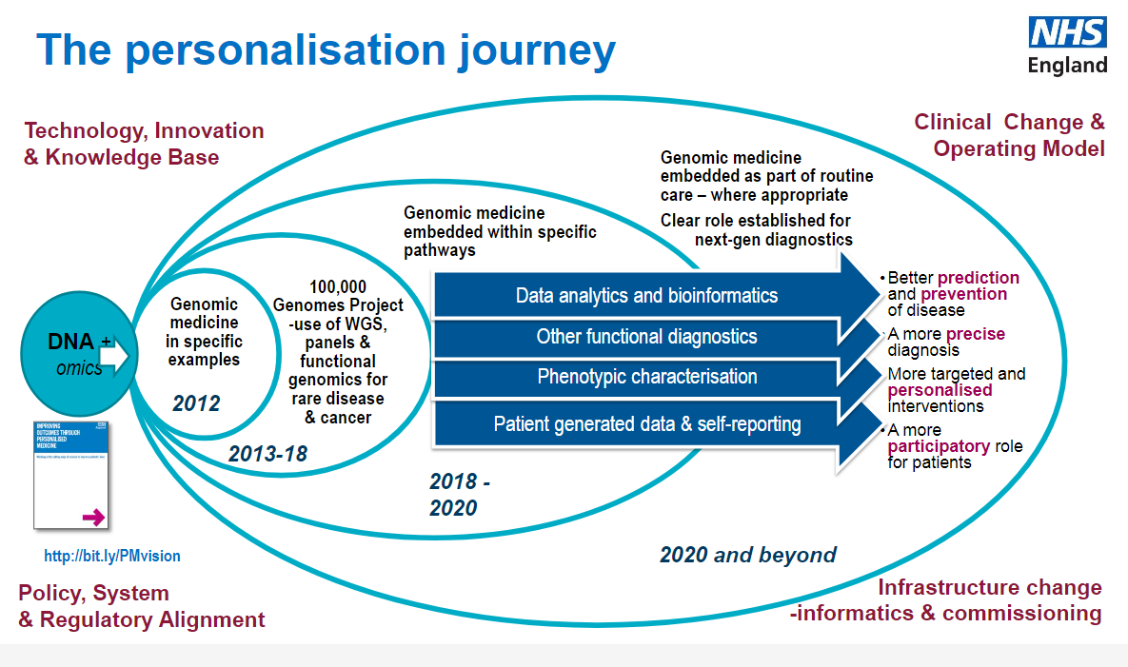
Genomic medicine in the next 5 to 10 years…
Notes:
The NHS will have:
•
A national Genomic Medicine Service
providing consistent & equitable care
for the country’s 55 million population
•
Operating to common national
standards, specifications & protocols
•
Delivering to a single national testing directory
–
covering use of all
technologies from single gene to whole genome sequencing
•
Building a national database that will inform academic & industry
research & discovery including clinical trials recruitment

Slide 5
Agenda
Genetic Risk to Disease and Polygenic Risk Scores
RGA / King’s College London Research Collaboration
Applications to Longevity
Key Messages

Slide 6

Genetic Risk to Disease and Polygenic Risk Scores (PRS)

Slide 7
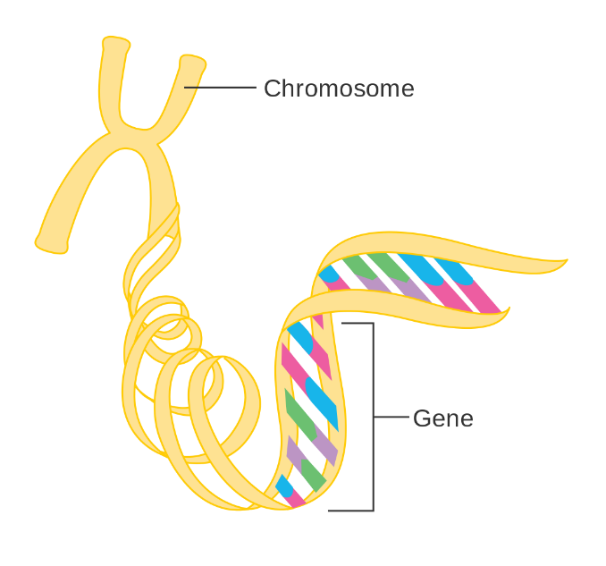
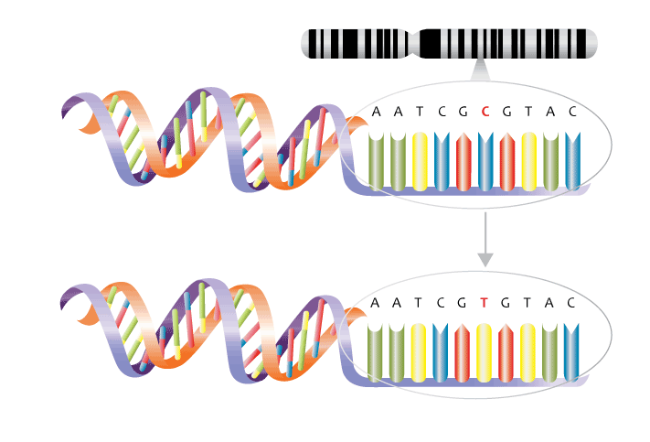
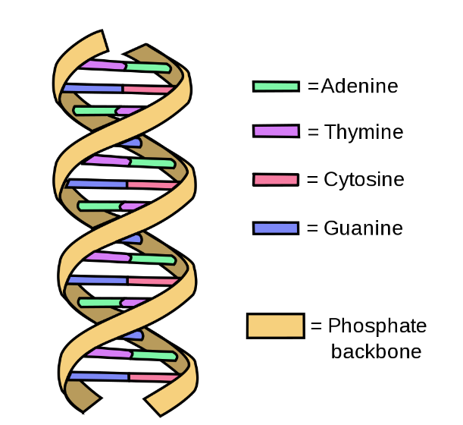
DNA, chromosomes and single nucleotide polymorphisms (SNPs)
SNP
DNA
Base pairs
A single nucleotide polymorphism (SNP) describes variation in a single nucleotide position. E.g., here, a Thymine nucleotide exists instead of Cytosine, which is most commonly observed.
DNA is composed of four ‘building blocks’ (nucleotides) :
adenine (A), cytosine (C),
guanine (G) and thymine (T)
Human DNA is packaged into 23 pairs of chromosomes

Slide 8
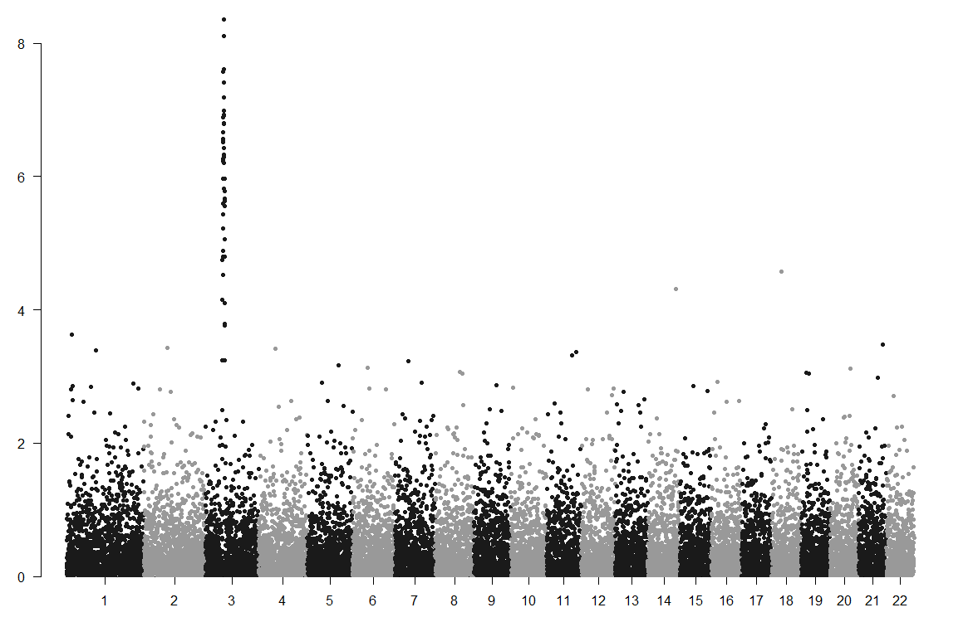


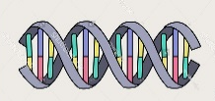
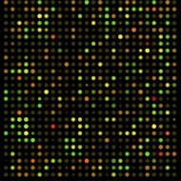
Genome wide association studies (‘GWASes’)
Cases
(people with disease)
Controls
(people without disease)
SNPs associated with disease (with high significance)
−log(P value)
Compare DNA using DNA chip
Very low p-value
Disease-specific SNPS
Non-disease SNPS
Chromosome

Slide 9
Prevalence vs. penetrance of genetic variants
Low-frequency variants with intermediate penetrance
Most variants identified by GWAS
Mendelian disease
Hard to identify genetically
Highly unusual for common diseases
High
Intermediate
Penetrance
Modest
Most SNPs identified by GWAS are common but have small genetic effects. I.e., a marginal contribution to disease susceptibility (‘low penetrance’)
Low
Very rare
Prevalence
Common
Notes:
https://www.priv.gc.ca/en/opc-actions-and-decisions/research/explore-privacy-research/2011/gi_macdonald_201107/
https://theconversation.com/why-insurers-are-wrong-about-canadas-genetic-non-discrimination-law-81380
There are about two hundred dominantly inherited single-gene disorders (Pasternak, 2000), but most are extremely rare and not all have late onset.
CIA report looked at 13 such conditions

Slide 10

GWAS → Polygenic risk scores
Cases
(people with disease)
Controls
(people without disease)
Polygenic risk scores (PRSs) add together the genetic risk from all SNPs associated with the disease
−log(P value)
$$PRS=β1·snp1+β2·snp2+… βn·snp$$
$$n$$
Compare DNA using DNA chip
Increase (‘relax’) p-value
Disease-specific SNPS
Non-disease SNPS
Chromosome

Slide 11
Sample of PRS in literature (1)
Disorder | No. of Genetic Variants | Relative risk, comparing top 20% to bottom 20% PRS | Reference
Coronary artery disease | 50 | 2.0 | Khera AV. et al. (2016), N Engl J Med.
Coronary artery disease | 49,310 | 1.8 to 4.5 | Abraham G. et al. (2016), Eur Heart J.
Type 2 diabetes | 1000 | 3.5 | Läll K. et al. (2017), Genet Med.
Ischemic stroke | 10 | 1.2 to 2.0 | Hachiya T. et al. (2017), Stroke
Breast cancer | 77 | 3.0 | Mavaddat N. et al. (2015), J Natl Cancer Inst.
Breast cancer (East Asian ancestry) | 44 | 2.9 | Wen W. et al. (2016), Breast Cancer Res.
Prostate cancer | 25 | 3.7 (25%) | Amin Al Olama A. et al. (2015), Cancer Epidemiol Biomarkers Prev.
Lung cancer | 38 | 4.6 (25%) | Cheng Y. et al. (2016), Oncotarget

Slide 12
Sample of PRS in literature (2)
Condition | Genetic Variants | Difference in Risk
Sporadic early-onset Alzheimer’s disease | 21 (not including APOE alleles) | 2.27 [6.44 when including APOE alleles] (top to bottom tertiles)
Alzheimer’s disease | 31 (not including APOE alleles) | 3.34 (top to bottom deciles; in normal APOE [ε3/3] individuals)
Alzheimer’s disease | 356,033 | AUC = 78.2% (logistic regression model with APOE, the polygenic score, sex and age as predictors)
IBD | 2,986 | 5.69 for Crohn’s disease and 3.35 for Ulcerative Colities [top to bottom deciles]
Colorectal cancer (in Japanese men) | 6 | Including PSR significantly improved c-stat for classification from 0.6 to 0.66
Alcohol problems | 1,115,557 | Higher polygenic scores predicted a greater number of alcohol problems (range of Pearson partial correlations 0.07–0.08, all p-values ≤ 0.01).
Migraine | 21 | Odds ratio equal to 1.6x (case vs. control; 2x for migraine without aura)
Psoriasis | 16 | 12.3x (top to bottom 25%)
Cardiovascular mortality in patients with CAD | 32 | Hazard ratio of 1.5 (top to bottom 50%), after adjustment for classical risk factors)
Recurrent cardiovascular events in patients with CAD | 45 | Hazard ratio of 1.5 (top to bottom 50%)
Venous thromboembolism | 16 | 1.5x (top to bottom tertile)
Melanoma risk | 15 | 2.6x (top to bottom quintile)

Slide 13
PRS for coronary heart disease increases predictive power, even after adjustment for clinical risk factors
A study by Abraham and colleagues* tested the clinical utility of a PRS for coronary heart disease (CHD), in terms of lifetime CHD risk and relative to traditional clinical risk
PRS tested in independent cohorts (FINRISK and Framingham Heart Study [FHS]; combined n = 16,802 with 1,344 incident CHD events)
The PRS was tested alongside the best clinical risk factors as well as family history. After controlling for these risk factors, the PRS still proved to be a very powerful differentiator of CHD risk.
10% of men with the lowest genetic risk suffer a coronary event by 63 years old
10% of men with the highest genetic risk suffer a coronary event by 51 years old
*Paper: Abraham et al., Genomic prediction of coronary heart disease. Eur Heart J 2016, 37(43):3267-3278

Slide 14
How do PRS interact with lifestyle?
A genetic predisposition to coronary artery disease is not deterministic but attenuated by a favorable lifestyle; standardized 10-year coronary event rates in 3 studies:
 | Favourable lifestyle
 | Intermediate lifestyle
 | Unfavourable lifestyle
Paper: Khera et al., Genetic Risk, Adherence to a Healthy Lifestyle, and Coronary Disease. N Engl J Med 2016, 375:2349-2358

Slide 15







RGA Research Collaboration with King’s College London
Approved project: 23203
Prof. Cathryn Lewis
(Senior Lecturer)
Co-Principal Investigator
Dr Paul O’Reilly
(Senior Lecturer)
Co-Principal Investigator
Miss Jessye Maxwell
(PhD Student)
Project Research Assistant
Dr Beatrice Wu
(Postdoctoral Researcher)
Project Research Associate

Slide 16
RGA Research Collaboration with KCL
RGA-funded one year research project at KCL
Desire to inform the debate around significance of (lack of) access to genetic information by insurers in non-compulsory insurance markets
Collaborative agreement meets the principles set out in the UK Biobank Access Procedures, including commitment to publish all findings and results from the project so that they are available for other researchers to use for health-related research that is in the public interest
Only approved King’s College London research staff have access to UK Biobank data
!

Slide 17

About UK Biobank (UKB)
Summary
The UK Biobank is a major national health resource with the aim of improving the prevention, diagnosis and treatment of a wide range of serious and life-threatening illnesses
UK Biobank recruited 500,000 people aged 40-69 years in 2006-2010 from across the UK to take part in this project. All volunteers agreed to have their health followed indefinitely
Participants underwent vigorous testing, shared blood, urine and saliva samples, and provided detailed personal and health information
All data, including genetic, biochemistry and imaging data, are made available for research studies
A robot stores and retrieves biological
samples at UK Biobank
Notes:
No attribution required

Slide 18
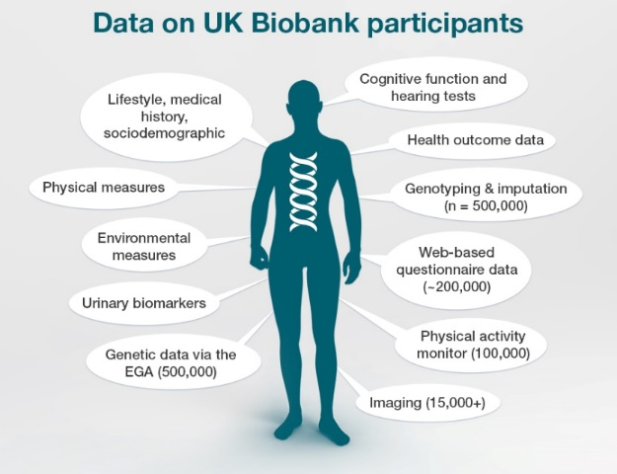
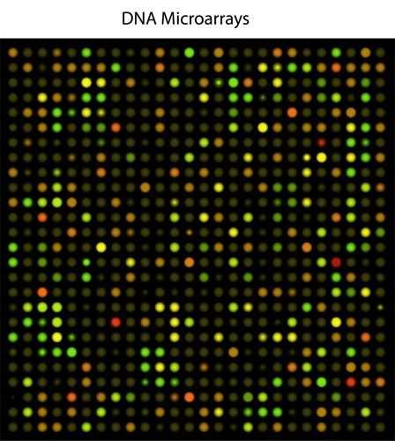

Why UK Biobank?
Breadth and Depth
Long-term follow up of multiple outcomes
Genotyping on all 500k participants
https://www.ebi.ac.uk/about/news/feature-story/biobanks-genetic-data-demand. Accessed 12 May 2018

Slide 19

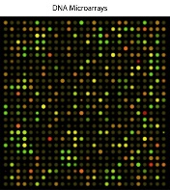
Predicting morbidity outcomes in UKB
Baseline information / risk factors as appropriate to the disorder
Polygenic risk scores for the morbidity of interest
Predict incident cases of the disorder
Notes:
Clinical/lifestyle/socio-demographics: gender, BMI, smoker status (incl. pack years), blood pressure, alcohol intake, heart rate, co-habiting status, education attainment, Townsend deprivation
Note still lacking bloods measurements!

Slide 20



‘Underwriting’ UKB participants and predicting disease incidence
‘Standard’ Risk (disease-free at baseline)
c. 340k individuals
UKB:
c. ½ million individuals
‘Underwriting’ Process
Prevalent disease in hospital records
+
Self-reported illness at baseline verbal interview (with nurse)
Prediction Model
Phenotypic risk factors (age, gender, smoking, family history, BMI, BP, etc.)
+
Genetics (PRS for disease)
Non-Standard Risk
(c. 160k individuals)

Slide 21
PRS to predict incidence of breast cancer
(RGA-KCL study results)
Total Participants: 199,517
Number of breast cancers: 3,882 (1.95%)
Total Participants: 143,958
Number of breast cancers: 2,684 (1.86%)
Percentile | Full cohort: Hazard ratio (95% CI)
0-1 | 0.36 (0.21 - 0.63)
1-5 | 0.56 (0.44 - 0.7)
5-10 | 0.56 (0.46 - 0.69)
10-20 | 0.7 (0.6 - 0.8)
20-40 | 0.84 (0.76 - 0.94)
40-60 | 1 (reference group)
60-80 | 1.21 (1.09 - 1.33)
80-90 | 1.4 (1.25 - 1.57)
90-95 | 1.86 (1.63 - 2.12)
95-99 | 1.97 (1.72 - 2.26)
99-100 | 2.51 (2.02 - 3.13)
Percentile | Standard cohort: Hazard ratio (95% CI)
0-1 | 0.41 (0.22 - 0.76)
1-5 | 0.56 (0.42 - 0.74)
5-10 | 0.6 (0.47 - 0.77)
10-20 | 0.71 (0.59 - 0.84)
20-40 | 0.84 (0.74 - 0.95)
40-60 | 1 (reference group)
60-80 | 1.22 (1.09 - 1.38)
80-90 | 1.41 (1.23 - 1.61)
90-95 | 1.87 (1.6 - 2.18)
95-99 | 1.96 (1.66- 2.31)
99-100 | 2.61 (2.02 - 3.38)
Decreased risk
Decreased risk
Increased risk
Increased risk
Notes:
Adjusted models (variables included: age at menarche, number of live births, FH of BC, age at menopause, hormone therapy, personal history of non-cancerous breast diseases, BMI, alcohol)

Slide 22
PRS to predict incidence of cardiovascular disease
(RGA-KCL study results)
Total Participants: 376,675
Number of CAD events: 4,598 (1.22%)
Total Participants: 261,204
Number of CAD events: 2,334 (0.89%)
Percentile | Full cohort: Hazard ratio (95% CI)
0-1 | 0.67 (0.47 - 0.97)
1-5 | 0.52 (0.42 - 0.65)
5-10 | 0.76 (0.65 - 0.9)
10-20 | 0.75 (0.66 - 0.85)
20-40 | 0.79 (0.72 - 0.88)
40-60 | 1 (reference group)
60-80 | 1.1 (1.01 - 1.2)
80-90 | 1.43 (1.29 - 1.58)
90-95 | 1.4 (1.24 - 1.6)
95-99 | 1.68 (1.47 - 1.91)
99-100 | 2.19 (1.78 - 2.69)
Percentile | Standard cohort: Hazard ratio (95% CI)
0-1 | 0.66 (0.4 - 1.11)
1-5 | 0.41 (0.29 - 0.57)
5-10 | 0.77 (0.61 - 0.97)
10-20 | 0.78 (0.65 - 0.93)
20-40 | 0.81 (0.7 - 0.93)
40-60 | 1 (reference group)
60-80 | 1.15 (1.01 - 1.3)
80-90 | 1.54 (1.33 - 1.77)
90-95 | 1.43 (1.19 - 1.72)
95-99 | 1.92 (1.61 - 2.29)
99-100 | 2.78 (2.11 - 3.67)
Decreased risk
Decreased risk
Increased risk
Increased risk
Notes:
Adjusted model results
Definition; coronary event or death from event (ICD-10): I21, I22, I23, I24.1, I25.2
All PRS highly significant
Very little attenuation after controlling for underwriting and clinical/lifetylse/socio-demographic risk factors
Note have not given HRs for all the other predictors in adjusted model

Slide 23
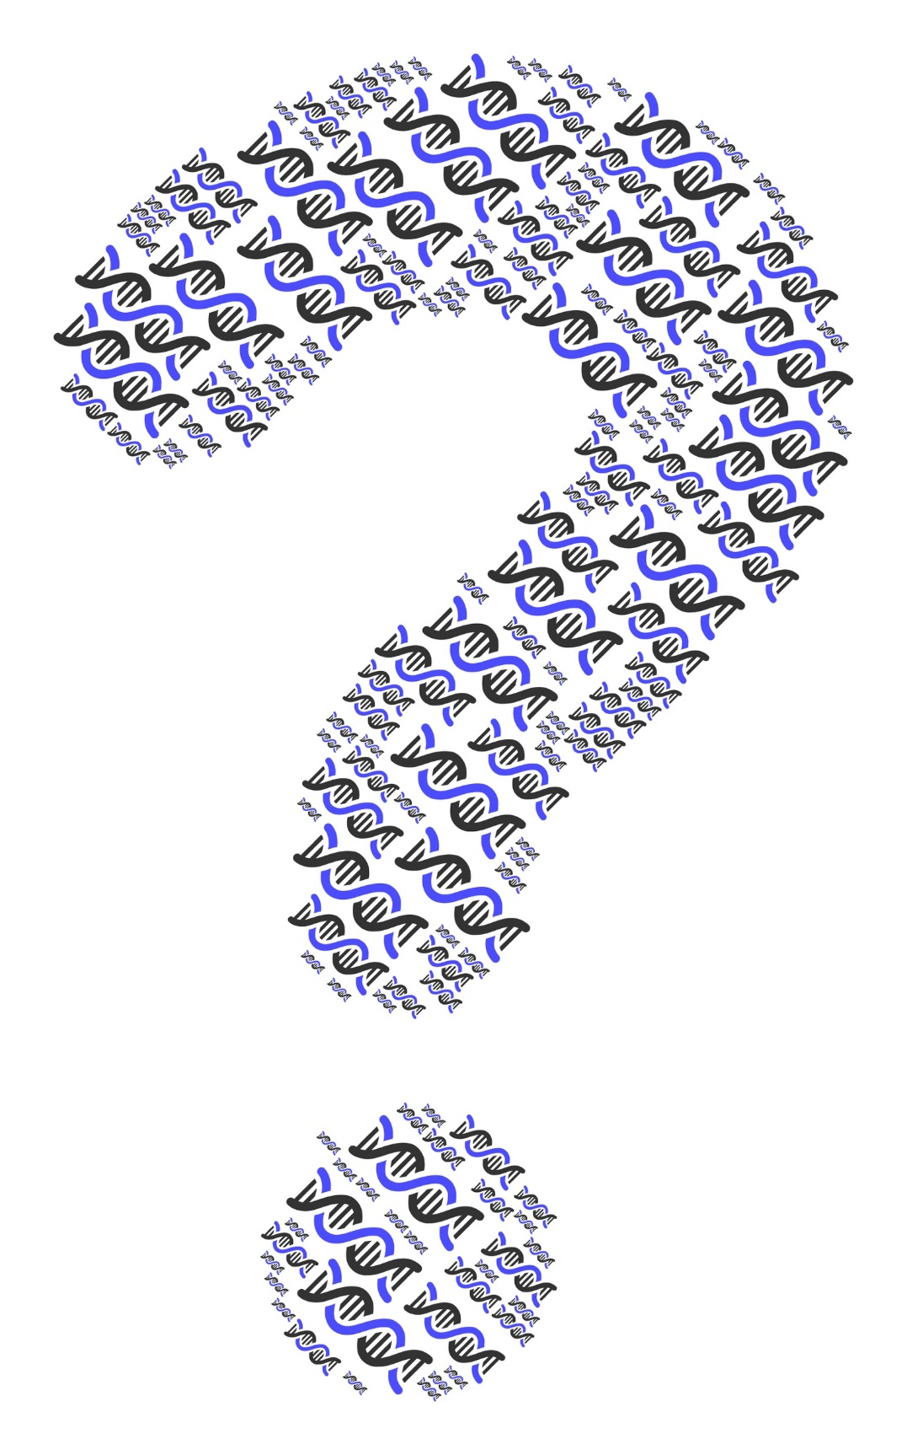
Applications to Longevity

Slide 24
Predicting impact of PRSs is still early
Genetic loci associated with disease will continue to be found and could confer additional predictive power
Correlations with other health and lifestyle factors could be more significant than high penetrance genes
Correlations between PRS for different conditions
Risk of developing a disease may be correlated with severity of disease
Application of PRS to non-Caucasian populations
Preventative or mitigating actions, such as:
  Screening programs based on PRS may limit mortality impact
  Impact of preventative lifestyle actions unknown
  Pharmacogenomics, precision medicine etc.
Notes:
Just reflecting on the models and progress of PRS so far.
The models we’ve looked at so far only included a small number of conditions when considering the potential anti-selective risk. Research on finding genetic loci associated with disease is carrying on at great speed and this, coupled with increasing work into correlations with lifestyle factors, will only increase the power of polygenic risk scores further.
Even though much work has already been done there is significantly more to do, for example most of the studies have concentrated on data from European or Caucasian lives and studies would suggest that results can be different for other populations.
However from what research has been done so far there looks to be significant potential for use of PRS in terms of:
Improving targeting of high risk groups for screening programs
Targeting high risk individuals to modify lifestyle to improve their health
Precision medicine

Slide 25
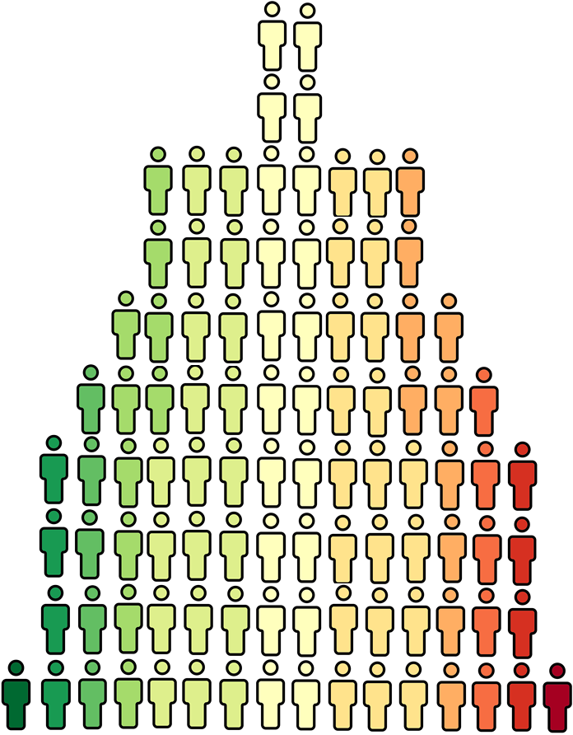
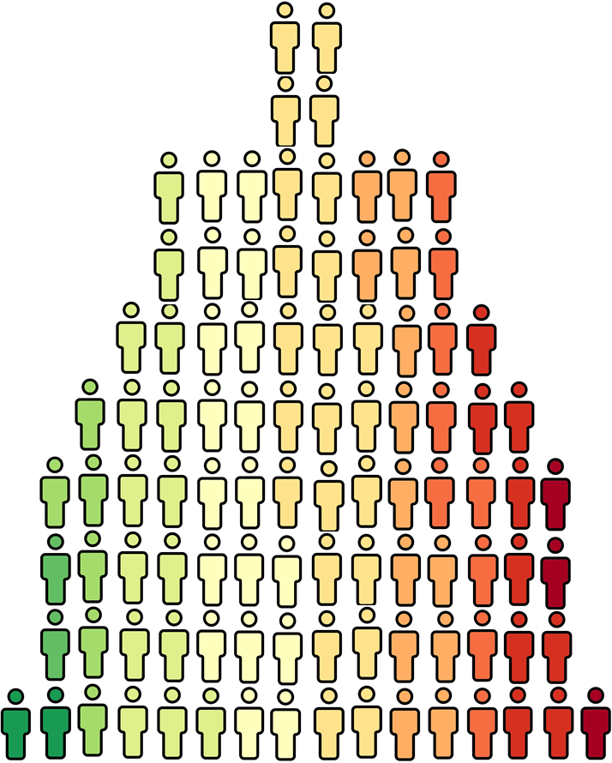
Example insurance anti-selection scenario using breast cancer PRS:
Percentile | % in general population | Hazard ratio for breast cancer | Probability of purchasing insurance * | % in new risk pool
0-1 | 1% | 0.41 | 1x | 0.9%
1-5 | 4% | 0.56 |  | 3.7%
5-10 | 5% | 0.6 |  | 4.6%
10-20 | 10% | 0.71 |  | 9.2%
20-40 | 20% | 0.84 |  | 18.3%
40-60 | 20% | 1 |  | 18.3%
60-80 | 20% | 1.22 | 1.11x | 20.3%
80-90 | 10% | 1.41 | 1.21x | 11.0%
90-95 | 5% | 1.87 | 1.44x | 6.6%
95-99 | 4% | 1.96 | 1.48x | 5.4%
99-100 | 1% | 2.61 | 1.81x | 1.7%
+4.8%
increase in incidence
+5.4%
increase if include BRCA1/2 mutations (assuming 0.2% prevalence and 5x odds ratio)

Slide 26
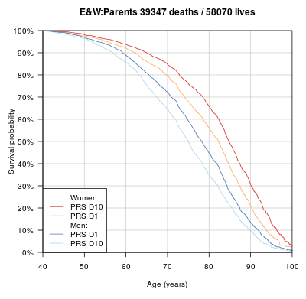
Polygenic Risk Scores for Longevity
Studies of parental longevity suggest 5 year mean lifespan difference between top and bottom deciles
Source: Genomic underpinnings of lifespan allow prediction and reveal basis in modern risks. http://dx.doi.org/10.1101/363036 Timmers, Joshi et al. Accessed 11 September 2018 from https://www.biorxiv.org/content/biorxiv/early/2018/07/06/363036.full.pdf . Graphic used with permission.

Slide 27
Key Messages
Notes:
https://www.ted.com/playlists/357/how_does_dna_work

Slide 28
Conclusions
Our work concentrates on common genetic variants, not the rare high penetrance gene mutations studied for insurance to date (e.g. BRCA1, Huntington’s)
These common variants, assessed using PRS, provide population risk information that is largely additive/independent to normal underwriting risk factors
For incidence of and death from CAD and cancers, we see material differentiation from PRS, even at older ages
Other research shows all-cause mortality PRS provide a mean lifespan difference of around 5 years between top and bottom deciles
Use of genetic data in underwriting protection is heavily regulated and likely to be so for annuities
Use of PRS remains an emerging risk issue for the Insurance Industry and we must continue to monitor and develop research on both the science and consumer behavior on the potential impact
Notes:
Next steps

