Slide 1
Health Cost Risk, Informal Insurance, and Annuitization Decisions
Meitong Ai, School of Insurance, Central University of Finance and Economics
Ming Gao, School of Economics, Peking University
Ruo Jia, School of Economics, Peking University
Yaojing Wang, School of Economics, Peking University
2025. 09. 08

Slide 2
Motivation I: Annuity puzzle
Households should fully annuitize their savings (Yaari, 1965).
  no bequest motives
  the time of death is the only uncertainty.
Elderly people annuitize little of their wealth, if any, to address their longevity risk of outliving their income (Benartzi et al., 2011; Lockwood, 2012).
A potential explanation for annuity puzzle: health cost risk
  Health cost risk → liquidity needs → annuity demand

Slide 3
Motivation II: Health cost risk
The existing theoretical models and simulations about the impact of the health cost risk on annuity demand in the early retirement years
  Negative (Davidoff et al., 2005; Peijnenburg et al., 2017)
  Positive (Pang and Warshawsky, 2010)
  Parameter-sensitive (Pashchenko, 2013).
Real world empirical evidence remains a gap

Slide 4
Institutional background
  Residents Basic Pension in China
  The individual-account pension benefits are financed by individual contributions in the heritable, fully funded individual accounts.
  The general account basic pension benefits are financed purely by the general tax on a pay-as-you-go basis.
Ideal setup for Yaari's (1965) assumption and prediction
* No bequest motive
* Full annuitization

Slide 5
Institutional background
The RBP program
initiated in some rural areas in 2009.
expanded to some urban areas in 2011.
became available to all eligible residents in 2012.
  Residents not covered by the compulsory Employees’ Basic Pension (EBP).
  No annuity access before the RBP program.
  Only make their annuitization decisions once when they decide to participate in the voluntary program.

Slide 6
Key findings
Informal insurance
Health cost risk increases the probability of pension participation
Health cost risk decreases the amount of pension contribution for pension participants
  Informal insurance
  The impact of the health cost risk on pension demand is consistently negative

Slide 7
Contribution I: Health cost risk
 | Existing literature | Our contributions
Annuity puzzle and the impact of health cost risk on annuitization decisions | Davidoff et al. (2005); Reichling and Smetters (2015): Partial or no annuitization can be the optimal level if considering health cost risk. Davidoff et al. (2005): An uninsured health cost risk early in life reduces the value of annuities when compared with alternative assets. Ai et al (2017); Peijnenburg et al. (2017): If uncertain health expenses occur later in life, individuals can annuitize and build a liquid wealth buffer against the risk. Pang and Warshawsky (2010): Positive impact of health spending risk on annuity demand. Panshchenko (2013): A very small effect on annuity ownership. | The first piece of empirical evidence regarding the impact of health cost risk on individuals’ annuitization decisions

Slide 8
Contribution II ：Informal insurance
 | Existing literature | Our contributions
Informal insurance and Its substitution effect on pensions | Bu and Liao (2022): Informal insurance is prevalent in developing economies. Bloch et al. (2008): The demand for social insurance depends on the availability of informal insurance. Kotlikoff and Spivak (1981); Foster and Rosenzweig (2001) ; Eugster et al. (2011): Altruism and trust within a household ameliorate the commitment constraints and reinforce the risk-sharing agreements within a household. Oliveira (2016): Having more children to support the parents in elderly life provides a more adequate and reliable hedge against longevity risks. | First to examine the pension substitution role that informal insurance plays in the relationship between health cost risk and annuitization decisions

Slide 9
Data and sample I
China Health and Retirement Longitudinal Study (CHARLS)
2011, 2013, 2015, 2018, revisit
Personal information, family structure and financial support, health status, work, income and assets, retirement and pension plans
Sample
45 to 59 years old in respective survey year
Eligible to participate in RBP
14,324 individual-year observations

Slide 10
Data and sample II: Summary statistics
 | Obs. | Mean | S.D. | Min | Median | Max
Panel A Key variables
Pension_participation | 14,324 | 0.79 | 0.40 | 0 | 1 | 1
Pension_contribution (CNY, incl. zero) | 13,734 | 254.1 | 768.0 | 0 | 100 | 9,000
Pension_contribution (CNY, excl. zero) | 10,789 | 323.5 | 853.4 | 100 | 100 | 9,000
Health^{poor} | 14,322 | 0.24 | 0.43 | 0 | 0 | 1
Health^{fair} | 14,322 | 0.50 | 0.50 | 0 | 1 | 1
Health^{good} | 14,322 | 0.26 | 0.44 | 0 | 0 | 1
Chronic_diseases | 14,323 | 1.47 | 1.54 | 0 | 1 | 12
Health_risk | 14,319 | 0.25 | 0.17 | 0.054 | 0.18 | 0.63
Unlikely_75 | 14,324 | 0.29 | 0.46 | 0 | 0 | 1
Maybe_75 | 14,324 | 0.39 | 0.49 | 0 | 0 | 1
Likely_75 | 14,324 | 0.32 | 0.47 | 0 | 0 | 1
Number_of_children | 14,324 | 2.24 | 1.01 | 0 | 2 | 10
Rely_on_children | 13,894 | 0.73 | 0.45 | 0 | 1 | 1

Slide 11
Results I: Impact of health cost risk on pension demand
$${Pension_demand}_{it}=β_{0}+β_{1}{Health_cost_risk}_{it}+β_{2}{Longevity_risk}_{it}+λX_{it}+δ{Year}_{t}+γ{Province}_{it}+ε_{it} \left(1\right)$$
VARIABLES | Pension_participation (1) (2) (3) |  |  |  | Ln(Pension_contribution) (4) (5) (6)
Health^{fair} | -0.0170** |  |  |  | 0.0287*
 | (0.00802) |  |  |  | (0.0174)
Health^{good} | -0.0200** |  |  |  | 0.105***
 | (0.00998) |  |  |  | (0.0229)
Chronic_diseases |  | 0.00491** |  |  |  | -0.00935*
 |  | (0.00220) |  |  |  | (0.00483)
Health_risk |  |  | 0.0484** |  |  |  | -0.126***
 |  |  | (0.0204) |  |  |  | (0.0449)
Maybe_75 | 0.0220*** | 0.0209*** | 0.0220*** |  | 0.0346** | 0.0440*** | 0.0390**
 | (0.00761) | (0.00755) | (0.00760) |  | (0.0169) | (0.0167) | (0.0168)
Likely_75 | 0.0261*** | 0.0244*** | 0.0258*** |  | 0.0679*** | 0.0868*** | 0.0801***
 | (0.00820) | (0.00803) | (0.00811) |  | (0.0194) | (0.0191) | (0.0195)
Observations | 14,322 | 14,323 | 14,319 |  | 10,788 | 10,788 | 10,787
(Pseudo) R² | 0.185 | 0.185 | 0.185 |  | 0.215 | 0.214 | 0.214
Health cost risk
↑ Participation
↓ Contribution

Slide 12
Results II: Substitution effect of informal insurance on pensions
${Pension_demand}_{it}$ = $α_{0}$ + $α_{1}{Health_cost_risk}_{it}$ + $α_{2}{Informal_insurance}_{it}$ + $α_{3}{Health_cost_risk}_{it}×{Informal_insurance}_{it}$ + $θZ_{it}+δ{Year}_{t}+γ{Province}_{it}+ε_{it} \left(2\right)$
VARIABLES | Pension_participation (1) (2) (3) |  |  |  | Ln(Pension_contribution) (4) (5) (6)
Health^{fair} | 0.0397** |  |  |  | 0.132***
 | (0.0193) |  |  |  | (0.0456)
Health^{good} | 0.0428** |  |  |  | 0.208***
 | (0.0207) |  |  |  | (0.0560)
Chronic_diseases |  | -0.0103** |  |  |  | -0.0430***
 |  | (0.00489) |  |  |  | (0.0126)
Health_risk |  |  | -0.0814* |  |  |  | -0.382***
 |  |  | (0.0463) |  |  |  | (0.111)
Health^{fair} × Number_of_children | -0.0245*** |  |  |  | -0.0436***
 | (0.00762) |  |  |  | (0.0167)
Health^{good} × Number_of_children | -0.0295*** |  |  |  | -0.0434**
 | (0.00945) |  |  |  | (0.0202)
Chronic_diseases × Number_of_children |  | 0.00658*** |  |  |  | 0.0141***
 |  | (0.00191) |  |  |  | (0.00480)
Health_risk × Number_of_children |  |  | 0.0562*** |  |  |  | 0.108***
 |  |  | (0.0180) |  |  |  | (0.0400)
Number_of_children | 0.0201*** | -0.00857* | -0.0138** |  | -0.0454*** | -0.101*** | -0.107***
 | (0.00635) | (0.00439) | (0.00588) |  | (0.0128) | (0.0114) | (0.0143)
Observations | 14,322 | 14,323 | 14,319 |  | 10,788 | 10,788 | 10,787
(Pseudo) R² | 0.186 | 0.186 | 0.186 |  | 0.216 | 0.214 | 0.214
Consistent negative impact
Substitution effect of informal insurance mitigates the impact of health cost risk

Slide 13
Results III Substitution effect of informal insurance on pensions in respective health status

Slide 14
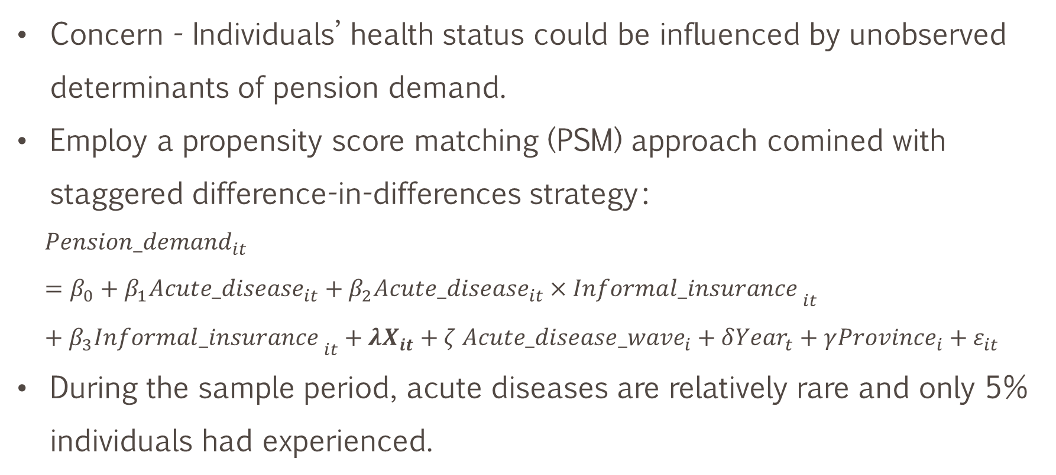
Impact of health cost risk: Endogeneity
Concern - Individuals’ health status could be influenced by unobserved determinants of pension demand.
Employ a propensity score matching (PSM) approach comined with staggered difference-in-differences strategy：
$${Pension_demand}_{it}=β_{0}+β_{1}{Acute_disease}_{it}+β_{2}{Acute_disease}_{it}×{Informa{l_insurance}_{ }}_{it}+β_{3}{Informa{l_insurance}_{ }}_{it}+λX_{it}+ζ {Acute_disease_wave}_{i}+δ{Year}_{t}+γ{Province}_{i}+ε_{it}$$
During the sample period, acute diseases are relatively rare and only 5% individuals had experienced.

Slide 15
Impact of health cost risk: Endogeneity
VARIABLES | Pension_ participation |  |  | Ln(Pension_ contribution) |  |  | Pension_ participation |  |  | Ln(Pension_ contribution)
 | (1) | (2) |  | (3) | (4) |  | (5) | (6) |  | (7) | (8)
Acute_disease | -0.0848** | -0.0627* |  | -0.195* | -0.216** |  | -0.0858** | -0.0644* |  | -0.180* | -0.199**
 | (0.0380) | (0.0373) |  | (0.101) | (0.102) |  | (0.0395) | (0.0384) |  | (0.0975) | (0.0940)
Acute_disease × Number_of_children | 0.0240** | 0.0210* |  | 0.0905** | 0.104*** |  | 0.0247** | 0.0211* |  | 0.0789** | 0.0923***
 | (0.0114) | (0.0112) |  | (0.0372) | (0.0382) |  | (0.0117) | (0.0114) |  | (0.0357) | (0.0338)
Control variables | Yes | Yes |  | Yes | Yes |  | Yes | Yes |  | Yes | Yes
Constant | Yes | Yes |  | Yes | Yes |  | Yes | Yes |  | Yes | Yes
Province FE | Yes | No |  | Yes | No |  | Yes | No |  | Yes | No
Year FE | Yes | No |  | Yes | No |  | Yes | No |  | Yes | No
Province × Year FE | No | Yes |  | No | Yes |  | No | Yes |  | No | Yes
Acute disease wave FE | Yes | Yes |  | Yes | Yes |  | Yes | Yes |  | Yes | Yes
Observations | 4,277 | 4,277 |  | 3,376 | 3,376 |  | 4,277 | 4,277 |  | 3,376 | 3,376
R² | 0.233 | 0.281 |  | 0.198 | 0.233 |  | 0.246 | 0.293 |  | 0.216 | 0.253

Slide 16
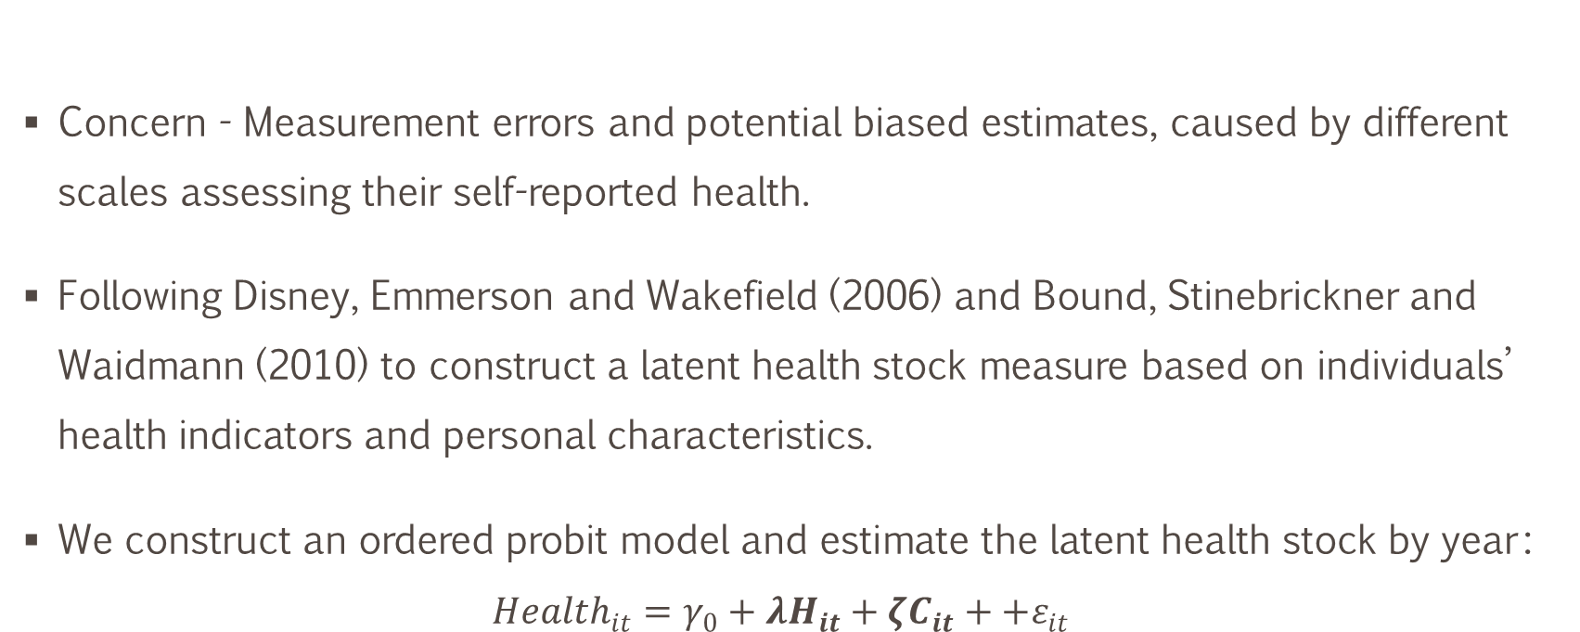
Impact of health cost risk: Endogeneity
Concern - Measurement errors and potential biased estimates, caused by different scales assessing their self-reported health.
Following Disney, Emmerson and Wakefield (2006) and Bound, Stinebrickner and Waidmann (2010) to construct a latent health stock measure based on individuals’ health indicators and personal characteristics.
We construct an ordered probit model and estimate the latent health stock by year：
$${Health}_{it}=γ_{0}+λH_{it}+ζC_{it}++ε_{it}$$

Slide 17
Impact of health cost risk: Endogeneity
VARIABLES | Pension_participation |  |  | Ln(Pension_contribution)
 | (1) | (2) |  | (3) | (4)
Health_stock | 0.0264* | 0.0256* |  | 0.124*** | 0.132***
 | (0.0143) | (0.0137) |  | (0.000) | (0.000)
Health_stock × Number_of_children | -0.0200*** | -0.0189*** |  | -0.0406*** | -0.0404***
 | (0.00566) | (0.00548) |  | (0.001) | (0.001)
Control variables | Yes | Yes |  | Yes | Yes
Constant | Yes | Yes |  | Yes | Yes
Province FE | Yes | No |  | Yes | No
Year FE | Yes | No |  | Yes | No
Province × Year FE | No | Yes |  | No | Yes
Observations | 10,741 | 10,687 |  | 7,979 | 7979
(Pseudo) R² | 0.190 | 0.219 |  | 0.213 | 0.248

Slide 18
Impact of health cost risk: Endogeneity
Reverse causality - Receiving pension benefits may improve an individual’s health condition.
  45-to-59-year-old sample - individuals were not receiving pension benefits until 60.

Slide 19
Impact of informal insurance: Endogeneity
Reverse causality - Individuals may expect a public pension and thus reduce their number of births.
  Individuals made their fertility decisions 15-40 years ago, when the RBP scheme had not been introduced and when they had neither access to nor expectation for any public pensions.
Omitted variable - Individuals’ fertility preference is considered a common omitted variable that causes endogeneity problem in labor economics.
  Fertility preference influences individuals’ Pension_demand only through its impact on the Number_of_children.

Slide 20
Additional analyses on the informal insurance effect
Dimension | Characteristics | Reason | Health cost risk impact is mitigated more significantly
Children | Education | A reliable indication of the quality of child-provided informal insurance | For households with better educated children
 | Gender differences | Traditionally, it is believed that sons should take on the responsibility of the old-age support. | does not differ depending on their children’s gender
Parental | Income level | Altruistic motives - more support for parents who have lower incomes. | For households with lower incomes
 | Social networks | More cohesive social networks → more easily form informal risk-sharing arrangements. | For households with more informal social networks
Regional | Male–female ratio | The level of gender selection prior to birth and the ideology about bringing up sons for old age support. | Higher male-female ratio regions
 | Mobility | The problem of pension account migration and the continuation of a pension scheme when moving between provinces. | Higher mobility regions
 | Development level | In less-developed areas in China, informal social and economic ties are important in household financial decisions (Bu and Liao, 2022). | Less developed regions

Slide 21
Alternative explanations: Income and property ownership
VARIABLES | Pension_participation (1) (2) |  |  | Ln(Pension_contribution) (3) (4)
 | Income as alternative explanation
Health^{fair} × Ln(Net_income) | 0.000640 |  |  | -0.00571
 | (0.00179) |  |  | (0.00378)
Health^{good} × Ln(Net_income) | 0.000911 |  |  | 0.000141
 | (0.00204) |  |  | (0.00483)
Health^{fair} × Ln(Labor_income) |  | 0.00132 |  |  | -0.00654*
 |  | (0.00176) |  |  | (0.00386)
Health^{good} × Ln(Labor_income) |  | -0.000884 |  |  | -0.00261
 |  | (0.00205) |  |  | (0.00494)
Observations | 14,319 | 14,319 |  | 10,787 | 10,787
(Pseudo) R² | 0.186 | 0.185 |  | 0.215 | 0.216
 | Property ownership as alternative explanation
Health^{fair} × Ln(Rental_income) | 0.00184 |  |  | 0.00385
 | (0.00346) |  |  | (0.00837)
Health^{good} × Ln(Rental_income) | 0.00771* |  |  | 0.00358
 | (0.00398) |  |  | (0.0103)
Health^{fair} × Property_ownership |  | 0.0403 |  |  | -0.210
 |  | (0.0517) |  |  | (0.200)
Health^{good} × Property_ownership |  | 0.0587 |  |  | -0.127
 |  | (0.0658) |  |  | (0.235)
Observations | 14,043 | 14,289 |  | 10,689 | 10,771
(Pseudo) R² | 0.173 | 0.186 |  | 0.216 | 0.216
Income can not explain the opposite results
Property ownership can not explain the opposite results

Slide 22
Alternative explanations: Income and property ownership
VARIABLES | Pension_participation (1) (2) (3) |  |  |  | Ln(Pension_contribution) (4) (5) (6)
Health^{fair} | -0.0678 |  |  |  | 0.000233
 | (0.0488) |  |  |  | (0.121)
Health^{good} | -0.0960* |  |  |  | 0.434***
 | (0.0532) |  |  |  | (0.163)
Chronic_diseases |  | 0.0337** |  |  |  | -0.00674
 |  | (0.0138) |  |  |  | (0.0390)
Health_risk |  |  | 0.215* |  |  |  | -0.634**
 |  |  | (0.115) |  |  |  | (0.316)
Healthfair × Health_insurance | 0.0526 |  |  |  | 0.0282
 | (0.0493) |  |  |  | (0.122)
Healthgood × Health_insurance | 0.0793 |  |  |  | -0.336**
 | (0.0537) |  |  |  | (0.163)
Chronic_diseases × Health_insurance |  | -0.0297** |  |  |  | -0.00265
 |  | (0.0139) |  |  |  | (0.0392)
Health_risk × Health_insurance |  |  | -0.173 |  |  |  | 0.520
 |  |  | (0.116) |  |  |  | (0.317)
Health_insurance | 0.251*** | 0.335*** | 0.344*** |  | 0.00396 | -0.0811 | -0.227*
 | (0.0394) | (0.0271) | (0.0368) |  | (0.0913) | (0.0819) | (0.119)
Observations | 14,322 | 14,323 | 14,319 |  | 10,788 | 10,788 | 10,787
(Pseudo) R² | 0.185 | 0.185 | 0.185 |  | 0.216 | 0.214 | 0.214
Formal health Insurance can not explain the opposite results

Slide 23
Conclusions
  The first piece of empirical evidence
    The impact of health cost risk on annuitization decisions and pension demand
    Consistently negative after teasing out the effect of informal insurance
    Individuals with lower health cost risk and with no children are more likely to participate in a pension and contribute more after enrollment
  A seemingly contradictory result
    Health cost risk increases the probability of pension participation
    Health cost risk decreases the amount of pension contribution for pension participants
  The substitution effect of informal insurance on pensions is stronger than thus mitigates the health cost risk impact more pronounced
    among households with better-educated children, lower incomes, and more informal social networks
    in regions that have a higher male–female ratio, that have higher mobility, or are less developed
    does not differ depending on their children’s gender

Slide 24
Q&A
aimeitong@cufe.edu.cn

Slide 25
Other robustness tests
Using a full sample including both pension participants and nonparticipants to estimate the impact on pension contribution
Using Rely_on_children to measure the existence of informal insurance, capturing individuals’ subjective belief
Using Ln(Number_of_children) to capture the potential marginally decreasing substitution effect of having more children
Using individuals’ registered residence (urban) for the regional development level in the analysis of heterogeneous informal insurance impact
Considering the bundling policy of parents and children; therefore controlling for Living_parent and using clustered standard errors at the household level
Considering the impact of health cost risk on pension demand may change as age increases; therefore adding an interaction term between health cost risk and age dummies

