Slide 1

Mortality trends and forecasts across the UK, US and Canada
Peter Banthorpe
SVP, Head of Global Research and Data Analytics
20 September 2018

Slide 2
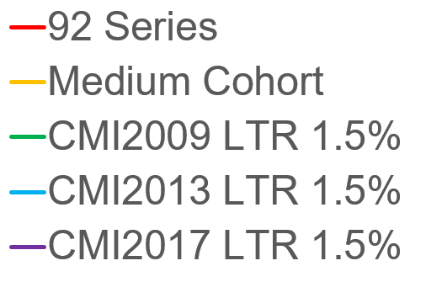
England and Wales Male Period Actuarial Life Expectancy Projections
Source: RGA calculations based on HMD Data

Slide 3

Recent Experience – relative to England Wales 2001
Unisex Age Standardised Mortality Ratios
Ages 30-65
Ages Over 65
Sources: RGA Calculations based on data from HMD and provisional data from Stat Can (2012-2016) and ONS (2017).

Slide 4
Recent UK experience in the longer term context
Unsmoothed Annual Rate of Change In Unisex Age Standardised Mortality Ratios
1996-2011
Source: HMD data, RGA analysis

Slide 5
Recent USA experience in the longer term context
Unsmoothed Annual Rate of Change In Unisex Age Standardised Mortality Ratios
1999-2009
Source: HMD data, RGA analysis

Slide 6
Recent Canadian experience in the longer term context
Unsmoothed Annual Rate of Change In Unisex Age Standardised Mortality Ratios
1994-2011
Source: HMD data, RGA analysis

Slide 7
Comparison of Average Annual Increase in Life Expectancy 2005-2011 with years after 2011
Sources: RGA Calculations based on data from HMD and provisional data from Stat Can (2012-2016) and ONS (2017). Years after 2011 mainly run 2015 or 2016, 2 run to 2017 and 4 run to 2014. Of the 6 that have ratios greater than 100, 3 only have data to 2014 (Australia, Italy and Norway)

Slide 8
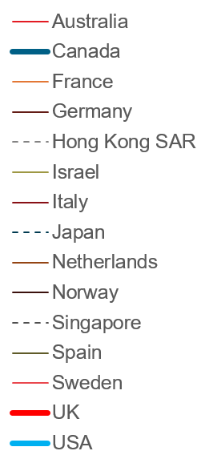
Global Comparisons by Cause of Death show some similarities
Age standardized cause specific mortality rates per 100,000 by country
Diseases of Circulatory System
Neoplasms
Source: WHO Cause of Death Database, accessed 12 September 2018.

Slide 9
Global Comparisons by Cause of Death show some differences
Age standardized cause specific mortality rates per 100,000 by country
Alzheimer's and other Dementias
Accidental Poisoning & Intentional Self-Harm
Source: WHO Cause of Death Database, accessed 12 September 2018.

Slide 10
Drivers of slowdown since 2011
Most commonly cited
Cited regularly
Reducing Cardiovascular Improvement Trends
Opioid Epidemic (US)
Health and Social Care Spending Cuts (UK)
Increasing Neurological Deaths as a reported cause of claim
(Widening social economic inequalities)
Excess winter mortality / flu / ineffective flu vaccines
Mentioned
A return to usual levels volatility

Slide 11
Future drivers of mortality trends in short – medium term
Most commonly cited
Cited regularly
Return of some CV improvements
More neurological disease
Increasing Excess Winter mortality
Genomic medicine
Digital Health advances
(Continuing widening of Socio-economic differentials)
Continuation of past trends such as CV deaths, UK spending cuts
Increasing impact of Obesity and Diabetes
Anti-microbial resistance
Breakthroughs on many cancer prevention, diagnosis and treatment avenues
Government policy
Mentioned
Cohort effect has exhausted itself (UK)
Behavioral changes
Environmental and Climate Changes

Slide 12
©2018 RGA. All rights reserved.
No part of this publication may be reproduced in any form without the prior permission of RGA.
The information in this publication is for the exclusive, internal use of the recipient and may not be relied upon by any other party other than the recipient and its affiliates, or published, quoted or disseminated to any party other than the recipient without the prior written consent of RGA.

Slide 13
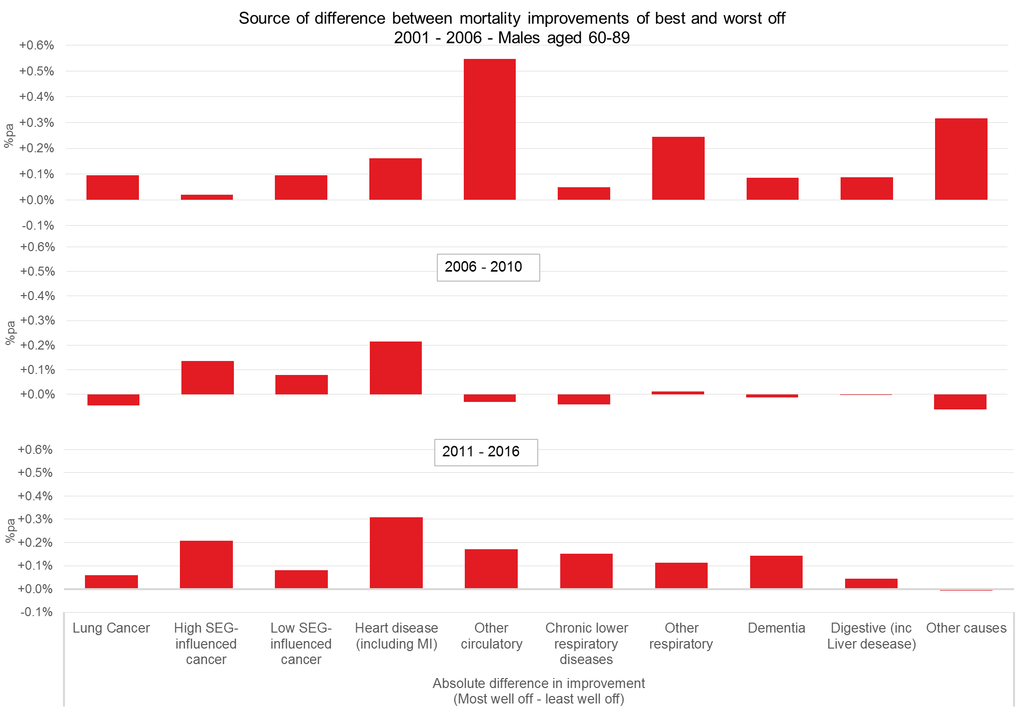
Differences in trends by SEG and cause of death
Differences in trends by cause between the most and least affluent – Males, 60-89
Source: ONS data, RGA analysis

