Slide 1
Long-Term Impacts of Exposure
to the COVID-19 Pandemic
in a Cohort Perspective
Kara Clark, FSA, MAAA
September | 2025

Slide 2
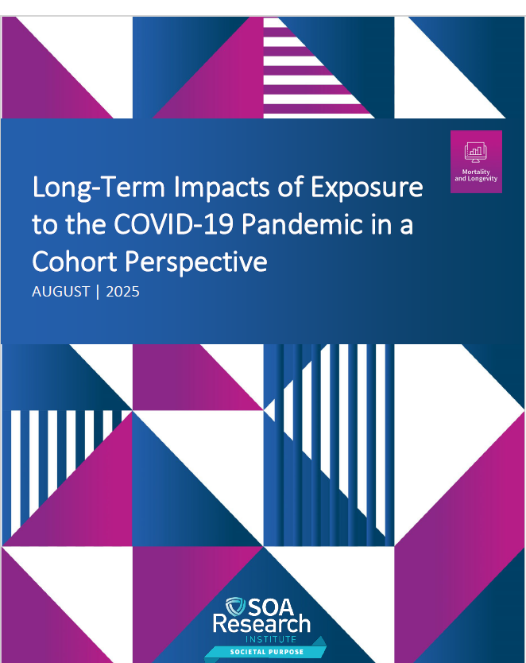

The COVID-19 pandemic reshaped long-term survival for older cohorts.
2

Slide 3
Short-term impacts are known, but long-term effects remain unclear.
Short-term mortality well documented.
Long-term cohort survival less studied.
U.S. birth cohorts 1935–1949 are focus.
1935-1949 Birth Cohorts
Aged 70-85 in 2020
Covid 19 Pandemic
2020-2023
3

Slide 4



The study examined how COVID-19 changed life expectancy across cohorts.
How much did COVID-10 reduce life expectancy?
What are possible future trajectories?
Are risks linked across ages within cohorts?
4

Slide 5



Scarring, immunity, or selection could shape future cohort mortality.
Scarring? (past illness ↑ future risk)
Acquired immunity? (exposure ↓ future risk)
Selection? (frailest die earlier, survivors stronger).
5

Slide 6
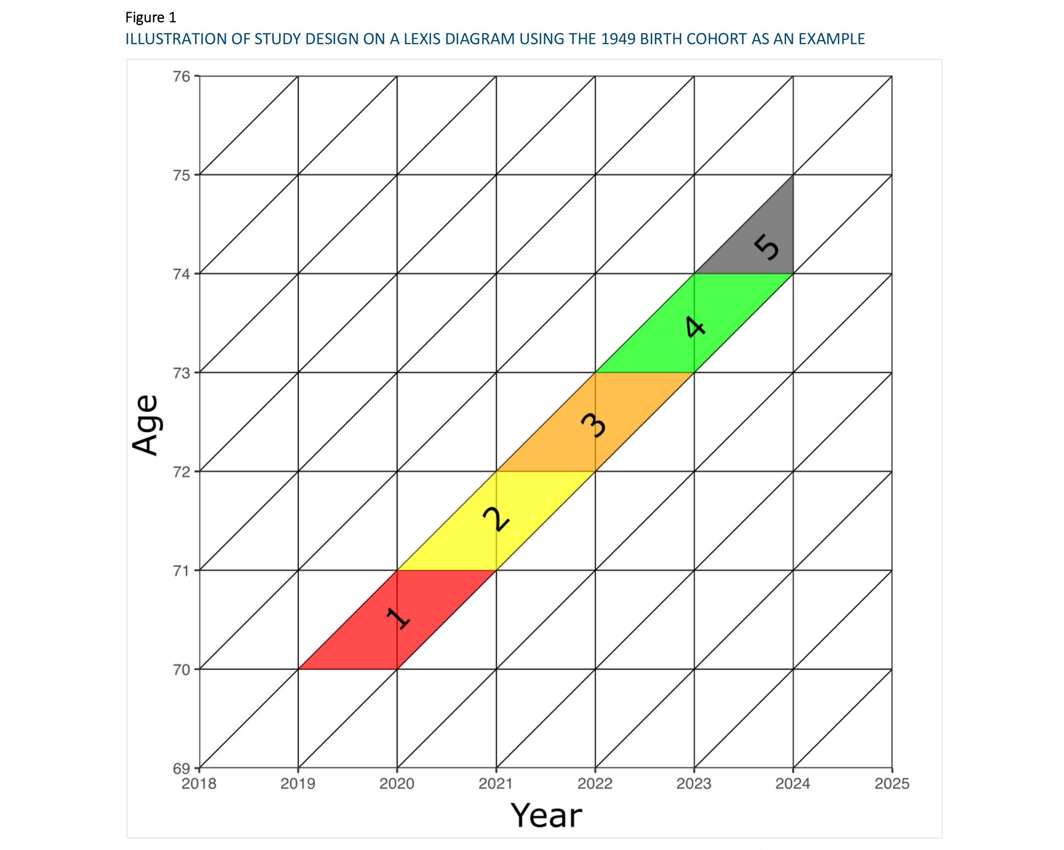
U.S. cohorts modeled using Human Mortality Database projections.
Human Mortality Database, 1985–2023.
U.S. cohorts 1935–1949.
Pre-pandemic baseline forecast vs. observed mortality.
Four recovery scenarios
  5
  10
  30 years
  Permanent shift
6

Slide 7
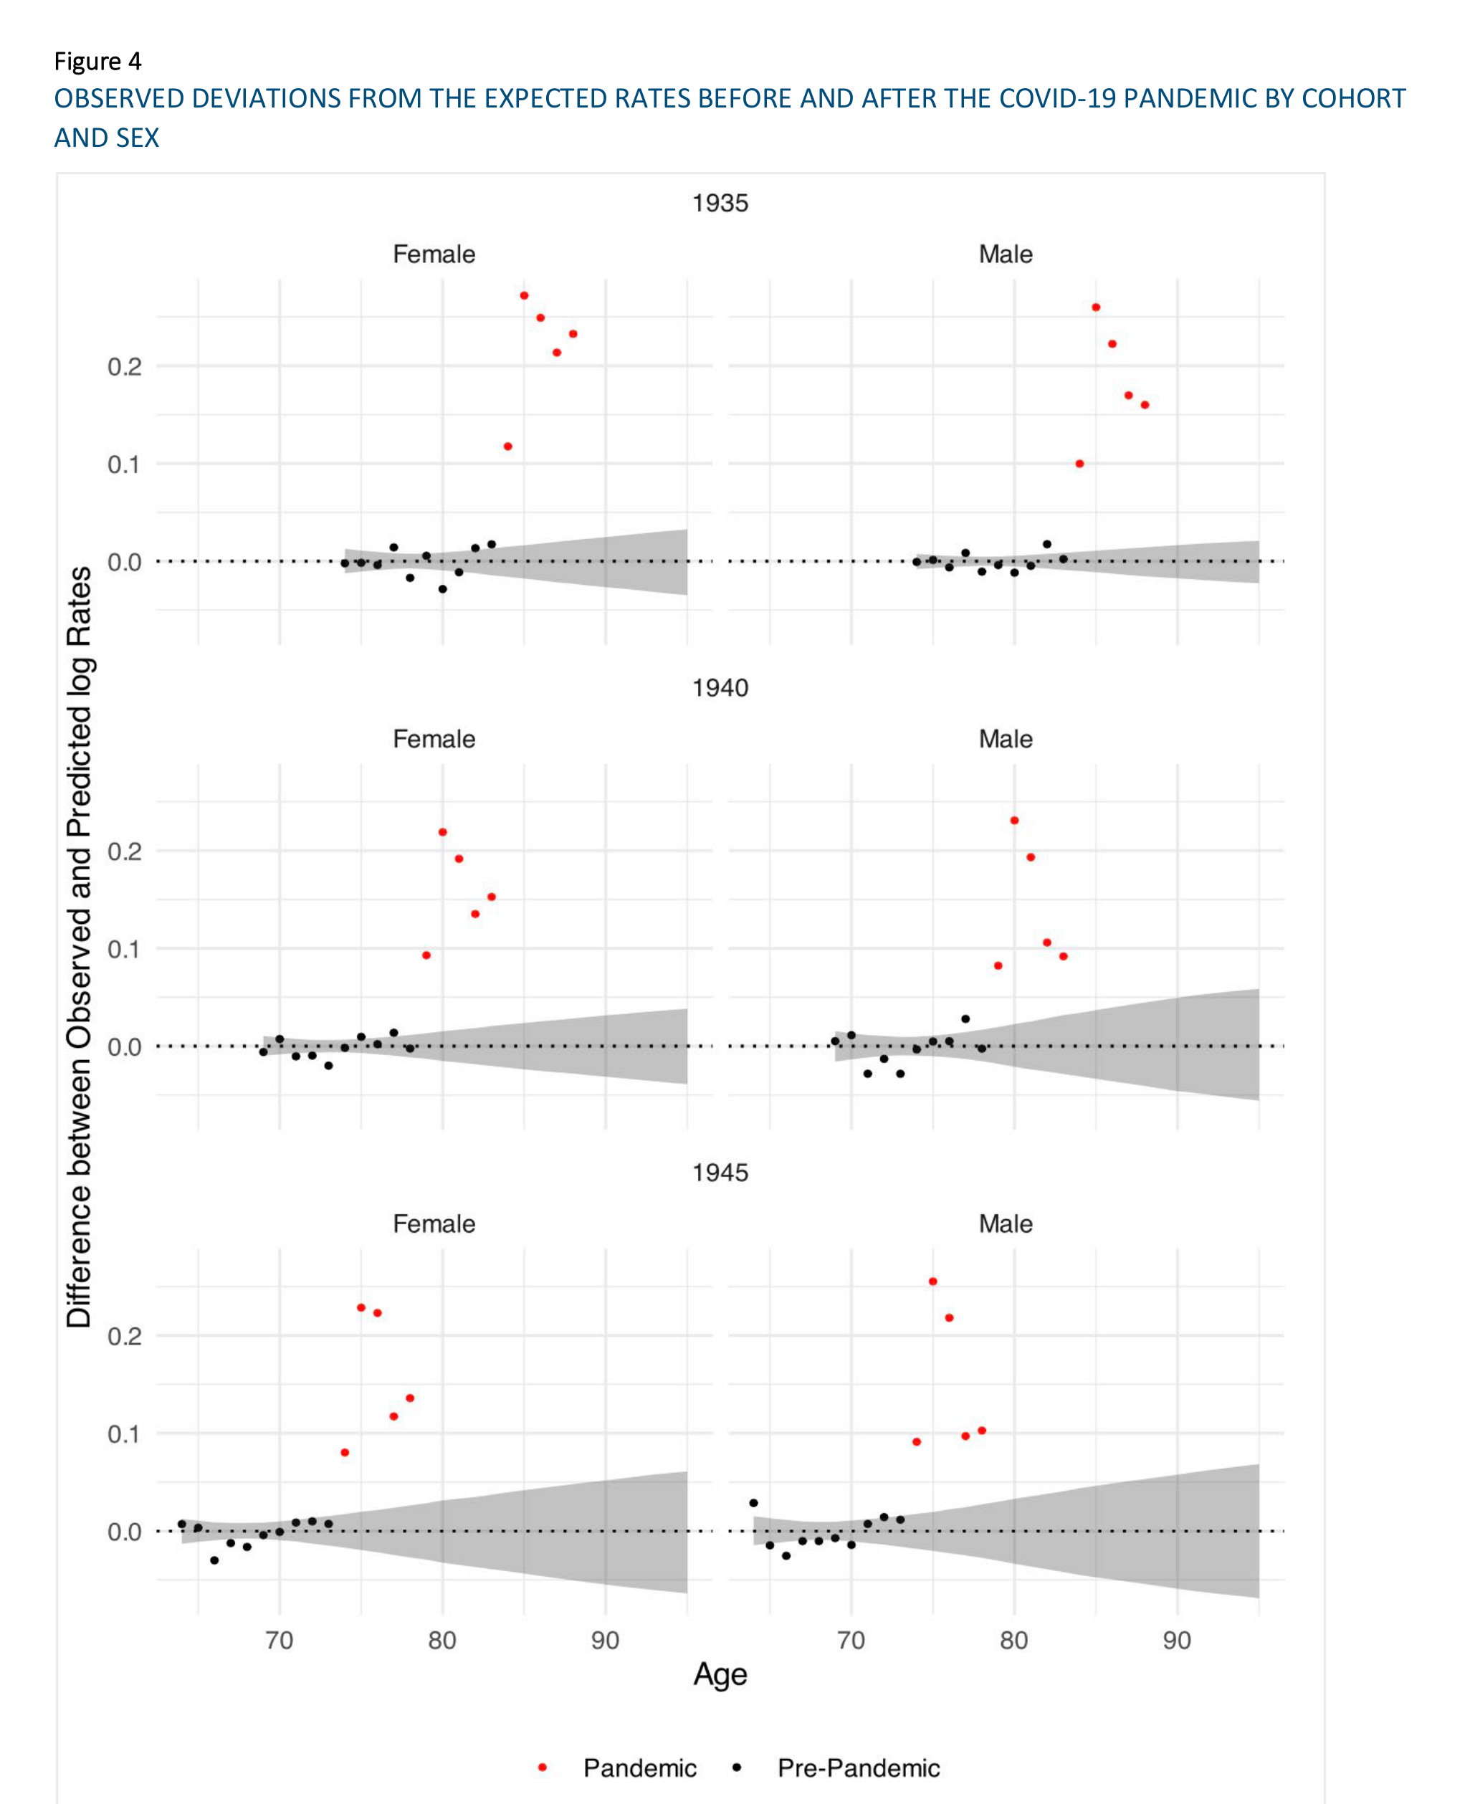
Mortality rose sharply in 2020–2023 and stayed above baseline.
All cohorts experienced above-expected
mortality.
Declines after 2020 but remained elevated.
7

Slide 8
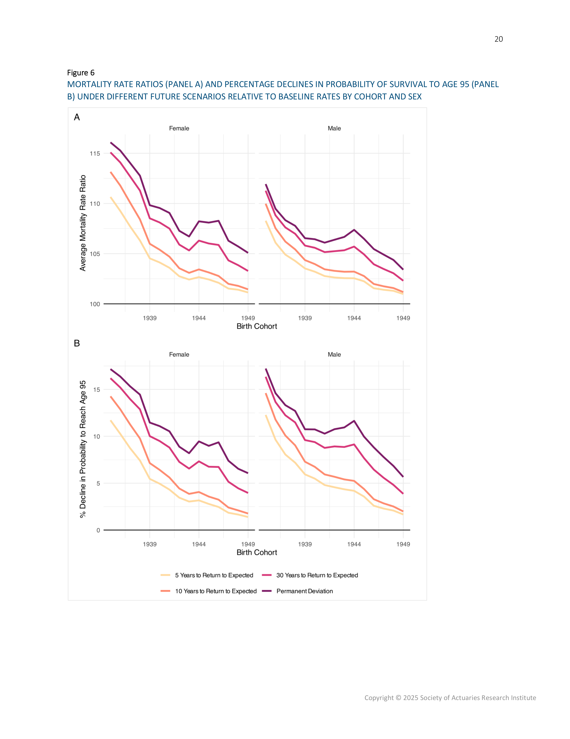
Life expectancy has already fallen for both men and women.
4.8% ↓ survival to 95 (females).
5.2% ↓ survival to 95 (males).
Equivalent: 206k female deaths;
113k male deaths.
8

Slide 9
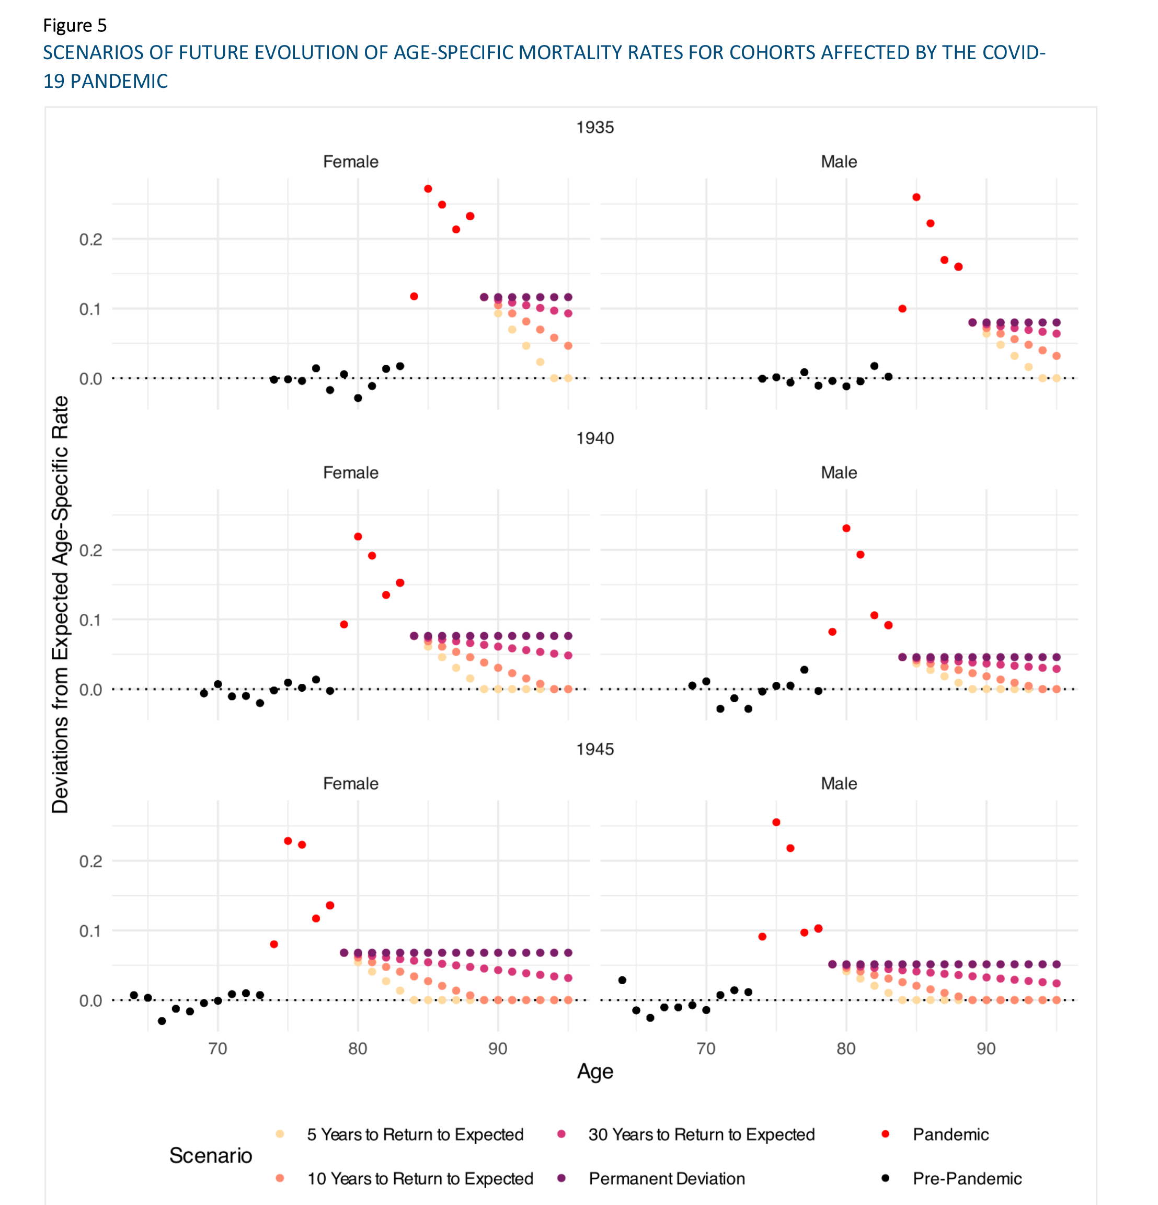
Future survival depends on how quickly mortality returns to trend.
Best case = losses already realized.
Worst case = 10.8% ↓ survival to 95
(~505k female, 260k male deaths).
Faster return could prevent
~half of these losses.
9

Slide 10

No evidence of scarring, immunity, or selection was found.
Excess mortality in early years predicted later levels, not changes.
Variation explained by socioeconomic and health differences.
10

Slide 11

COVID-19 redrew the longevity map.
Lasing reduction in cohort survival is already realized.
The pace of recovery determines how severe future losses become.
Cohort perspective can illustrate impacts not easily seen in period analyses.
11

