Slide 1
Quarterly Mortality Monitoring Report for the U.S. Population
Longevity 20: Parallel Session 3A: Mortality Modelling IV
Tuesday, September 9, 2025
R. Dale Hall, FSA, MAAA, CERA, CFA
September | 2025

Slide 2
Quarterly Mortality Tracking of U.S. Population
Recurring assessment of mortality levels, updated every quarter
Focus on the data sources and methodology that allow us to track mortality in a consistent, standardized way
Quarterly numbers serve as illustrations of how the system functions in practice
CDC: Death counts
HMD: Population exposures, interpolated monthly
Supports actuaries and academics in ongoing analysis
https://www.mortality.org/File/GetDocument/hmd.v6/USA/STATS/Population.txt
https://wonder.cdc.gov/mcd.html

Slide 3
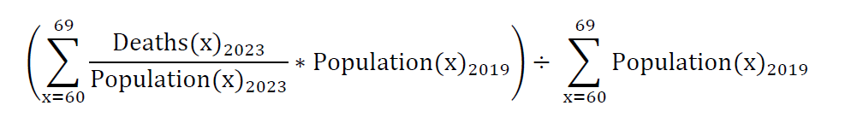
Quarterly Mortality Tracking of U.S. Population
Modeling Considerations
  Volatility and seasonality in raw death counts
  Standardized monitoring
  Currently using 2019 frozen population weights

Slide 4
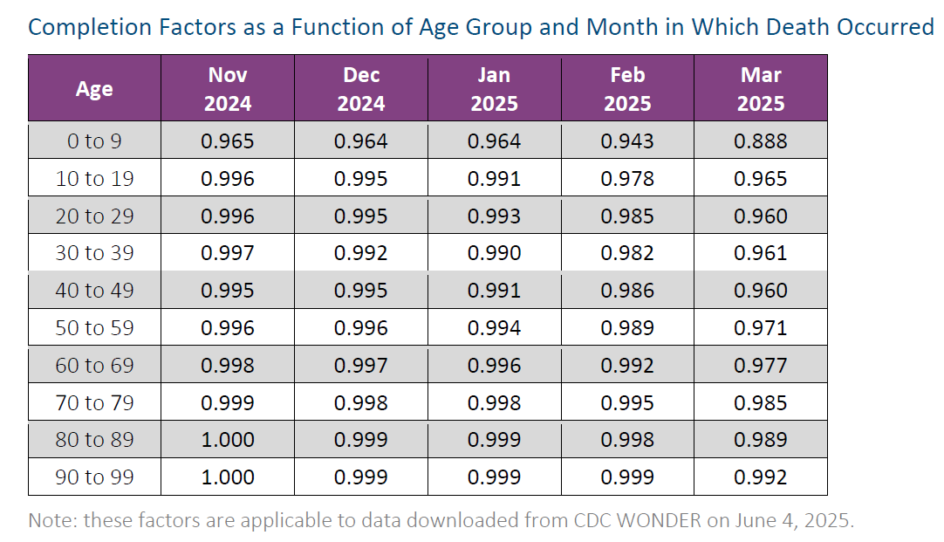
Quarterly Mortality Tracking of U.S. Population
Recent months are incomplete
Completion varies by age and lag time
Completion factors, estimated by comparing successive CDC WONDER downloads across 2024–2025

Slide 5
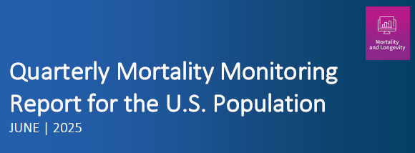
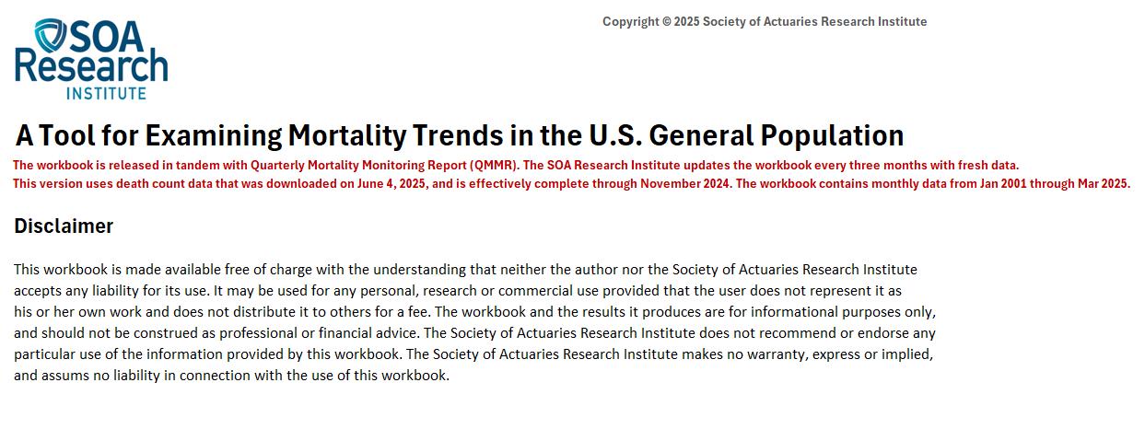
Report and Tool
Report:
https://www.soa.org/resources/research-reports/2025/qmmr-us-population/
Tool: 2025Q2 QMMR Excel/VBA Workbook
https://www.soa.org/49deaa/globalassets/assets/files/resources/research-report/2025/2025-q2-qmmr-us-population.xlsm

Slide 6
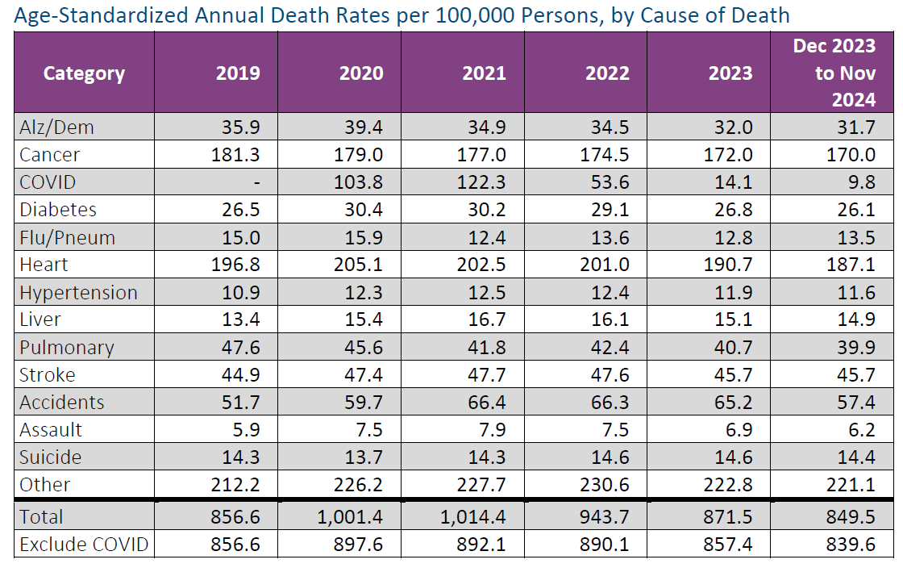
Results and Trends
Cause of Death trends
Standardized ICD mapping ensures consistency

Slide 7
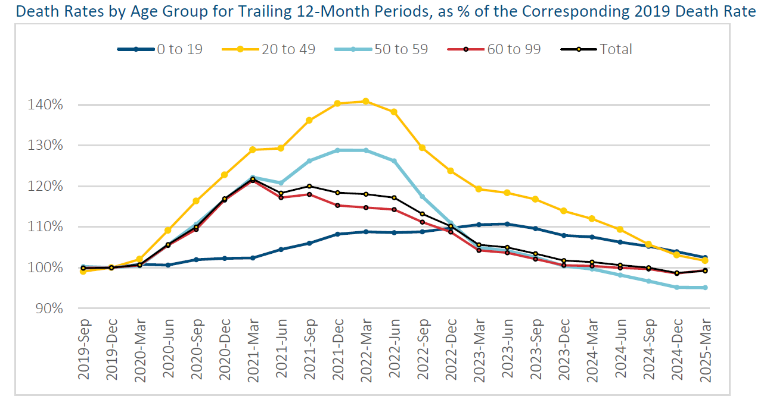
Results and Trends

Slide 8
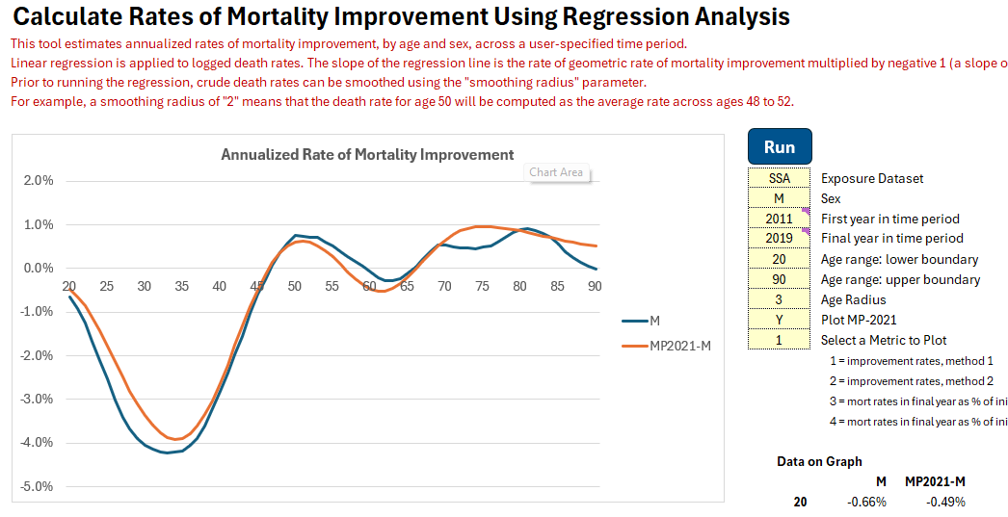
Using Results for Mortality Improvement Modeling

Slide 9
Using Results for Comparison to Insured Mortality

