Slide 1

Synergistic Reform of Pension Contribution Rates and Delayed Retirement
Reporter: Zhi Qiao
School of Insurance, Central University of Finance and Economics
2025.9.9

Slide 2
Introduction
Essential collaborative design
Delayed retirement is both an inevitable response to population aging and a crucial mechanism for maintaining workforce vitality. Although delayed retirement effectively postpones peak pension expenditures, it simultaneously reduces benefit collection periods and amplifies labor disutility, necessitating synergistic policy design.
China's implementation of delayed retirement in 2025 has heightened academic interest in its complementary measures. Recent policy shifts, particularly the 2019 reduction of enterprise contribution rates from 20% to 16%, demonstrate a strategic emphasis on alleviating corporate burdens and enhancing contributors' disposable income.
A natural synergy exists between delayed retirement and contribution rate reductions. Contribution cuts increase disposable income during working years, incentivizing retirement postponement. Conversely, extended working lives improve pension fund solvency, creating fiscal space for rate reductions.

Slide 3
Literature Positioning
Dialogue with Two Literatures
The impacts of delayed retirement
As a critical policy response to population aging, delayed retirement has been shown to effectively alleviate pressures on social security systems (Bagchi, 2016). The policy essentially shifts pension responsibilities from governments to individuals (Litwin et al., 2009). Given the disutility of labor, workers exhibit varying preferences for retirement postponement depending on socioeconomic factors including income, education, family size, and target retirement wealth (Bidewell et al., 2006; Ivanov & Tian, 2024).
Complementary reform measures.
These complexities necessitate careful policy design, as evidenced by empirical findings(Dai et al, 2022; Dai et al., 2025; Lalive et al., 2023). Complementary reforms prove crucial for successful implementation. Pension system restructuring emerges as a fundamental component, with studies highlighting how defined benefit plans encourage later retirement compared to defined contribution systems (Lacomba & Lagos, 2006; Manoli & Weber, 2016; Maurer et al., 2021). Additional supportive measures include minimum wage regulations (Hampton & Totty, 2023), elderly care provisions (Li, 2025), and educational system adaptations (Zhang & Cao, 2024).

Slide 4
Research Question
Reform and Promotion
How to design a retirement reform plan that complies with the four principles.
Is there a pilot condition for delaying retirement under the current institutional parameters.
Is there a certain upper limit to the coordinated reform of reducing account fees and delaying retirement.

Slide 5
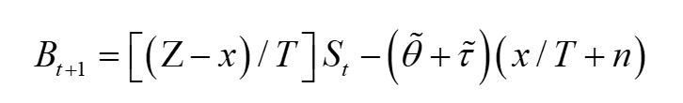
Fiscal Burden
Set up
The fiscal burden of social pension insurance refers to the necessary government subsidies for maintaining the operation of the social pension system. In this model, the pension fund gap in each period can be simplified as the difference between contemporaneous contributions and expenditures.
The first period is 30 years, with a remaining lifespan of 20 years.
Retirement is delayed by 5 years, and the pension is received for 15 years, with a receiving time of 15/30=0.5.The replacement rate of pension is 60%, which is only issued for 15 years.
The actual replacement rate of pension is 60% * 0.5=30%. Individuals who work during the same period and delay retirement are still contributing, with a total contribution of 20%.
The fund gap is 10%.

Slide 6
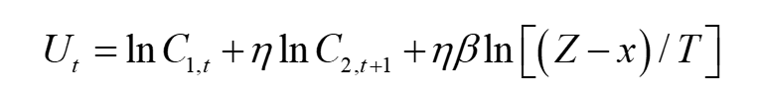
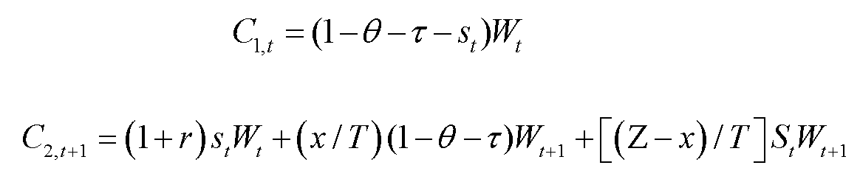
Utility
Set up
According to Yan (2018) and Miyazaki (2019), the utility of a representative individual mainly depends on their consumption and leisure during adulthood and old age.

Slide 7
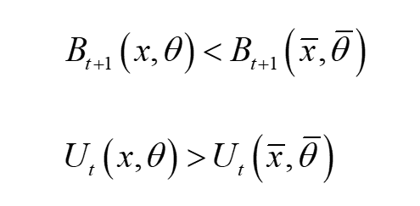
Synergistic Reform
Set up
Simultaneously reducing financial burden and enhancing personal utility requires meeting the following conditions.

Slide 8
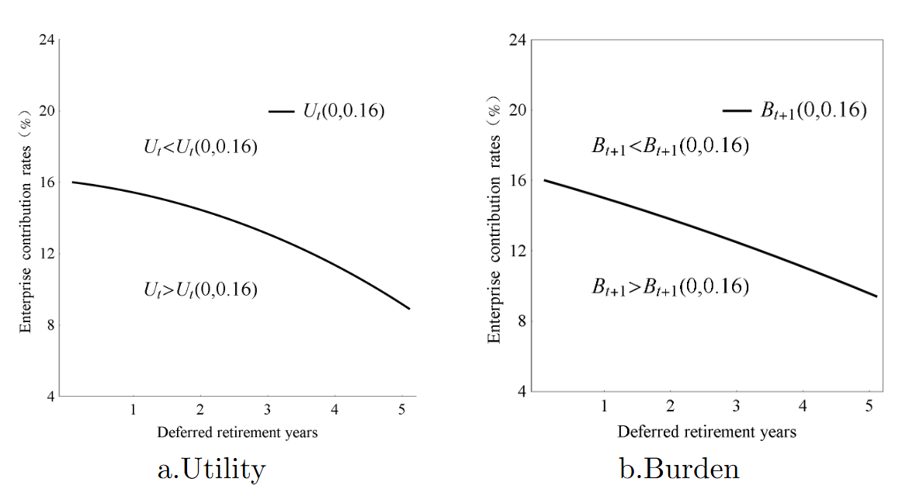
Synergistic Reform
Equivalent line and equal burden line

Slide 9
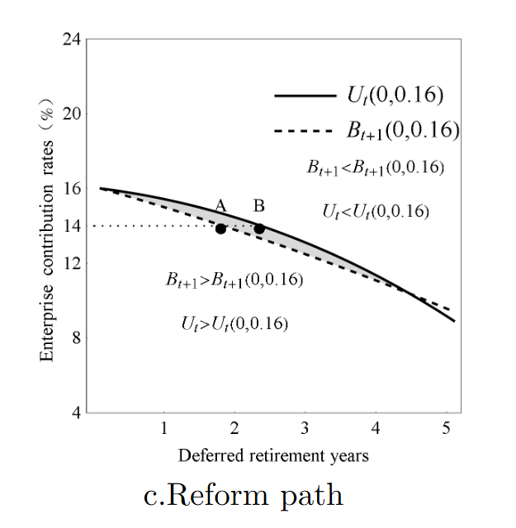
Synergistic Reform
Reform path

Slide 10
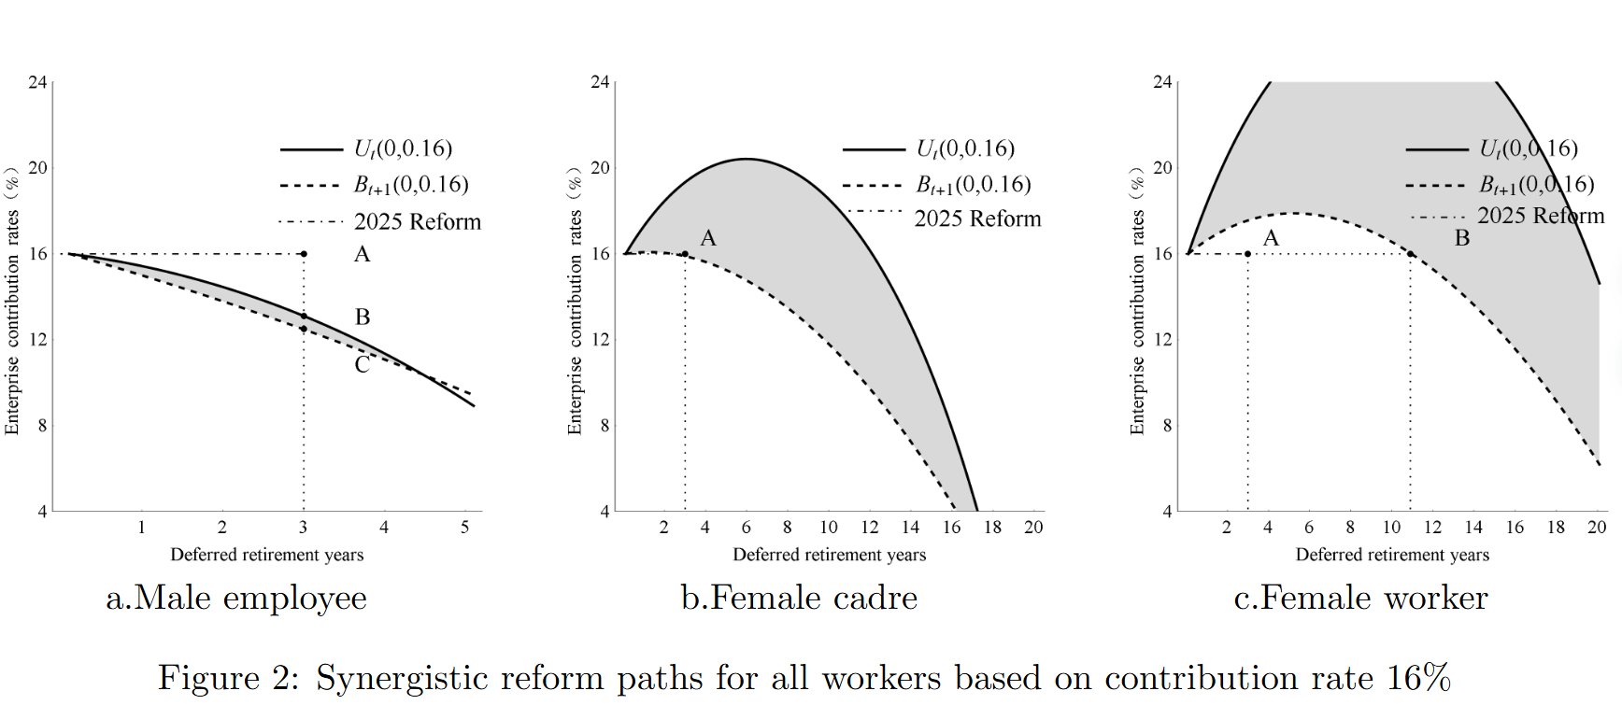
Synergistic Reform
Reform path

Slide 11
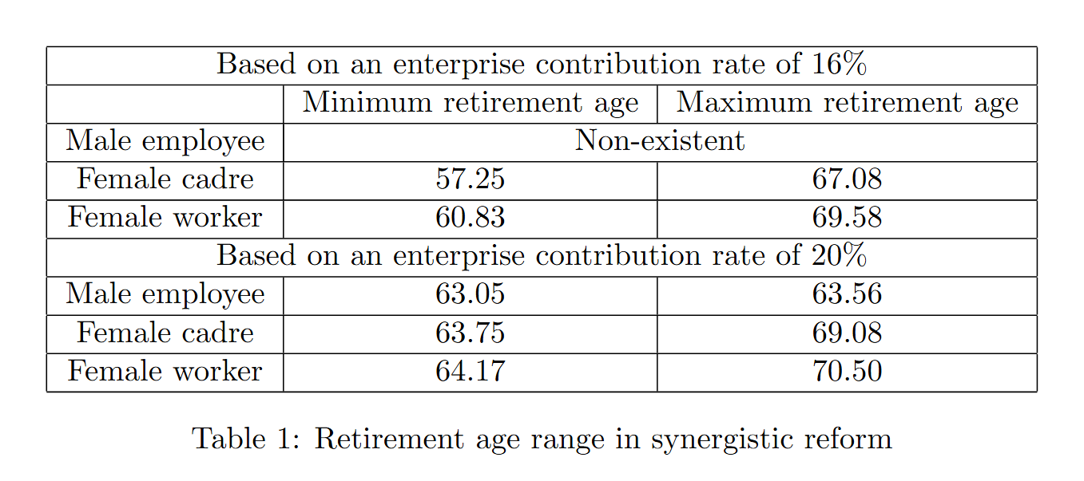
Synergistic Reform
Modifying retirement delay periods according to current contributionrates

Slide 12
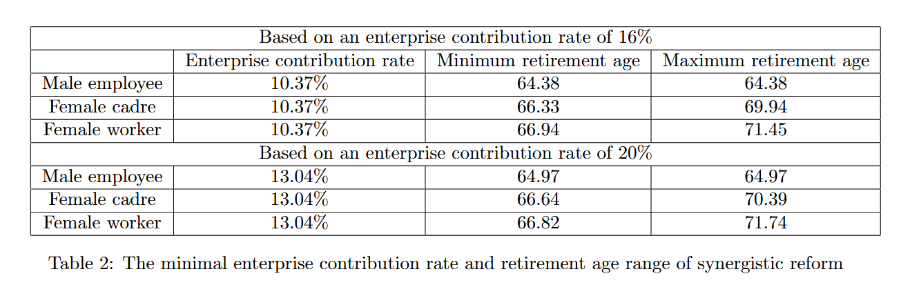
Synergistic Reform
Adjusting enterprise contribution rates basedon retirement delay duration

Slide 13
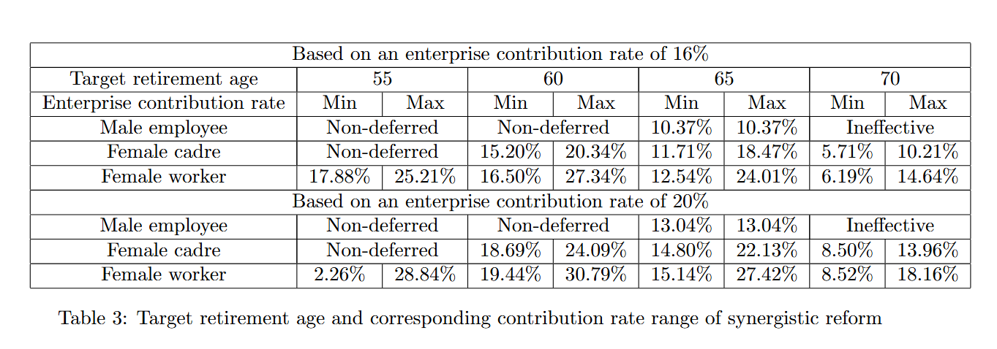
Synergistic Reform
The target retirement age and corresponding enterprise contributionrates

Slide 14
Conclusion
Under the 16% enterprise contribution rate baseline, male workers require a rate reduction to 12.35%-12.96% to achieve policy synergy, while female workers may either increase contributions to 17.88%-25.21% or delay retirement to 60.83-69.58 years. Female cadres currently operate within the effective reform zone without requiring adjustments.
The uniform contribution rate analysis identifies male workers as the first cohort reaching coordination failure thresholds, establishing their lower rate boundaries at 10.37% (16% baseline) and 13.04% (20% baseline). Optimal retirement ages converge within 64-67 years across gender groups, with 65 years proposed as a balanced target
Differentiated contribution regimes facilitate targeted retirement age reforms. At the 16% baseline, policymakers can implement distinct retirement thresholds of 60/65 years for female cadres and 60 years for female workers without altering statutory rates.

Slide 15
Thanks!

