Slide 1
Pension Buyouts: Tackling the Solvency Challenges in Multiemployer Defined Benefit Plans
Yijia Lin
University of Nebraska - Lincoln
Tianxiang Shi
Temple University
Presented at the 20th International Longevity Risk and Capital Markets Solutions Conference
September 9, 2025

Slide 2
Multiemployer Defined Benefit (DB) Pension
Sponsored by two or more employers in the same or related industry
Unionized workers covered under collective bargaining agreements
Benefits: $ per year × years of credited service.
Governed by joint board of trustees - representatives from employers and union
  Role - administrative, fiduciary, investment, legal and accounting tasks

Slide 3
Why Multiemployer DB Plans?
Employers
  Economies of scale by pooling investment and administrative activities (Caswell, 1976; Mitchell and Andrews, 1981; Ghilarducci and Terry, 1999)
  Most participating employers are small businesses
Employees
  Portable benefits when switching jobs
  Good for industries with high worker mobility, such as construction, transportation, entertainment, etc.

Slide 4
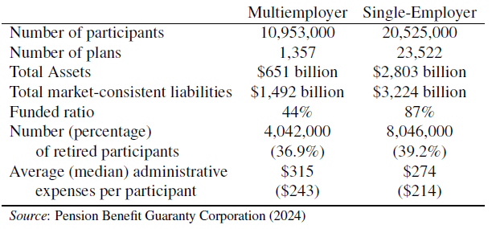
Comparison of Multiemployer and Single-Employer DB Pensions in US—2021 Overview

Slide 5
Comparison of Multiemployer and Single-Employer DB Pensions in US—2021 Overview

Slide 6
Prolonged Insolvency Crisis of Multiemployer DB Plans
Financial downturns
Shifting economic conditions
Heightened industry competition
Lax regulations on valuation, funding, withdrawal liabilities, and premiums
Inequities of orphan liabilities after employer withdrawals

Slide 7
Withdrawal Liability
Withdrawal liability represents a withdrawing employer’s share of the plan’s unfunded liability (McNally, 2020)
Inadequate estimation and collection of withdrawal liability
  Lenient pension rules
    Discount rates exceed those appropriate for reflecting the true settlement value of promised benefits (Naughton, 2018)
  Payment cap
    Withdrawal liability payments ≤ the employer’s highest contribution rate over the previous 10 years
  20-year payment limit
  Bankruptcy

Slide 8
“In what is thought to be an industry first, Sound Retirement Trust (SRT), a multiemployer pension plan based in Seattle, has selected the Prudential Insurance Co. of America to complete a pension risk transfer [PRT]—the first PRT to involve a multiemployer plan.” (Miller, 2023)
The Trust purchased a group buyout annuity from the Prudential Insurance Co. of America (PICA) in August 2024.
The deal transferred liability for 8,700 retirees of the United Food and Commercial Workers (UFCW), representing 46.7% of all retirees.
PICA assumed responsibility for paying retirement benefits to these retirees and their beneficiaries from September 1, 2024.

Slide 9
Benefits of Pension Buyouts
Pension buyouts can alleviate the burden and uncertainty of paying benefits to retired participants.
  Fewer active participants lead to declining contributions, while more retirees drive up benefit payments (Munnell et al., 2017).
Pension buyouts have the potential to lower the probability of employer withdrawals.
  Shi et al. (2025) find that larger plans are typically associated with higher withdrawal probabilities.

Slide 10
Benefits of Pension Buyouts (Cont’)
Pension buyouts can reduce administrative expenses and Pension Benefit Guaranty Corporation (PBGC) premiums for multiemployer plans.
  Administrative expenses: expenses related to management, compliance, and participant services
  PBGC premiums: $39 per participant in 2025

Slide 11
Benefits of Pension Buyouts (Cont’)
Plan participants covered by buyout annuities benefit from greater protection under the State Guarantee Associations compared to the PBGC.
  PBGC maximum guarantee: $12,870 per year for a participant with 30 years of service in recent years
  State Life and Health Guarantee Associations protection limit: $250,000 ~ $500,000

Slide 12
Costs of Pension Buyouts
Buyout annuity risk premiums
Transaction costs
  Search and information expenses
Buyouts can be particularly costly for underfunded plans
  Substantial cash infusions to meet minimum funded status requirements (Cox et al., 2013; Lin et al., 2014).

Slide 13
Contributions
Our study extends literature by demonstrating that pension risk transfer (PRT) can serve as a viable strategy for mitigating employer withdrawal and insolvency risk in multiemployer plans.
  PRT can mitigate pension risk (Lin et al., 2015), enhance firm value (Lin et al., 2017; Cantor et al., 2017; Silverstein, 2021; Simasek, 2021), and improve participant welfare (Lin et al., 2023).
  PRT strategies (e.g., pension buyouts) have been widely adopted by firms sponsoring single-employer plans.
  PRT can also reduce the persistent underfunding of multiemployer plans that has not been adequately resolved by recent pension law reforms.

Slide 14
Contributions (Cont’)
This study develops a calibrated model to assess the welfare of multiemployer plan participants.
  Key factors: pension size, funding status, future benefit accruals, and PBGC premiums
  Estimate employer withdrawal probability, withdrawal liability, and plan default risk
  Compare the welfare of plan participants with and without pension buyouts
    Expected pension default losses

Slide 15
Contributions (Cont’)
We propose a “pension buyout + subsidized loan” solution to address the challenges faced by “critical and declining” plans.
  “Critical and declining” plans face imminent insolvency (Blahous III, 2018).
    Red zone with actuarial funding ratio < 65%
  Plans could borrow funds to cover funding deficits and pension buyout costs, with a federal government guarantee.
    International Brotherhood of Teamsters (IBT)’s loan proposal
  Our results indicate that combining pension buyouts with the loan program decreases employer withdrawal and the expected pension default loss
    Transfer the burden of orphan participants to an annuity insurer through a pension buyout

Slide 16
Basic Framework
Multiemployer DB Pension Liabilities
  Consider a multiemployer DB plan with a cohort of N(0) members at time 0
  At time t, M(t) new entrants will join the plan with a total number of participants
  All employees join the plan at age xe = 30 and retire at age xr = 65.
  xj,t is the jth participant’s age at time t.

Slide 17
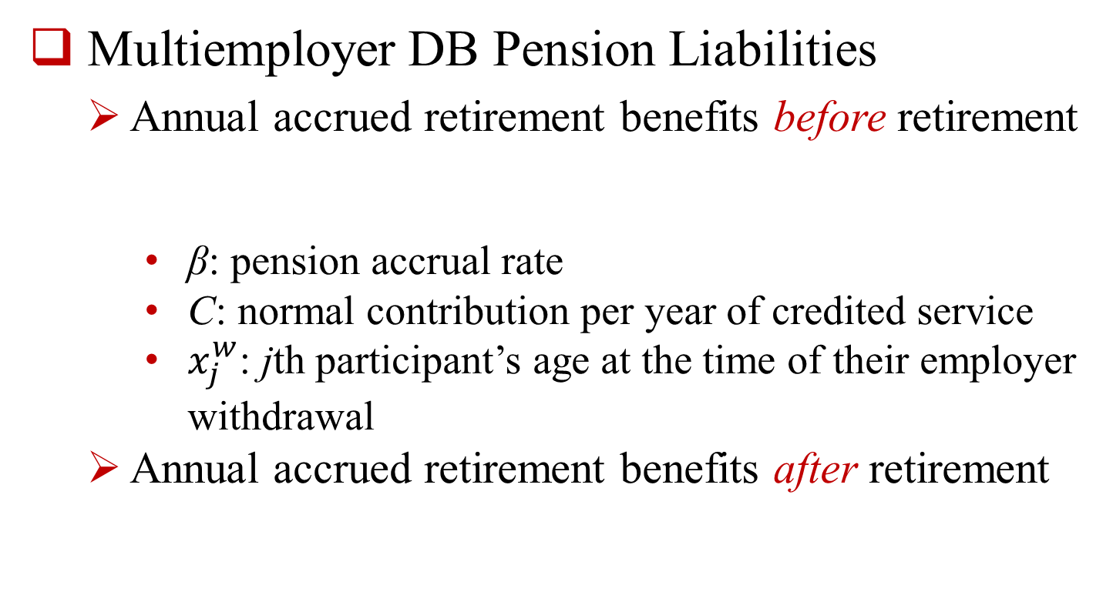
Basic Framework (Cont’)
Multiemployer DB Pension Liabilities
  Annual accrued retirement benefits before retirement
    β: pension accrual rate
    C: normal contribution per year of credited service
    $x_{j}^{w}$: jth participant’s age at the time of their employer withdrawal
  Annual accrued retirement benefits after retirement

Slide 18

Basic Framework (Cont’)
Multiemployer DB Pension Liabilities
  Total accrued retirement benefits at time t
    Before retirement
    After retirement
  The total pension liabilities PLt at time t:

Slide 19


Basic Framework (Cont’)
Multiemployer DB Withdrawal Liabilities
  Logistic Regression Model: The probability of employer withdrawals during year t + 1:
  Factors that affect employer withdrawals (Shi et al., 2025; Shi and You, 2023):
      Wt: withdrawal liability for participants withdrawn in year t
      Nt: total number of participants in the plan in year t
      Ot: percentage of orphan participants in year t
      : red-zone indicator

Slide 20
Basic Framework (Cont’)
Multiemployer DB Withdrawal Liabilities
  Conditional on the occurrence of employer withdrawal, the percentage of participants withdrawn during a year, z, follows a beta distribution with density function
    is a Gamma function.

Slide 21
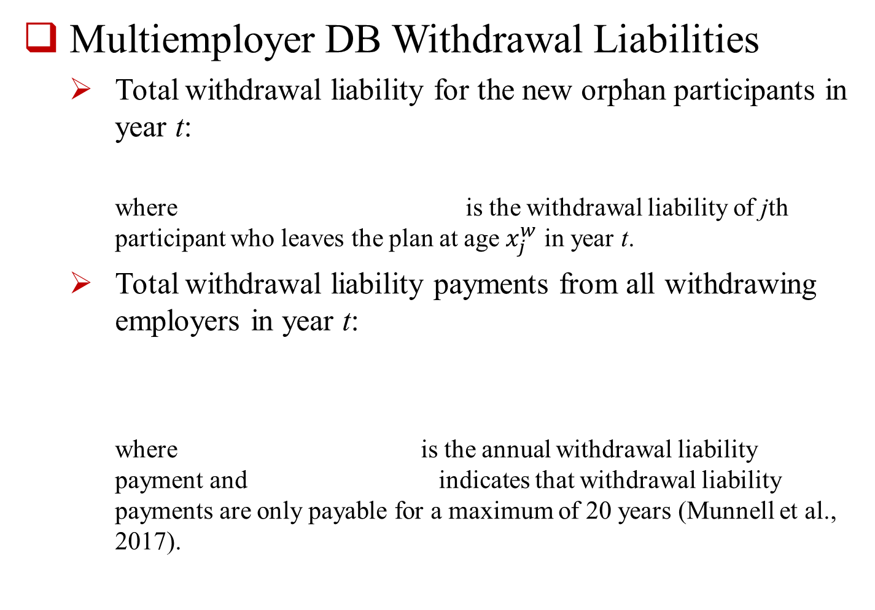
Basic Framework (Cont’)
Multiemployer DB Withdrawal Liabilities
  Total withdrawal liability for the new orphan participants in year t:
    where is the withdrawal liability of jth participant who leaves the plan at age $x_{j}^{w}$ in year t.
  Total withdrawal liability payments from all withdrawing employers in year t:
    where is the annual withdrawal liability payment and indicates that withdrawal liability payments are only payable for a maximum of 20 years (Munnell et al., 2017).

Slide 22

Basic Framework (Cont’)
Multiemployer DB Pension Assets
  The plan invests its pension funds in 3 asset indices: the S&P 500 index (i = 1), the Merrill Lynch corporate bond index (i = 2), and the 3-month T-bill index (i = 3)
  The three indices follow a lognormal process:

Slide 23

Basic Framework (Cont’)
Multiemployer DB Pension Assets
  Pension assets after pension benefit payments at time t:
    BPt is the total benefits payable at time t.
  Pension assets after pension benefit payments, contributions, and PBGC premiums at time t+
    NCt is the total normal contribution at time t.
    WCt is the total withdrawal liability payment from all withdrawing employers at time t.
    PBGCt is the PBGC premiums at time t.

Slide 24
Numerical Illustration
All employees join a multiemployer DB plan at age xe = 30 and retire at age xr = 65
The normal contribution is $0.55 per hour, or C = $1,001 = 0.55 × 52 × 35 per year.
The accrual rate is β = 0.03 per dollar contribution.
Based on the U.S. total population mortality tables from 1970 to 2023 in the Human Mortality Database, we obtain the parameter estimates for the Lee-Carter model.
Using Form 5500 data from 2009 to 2023, we estimate parameters for both the probability of employer withdrawals and the proportion of participants affected, conditional on a withdrawal event.

Slide 25
Numerical Illustration (Cont’)
At time t = 0, the plan has participants aged 30 to 75, with 40 participants in each age group.
  Total number of participants at time t = 0: N(0) = 1,840
At time t = 0, 20% of participants are orphans, distributed evenly across ages 31 to 75 (i.e., 8 orphan participants per age group).
  Orphan participants are individuals whose employers have exited the plan and ceased making contributions.
At the beginning of each subsequent year, up to 20 new entrants join at age 30. However, the number of new entrants may decrease if employer withdrawals occur.

Slide 26
Numerical Illustration (Cont’)
Suppose the plan invests the funds in n = 3 asset indices: the S&P 500 index, the Merrill Lynch corporate bond index, and the 3-month T-bill
  Weights invested in stocks, bonds and cash by SRT in 2023 = [0.3, 0.67, 0.03]
  Data: Monthly data of the three asset indices from January 1990 to December 2023 from LSEG Eikon Datastream
Pension valuation rate = withdrawal liability amortization rate = expected return of pension assets = 6.9%

Slide 27
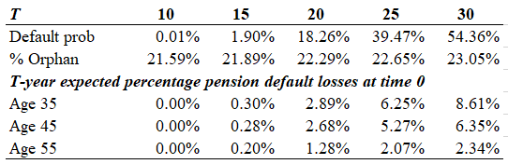
Pre-Buyout for a Plan in Green Zone
The plan is in the green zone.
  Green zone: considered financially healthy with an actuarial funding ratio ≥ 80%
The initial funding ratio is PF0 = 91.1%.
Half of withdrawal liability payments are collected.

Slide 28
Pre-Buyout for a Plan in Green Zone
The plan is in the green zone.
  Green zone: considered financially healthy with an actuarial funded ratio ≥ 80%
The initial funding ratio is PF0 = 91.1%.
Half of withdrawal liability payments are collected.

Slide 29
Pre-Buyout for a Plan in Green Zone
The plan is in the green zone.
  Green zone: considered financially healthy with an actuarial funded ratio ≥ 80%
The initial funding ratio is PF0 = 91.1%.
Half of withdrawal liability payments are collected.

Slide 30
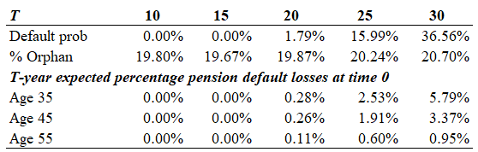
Post-Buyout for a Plan in Green Zone
The pre- and post-buyout finding ratio is PF0 = 91.1%.
Half of withdrawal liability payments are collected.
The plan transfers its liability for retirees aged 65+ to an insurer through a buyout annuity.
Assume 5% buyout risk premium.
Buyout costs (i.e., funding deficit and buyout risk premium) are paid by contributing employers via increased contributions.

Slide 31
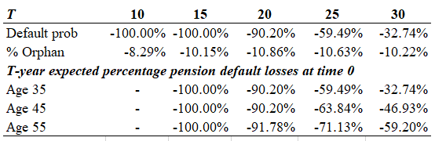
Comparative Percentage Change: Post-Buyout vs. Pre-Buyout

Slide 32
Comparative Percentage Change: Post-Buyout vs. Pre-Buyout
The pension buyout has a positive impact on the plan’s financial status and improves the welfare of plan participants.

Slide 33
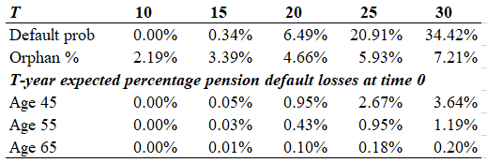
Pension Buyout + Subsidized Loan Strategy for a “Critical and Declining” Multiemployer DB Plan
The initial funding ratio is PF0 = 60%.
Half of withdrawal liability payments are collected.
All orphan participants are transferred to an insurer via buyout annuity.
Subsidized loan is equal to 105% of the funding deficit (i.e., funding deficit plus a 5% buyout risk premium).
After the buyout, the plan is 100% funded.

Slide 34
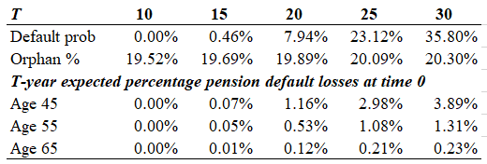
Subsidized Loan Only Strategy for a “Critical and Declining” Multiemployer DB Plan
The initial funding ratio is PF0 = 60%.
Half of withdrawal liability payments are collected.
Subsidized loan is equal to 105% of the funding deficit (i.e., funding deficit plus a 5% buyout risk premium).
After the buyout, the plan is 101% funded.

Slide 35
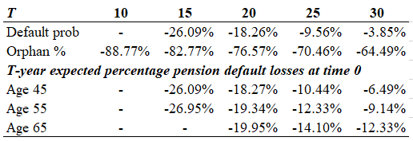
Comparative Percentage Change: Pension Buyout + Subsidized Loan vs. Subsidized Loan Only

Slide 36
Comparative Percentage Change: Pension Buyout + Subsidized Loan vs. Subsidized Loan Only
The pension buyout + subsidized loan strategy is more effective in addressing the funding crisis faced by “critical and declining” plans than relying solely on subsidized loans.

Slide 37
Conclusion
This study investigates the effect of pension buyouts on multiemployer DB plans.
Pension buyouts improve plan solvency and participant welfare when a plan’s funding ratio is not too low.
Our proposed “pension buyout + subsidized loan strategy” outperforms the “subsidized loan only strategy” for deeply underfunded plans.

