Slide 1
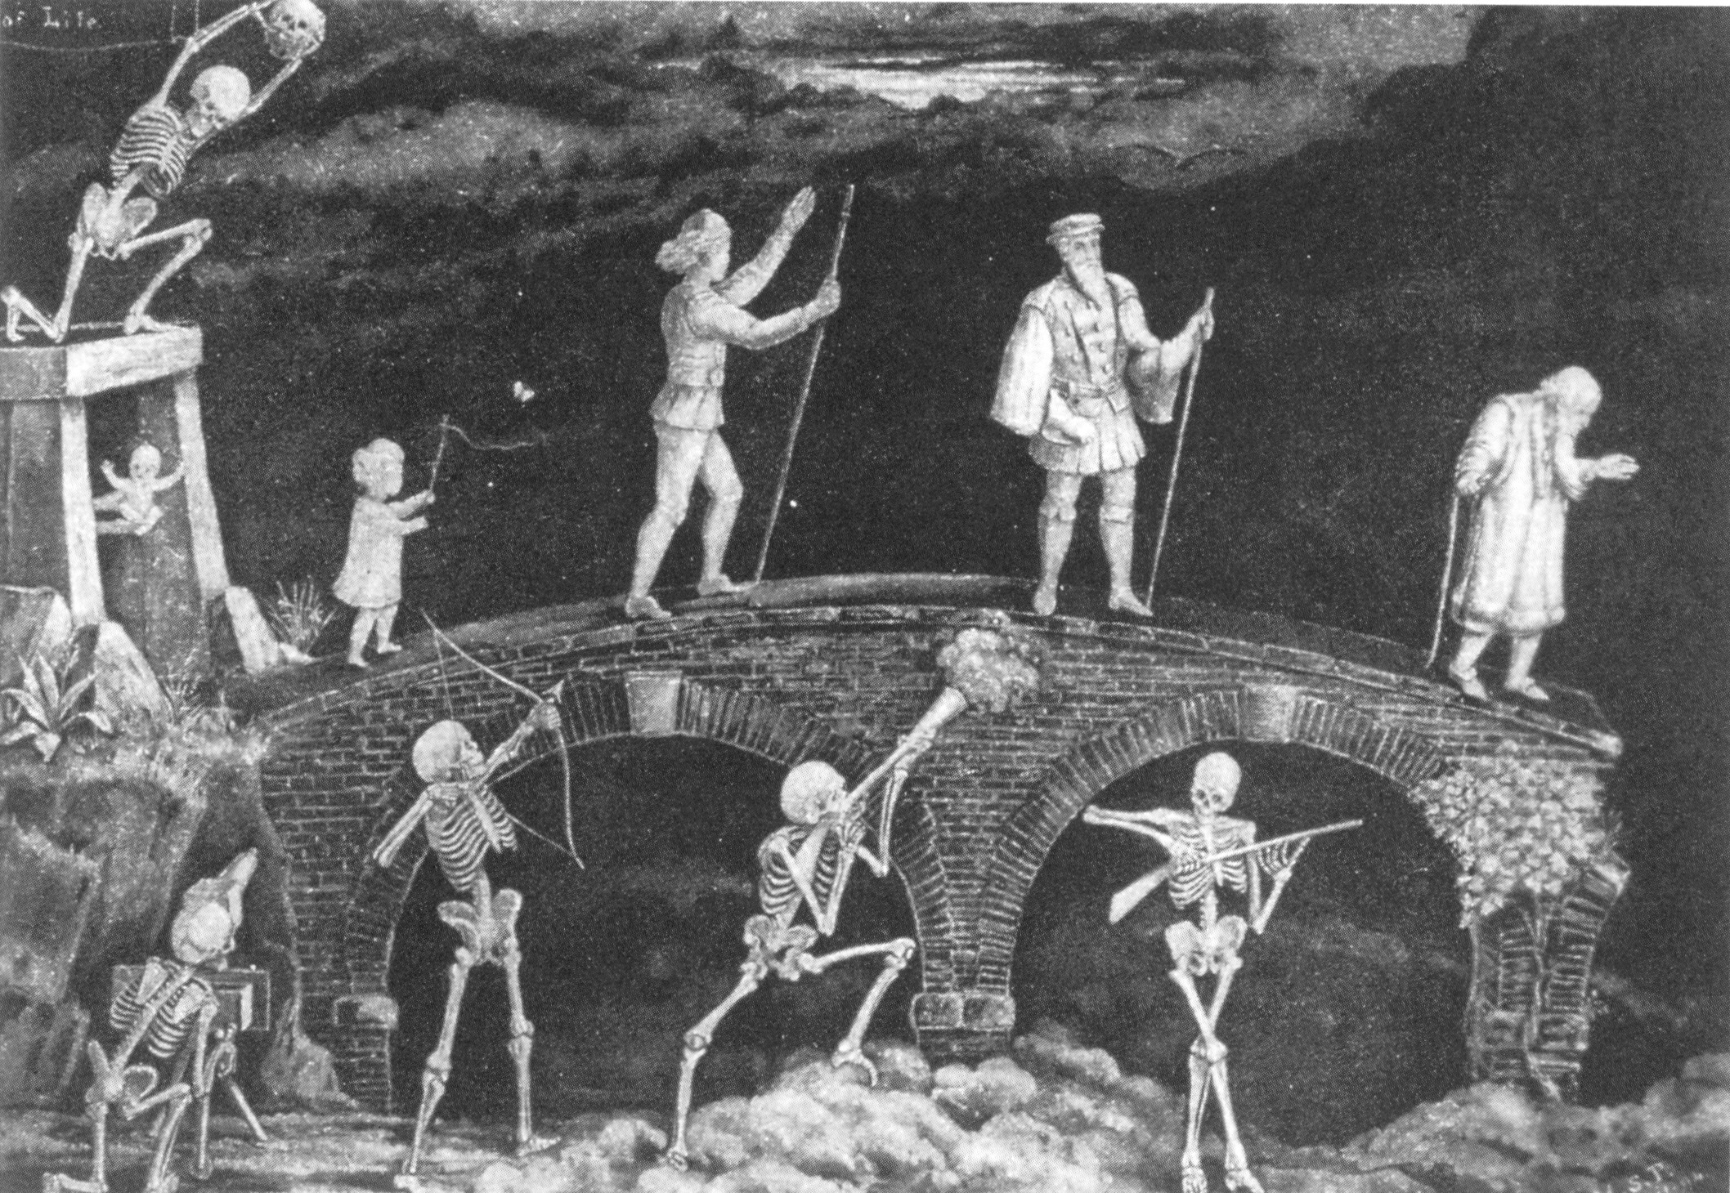
The Rise and Fall of Longevity in the 21st Century
S. Jay Olshansky, Ph.D.
University of Illinois at Chicago
Lapetus Solutions

Slide 2
The Rise

Slide 3
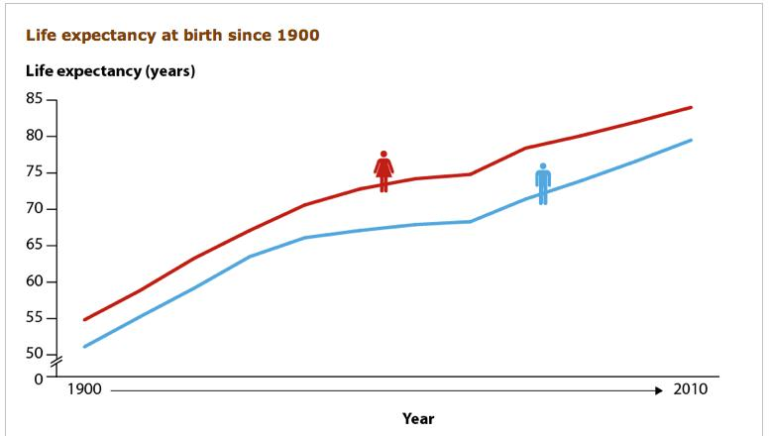

Slide 4
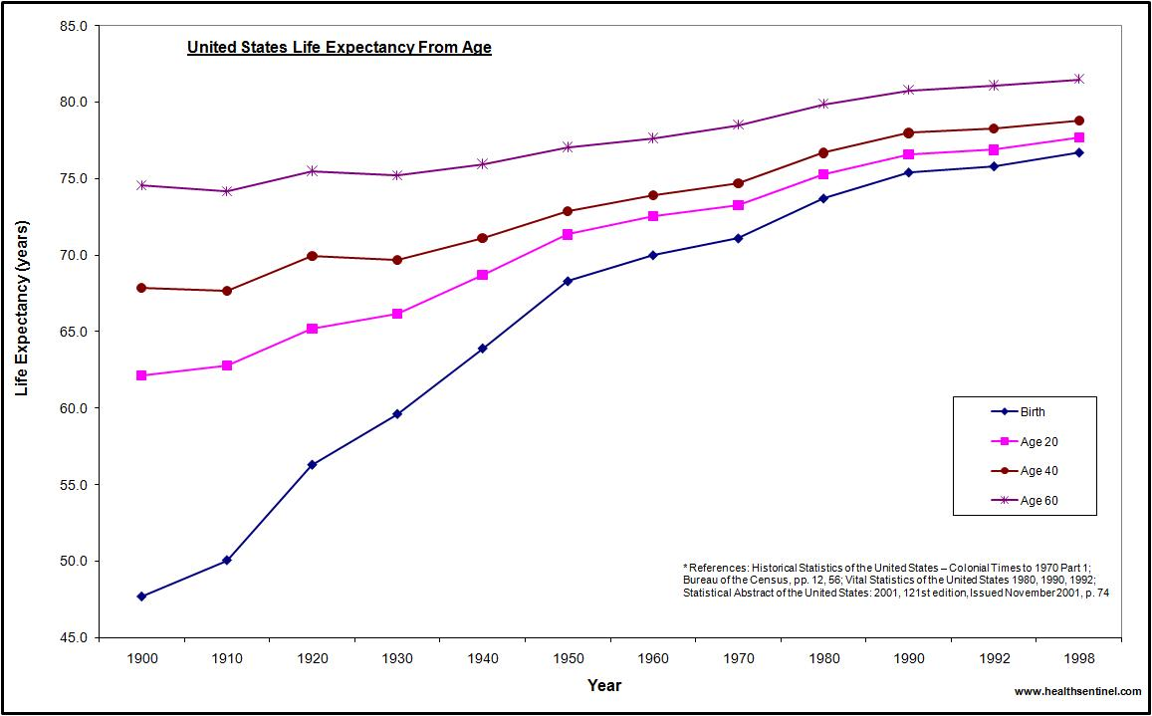

Slide 5
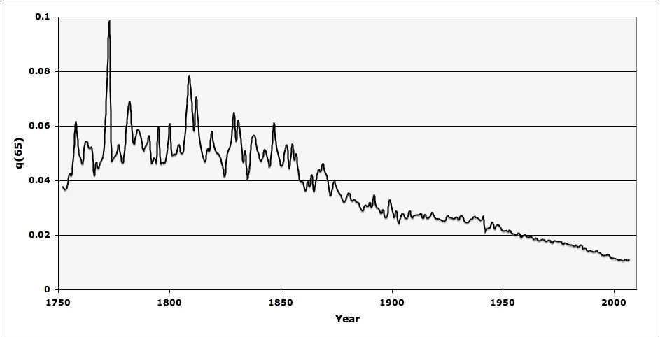
q(65) in Sweden
(males and females, 1751-2005)

Slide 6
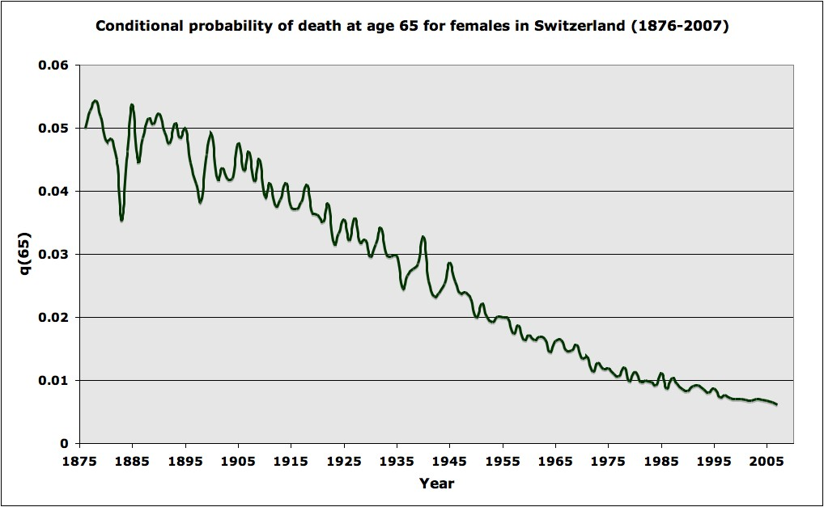
q(65) for females in Switzerland (1876-2007)

Slide 7
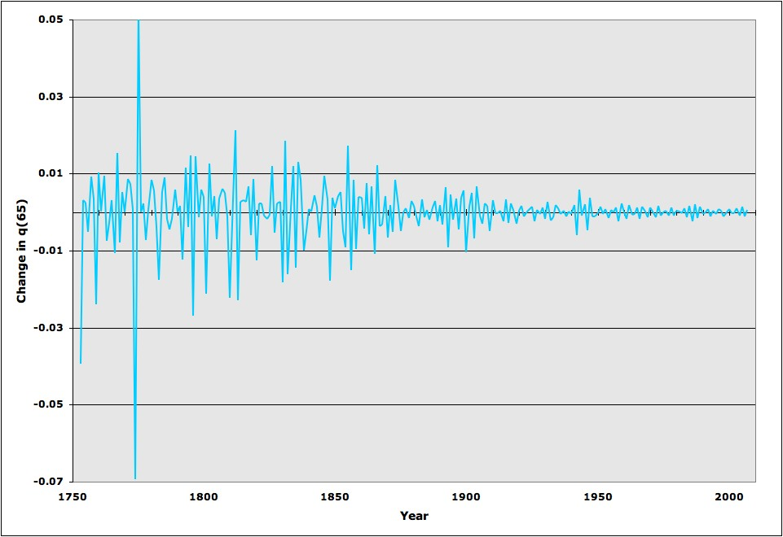
Annual change in death rate at age 65 in Sweden (males and females, 1751-2005)
has been replaced by relative stability

Slide 8
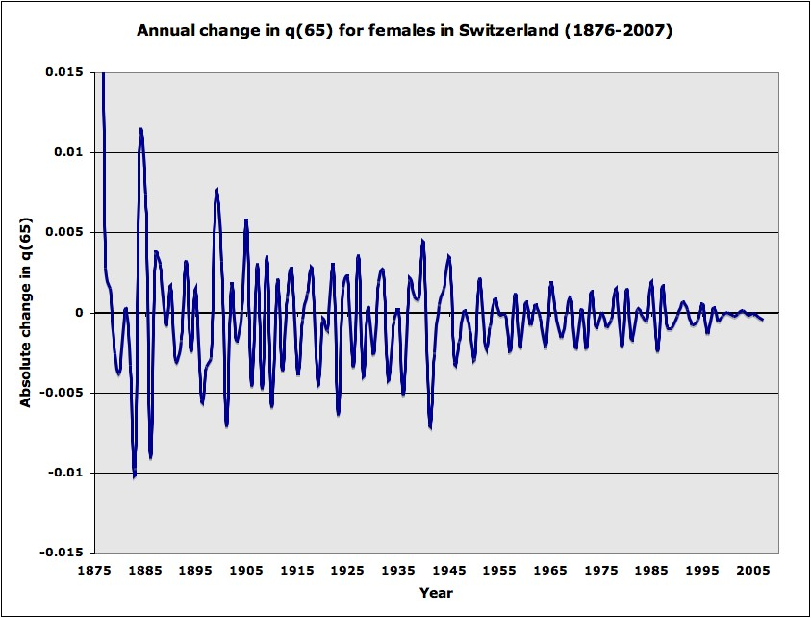
Annual change in q(65) for females in Switzerland (1876-2007)

Slide 9
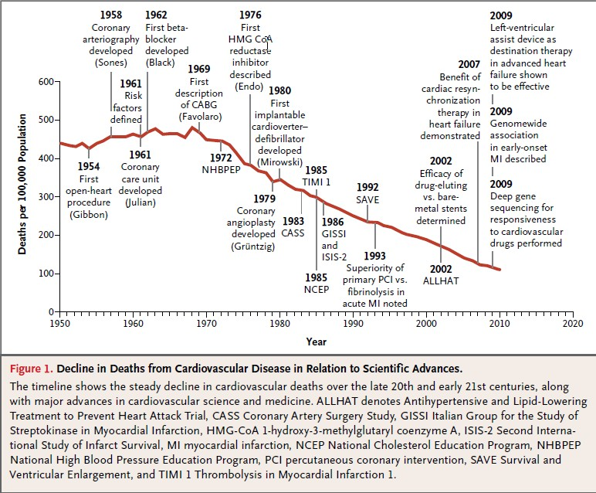

Slide 10
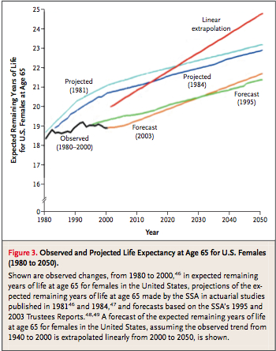
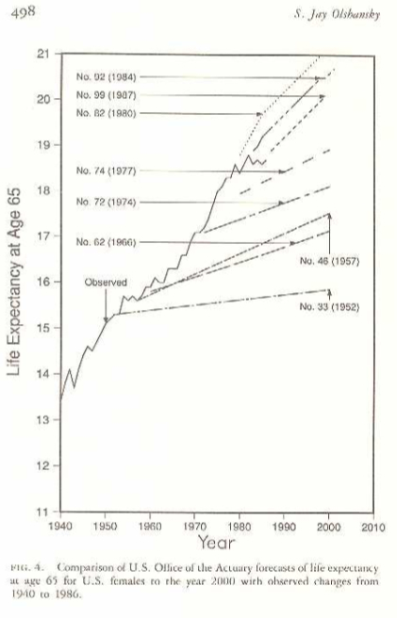
Source: Olshansky, 1988
Source: Olshansky et al., 2005

Slide 11
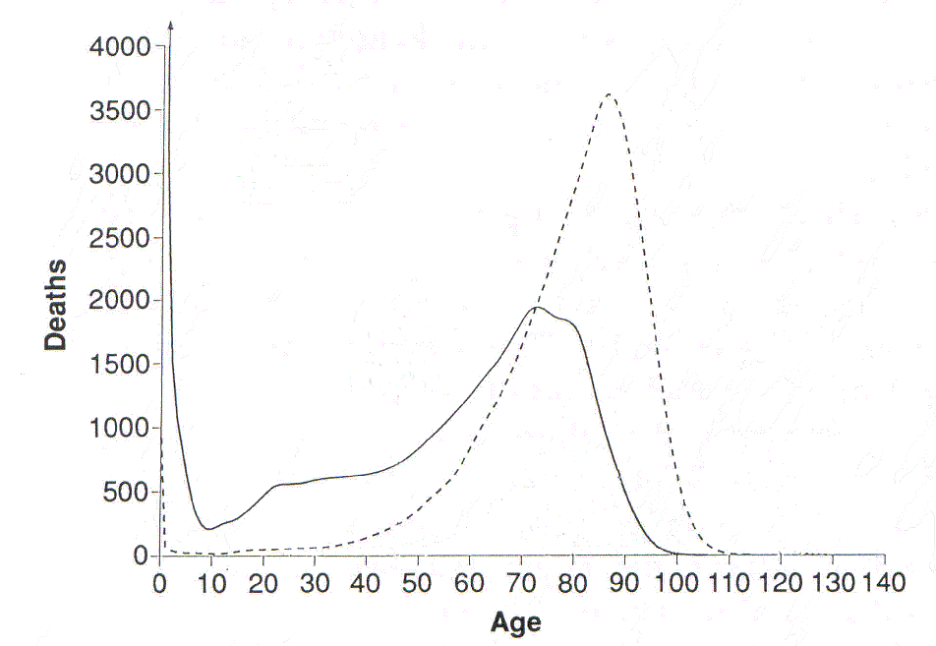
U.S. Females
Maximum Lifespan Potential = 120
Maximum Observed Age at Death = 105, 113 *
Period Life Expectancy at Birth = 49, 80 *
2010
1900

Slide 12
The Hype

Slide 13




Slide 14
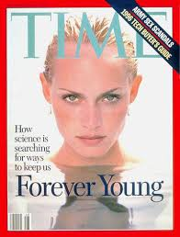

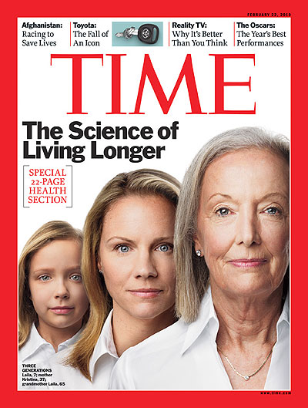
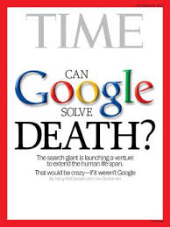

Slide 15
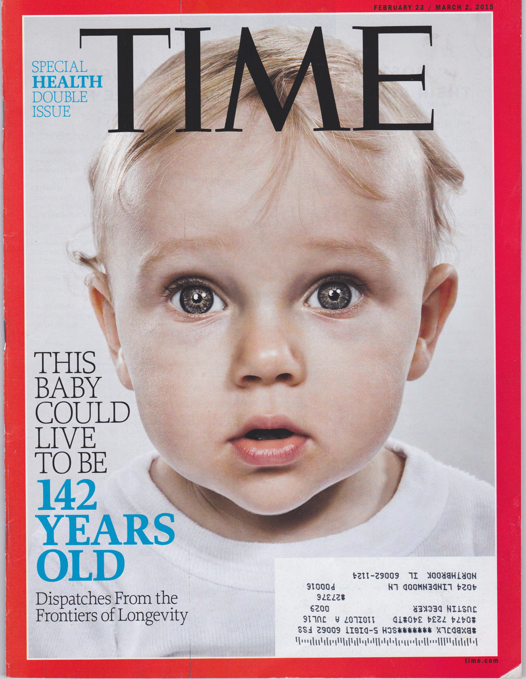
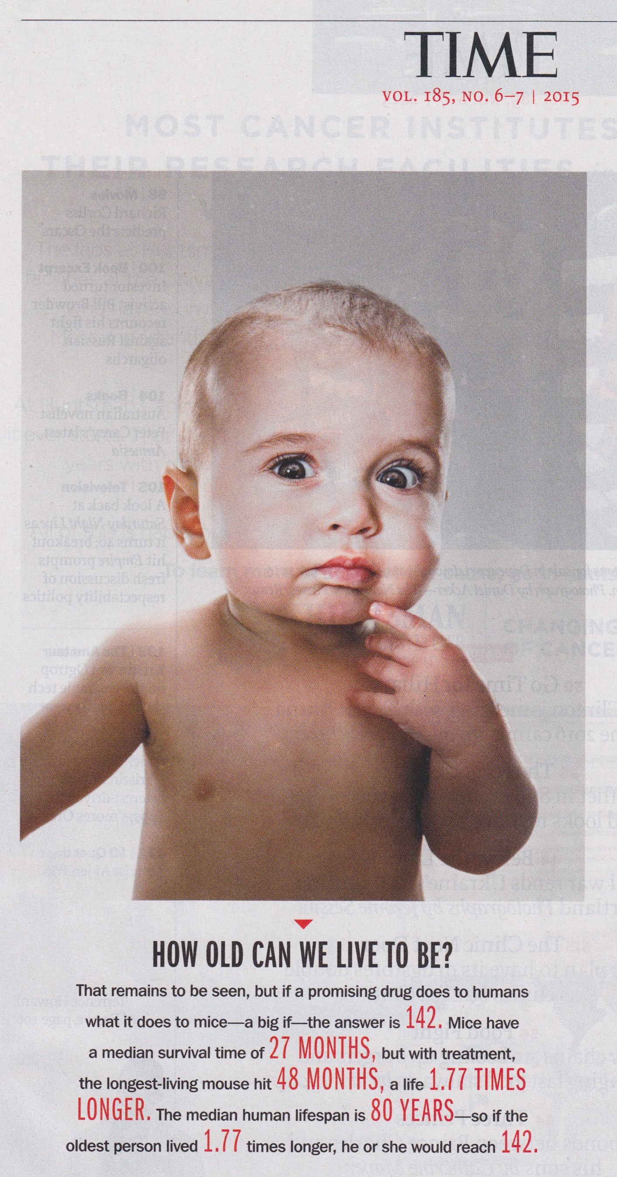

Slide 16


Slide 17
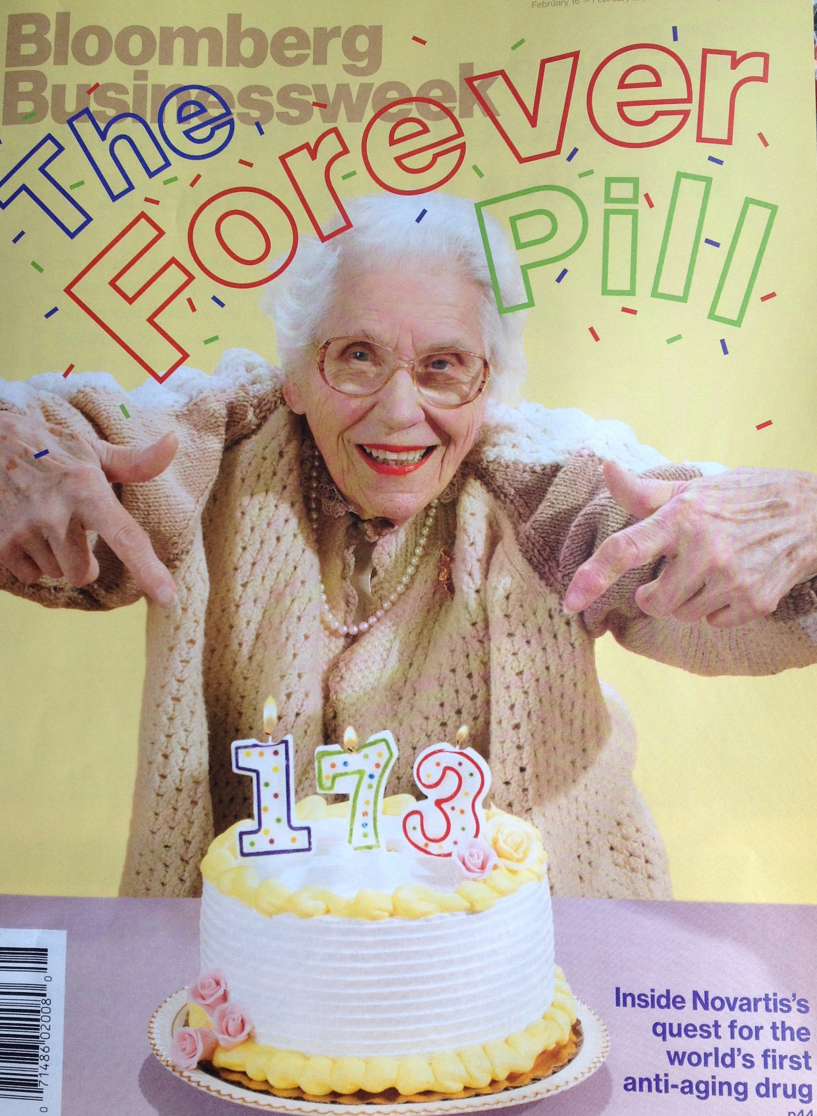

Slide 18
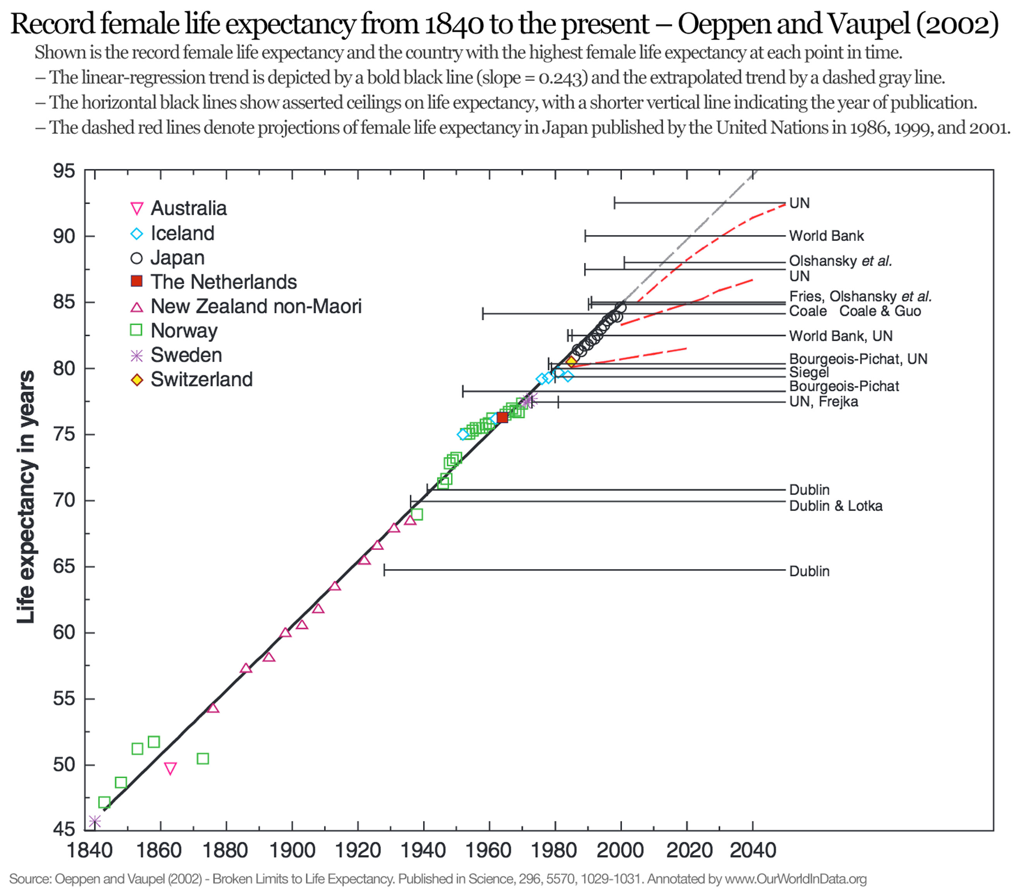
Conclusion: Life expectancy at birth in the U.S. will rise to 100 by 2060.

Slide 19
Unstated Assumptions That Accompany Linear Extrapolation of Life Expectancy
Past trends in life expectancy are more important than biology when it comes to forecasting.
Declines in mortality in the future will occur at a faster pace for people aged 65 and older than what was observed for infants and children in the early 20th century.
2a. Unknown medical technologies in the future will add decades to the lives of people aged 65 and older at a faster pace than public health added survival time to children in the 20th century.
3. Declines in mortality in the future will occur for diseases present today that have historically increased or stayed level – violating the underlying premise of linear extrapolation.
4. Deaths from cardiovascular diseases will be reduced to zero within the next decade.

Slide 20
Can most live to 100?
Can we really add decades of life to people aged 70+ today faster than we added decades of life to children born in the early 20th century?

Slide 21
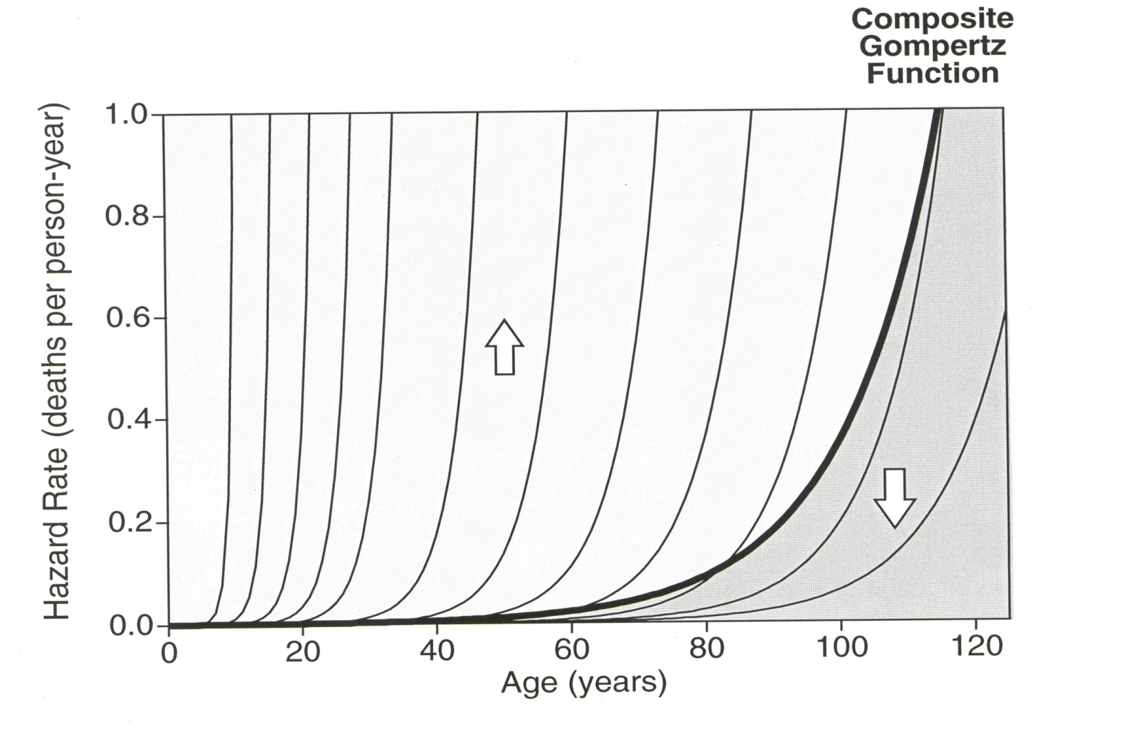

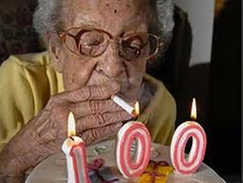
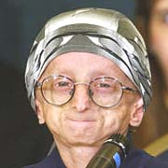
Does Anyone Really Believe We Can Eliminate Genetic Heterogeneity?

Slide 22
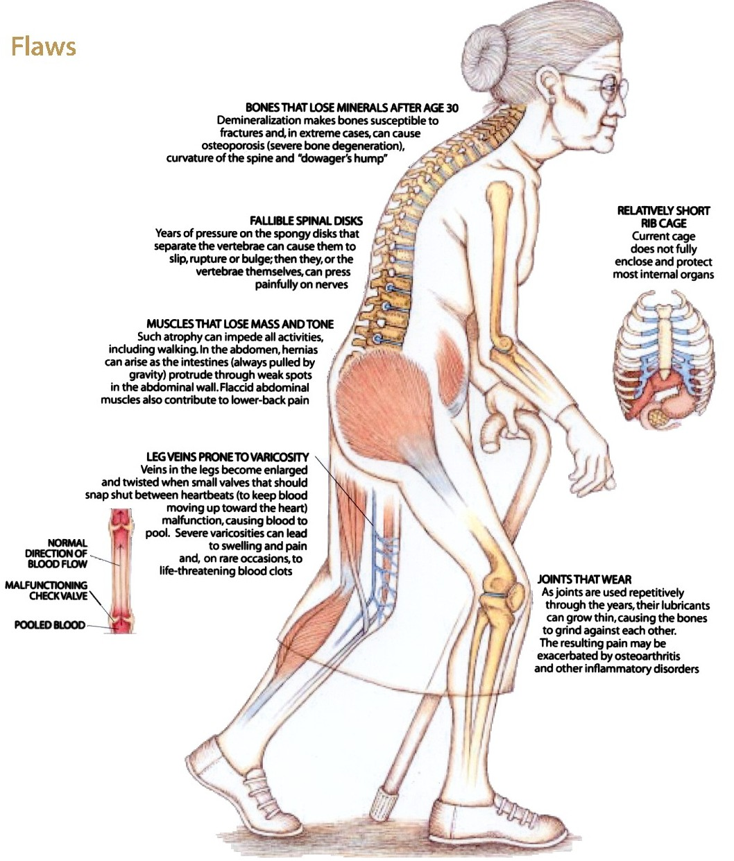

Aging Gets in the Way

Slide 23
The Fall

Slide 24
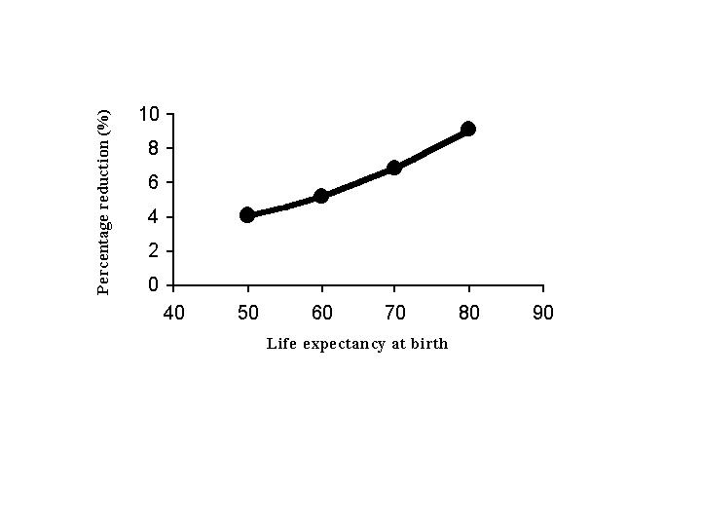
Olshansky et al., 2001. Science.

Slide 25
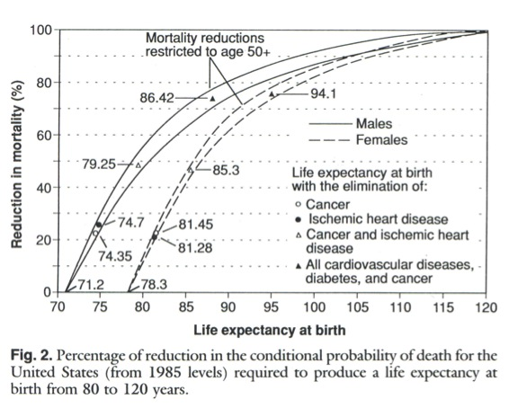
Olshansky et al., 1990. Science.

Slide 26
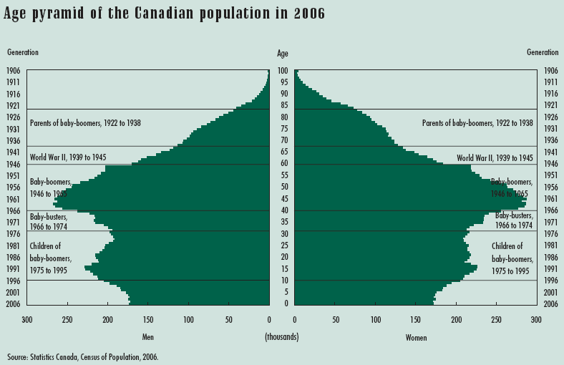
The usual approach to forecasting is to look back in time at the mortality experience of older cohorts and then extend these observed trends forward.
The cohorts that will express mortality in the future are located in this region of the population.
26

Slide 27
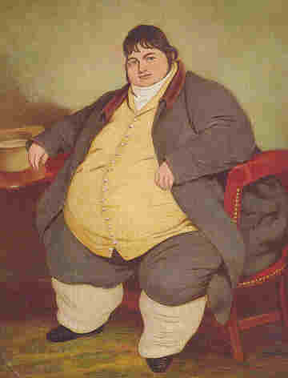
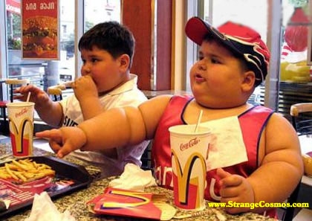
A Possible Decline in Life Expectancy in the United States in the 21st Century?
S. Jay Olshansky, Ph.D.
University of Illinois at Chicago
Douglas J. Passaro, M.D.
University of Illinois at Chicago
Ronald C. Hershow, M.D.
University of Illinois at Chicago
Jennifer Layden, MPH
University of Illinois at Chicago
Bruce A. Carnes, Ph.D.
University of Oklahoma
Jacob Brody, M.D.
University of Illinois at Chicago
Leonard Hayflick, Ph.D.
University of California at San Francisco
Robert N. Butler, M.D.
International Longevity Center
David B. Allison, Ph.D.
University of Alabama at Birmingham
David S. Ludwig, M.D., Ph.D.
Children’s Hospital, Boston
New England Journal of Medicine 2005 352:1103-1110.
Funding: NIH/NIA; NIDDK; IGPA

Slide 28

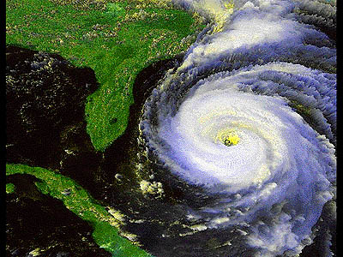
Obesity
We see a storm approaching.

Slide 29
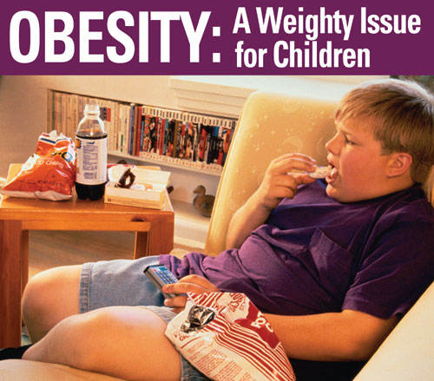
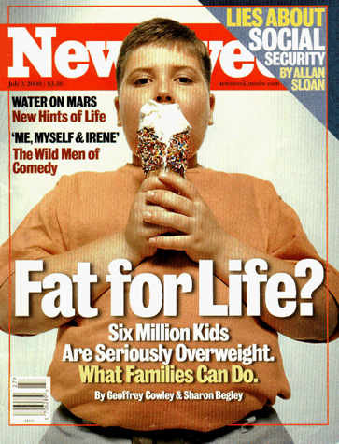

Slide 30
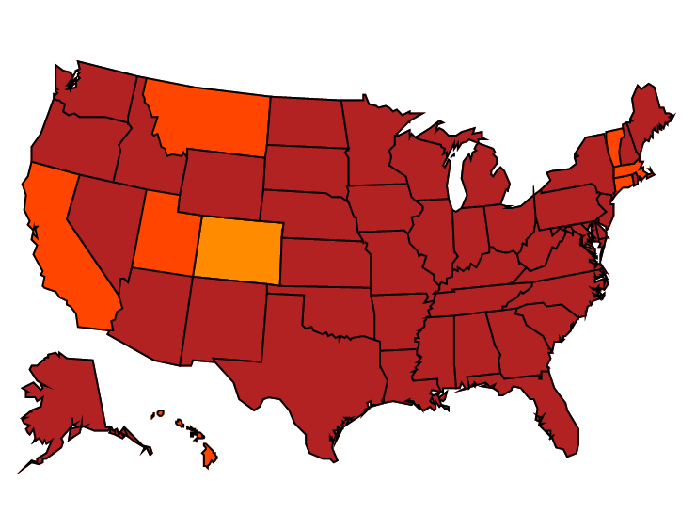
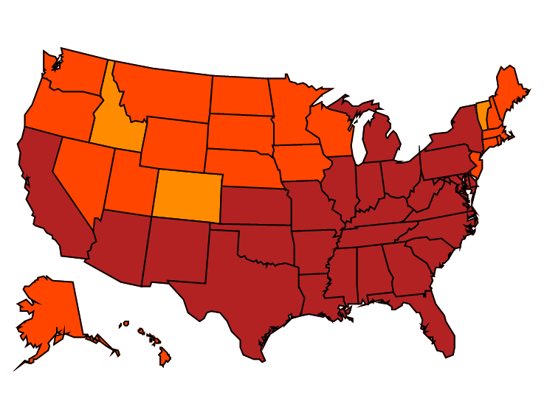


Age-adjusted Prevalence of Obesity and Diagnosed Diabetes Among US Adults
Obesity (BMI ≥30 kg/m²)
1994
2000
2014
No Data <14.0% 14.0%–17.9% 18.0%–21.9% 22.0%–25.9% > 26.0%
Diabetes
1994
2000
2014
No Data <4.5% 4.5%–5.9% 6.0%–7.4% 7.5%–8.9% >9.0%
CDC’s Division of Diabetes Translation. United States Surveillance System available at http://www.cdc.gov/diabetes/data

Slide 31
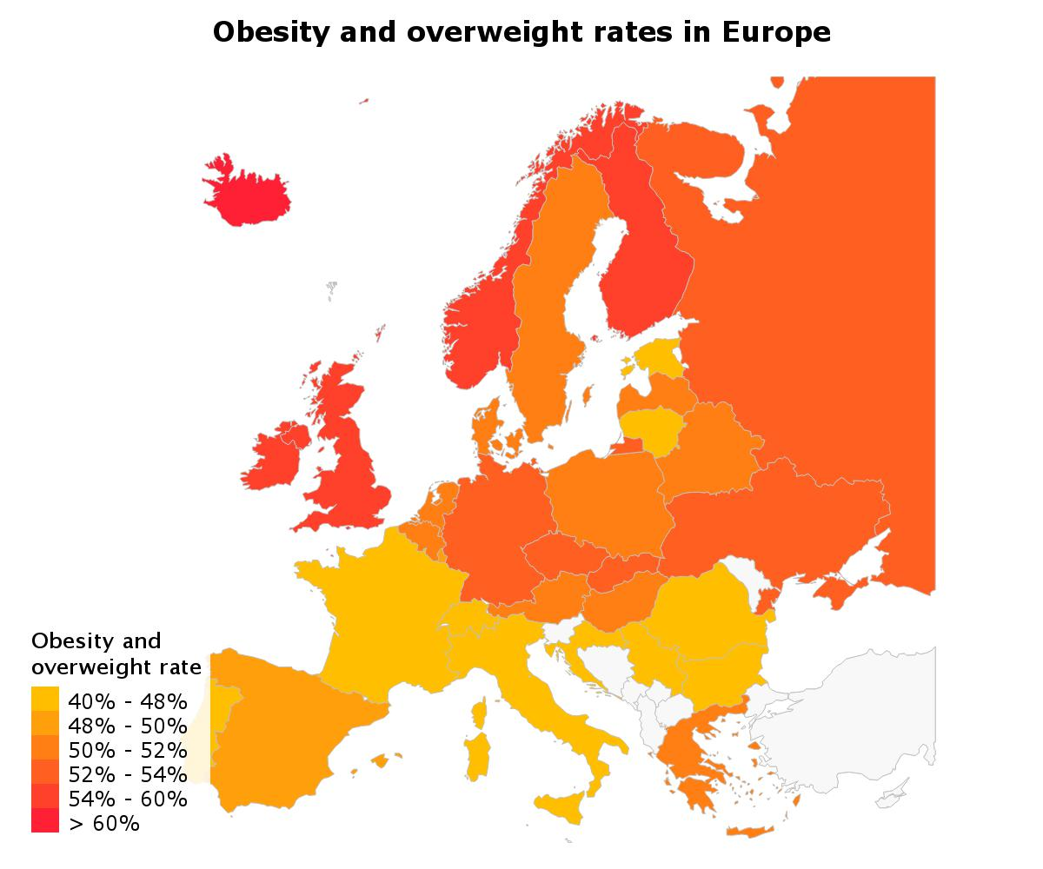

Slide 32

Males
1980-1984
% Obesity
 | < 5 %
 | 5-9.9%
 | 10-14.9%
 | 15-19.9%
 | 20-24.9%
 | ≥ 25%
fin
nor
swe
den
ire
uk
net
pol
bel
ger
sw
aus
fr
it
sp
por
© International Obesity TaskForce 2005

Slide 33
% Obesity
 | < 5 %
 | 5-9.9%
 | 10-14.9%
 | 15-19.9%
 | 20-24.9%
 | ≥ 25%
 | Self Reported data
Males
2000-2005
fin
nor
swe
den
ire
uk
net
pol
bel
ger
sw
aus
fr
it
sp
por
© International Obesity TaskForce 2005

Slide 34
Females
1980-1984
% Obesity
 | < 5 %
 | 5-9.9%
 | 10-14.9%
 | 15-19.9%
 | 20-24.9%
 | ≥ 25%
fin
nor
swe
den
ire
uk
net
pol
bel
ger
sw
aus
fr
it
sp
por
© International Obesity TaskForce 2005

Slide 35
% Obesity
 | < 5 %
 | 5-9.9%
 | 10-14.9%
 | 15-19.9%
 | 20-24.9%
 | ≥ 25%
 | Self Reported data
Females
2000-2005
fin
nor
swe
den
ire
uk
net
pol
bel
ger
sw
aus
fr
it
sp
por
© International Obesity TaskForce 2005

Slide 36

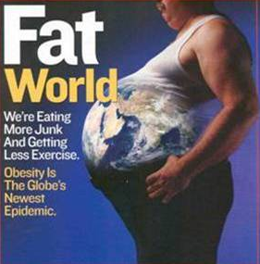
Obesity is a global pandemic

Slide 37
The Excitement of Aging Science

Slide 38
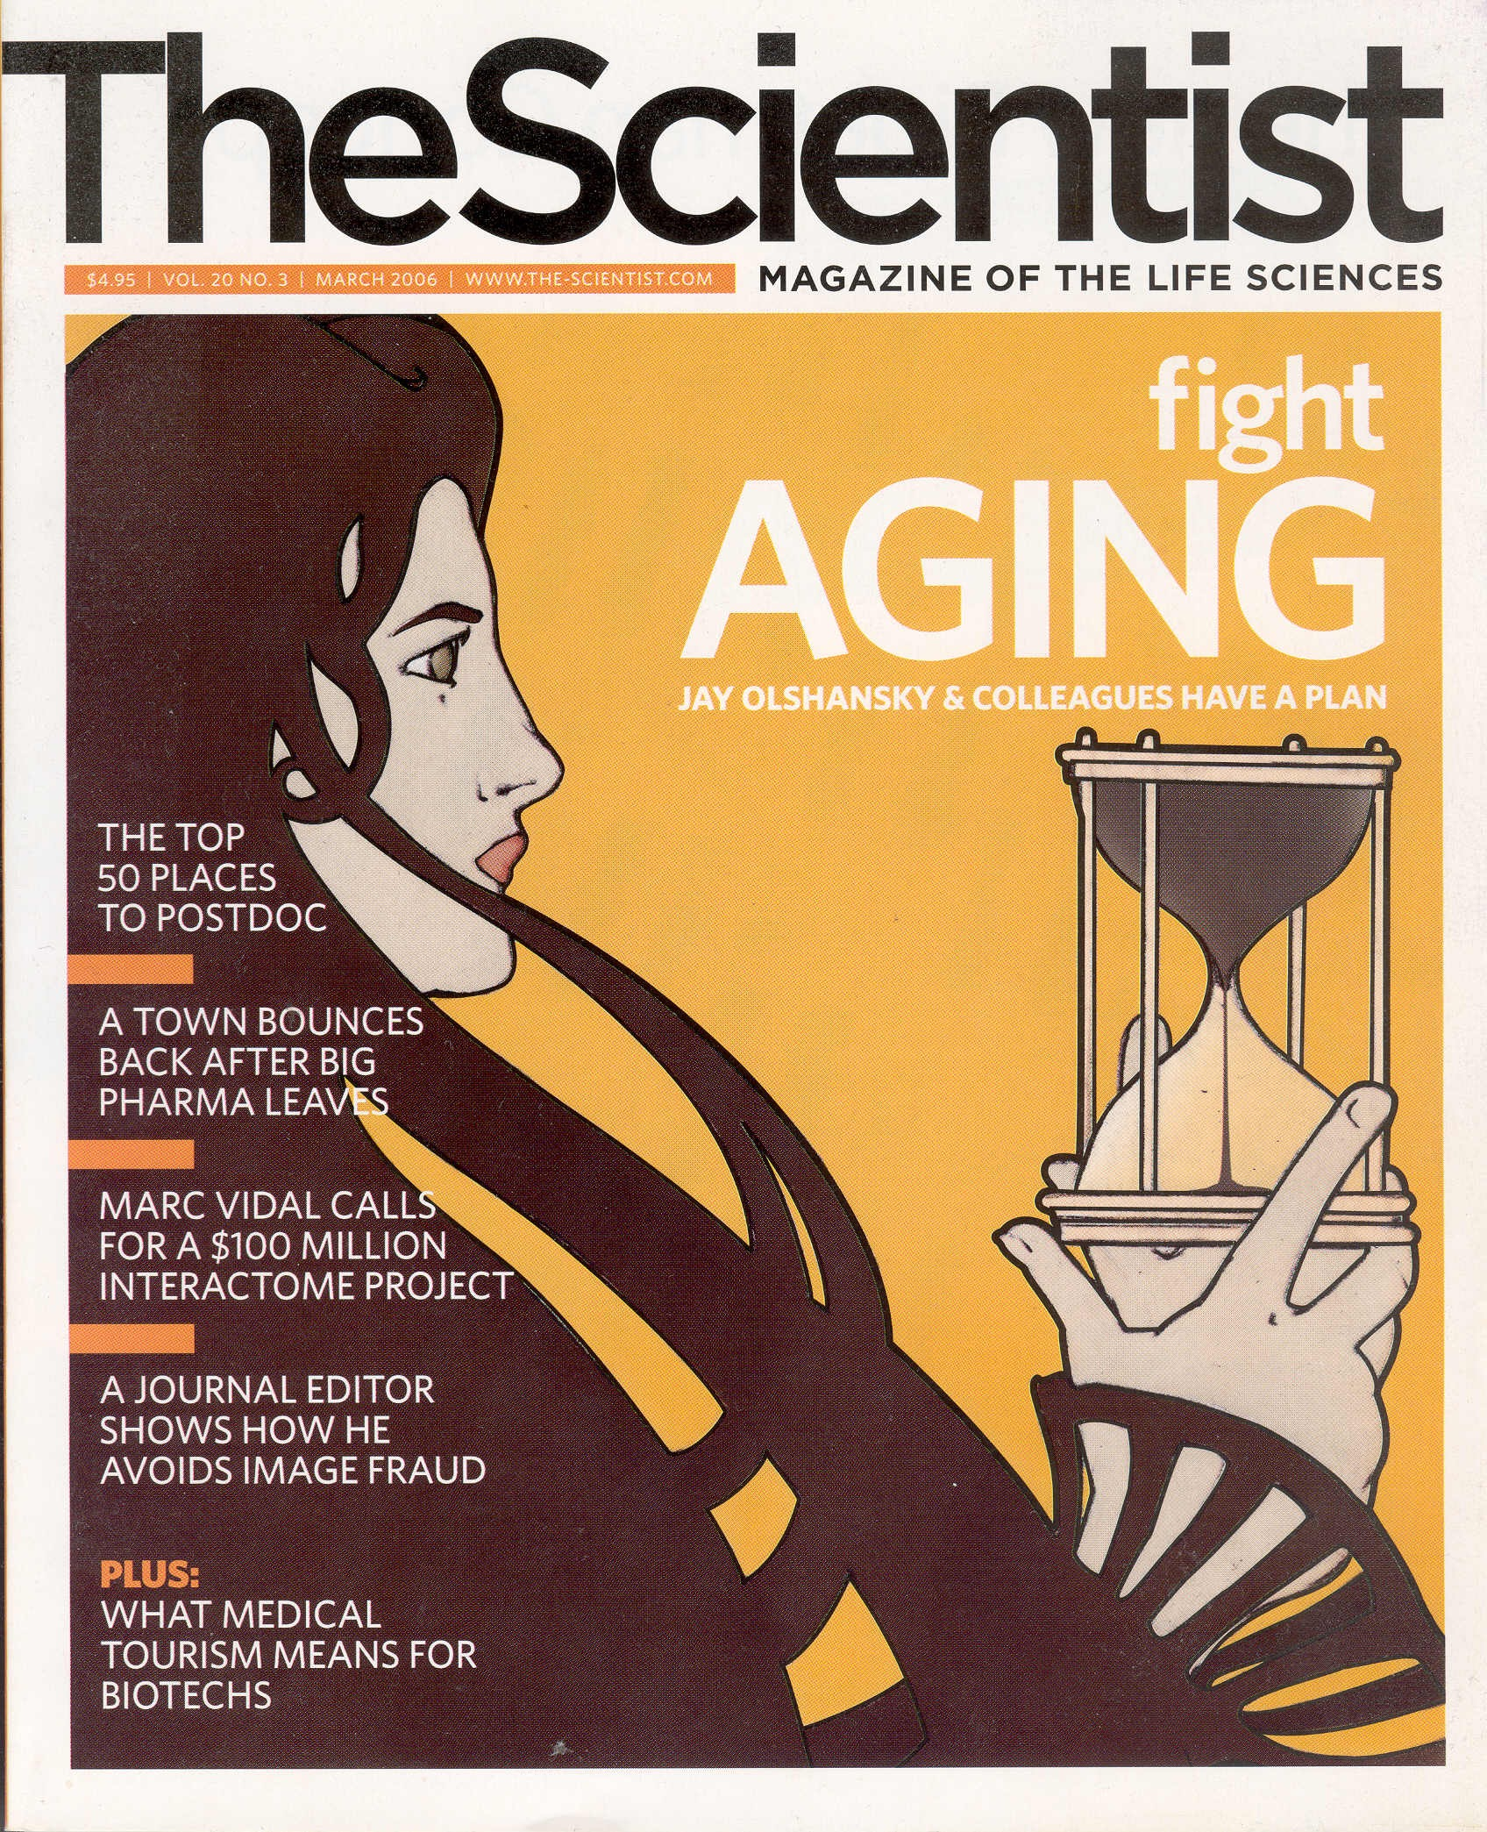

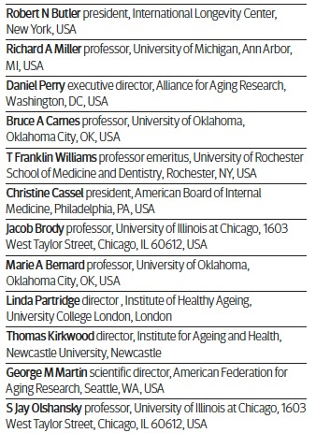

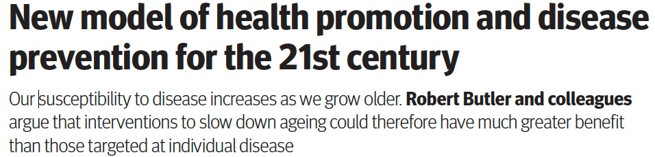
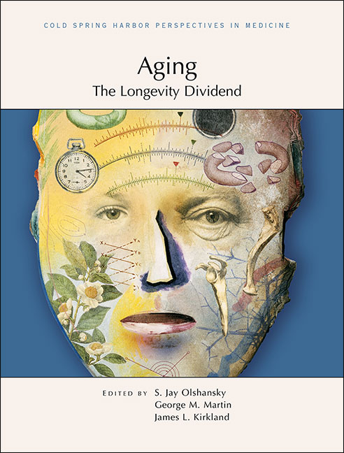

Daniel Perry Richard A. Miller Robert N. Butler
July, 2008

Slide 39
AGING BIOLOGY IS AT THE CORE OF CHRONIC DISEASES
Frailty/Sarcopenia
CKD
Diabetes
Neurodegenerative
Cancer
AGING
Frailty
Resilience
Menopause
Stroke
HIV/AIDS
CVD
Blindness
COPD/ Pulmonary Fibrosis
Arthritis/Osteoporosis
Source: Dr. Felipe Sierra

Slide 40













LDI Leading Organizations / Research Advisory Committee
Affiliated Research Institutions and Universities

Slide 41
300 Word Video

Slide 42
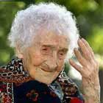
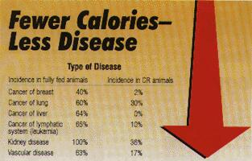


Do We Need to Know in Advance Which Scientific Pathways to the Longevity Dividend Will Work?
Genetics of long-lived people
Caloric restriction
Compounds with properties that appear to slow aging

Slide 43
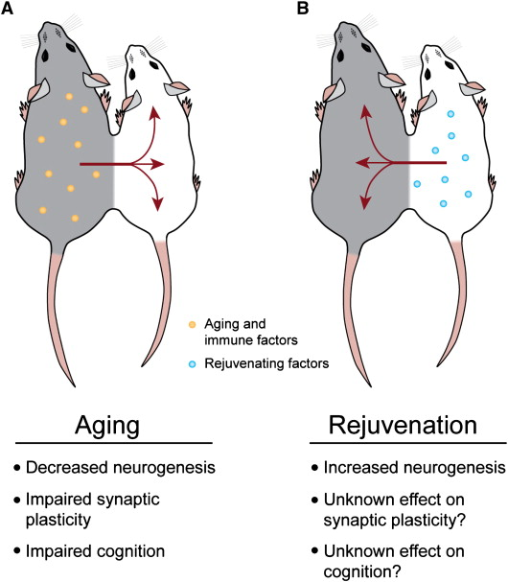
Parabiosis

Slide 44
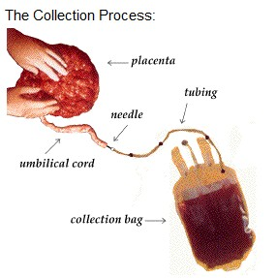
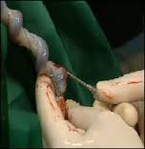
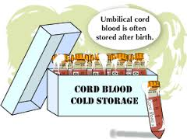
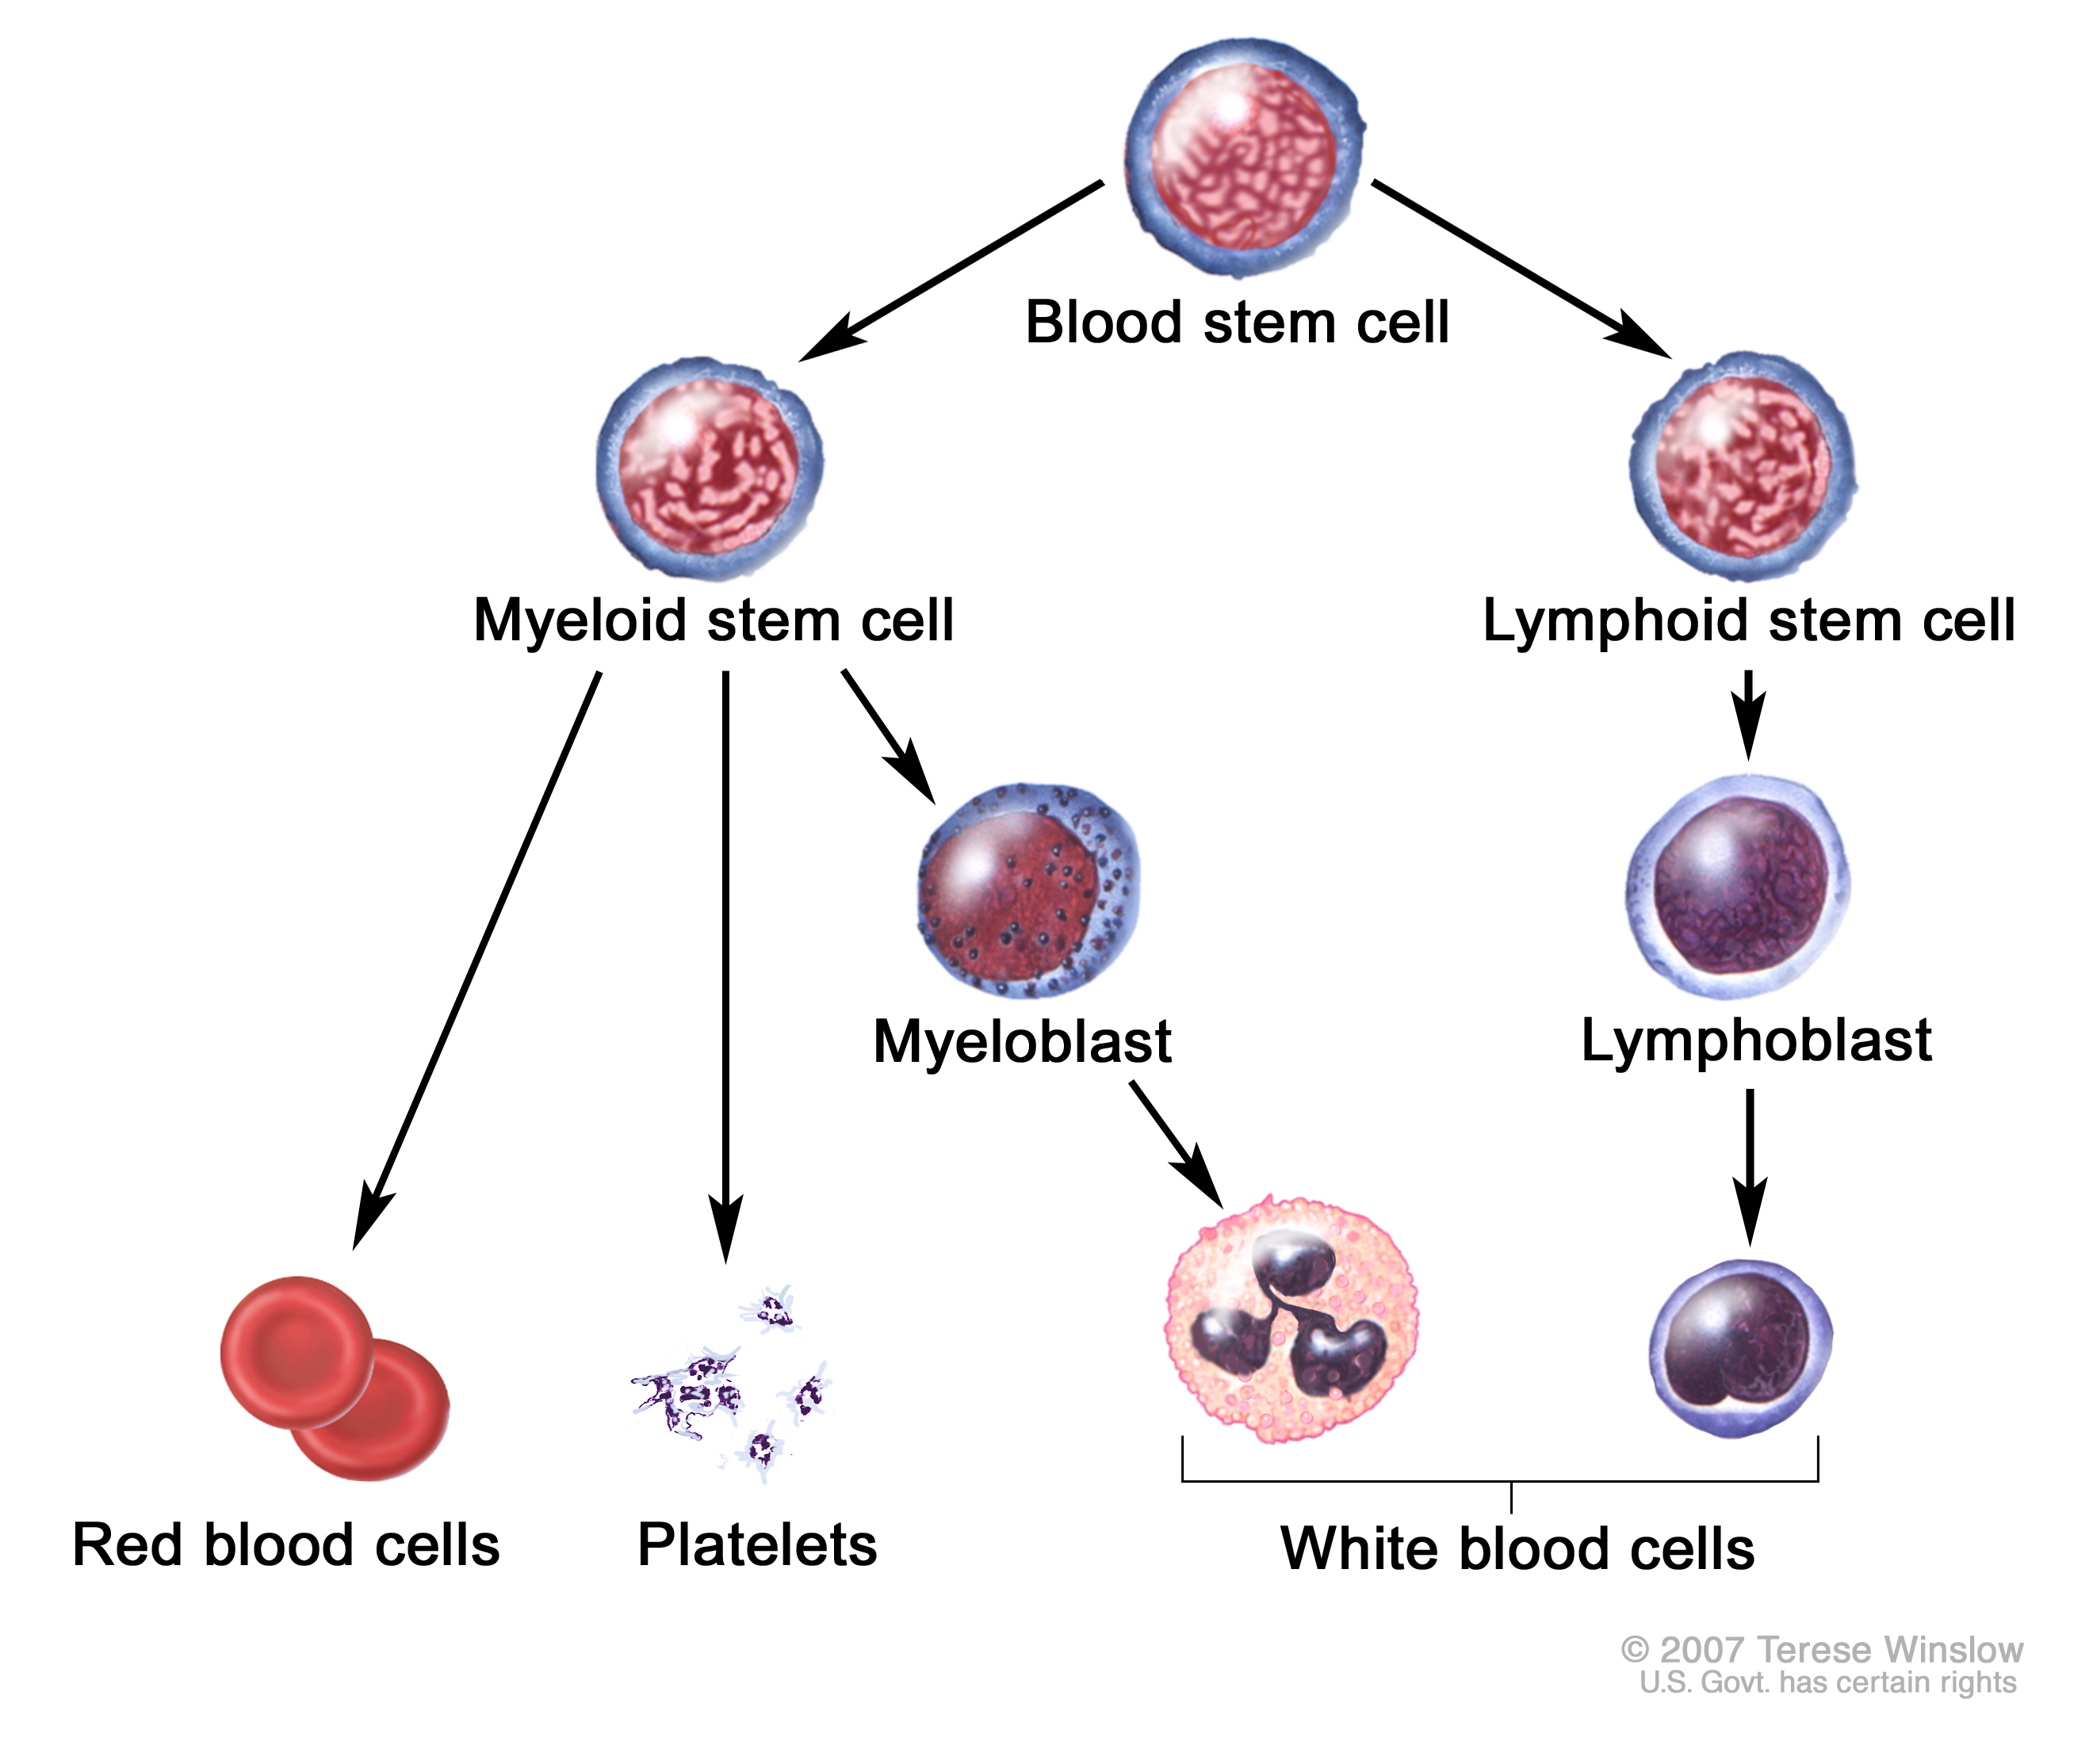


Slide 45
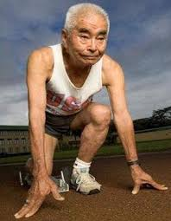

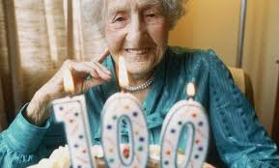
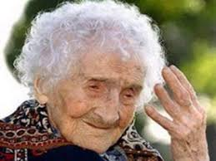

The secret to Primary Prevention is already here…
Centenarians and their offspring possess genes that protect them from fatal diseases that kill the rest of us at younger ages

Slide 46
