Slide 1
Longevity 12
The Continuing Evolution of RPEC’s Mortality Projection Methodology
LAURENCE PINZUR, PhD, FSA
Aon Hewitt
30 September 2016

Slide 2
Today’s Topics
About RPEC
Ancient History
The RPEC_2014 Model
RPEC’s Ongoing Research
Other Related SOA Research Projects

Slide 3
About RPEC
Retirement Plans Experience Committee
  Currently composed of 19 volunteer members
Prior to 2009, primarily interested in developing tables of base mortality rates for retirement-related applications in the US
  Exception was Scale AA (1994)
Mortality Improvement (MI) subcommittee of RPEC has been very busy since 2009

Slide 4
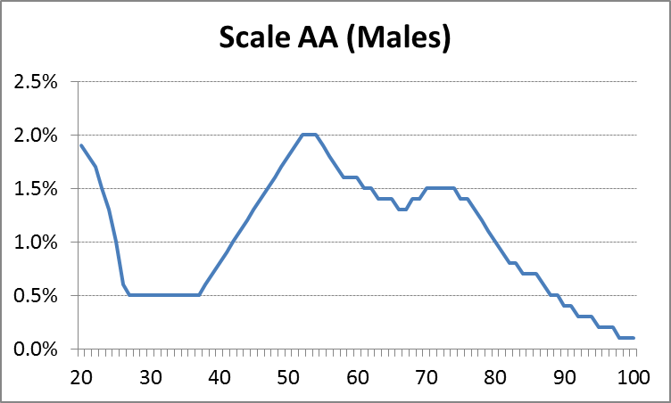
Ancient History: Scale AA
Released in 1994; based on average MI experience over the period 1977 – 1993

Slide 5
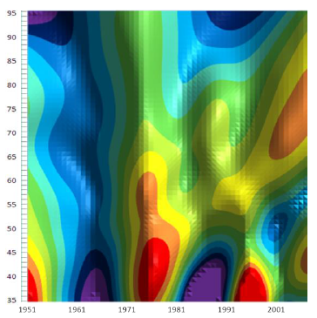
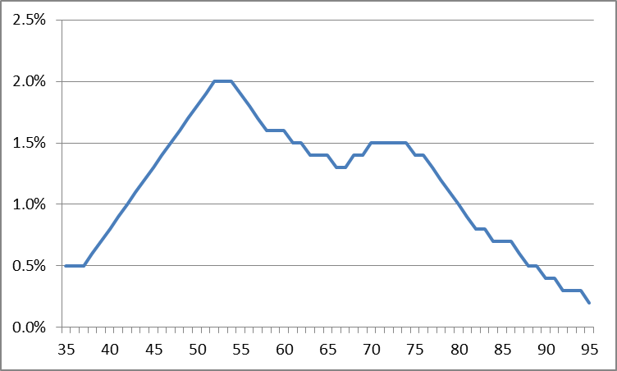
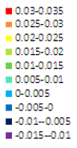
Ancient History: Scale AA

Slide 6
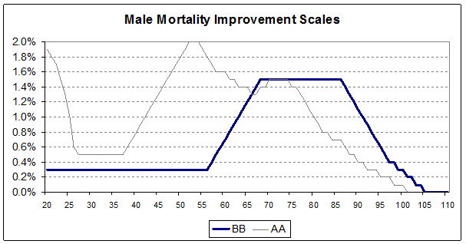
Scale BB (Fast forward to 2012…)
Interim set of age-only “rates” (like Scale AA)

Slide 7
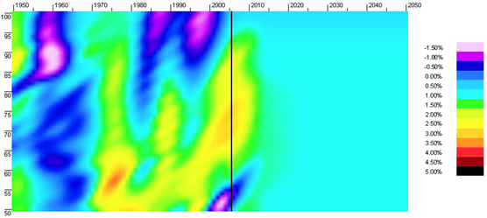
Scale BB (Fast forward to 2012…)
Derived from 2D array of smoothed/projected MI rates
RPEC backed into Scale BB from a table of deferred-to-age-62 annuity values (RP-2000; i = 6%)
“BB-2D” (Males)

Slide 8
Scale BB (Fast forward to 2012…)
Scale BB could be applied just like Scale AA to RP-2000 mortality rates…
…but the pension actuarial community was given a heads-up in 2012 that
  the recommended replacement for Scale AA will likely be two-dimensional tables of age/calendar year mortality improvement rates

Slide 9
The RPEC_2014 Model
RPEC model based on the same conceptual underpinnings of the CMI model
  Recently observed experience is the best predictor of future near-term mortality improvement rates.
  Long-term rates of mortality improvement should be based on “expert opinion” and analysis of longer-term mortality patterns.
  Near-term rates should transition smoothly into the assumed long-term mortality improvement rates over appropriately selected convergence periods.
But unlike CMI, RPEC’s age/period and cohort components are implicitly developed

Slide 10
The RPEC_2014 Model
Committee-Selected Assumption Set
Scale
MP-20yy
Rates
RPEC_2014 Model
+
User-Selected
Assumption Set
+
Other 2D
Rates

Slide 11
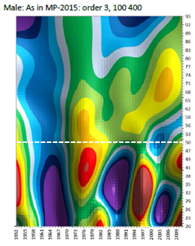
The RPEC_2014 Model
Graduated Historical MI
Horizontal trends (“A/P”)
Determine MI values -- and slopes -- in the final year of graduated data
(after 2-year step-back)
Diagonal trends (“C”)
Implicit derivation of
A/P & C components

Slide 12
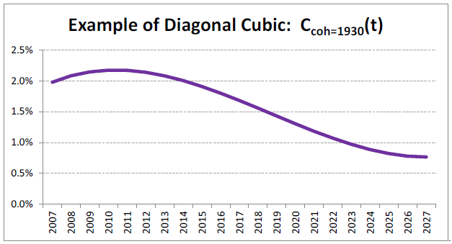
The RPEC_2014 Model
Interpolating polynomials; two points and two slopes ⇒ cubics
Source: Scale MP-2014 Report

Slide 13

Scales MP-2014 and MP-2015
Historical MI
20-Yr Interpolation
LTR Attained
A/P
100% of LTR
50%
LTR
+
C
100% of LTR
50%
LTR
Longevity 12 | September 2016

Slide 14
RPEC’s Ongoing Research
Historical mortality data sources
Graduation methodology and parameters
Step-back years
APC component split
Interpolation methodologies
Committee-selected assumption sets
  Long-term rate of mortality improvement
  Convergence periods
  Blending of horizontal and diagonal projections

Slide 15
Other SOA Longevity Projects
Research on base mortality rates
  RPEC experience studies for public and private pension plans in the US
  Raw SSA mortality rates through 2014
  Interactions with SSA, CDC, and CMS (Medicare)
  HMD (partnership project)
    Cause of death tables
    State-specific tables

Slide 16
Other SOA Longevity Projects
Research on mortality improvement
  Participation in IFoA project on approaches to mortality modeling
    “This programme of research concerns how we model, measure and manage longevity and morbidity risk. It will be application driven, with impact and innovation in the pensions and insurance industries and beyond as its primary aims.”
  Longevity Advisory Group projects
    Comparison of methodologies for APC components
    Explanation for variations in mortality improvement
    Consistent framework for SOA mortality improvement applications
Living to 100

