Slide 1
Measures of risk in life-long financial planning for households – what should they be like
Radosław Pietrzyk & Paweł Rokita
Wrocław University of Economics
Longevity 12, Chicago, 29-30 September 2016

Slide 2
Measures of risk in life-long financial planning for households
– what should they be like?
General types of risk in household financial planning
Proposal on systematization:
  Life-length risk
  Risk of investment and financing
  Income risk
  Risk of events (insurance-like events)
  Risk of goal realization
  Operational risk of plan management (particularly risk of plan implementation)
  Model risk

Slide 3
Measures of risk in life-long financial planning for households
– what should they be like?
Specificity of household financial planning
Human life-cycle concerns
Multitude of financial goals and ways of their financing
All-goal-oriented planning
Multi-person concerns
Specificity of household preferences with regard to goals
Specificity of household preferences with regard to intertemporal choice
Specificity of household risk

Slide 4
Measures of risk in life-long financial planning for households
– what should they be like?
Specificity of household financial planning
Human life-cycle concerns:
  long-term planning,
  human-capital-to-financial-capital transfer,
  human capital development staring years before one may use it (childhood, youth, early career),
  parenthood considerations
  (significant changes both to income and consumption),
  human capital depletion taking place long before the end of the human life
  (non-labor sources of income needed),
  the specificity of retirement goal
  (big magnitude and no post-financing).

Slide 5
Measures of risk in life-long financial planning for households
– what should they be like?
Specificity of household financial planning
Multitude of financial goals and ways of their financing:
  Goals (e.g.):
    Bringing up of one’s children
    House
    Education for children
    Endowments
    RETIREMENT
    Bequest
    other …
  Financing
    Pre-
    Post
    (different possible proportions of own contribution to debt,
    different investment programs, many possibilities of crediting)

Slide 6
Measures of risk in life-long financial planning for households
– what should they be like?
Specificity of household financial planning
All-goal-oriented planning:
  the general aim of life-long financial planning
  is accomplishment of all financial goals, if possible, with a special emphasis on retirement goal,
  rather than maximization of value or profit

Slide 7
Measures of risk in life-long financial planning for households
– what should they be like?
Specificity of household financial planning
Multi-person concerns:
  internal risk sharing and capital transfer between household members,
  multivariate survival process.

Slide 8
Measures of risk in life-long financial planning for households
– what should they be like?
Specificity of household financial planning
Specificity of household preferences
with regard to goals:
  inseparable preferences,
  non-transitive preferences
  (except simple cases with purely non-complementary goals).

Slide 9
Measures of risk in life-long financial planning for households
– what should they be like?
Specificity of household financial planning
Specificity of household preferences with regard to intertemporal choice:
  for term structure of the cumulated net cash flow:
  inapplicability of the simple rule that the nearer future is more important than the distant one
    (what makes sense with regard to time preference of consumption, would be an absurd when applied to timing of cumulated surplus or cumulated shortfall),
  the role of age-related costs of financing.

Slide 10
Measures of risk in life-long financial planning for households
– what should they be like?
Specificity of household financial planning
Specificity of household risk:
  many types of risk; risk factors of different nature (in the sense of their economic interpretation) and with different statistical properties (distributional models, dynamics, observability, etc.)
  no consensus on how to integrate the types of household risk in one model,
  no obvious success-failure measure(s) to serve as risk variable(s), nor any unambiguous candidate for a benchmark that could be interpreted as an indicator of a normal (typical) or desired state,
  special role of life-length risk (and of the survival models that are used in its modelling – compare Yaari [11] model, and also its numerous modifications and augmentations),
  very long risk management horizon.

Slide 11
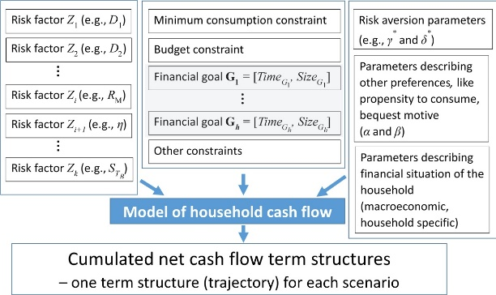
Measures of risk in life-long financial planning for households
– what should they be like?
The model of household’s cumulated net cash flow

Slide 12
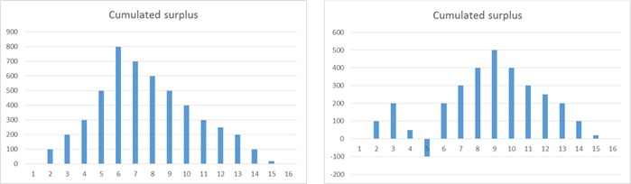
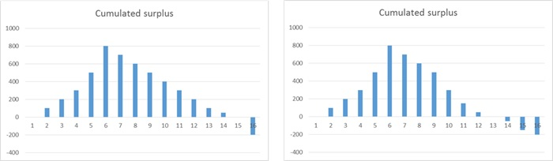
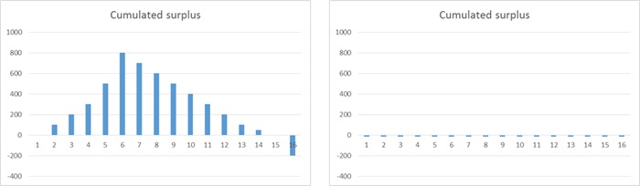
Measures of risk in life-long financial planning for households
– what should they be like?
Examples of the outcome – cumulated net cash flow „trajectories”
In both cases: a positive residual wealth (and equal), but one CNSF term structure is always positive and the second contains a shortfall somewhere along the line.
In both cases: the same shortfall at the end, but different speed of deterioration
In both cases: sums of shortfalls, taken time value of money into account, are equal, but severity of one big shortfall in an old age is much more serious than that of permanent small shortfalls

Slide 13
Measures of risk in life-long financial planning for households
– what should they be like?
A decent integrated risk measure of a household financial plan
(7 postulates)
Postulate 1* (An analogue to subadditivity)
  The value of the risk measure of a common plan for a two person household
  is lower or equal than
  the sum of values of this measure for two plans of the two persons – treated separately in the financial sense
  (assuming that other conditions are unchanged)

Slide 14
Measures of risk in life-long financial planning for households
– what should they be like?
A decent integrated risk measure of a household financial plan
(7 postulates – continued)
Postulate 2* (Transitivity)
  If a plan A is not more risky than B and B is not more risky than C, then the plan A is also not more risky than C

Slide 15
Measures of risk in life-long financial planning for households
– what should they be like?
A decent integrated risk measure of a household financial plan
(7 postulates – continued)
Postulate 3*
  The measure should reflect the size of a potential shortfall

Slide 16
Measures of risk in life-long financial planning for households
– what should they be like?
A decent integrated risk measure of a household financial plan
(7 postulates – continued)
Postulate 4 ^{(?)}
  The measure should be sensitive to the phase of the household life cycle in which the potential shortfall will be encountered

Slide 17
Measures of risk in life-long financial planning for households
– what should they be like?
A decent integrated risk measure of a household financial plan
(7 postulates – continued)
Postulate 5 ^{(?)}
  The measure should reflect the length of period (periods) during which the potential shortfall will be faced by the household

Slide 18
Measures of risk in life-long financial planning for households
– what should they be like?
A decent integrated risk measure of a household financial plan
(7 postulates – continued)
Postulate 6*
  The measure should incorporate the information about probability of shortfalls (e.g., number of scenarios with shortfalls and probabilities of these scenarios)

Slide 19
Measures of risk in life-long financial planning for households
– what should they be like?
A decent integrated risk measure of a household financial plan
(7 postulates – continued)
Postulate 7 (?) - controversial (what about HDP measure)
  The measure should be in conformity with the interpretation that a scenario which is ending with a surplus (over a benchmark) is better than a scenario ending with a shortfall (bellow the benchmark)

Slide 20
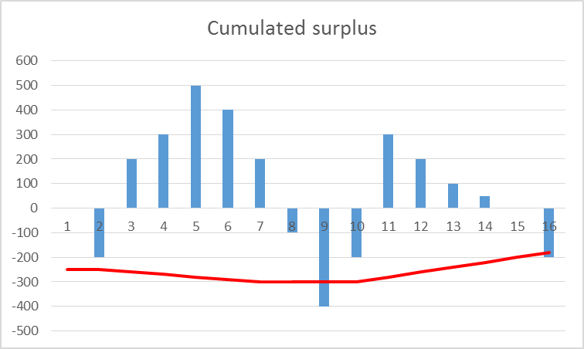
Measures of risk in life-long financial planning for households
– what should they be like?
Default threshold
  the minimum cumulated net cash flow (maximum cumulated shortfall) below which the household is not able to finance its shortfalls by debt any more
  Roughly speaking, the more scenarios like this one are possible, the higher default probability of the whole plan

Slide 21
Measures of risk in life-long financial planning for households
– what should they be like?
Default threshold
… and the doubts about Postulate 7
This is, what really matters
Not this

Slide 22
Measures of risk in life-long financial planning for households
– what should they be like?
A decent integrated risk measure of a household financial plan
To that, a postulate referring to plan optimization is needed.
  The risk optimization procedure must be consistent with the household preference model and with the risk measure

Slide 23
Measures of risk in life-long financial planning for households
– what should they be like?
A decent integrated risk measure of a household financial plan
  The higher risk aversion declared by the household members, the less risky the optimal plan.
    The inverse does not hold, because a lower risk aversion should not automatically mean a more risky optimization outcome
    (the resulting plan may be more risky indeed, but only if the expected value of a measure of success for this more risky outcome is higher than for a less risky one).

Slide 24
Measures of risk in life-long financial planning for households
– what should they be like?
Integrated measures of risk
for household financial planning
measures based on residual wealth
    Residual Wealth at Risk
    Residual Wealth Volatility
    Residual Wealth Aspiration Level
measures indicating problems during whole life-cycle
  measures indicating threats to financial plan realization
    Lifetime Cumulated Net Cash Flow at Risk
    Incremental Shortfall
    Shortfall Scenario Probability
  measures of household default risk
    Household Default Probability

Slide 25
Measures of risk in life-long financial planning for households
– what should they be like?
Conclusions and remarks
Neither of the aforementioned measures fulfill all the 7 (+1) postulates.
There arises a question if some of the postulates are not too specific to be imposed on all integrated risk measures of household financial plans.
An integrated risk measure of household financial plan would be useful, as it would allow to:
  compare financial plans with respect to risk – easier task,
  better structuralize financial plan optimization by giving to it a Markowitz-like interpretation
  (i.e.: minimization of risk for a given level of a „success measure” or maximization of the „success measure” for a given level of risk) – harder task.
To construct a good measure of risk, one needs to define (first):
  a good risk variable,
  a benchmark (that may also serve as a measure of success).
So, the further discussion should be aimed at defining a risk variable that would integrate all risk factors and setting a benchmark, then one may come back to integrated risk measure developing.

Slide 26
Thank You for Your Attention

